Slide 1



Deforestation
Martina Kofler & Mathieu Maréchal

Slide 2
Research Question
Which countries are affected by deforestation?
How does this differ by years?
What are the causes of deforestation?
Which of these causes have the highest effect?
The potential causes examined
Amount of agricultural land,
Percentage of agricultural raw material exports and food export
Production/Extraction of source of energy
Percentage of population growth
Openness to trade
Soy production

Slide 3
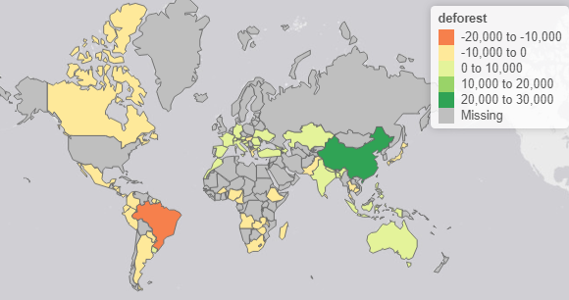
Most affected countries

Slide 4
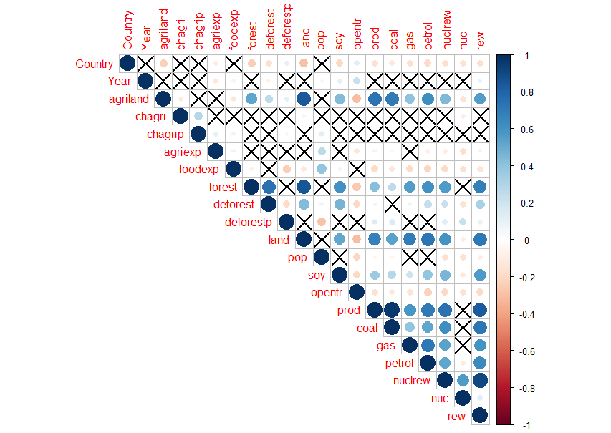
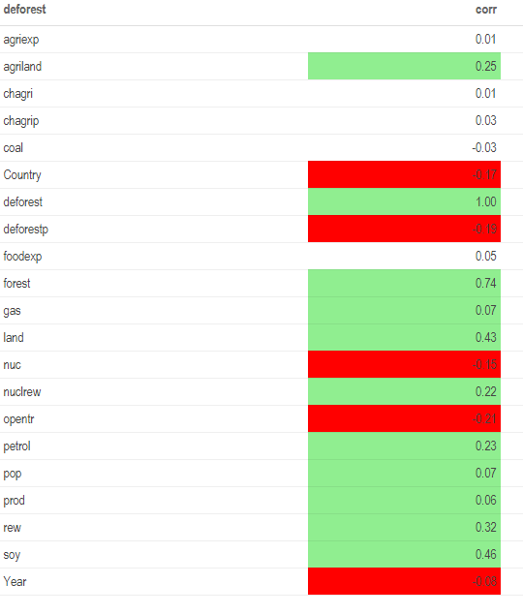
Correlation plot

Slide 5
Analysis
Ordinary Least Square regression
Panel Data
Panel with Balanced Model
OLS per year

Slide 6
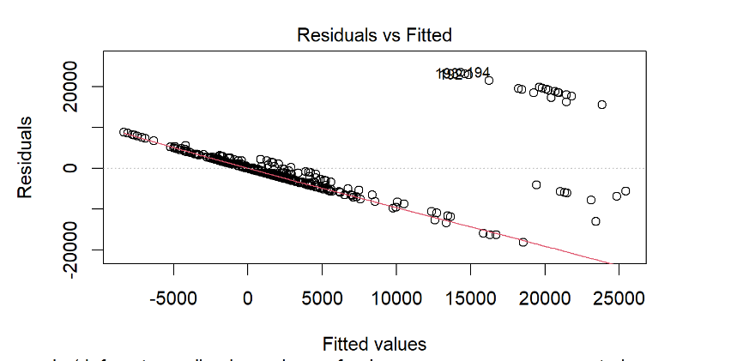
OLS & Heteroskedasticity

Slide 7
Analysis
Ordinary Least Square regression
Panel Data
Panel with Balanced Model
OLS per year

Slide 8
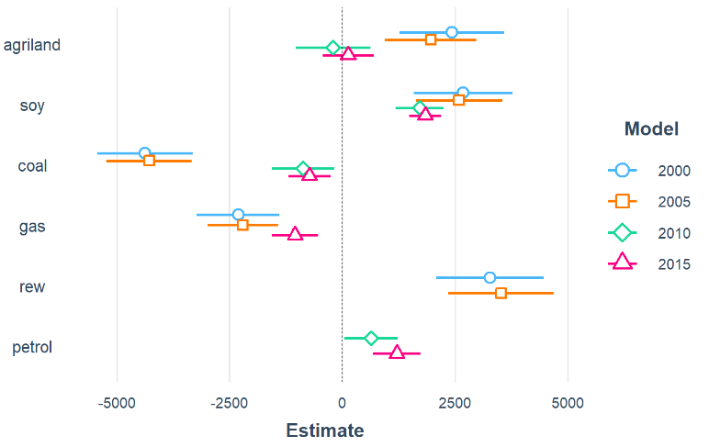
OLS per year

Slide 9
Final Result and critics

