Slide 1
Archaeological
Pipeline
Fragment Reconstruction
1 Preprocessing
2 Shape Encoding
An Automatic Computer Vision Pipeline for Reassembling Broken Artifacts
3 Edge Compatibility
4 Color Pre-Check
5 Relaxation Labeling
Introduction to Computational and Biological Vision (ICBV)
Final Project
9 / 9 positive ✓
100% detection rate
Shahaf • 2026

Slide 2
The Problem
Broken artifacts are everywhere — and reassembling them is extremely hard.
What We Want to Automate
Excavations uncover hundreds of broken sherds from a single object.
A conservator may spend weeks trying to find matching pieces by hand.
The search space grows exponentially: with N fragments, there are N! possible arrangements.
Manual work is slow, expensive, and error-prone.
Given: photos of individual fragments
Find: which edges fit together
Propose: how the artifact looked
N!
Weeks
Seconds
possible arrangements for N fragments
manual reassembly time for a typical artifact
with our automated pipeline
ICBV Final Project — Fragment Reconstruction

Slide 3
Our Pipeline — 5 Stages
Every stage maps directly to an algorithm from the ICBV lectures.
Preprocessing
Shape Encoding
Edge Compatibility
Color Pre-Check
Assembly Search
1
Gaussian blur + Otsu thresholding + contour extraction
2
Freeman chain code + PCA normalization
3
Curvature cross-correlation + Fourier descriptors
4
Bhattacharyya histogram distance + bimodal detection
5
Relaxation Labeling (iterative constraint propagation)
▶
▶
▶
▶
INPUT
────────────────────────────────────────────►
OUTPUT
Folder of fragment images (PNG/JPG, clean background, one fragment per file)
Annotated assembly images + confidence scores + [RESULT] verdict
ICBV Final Project — Fragment Reconstruction

Slide 4
Dataset — Generating Realistic Fragments
Since real pre-segmented fragment images are hard to obtain, we built a fragment generator from scratch.
Dataset Statistics
9
source images (archaeological photos)
▸ Voronoi tessellation
– Divide the image into N random Voronoi cells — each becomes a fragment.
▸ Gaussian noise displacement
6 – 8
fragments per image (1 always dropped)
– Jitter cell boundaries to produce irregular, jagged fracture lines.
▸ Missing pieces
~30%
fragments with erosion damage
– Randomly drop K fragments to simulate lost or unrecovered pieces.
▸ Erosion damage
– Apply random elliptical erosion blobs to simulate weathering effects.
9
positive test cases (same-image fragments)
36
negative test cases (mixed-image fragments)
ICBV Final Project — Fragment Reconstruction

Slide 5
Test Case Design — Positive & Negative
✓ POSITIVE cases (9 total)
✗ NEGATIVE cases (36 total)
All fragments come from the SAME source image.
1 fragment is always dropped (missing piece).
~30% of fragments have erosion damage.
Expected verdict: MATCH or WEAK MATCH
Result: 9 / 9 (100%) pass rate
Fragments come from TWO DIFFERENT source images (half and half).
Expected verdict: NO MATCH
Detected via bimodal color distribution check.
Result: 19 / 36 (53%) pass rate
Failures: image pairs with very similar color palettes.
Example
Example
scroll/ → 6 fragments from one photograph of an ancient scroll, 1 fragment omitted at random.
mixed_scroll_shard_01/ → 3 fragments from a scroll + 3 from a pottery shard. Color histograms are very different → NO MATCH in 0.2 s.
ICBV Final Project — Fragment Reconstruction

Slide 6
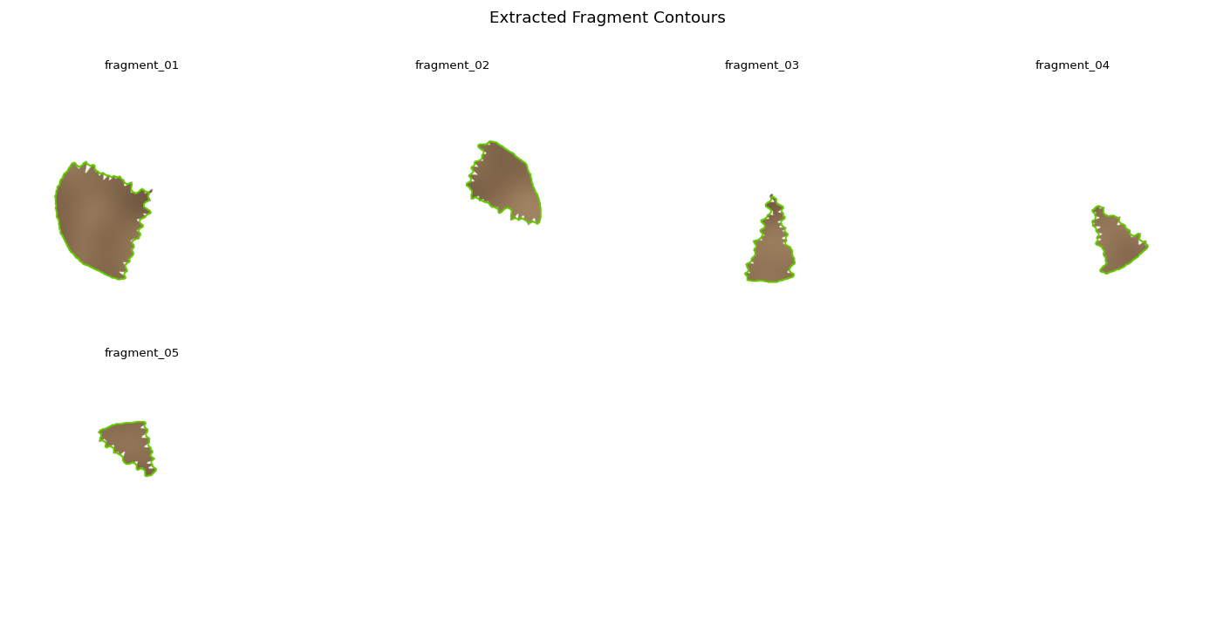
Stage 1 — Preprocessing
Lectures 22 & 23
Load
Read RGBA image; convert alpha channel to binary mask if present.
Gaussian Blur
Apply Gaussian kernel (σ=1.5) to suppress noise before thresholding. → Lecture 22: linear filtering in frequency domain.
Otsu Threshold
Automatically find the optimal foreground/background split. → Maximizes inter-class variance of pixel intensities.
findContours
Extract the outer boundary chain from the binary mask. → Lecture 23: connects to Canny edge detection theory.
Segment Split
Divide each contour into 4 edge segments (top, right, bottom, left) for pairwise comparison.
Extracted contours overlaid on fragment images
ICBV Final Project — Fragment Reconstruction

Slide 7
Stage 2 — Shape Encoding with Chain Code
Lecture 72
The key idea: represent each fragment boundary as a sequence of direction codes, then compare sequences directly.
Freeman Chain Code
Rotation Invariance
Curvature Profile
Walk along the contour pixel by pixel. At each step, record the direction (0–7, 8-connected): 3 2 1 4 ○ 0 5 6 7 Result: a string of digits, e.g. "00711263…"
PCA aligns each fragment to its principal axis before chain code extraction. Cyclic-minimum normalization: find the lexicographically smallest rotation of the chain string. Two boundaries are now comparable regardless of fragment orientation.
Compute finite differences along the chain to get a curvature profile (sequence of turn angles). Curvature is more informative than raw chain codes for matching: it captures the shape of the break.
Lecture 72
Lect. 72 + 74
Lecture 72
ICBV Final Project — Fragment Reconstruction

Slide 8
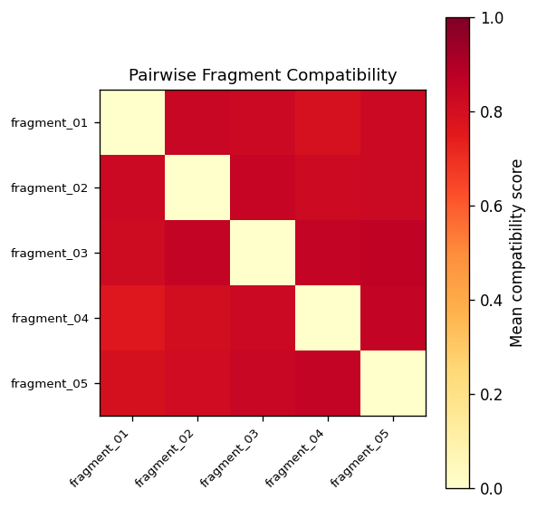
Stage 3 — Edge Compatibility Scoring
Lectures 23, 52, 72
For every pair of edge segments (one from each fragment), we compute a compatibility score in [0, 1].
Curvature cross-correlation (FFT)
When two edges fit together, one curvature profile is the mirror-reverse of the other. Correlate via FFT — rotation invariant and fast. → Lec. 23
Fourier descriptors
Represent each segment shape in frequency domain. Low-frequency terms capture global shape; high-frequency terms capture fine detail. → Lec. 72
Good continuation bonus
If the joined boundary at the proposed match forms a smooth curve (low curvature change), add a bonus. → Gestalt principle, Lec. 52
Final score
score = α · curvature_sim + β · fourier_sim + γ · continuation_bonus Normalized to [0, 1]. Stored in a 4D compatibility tensor (frag_i, edge_i, frag_j, edge_j).
Compatibility heatmap — brighter = more compatible
ICBV Final Project — Fragment Reconstruction

Slide 9
Stage 4 — Color Pre-Check (Fast Rejection)
Lecture 71
Before running the expensive geometric pipeline, we ask: could these fragments all come from the same image?
Algorithm
Why It Works
1. Compute a 16×4 HSV histogram for each fragment (Bhattacharyya coefficient).
Fragments from the same artifact share a color palette (same material, lighting, and patina).
2. Build an N×N matrix of pairwise histogram similarities.
Fragments from two different artifacts typically have different palette centers — yielding a clearly bimodal BC distribution.
3. Sort all pairwise values. Look for a large gap between consecutive values.
Detects mixing in ~0.2 seconds — vs. ~4 seconds for full pipeline.
4. If gap ≥ 0.25 AND lower-group max ≤ 0.62: → bimodal distribution detected → two distinct sources → NO MATCH immediately.
Catches 19/36 negative cases. Fails only when two artifacts share nearly identical hue distributions.
5. Otherwise: pass to full geometric pipeline.
ICBV Final Project — Fragment Reconstruction

Slide 10
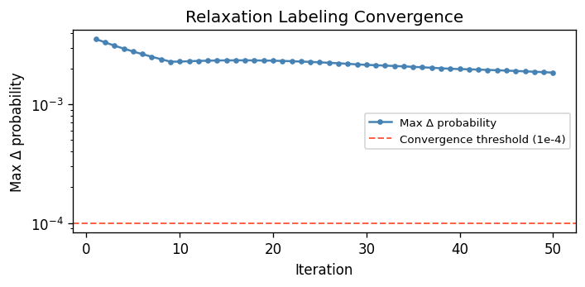
Stage 5 — Relaxation Labeling (Assembly Search)
Lecture 53
The update rule (direct from Lecture 53):
P(i,λ) ← P(i,λ) · (1 + Q(i,λ))
Σμ [ P(i,μ) · (1 + Q(i,μ)) ]
Initial state
Each fragment edge gets equal probability of matching every other fragment's edge.
Q(i,λ) — context support
Measures how much neighboring fragment pairs agree with the label λ. If surrounding assignments are consistent → Q is high.
Iteration
Repeat until convergence (Δ < 10⁻⁴) or max 50 iterations. Consistent matches reinforce each other; contradictory ones cancel out.
Convergence trace — confidence per iteration
Assembly extraction
MATCH
WEAK MATCH
NO MATCH
After convergence, extract the highest-probability assignment. Count how many pairs exceed a confidence threshold → MATCH / WEAK MATCH / NO MATCH.
≥ 60% of pairs above threshold
40–60% of pairs
< 40% of pairs
ICBV Final Project — Fragment Reconstruction

Slide 11
Visual Results — Fragment Contours & Compatibility
These outputs are generated automatically for every pipeline run.
fragment_contours.png Extracted boundaries overlaid on each input fragment
compatibility_heatmap.png Pairwise edge compatibility matrix — bright cells = likely matches
ICBV Final Project — Fragment Reconstruction

Slide 12
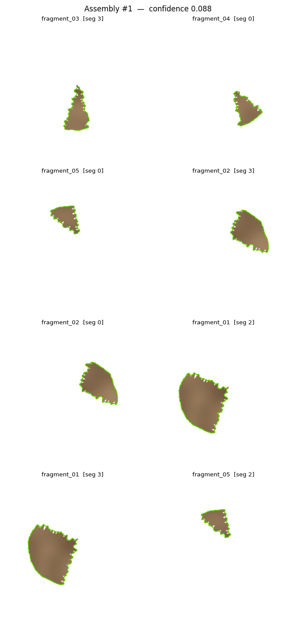
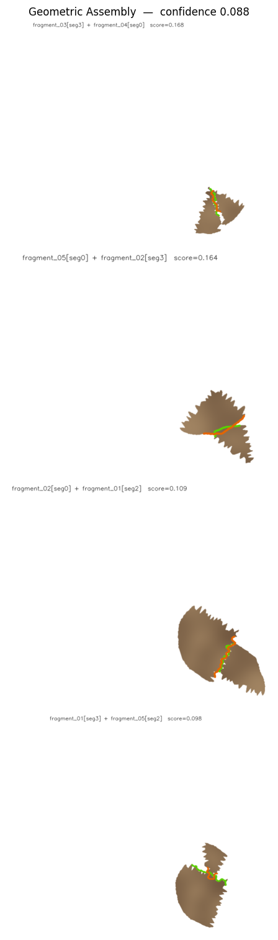
Visual Results — Proposed Assemblies
The pipeline proposes the top-3 assemblies, each with a confidence score.
assembly_01.png — Top proposal with match annotations
assembly_01_geometric.png — Fragments arranged in proposed positions
ICBV Final Project — Fragment Reconstruction

Slide 13
Benchmark Results
Running run_test.py --no-rotate against the full data/examples/ suite:
9 / 9
19 / 36
POSITIVE cases (same image)
NEGATIVE cases (mixed images)
100% pass rate
53% pass rate
Why do 17 negative cases fail?
The 17 failing negative cases all involve image pairs with very similar color palettes — for example, two different pottery fragments made of the same clay, or two stone carvings photographed under the same lighting. In these cases, the pairwise Bhattacharyya coefficient matrix is NOT bimodal, so the pre-check cannot detect the mixed source. The geometric pipeline then finds high-confidence within-group matches (A↔A, B↔B) and reports MATCH incorrectly.
ICBV Final Project — Fragment Reconstruction

Slide 14
Algorithms from the Course
Every major component maps directly to a lecture from ICBV:
Pipeline Stage
Algorithm Used
Lecture
Preprocessing
Gaussian blur + Otsu thresholding
Lecture 22
Contour extraction
cv2.findContours (connected to Canny edge theory)
Lecture 23
Shape encoding
Freeman 8-directional chain code
Lecture 72
Rotation invariance
PCA alignment + cyclic-minimum chain normalization
Lect. 72 + 74
Edge compatibility
Curvature cross-correlation via FFT + Fourier descriptors
Lect. 23 + 72
Grouping constraint
Gestalt good continuation bonus at join points
Lecture 52
Color consistency
Bhattacharyya HSV histogram distance
Lecture 71
Assembly search
Relaxation labeling — iterative belief update
Lecture 53
Hypothesis pruning
Confidence threshold + interpretation-tree framing
Lecture 73
ICBV Final Project — Fragment Reconstruction

Slide 15
Additional Tools & Techniques
Beyond the core course algorithms, we used several additional techniques to make the system practical:
Voronoi Tessellation + Gaussian Noise
Data Generation
FFT Cross-Correlation
Speed & Matching
Partitions source images into fragments with realistic fracture-like boundaries. Each Voronoi cell boundary is displaced by Gaussian noise to produce jagged, irregular fractures rather than straight lines — mimicking real-world breaks.
Efficient O(N log N) curvature profile comparison instead of O(N²) direct sliding-window matching. At the core of edge compatibility: the curvature of a broken edge should be the mirror-reverse of its partner — FFT cross-correlation finds the best alignment in one pass.
Bhattacharyya Coefficient + Bimodal Detection
Color Pre-Check
Morphological Erosion (Damage Simulation)
Simulation
A symmetric similarity measure for comparing HSV color histograms. We build an N×N pairwise matrix, sort all values, and look for a large gap — a clear bimodal distribution signals that two distinct source images are present, triggering immediate rejection before the slow geometric pipeline runs.
Applied to fragment masks using random elliptical structuring elements placed at random positions and angles inside each fragment. Simulates the weathering and wear that real archaeological fragments accumulate over centuries. Also erodes outer boundary pixels to roughen edges.
ICBV Final Project — Fragment Reconstruction

Slide 16
Known Limitations
Same-color false positives
The color pre-check cannot distinguish two artifacts made of the same material. Fragments from two brown clay pots look identical in HSV histogram space. A texture or gradient feature would help here.
Pre-segmented images only
The system requires one fragment per image with a clean background. Raw excavation field photographs with complex backgrounds are not supported — a segmentation step would be needed first.
2D only — no depth or texture analysis
3D surface scans would provide far stronger matching signals (fracture surface geometry). This is a 2D photograph-only pipeline.
Scale — designed for 5–15 fragments
The pairwise scoring is O(N²) in the number of edge segments. Scaling to hundreds of fragments would require approximate nearest-neighbor indexing rather than exhaustive pairwise computation.
ICBV Final Project — Fragment Reconstruction

Slide 17
Summary
We built a complete, working pipeline for 2D fragment assembly from photographs.
Every stage maps to a concrete algorithm from the ICBV course.
The system achieves 100% on positive test cases and 53% on negative cases.
A fast color pre-check (0.2 s) catches mixed-source inputs before the 4 s geometric pipeline.
Fragment generation with Voronoi + noise + erosion damage produces realistic test data.
Future directions:
– Add texture / gradient histogram features to improve negative discrimination.
– Extend to 3D surface scans for stronger geometric matching.
– Replace exhaustive scoring with ANN index for scalability.
Thank you

