Slide 1
Q3 Program Update
Community Water Access Program, September 2026

Slide 2
Where we are
  Kiosk rollout status
  Usage and downtime
  Budget
  Next steps

Slide 3
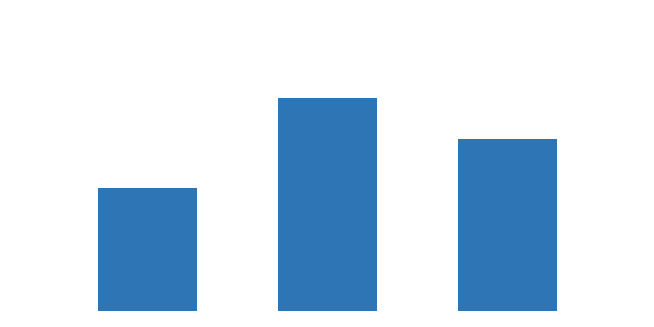
Kiosk usage by district

Slide 4
Downtime causes
Filter shortages: 62% of downtime days
Pump faults: 23%
Power outages: 15%

Slide 5
Budget to date
Line | Budget | Spent
Kiosks | $480k | $455k
Filters | $120k | $131k
Training | $60k | $41k

Slide 6
Next steps
Build a three-month filter reserve
Approve 2027 expansion budget
Report back in December

