Slide 1

Team 9 Piazza Panic
By Liam Burnand, Cameron Fox, Adam Penny,
Eoin O’Connor, Jack Cameron and Ben Brown
https://kitchentossups.github.io/
Notes:
Invite them to look at website

Slide 2
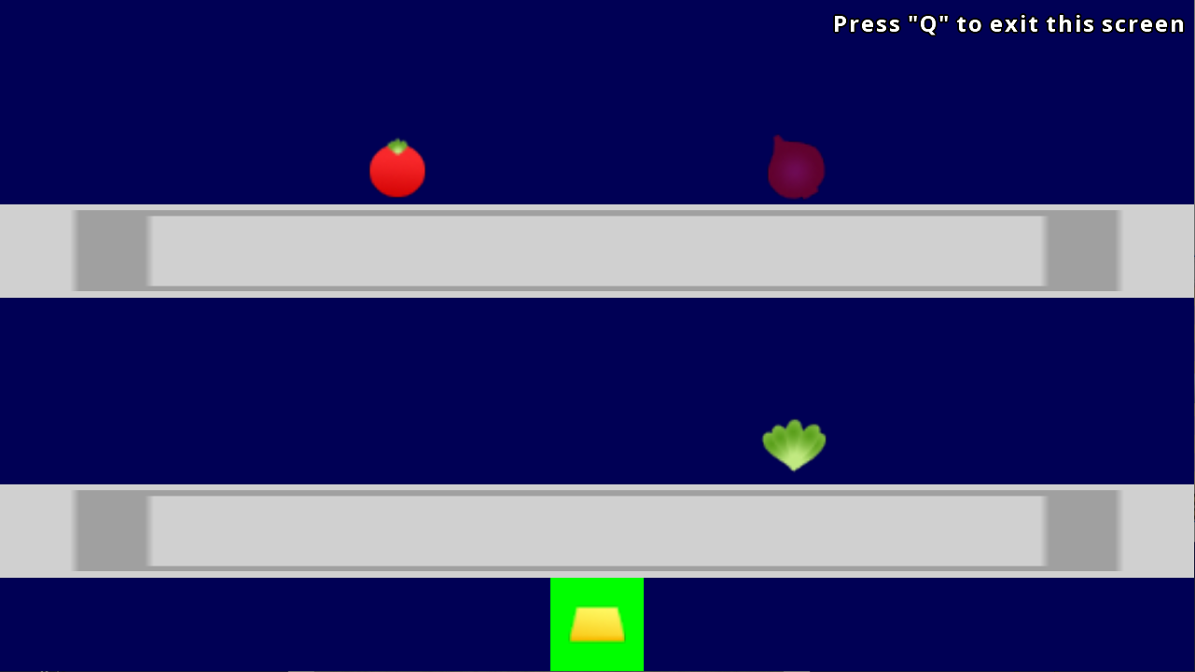
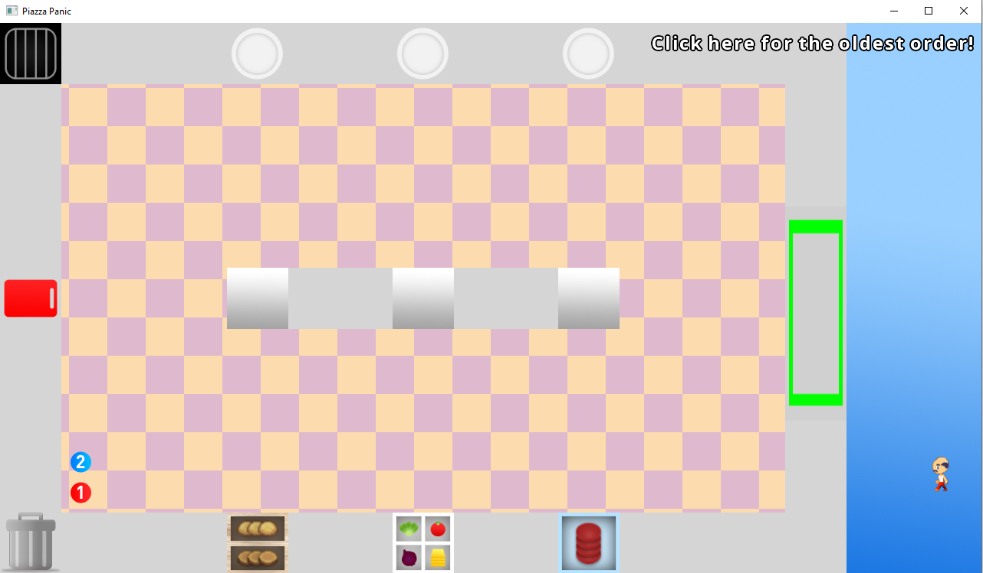
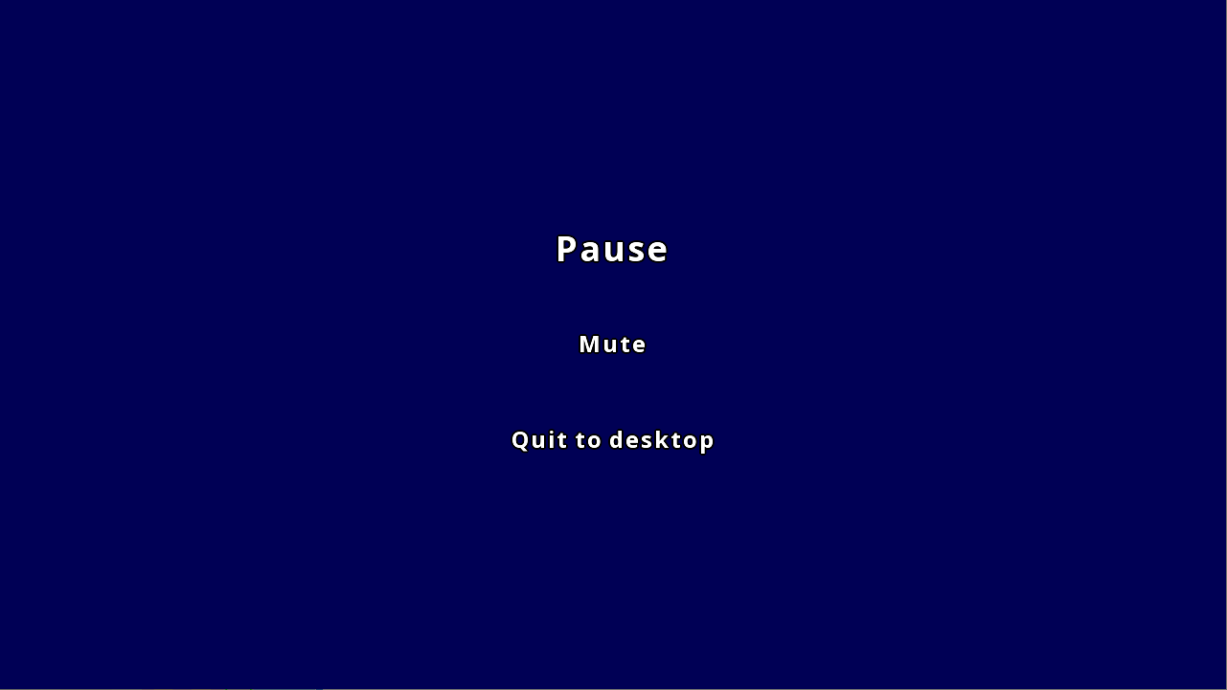
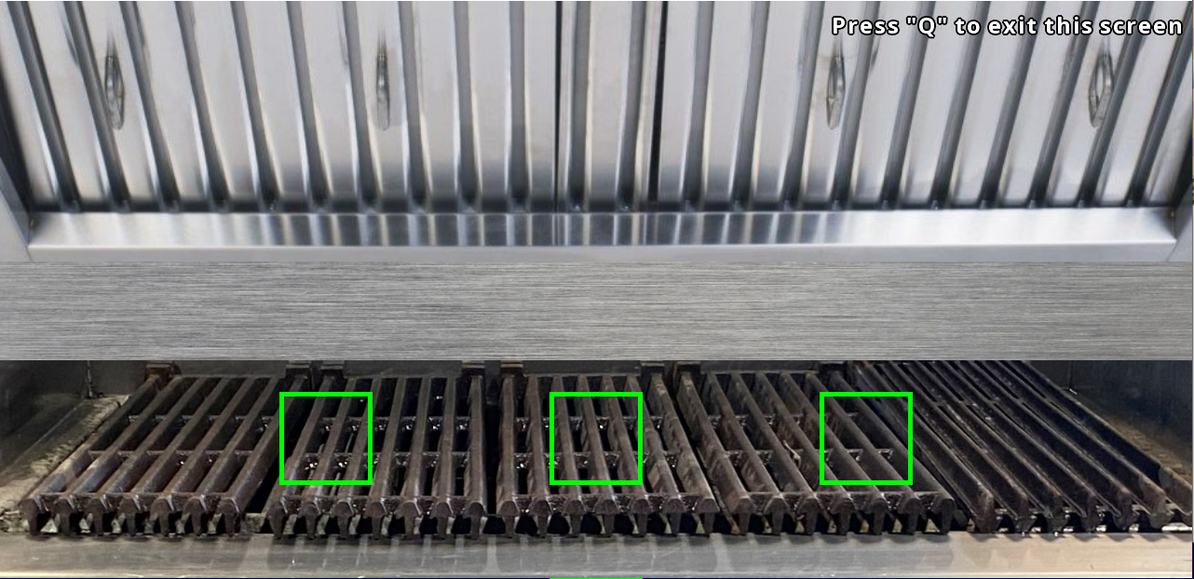
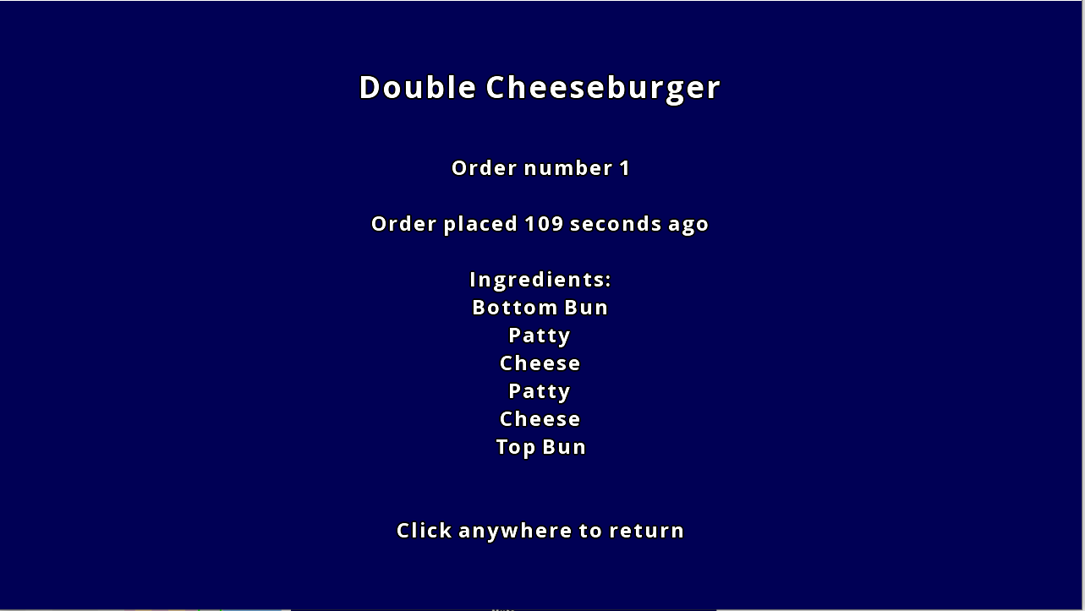
Project Description
Piazza Panic is a small cooking game based on the Piazza restaurant on Campus East at the University of York.
-2 controllable chefs, two base recipes with variations on the burger.
-Java JDK 11 project built with libGDX on IntelliJ.
Food Chest Screen
Main Game Screen
Pause Menu
Grill Screen (Cooking Station)
Order Screen
Notes:
Just mention the library it uses and how it meets the criteria
Talk about screens on next slides

Slide 3
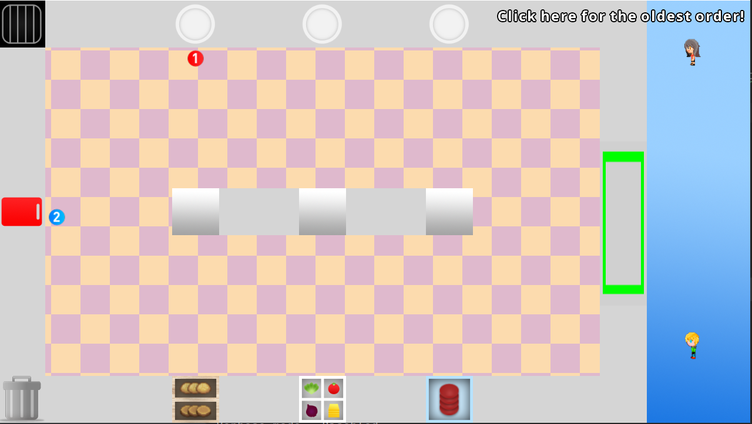
Kitchen Screen
Notes:
Overview of kitchen
Each one is a station
Pressing e near station -> new screen

Slide 4
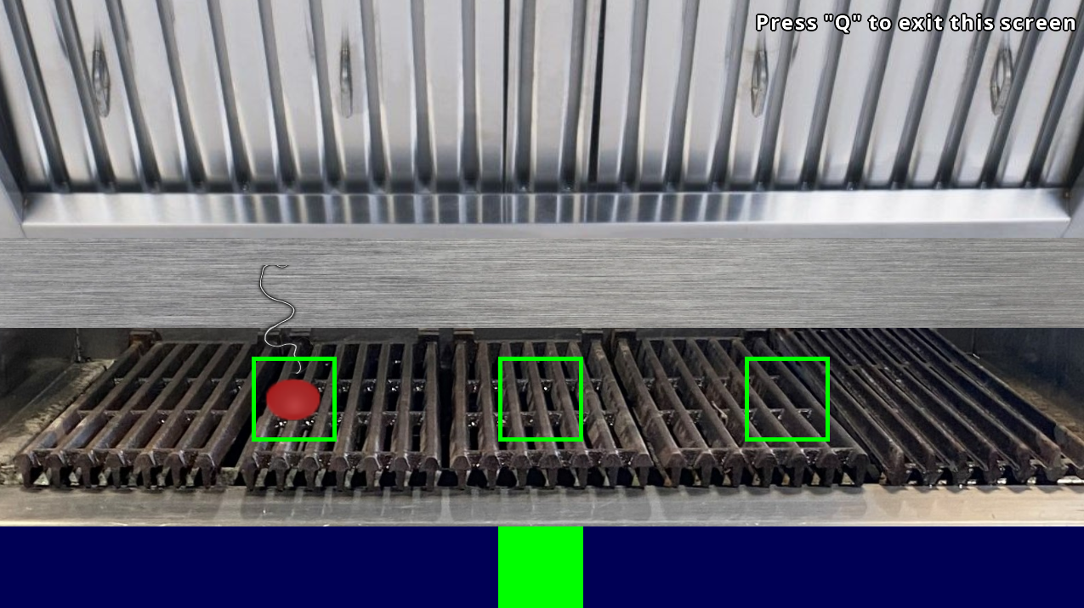
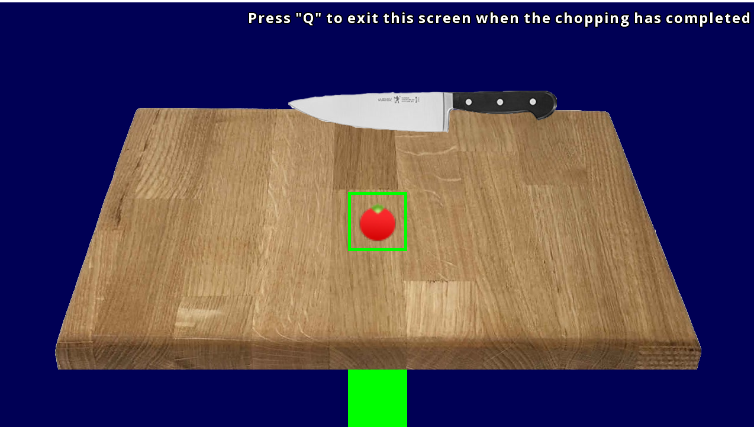
Food Chest
Grill
Chopping Station
Order Screen
Notes:
Just a quick overview so they can get a feel for it
Don’t spend long on this slide

Slide 5
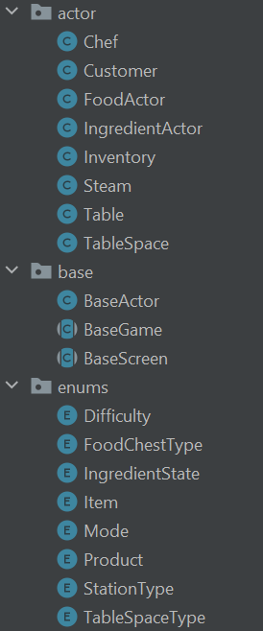
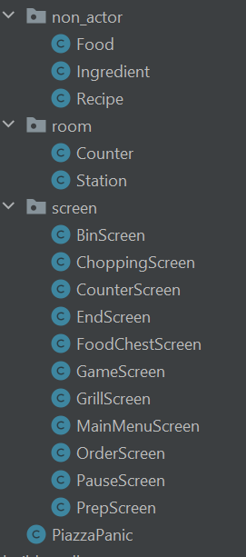
Class Implementation
Clear organised file structure grouped by function.
Base classes make adding new classes simple.
Classes are easy to understand and the code is intuitive.
All the code fits together very well.
Notes:
Base classes make adding classes simple
Split into actors, screens, non actors
Well organised for ease of access + finding files
Many examples of each class

Slide 6
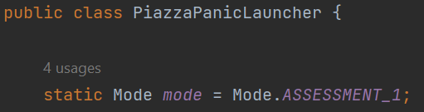
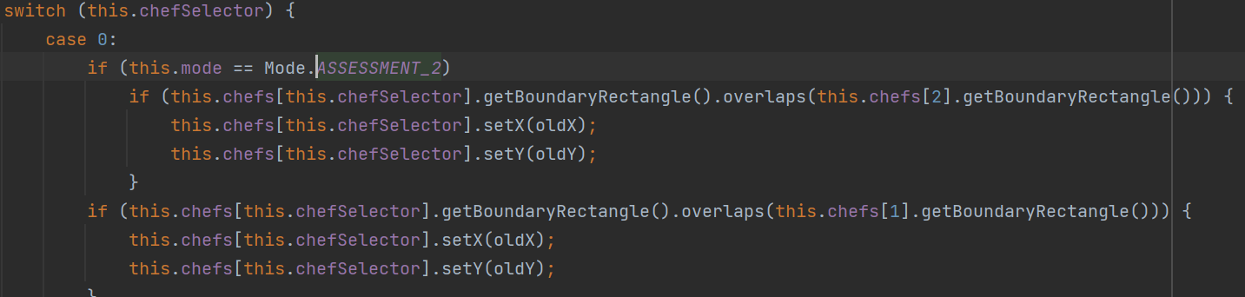
Implementing Assessment 2
In the launcher class, change mode from ASSESSMENT_1 to ASSESSMENT_2.
Will create more chefs and add them to the game.
Notes:
Change mode to add some things required for assessment 2

Slide 7
Adding New Stations
this.stations.add(new Station(0, this.height / 2f - 40f, 80, 80, this.loci, StationType.CHOPPING, this.mainStage));
Simple architecture and coding design make it easy to add new stations, food etc. with just one line of code.
Variable names and parameters are self describing e.g CHOPPING.
Easy to specify the dimensions and position of stations.
Notes:
Easy to add stations
One simple line of code

Slide 8
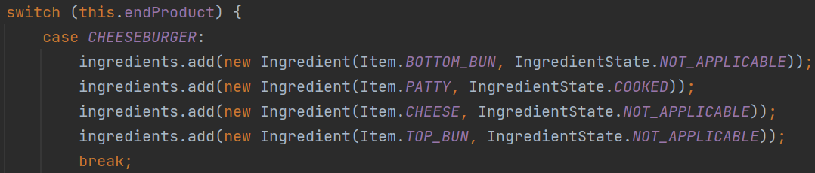
Adding New Recipes
Logical and easy to understand.
Simple to add a new recipe and specify its component ingredients.
States for ingredients easy to implement e.g. patty must be cooked.

Slide 9
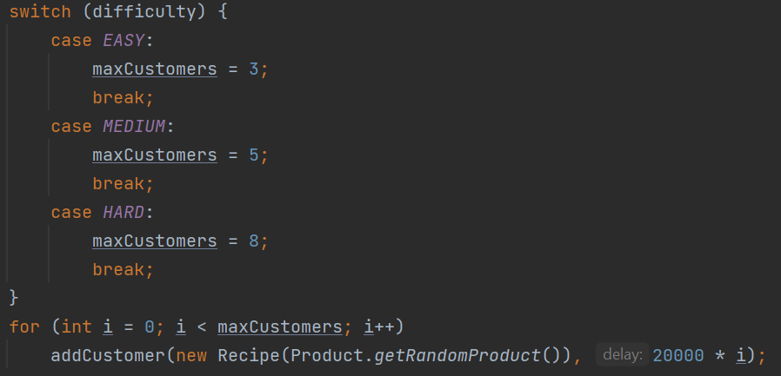
Adding Customers
Simply change maxCustomers or change difficulty to add more customers to the game.
Notes:
Once again, show off simple code

Slide 10

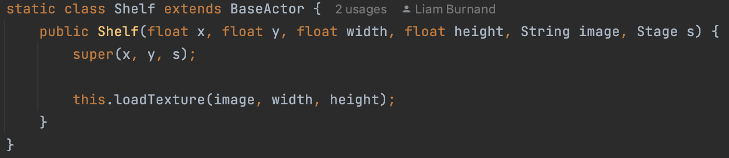
Adding more actors/images
Adding more images to the screen is as easy as this, set the x, y, width, height and image and you are done, it is as easy as that! We have a parent class that takes all the complications out of making something new.

Slide 11
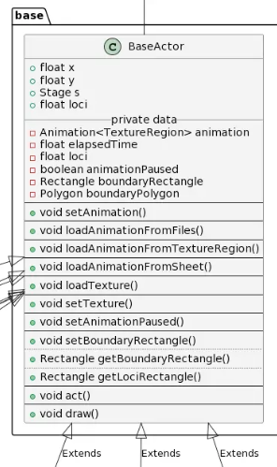
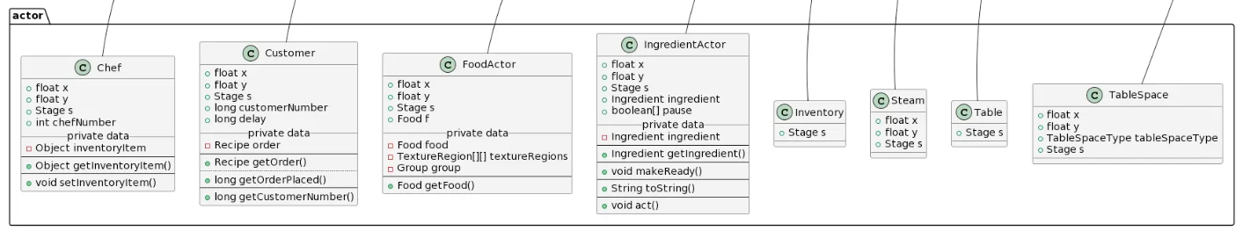
Architecture
Existing UML for every class.
E.g. Actors and how they inherit BaseActor.
Full UML diagram code on project website.
Notes:
Emphasise easy to add to and existing code available on website
Shows how easy adding new actors is as all methods are predefined in BaseActor

Slide 12
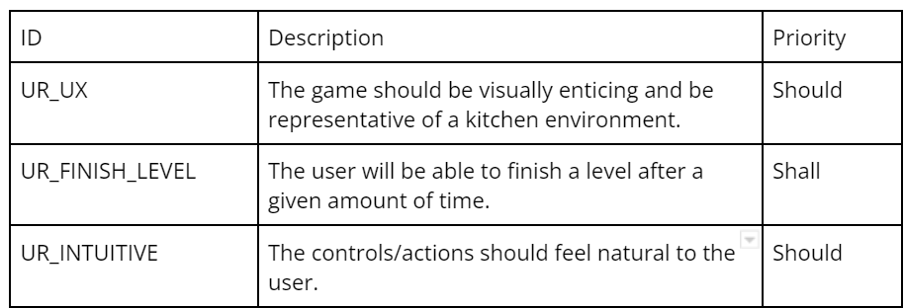
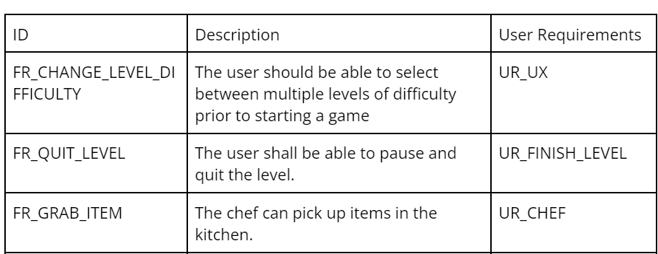
User Requirements
User Requirements
User requirements and functional requirements have been created which in tandem ensure the needs of the customer are met.
Functional Requirements
Notes:
Brief - they exist, move on

Slide 13
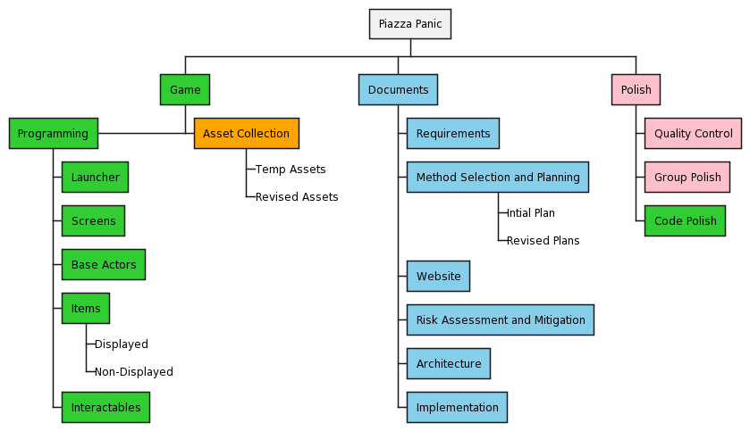
Method Selection and Planning
Divided into 3 key tasks
Assigned team leaders
Weekly scrums

Slide 14
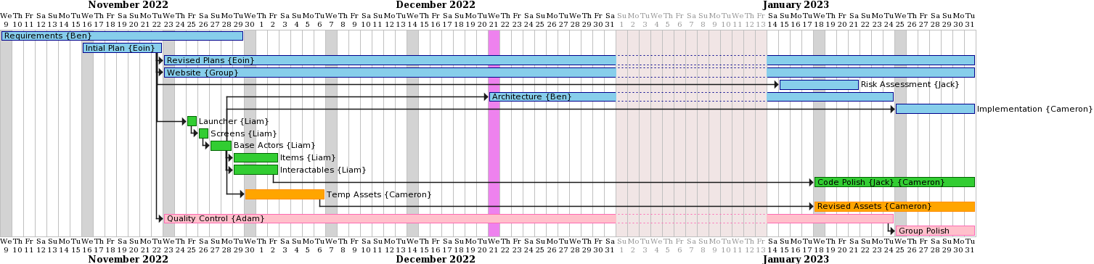
Method Selection and Planning
Colour coded tasks.
All PlantUML code on website for easy editing.

Slide 15
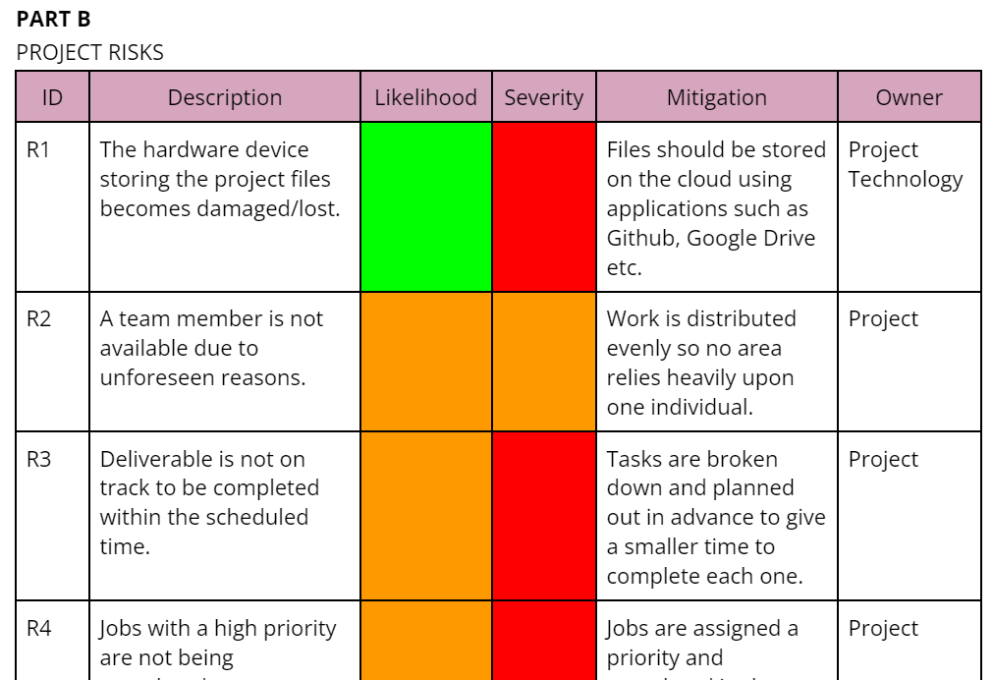
Risk Assessment and Mitigation
Easy to understand and add to as risks are identified throughout project development.
Red, amber and green show likelihood and severity from the most to least impactful.
Notes:
Very brief, just say it exists

Slide 16
Thank you!
Feel free to ask us any questions.
Team 9
https://kitchentossups.github.io/

