Slide 1
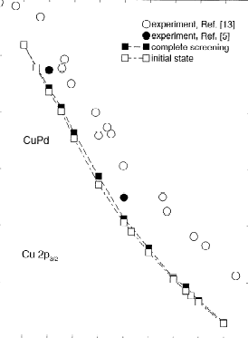
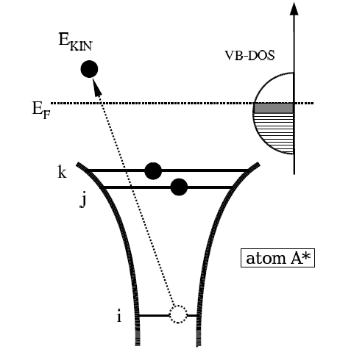
XPS Core Level Shifts
XPS binding energies used to identify elements
Binding energy shifts sensitive to chemical environment.
This point also doesn’t follow the expected trend for Pd CLS.
I suspect something may be wrong with the supercell.
BE
Photon
W. Olovsson et al. J. Elect. Spect. & Rel. Phenom. 127 (2002) 65

