Slide 1

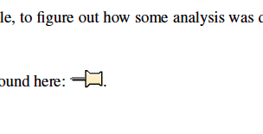
An embedded file in the PDF

