Slide 1
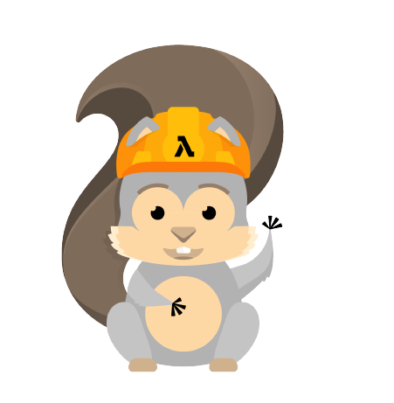
S3-Image-Monitoring-Detection-Using-Rekognition-Publish-Data-on-SNS
AWS Serverless Application Model (SAM)

Slide 2



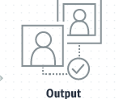

Workflow
2-Event Triggered For Lambda Function
3-Image is analyzed using recognition API
1-File Uploaded on S3 Bucket
4- Publish Data to SNS Topic
4- Detect Labels, Moderation Labels and Text in the Image

Slide 3
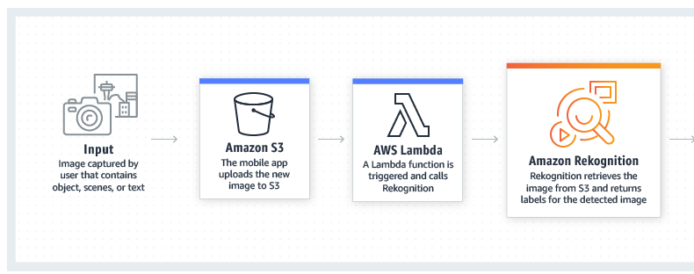
Use Case
SEARCHABLE IMAGE LIBRARY
Amazon Rekognition makes images searchable so you can discover objects and scenes that appear within them. You can create an AWS Lambda function that automatically sends data to SNS Topic
Example:
Subscribe SNS Topic for
EMAIL
SMS
Publish to SNS Topic
Text
Labels
Moderation Labels
* Above picture is taken from AWS recognition documentation

