Slide 1
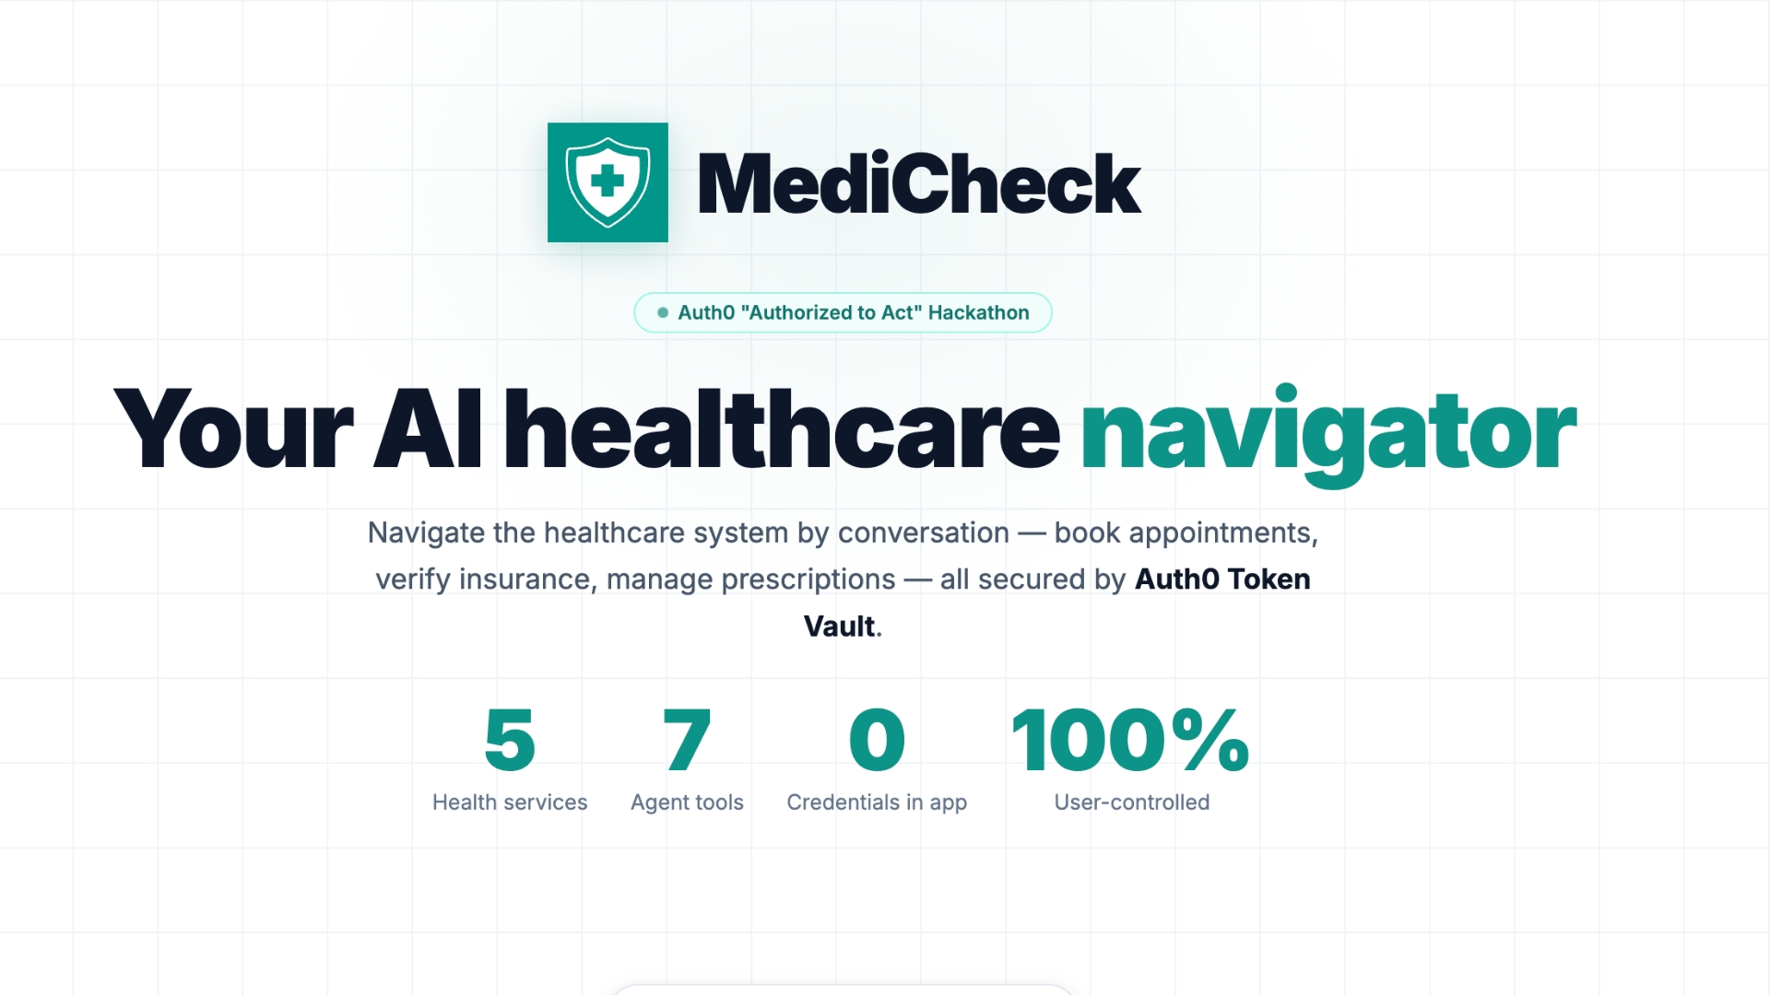

Slide 2
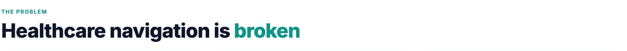
Fragmented systems
EHR, insurance, pharmacy, and scheduling live in separate portals — all with separate logins and zero coordination.
Time-consuming
Average patient spends 2+ hours a year on hold verifying coverage and booking appointments — before any care happens
Credential risks
Existing AI tools ask for passwords directly — storing credentials in prompts, databases, or environment variables

Slide 3
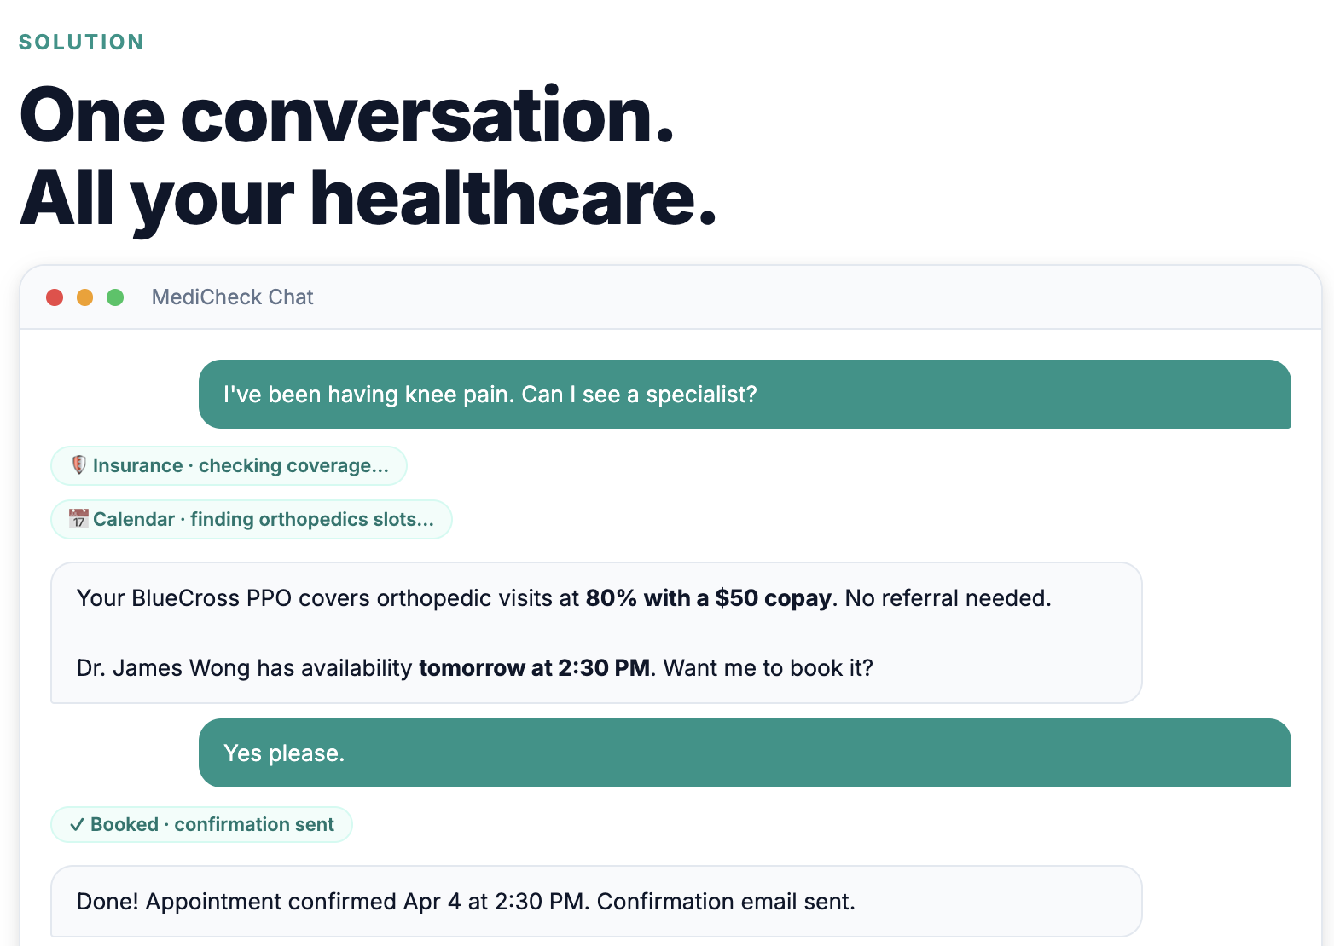

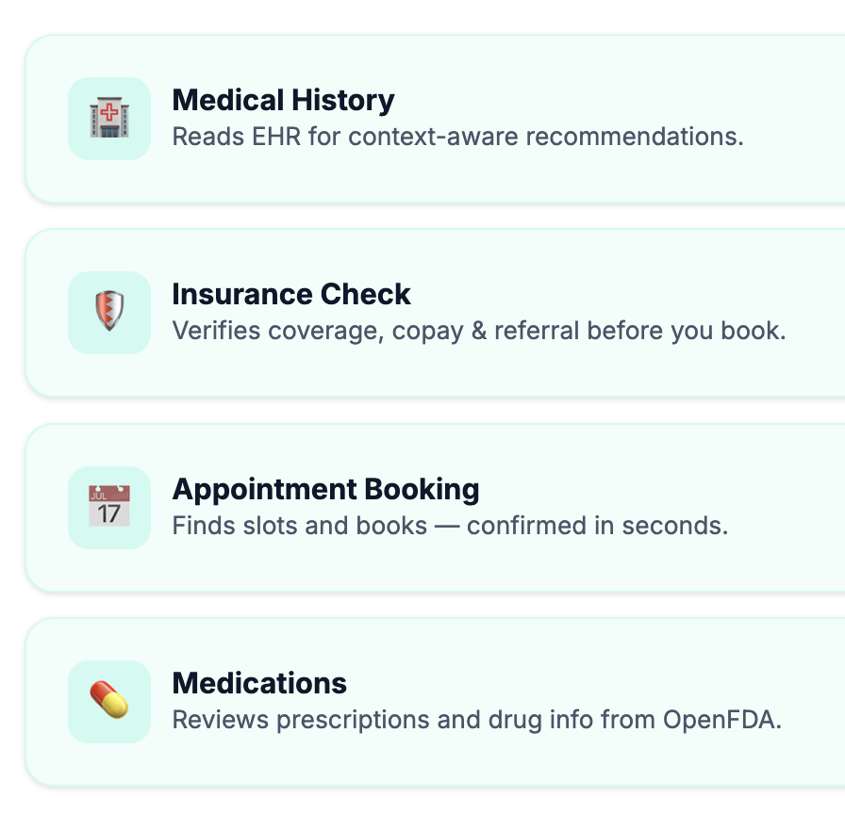

Slide 4
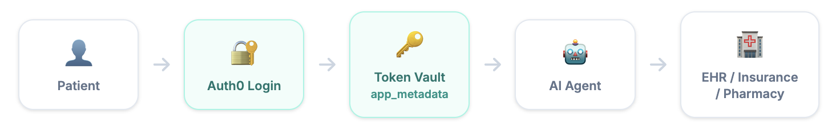
Secure Auth0 Token Vault
Per-Service Tokens
Runtime Fetch Only
Instant Revocation
No credentials stored in the app

