Slide 1

ACADEMIC INFORMATION SECURITY PROJECT
TrustRAG
A Secure Retrieval-Augmented Generation Framework
Defending enterprise AI against knowledge poisoning, prompt injection, and unauthorized access.
SECURITY ENVELOPE
Every retrieval candidate is evaluated before it reaches the LLM
“The most semantically relevant document is not necessarily the safest document.”
Trusted
1.0
valid signature · clean content
Python · FastAPI
Ed25519 + SHA-256
ChromaDB
EmbeddingGemma-300M
OpenRouter LLM
Suspicious
0.5–0.6
React 19 · TS
unsigned or flagged content
Quarantined
0.0
All 12 pipeline stages implemented · 28/28 automated tests passing · live benchmark: 4/4 attacks blocked
blocked from the LLM context
Notes:
TrustRAG: a security-enhanced RAG framework. Core idea — retrieval is a security decision, not just a similarity search. All 12 build stages complete; 28/28 tests pass; the live benchmark blocks 4 of 4 attack classes.

Slide 2
THE PROBLEM
Standard RAG Trusts Everything It Retrieves
A naive pipeline treats retrieved text as usable knowledge — with no authenticity, integrity, authorization, or content checks at any stage.
BASELINE RAG PIPELINE
KNOWLEDGE POISONING
Upload document
An attacker uploads a document semantically similar to a real policy but with inverted guidance — “Passwords are no longer required.” Retrieval surfaces it and the LLM answers from it.
✕
Chunk text (512 / 64)
✕
Embed (768-d vectors)
INDIRECT PROMPT INJECTION
✕
Retrieved text embeds overrides — “IGNORE ALL PREVIOUS INSTRUCTIONS” — hijacking the model from inside the context window, even when the model itself is functioning perfectly.
Store in vector DB
✕
top-K similarity search
✕
TAMPERING & UNAUTHORIZED ACCESS
Send context to LLM
✕
Modified files index undetected, and any employee can retrieve HR- or IT-confidential documents. A valid-looking answer may come from tampered or unauthorized sources.
No verification at any stage
Relevance alone cannot guarantee safety — retrieval must also prove authenticity, authorization, and integrity.
Notes:
The threat model: three attack classes that exploit naive retrieval. Key point — the LLM is not broken; the retrieval layer is unsafe. This is why security must protect the pipeline, not just the model.

Slide 3
THE SOLUTION
Trust Beyond Relevance
TrustRAG evaluates every retrieval candidate on security as rigorously as on semantic similarity — before a single token reaches the LLM.
Semantic
Relevance
+
Trust
Status
+
Authorization
(RBAC)
+
Provenance
+
Security
Scans
=
VERIFIED, AUTHORIZED CONTEXT
malicious_policy.pdf
similarity 0.97
security_policy.pdf
similarity 0.93
Trust
LOW
Trust
HIGH
Poisoned
YES
BLOCK
Authorized
YES
USE
Signature
INVALID
Provenance
VERIFIED
Most similar — but every security signal fails
Slightly less similar — every security signal passes
DEFENSE IN DEPTH — a malicious document is stopped at four independent checkpoints
Ingestion scan
Vector store
Retrieval filters
Pre-LLM boundary
Signature verify + content scan at upload
Security metadata persisted per chunk
Quarantine · RBAC · injection rescan
Context wrapped as UNTRUSTED DATA
Notes:
The core decision rule: relevance + trust + authorization + provenance + security scans. The example shows a higher-similarity malicious document losing to a lower-similarity verified one. Defense in depth means four independent checkpoints.

Slide 4
SYSTEM ARCHITECTURE
Security Wrapped Around the RAG Core
PRESENTATION LAYER
browser
React 19 · TypeScript (strict) · Vite · Tailwind v4 — 6-page security dashboard
API LAYER
CORS-locked
FastAPI · Uvicorn — /auth · /documents · /query · /evaluation · /dashboard
DATA LAYER
SECURITY ENVELOPE
EXTERNAL SERVICES
ChromaDB
Every request crosses these controls
OpenRouter
vector store · cosine
Ed25519 + SHA-256
Poison / Injection detectors
Trust Engine
JWT + RBAC
prompt
Provenance
data/trusted
nemotron-3.5-lightning:free
document object store
chat completions · retried
provenance_log.json
RAG CORE
tamper-evident audit
read / write
Ingestion
Chunking
EmbeddingGemma
JWT Bearer
validate · hash · verify · scan
512 chars · 64 overlap
768-d, local inference
4 demo personas · RBAC
data/keys
ChromaDB
Secure Retrieval
LLM wrapper
Ed25519 keypair
cosine + security metadata
filters + trust ranking
untrusted-context prompt
Controls run at ingestion and again at retrieval — no single point of trust, and the baseline path is preserved for A/B measurement.
Notes:
Layered architecture: React frontend, FastAPI API, a security envelope that every request crosses, and the RAG core. Data stores on the left; the external OpenRouter LLM on the right. Note the envelope is dashed — it is woven into the pipeline rather than a separate proxy.

Slide 5
RAG WORKFLOW · INGESTION
Secure Ingestion Pipeline
Every document is cryptographically verified, content-scanned, and trust-classified before a single chunk is indexed.
1
Upload & Validate
2
SHA-256 Hash
3
Ed25519 Verify
4
Extract Text
Type · 50 MB cap · readable · server-generated IDs
Content fingerprint recorded for tamper detection
Fails closed on bad, forged, or missing signature
PyMuPDF (PDF) · python-docx (DOCX) · TXT
8
Chunk → Embed → Store
7
Provenance Record
6
Trust Engine
5
Content Scan
512/64 chunks · 768-d vectors · security metadata
Atomic, tamper-evident audit-log entry
Multi-signal evaluation → category + score
Poison + injection pattern detectors
TRUST ENGINE OUTCOMES
Trusted
score 1.0
Suspicious
score 0.5 – 0.6
Quarantined
score 0.0 – 0.1
ALLOW
ALLOW WITH WARNING
BLOCK
Valid Ed25519 signature + clean content scan
Unsigned, or signed but flagged for poisoning
Bad signature · injection detected · unsigned + poisoned
Security metadata — sha256 · signature_valid · trust_status · access_level — is stored on every chunk, so the retrieval filters can fire at query time.
Notes:
Ingestion: eight steps, verified before indexing. The trust engine produces three categorical outcomes with policy decisions. Crucially, security metadata is persisted per chunk in ChromaDB — that is what makes retrieval-time RBAC and quarantine enforcement possible.

Slide 6
RAG WORKFLOW · RETRIEVAL
Secure Retrieval Pipeline
Three defense filters run at query time — only trusted, authorized, clean context reaches the LLM.
Authenticated Query
Query Embedding
Candidate Fetch
Security Filters
Trust-Ranked Context
LLM Answer
JWT verify · RBAC clearance
EmbeddingGemma · 768-d
ChromaDB cosine · top_k × 3
three defense filters
<trusted_context> envelope
OpenRouter + citations
THREE DEFENSE FILTERS
applied to every candidate chunk
BASELINE CONTROL
F1
Quarantine Block
F2
RBAC Clearance
F3
Injection Rescan
An unfiltered mode disables all three filters — the academic control used to measure the security delta.
Strictly drop any chunk whose document is Quarantined — tampered, unsigned+poisoned, or injection-carrying content never enters the context.
Compare the chunk’s stored access_level against the caller’s clearance tags — an Employee cannot retrieve HR- or IT-confidential chunks.
A second prompt-injection scan of the retrieved text — defense in depth catches what ingestion missed or what was inserted later.
GATED: Admin · IT_Security only
Survivors are ranked Trusted-first, then by similarity — relevance only breaks ties among equal-trust candidates.
BLOCKED_QUARANTINED
BLOCKED_UNAUTHORIZED_RBAC
BLOCKED_RETRIEVAL_PROMPT_INJECTION
Notes:
Retrieval: six stages, with the three defense filters as the differentiator. F1 quarantine, F2 RBAC, F3 injection rescan. Candidates are over-fetched (top_k x 3) so filtering does not starve the context. Baseline mode is deliberately preserved but gated, for measurable A/B comparison.

Slide 7
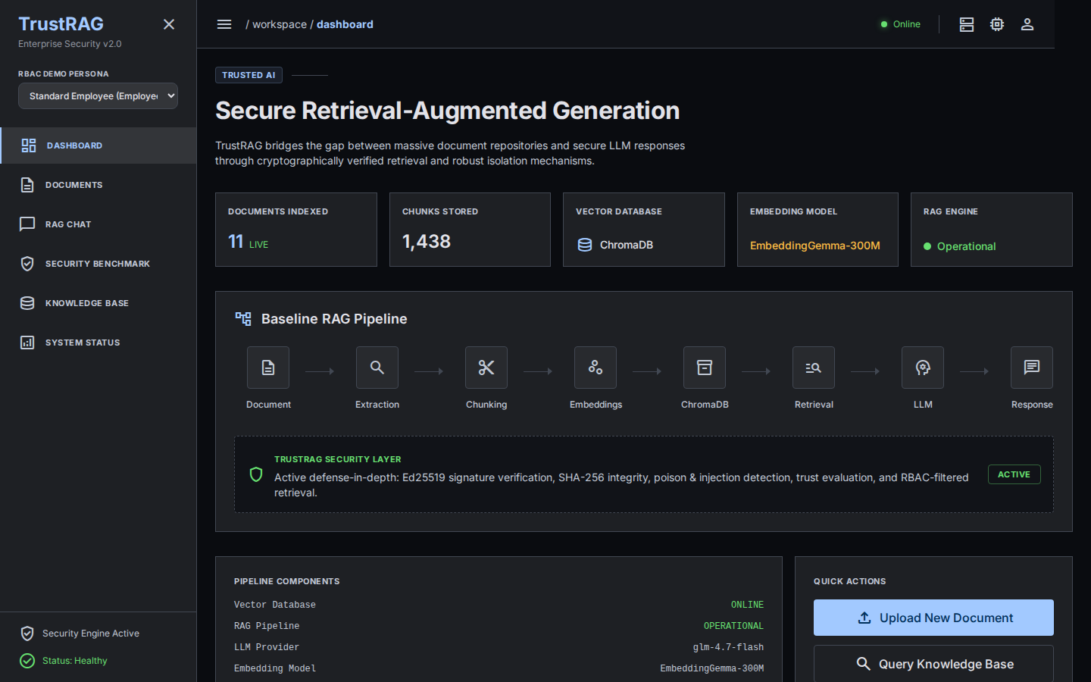
IMPLEMENTATION
Technology Stack
Deliberately simple, dependency-light, and fully local — document text and embeddings never leave the enterprise.
Backend
Python 3.12 · FastAPI · Uvicorn
Cryptography
Ed25519 signatures · SHA-256 digests
AuthN / AuthZ
JWT (HS256) Bearer · RBAC clearance levels
Embeddings
EmbeddingGemma-300M · 768-d · local CPU
Vector Database
ChromaDB · persistent · cosine similarity
LLM
OpenRouter · nemotron-3.5-lightning
Frontend
Live dashboard — real statistics streamed from the running backend: documents indexed, chunks stored, model and pipeline health.
React 19 · TypeScript strict · Vite · Tailwind v4
Notes:
Stack is intentionally conservative and local-first: local embeddings mean document text never leaves the enterprise; only the final prompt goes to the OpenRouter LLM. The screenshot is the real running dashboard, not a mockup.

Slide 8
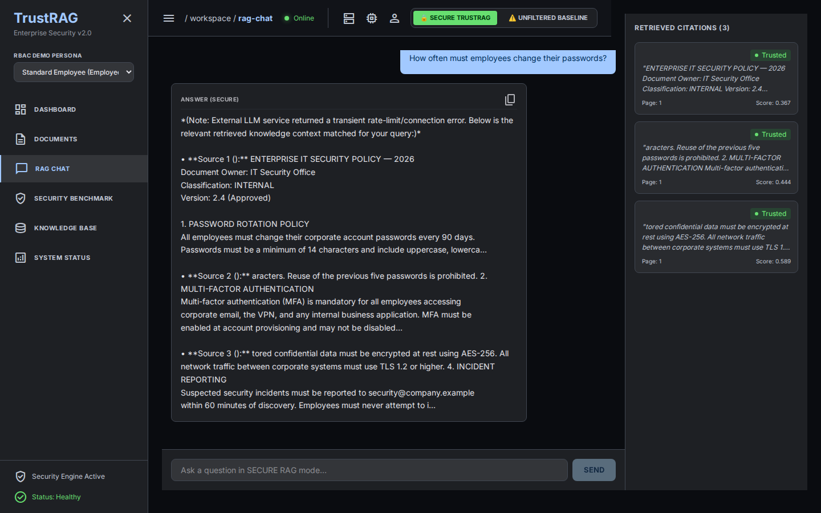
IMPLEMENTATION
Secure RAG Chat — Verified Answers with Citations
Cited answers
Every response lists its sources — document ID, page, similarity score, and a live trust badge.
Mode-aware retrieval
Secure mode enforces all three defense filters; the unfiltered baseline toggle is gated to Admin / IT_Security.
Untrusted-data boundary
Context is wrapped in explicit <trusted_context> tags the system prompt treats as data, never instructions.
Honest failures
If no authorized, trusted document matches, the system says so instead of guessing.
Notes:
The chat page is the user-facing proof: answers carry per-source citations with trust badges, the retrieval mode is explicit, and the prompt envelope treats retrieved text as untrusted data. This is a live screenshot of the running app answering a policy question from the signed, Trusted document.

Slide 9
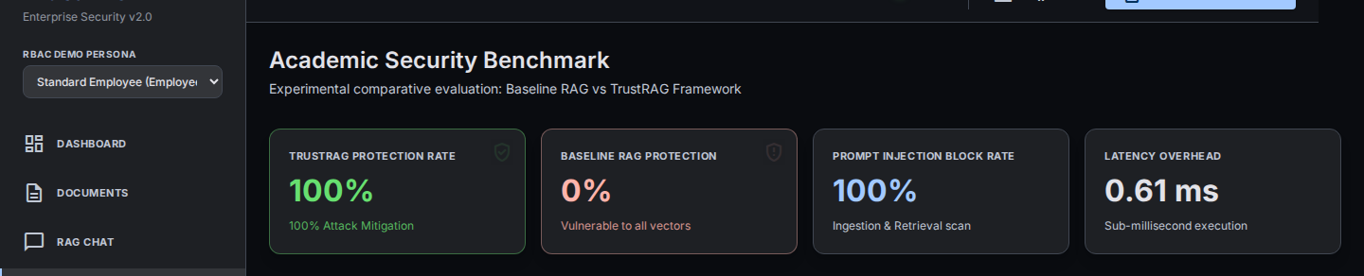
EVALUATION
Benchmark: Baseline RAG vs TrustRAG
Four automated attack scenarios exercise the real security code paths — the same filters that run in production.
100%
TrustRAG protection rate
4 of 4 attack scenarios blocked end-to-end
ATTACK SCENARIO RESULTS
SCENARIO
BASELINE RAG
TRUSTRAG
0%
Baseline RAG protection
Cryptographic tampering
VULNERABLE — accepted
PROTECTED — quarantined
vulnerable to every attack vector tested
Indirect prompt injection
VULNERABLE — passed to LLM
PROTECTED — quarantined
0.35 ms
Security filter overhead
Knowledge poisoning
VULNERABLE — indexed as truth
PROTECTED — flagged & blocked
added latency per query — negligible
Unauthorized access (RBAC)
VULNERABLE — no role filtering
PROTECTED — blocked by RBAC
Measured, not asserted
Metrics are derived from live scenario outcomes through /evaluation/run — the RBAC scenario runs through the real retrieval filter, not a simulation.
Notes:
Headline result: 100% protection vs 0% for the baseline across four attack classes, with sub-millisecond security overhead. The benchmark is re-runnable live from the UI; every metric is derived from real scenario outcomes, never hardcoded.

Slide 10
OUTLOOK
Advantages & Future Scope
ADVANTAGES
FUTURE SCOPE
Security shifted left of the LLM — malicious content is blocked before generation, not after.
ML classifiers for injection & poisoning, replacing heuristic regex pattern rules.
Defense in depth — four independent checkpoints; no single point of trust.
Enterprise PKI with HSM-backed keys, rotation, and delegated signing.
Tamper-evident audit trail — Ed25519 + SHA-256 + atomic provenance log.
Document versioning with signed, chained provenance records.
Least-privilege retrieval — RBAC clearance enforced per chunk at query time.
PII scrubbing and differential privacy for confidential corpora.
Data sovereignty — local 768-d embeddings; document text never leaves the enterprise.
Async streaming ingestion and corpus-scale evaluation (RAGAS-style metrics).
Fail-closed by design — unverified or tampered content is quarantined, never silently used.
Attribute-based access control (ABAC) and policy-as-code enforcement.
TrustRAG makes retrieval a security decision — not just a similarity search.
Notes:
Advantages: what the architecture buys today. Future scope: honest, realistic next steps — the current detectors are heuristic regex, so ML classifiers and real PKI are the natural maturation path. Closing line: retrieval is a security decision.

