Slide 1







Visual Analytics and User Experience Design (IT4031)

Slide 2






The Team
NIMASHA K G K IT19117706
MANDAKINI N D C IT19238340
DE SERAM E M H S IT19951454
GUNASIRI R H I M IT199553816

Slide 3

Member Contribution
VPC/Docker
Setting up Cloud environment and deploying application inside VM
IT19951454
Prometheus
Configuration and Setting up Prometheus and deploy using docker
IT19117706
Node-exporter
Setting up the Node exporter and deploy using docker
IT19238340
Target configuration
Configure the target using Node exporter in Prometheus.yml file
IT19953816
Grafana Dashboard
Visualize metrics using Grafana dashboards deployed in docker Cloud
All Members

Slide 4

Introduction
The main object of this assignment is to implement a deployment to capture metrics from an application and visualize those by using the Grafana dashboards. To archived that we Set up a Linux server monitoring system using Grafana, node exporter & Prometheus.
Our Linux monitoring system consists of 3 components. 1)Prometheus
2)Exporter 3)Grafana

Slide 5
Prometheus
What is Prometheus ?
It is an open-source system monitoring and alerting toolkit. Prometheus collects and stores its metrics as time-series data which means that the information about the metrics is kept together with the timestamp at which it was captured and optional key-value pairs known as labels.

Slide 6

Grafana
What is Grafana ?
Grafana is the dashboard component of this monitoring system. With Grafana you can create, explore and share all of your data through beautiful, flexible dashboards.
In this system, Grafana collects the metrics from Prometheus & displays that in form of graphs & charts.
t

Slide 7

Node Exporter
What is Node Exporter ?
An exporter is a library that exports metrics from 3rd party systems, such as Linux servers, to Prometheus.
To monitor the Linux servers, Node Exporter is used. The Prometheus Node Exporter is an open-source time-series monitoring and alerting system for cloud- native environments, including Kubernetes. It is capable of gathering and archiving node-level measurements as time-series data and timestamping the information.

Slide 8
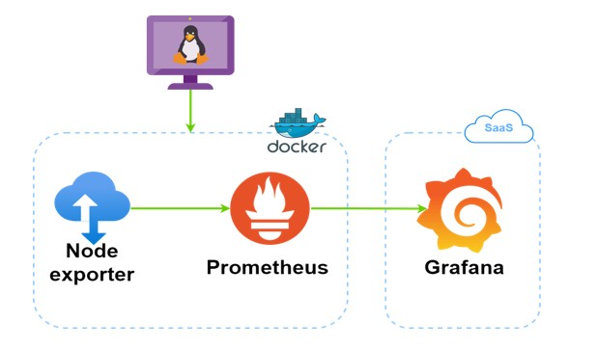
Architecture Diagram

Slide 9
Setup Procedure
1.Create two ec2 instances. 2.Install docker inside the VM. 3.Install Prometheus and Grafana
Install Prometheus Node Exporter on Linux servers to be monitored
Configure Node Exporter 6.Configure Prometheus server 7.Add Dashboards to Grafana
8.Start visualizing system metrics on Grafana

Slide 10


Grafana Dashboard
There are four types of metrics collected by Prometheus as part of its exposition format:
Counters. Gauges.
Histograms. Summaries.

Slide 11
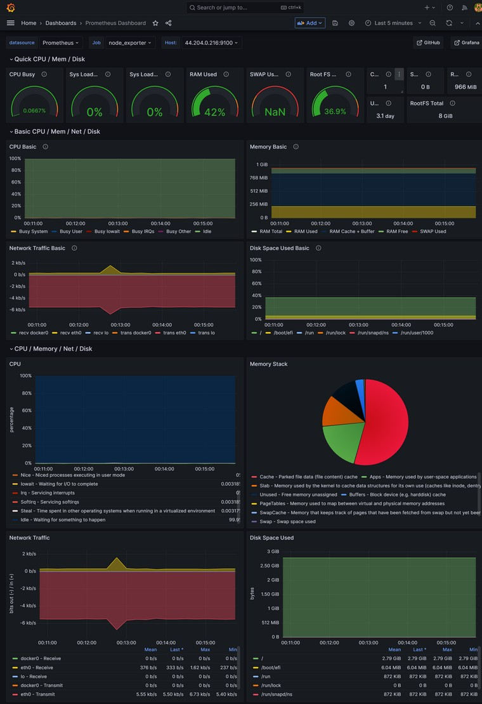
Grafana Dashboard

Slide 12
Thank You

