Slide 1

旅游服务定制系统
Best Travel Plan for You
张钊诚 2019104216
牟善磊 2019101405

Slide 2
REST Design Style
REST (REpresentational State Transfer) 软件架构设计风格。
降低开发复杂性
提高系统可伸缩性
以URL作为API进行服务调用
GET : url
POST: url
PUT/DELETE/HEAD/OPTIONS

Slide 3
Operation Flow
Client
Admin
Query
Add/Delete/Update/Query…
Service Consumer
Car
Flight
Hotel
Attraction

Slide 4
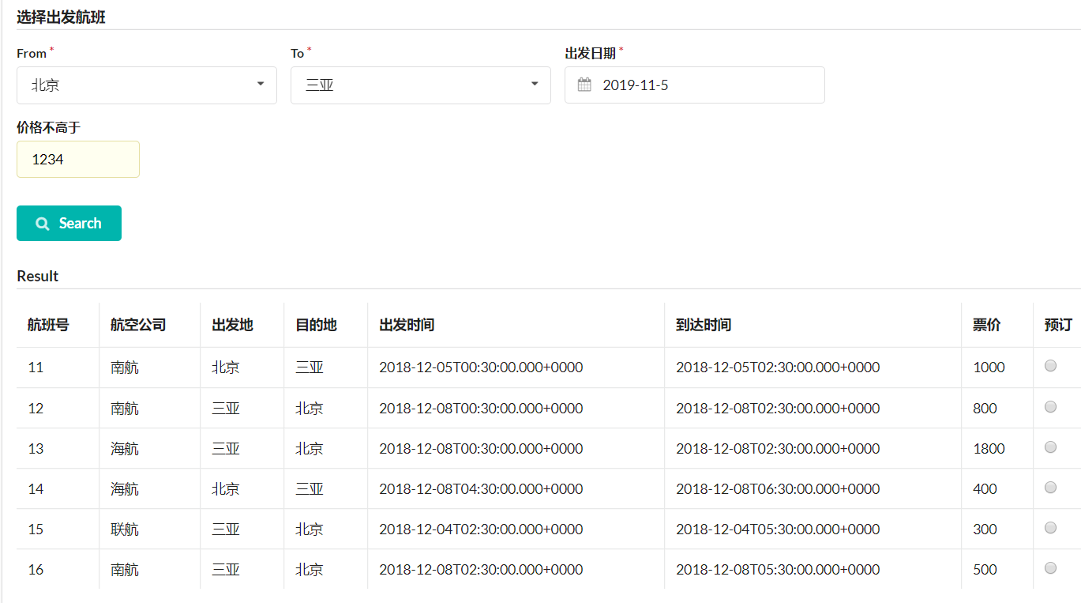

Slide 5
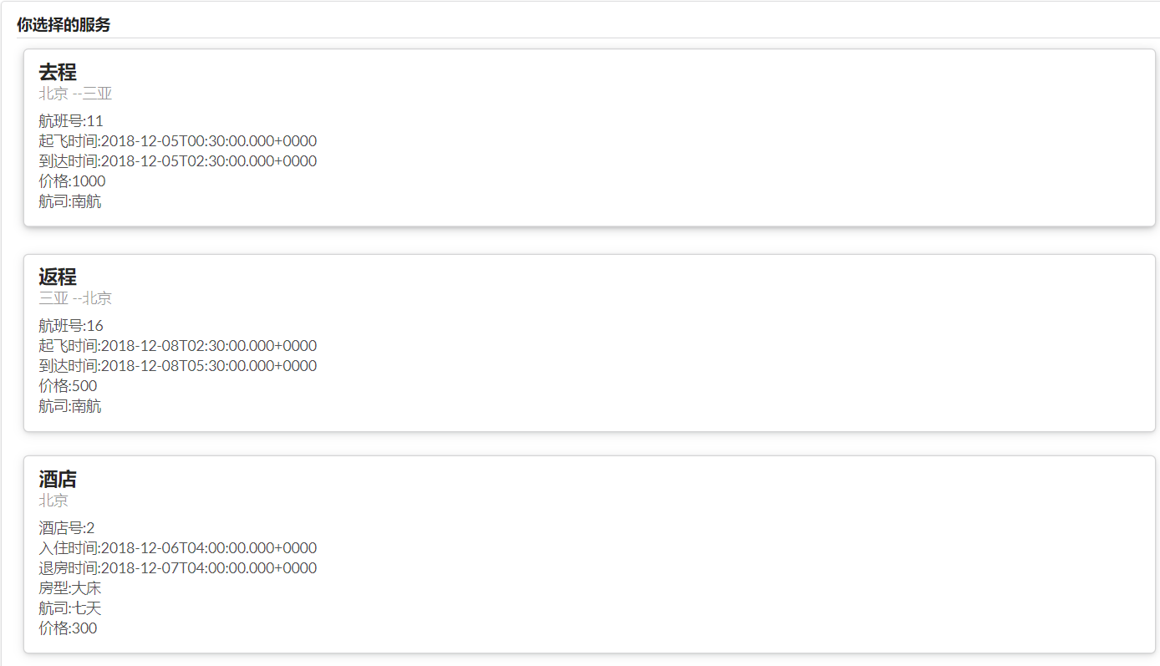

Slide 6
