Slide 1
SLAM Vibration Robustness Evaluation
Point-LIO performance under quadruped robot vibration across indoor and outdoor terrain scenarios
2026.03
1

Slide 2
Outline
1.
Motivation & Test Criteria
2.
Experimental Setup
3.
2D Trajectory Visualization (per scenario)
4.
Overlaid Trajectory Comparison
5.
Z-axis Drift Analysis
6.
Displacement & Speed Profiles
7.
Position Component Analysis
8.
Quantitative Comparison
9.
Algorithm Comparison (table, trajectory, analysis)
10.
Conclusion
2

Slide 3
1. Motivation & Test Criteria
Problem
Quadruped robots generate persistent high-frequency vibration:
- Foot-ground impact: 10-50 Hz impulse acceleration
- Body pitch/roll oscillation: ±5° attitude swing
- IMU noise variance increases 3-10x
These directly challenge LiDAR-IMU coupled SLAM:
- Point cloud motion distortion
- IMU pre-integration drift accumulation
- Odometry discontinuity risk
Metric | Pass Criterion
Survivability | Zero crashes
Odometry output | Stable ≥5 Hz
Pose plausibility | Consistent with geometry
Z-axis drift | < 2 m (flat corridor)
Loop consistency | Measurable return error
Test scope
Three terrain scenarios tested with Leg-KILO open dataset (Unitree Go1 + VLP-16):
1. Corridor — indoor flat L-shaped hallway (445 s)
2. Grass — outdoor uneven grass terrain (91.6 s)
3. Slope — outdoor hill/slope terrain (312 s)
+ Real-time baseline: Livox Mid-360 static drift test (30 s)
3

Slide 4
2. Experimental Setup
Parameter | Value
Source | Leg-KILO (KAIST, 2023)
Robot | Unitree Go1 quadruped
LiDAR | Velodyne VLP-16 (16-beam, 10 Hz)
IMU | Built-in (~500 Hz)
Corridor | 445 s, 670 K msgs, L-shape
Grass | 91.6 s, 211 K msgs, uneven
Slope | 312 s, 467 K msgs, hill terrain
SLAM | Config
Point-LIO | lidar_type=2, scan_line=16
 | timestamp_unit=2 (μs)
 | iVox point-wise update
Fast-LIO2 | lidar_type=2, acc_scale=1.0
 | iKD-Tree frame-wise update
Platform
RDK S100P (aarch64), ROS2 Humble
CycloneDDS, single-threaded (MP=1)
Data conversion
ROS1 bag → rosbags → ROS2 Humble
Metadata fix: version=4, rm hash,
offered_qos_profiles=""
4

Slide 5
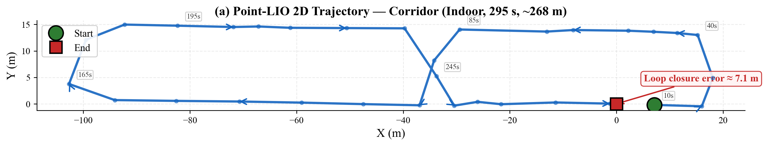
3a. 2D Trajectory — Corridor (Indoor, 295 s)
5

Slide 6
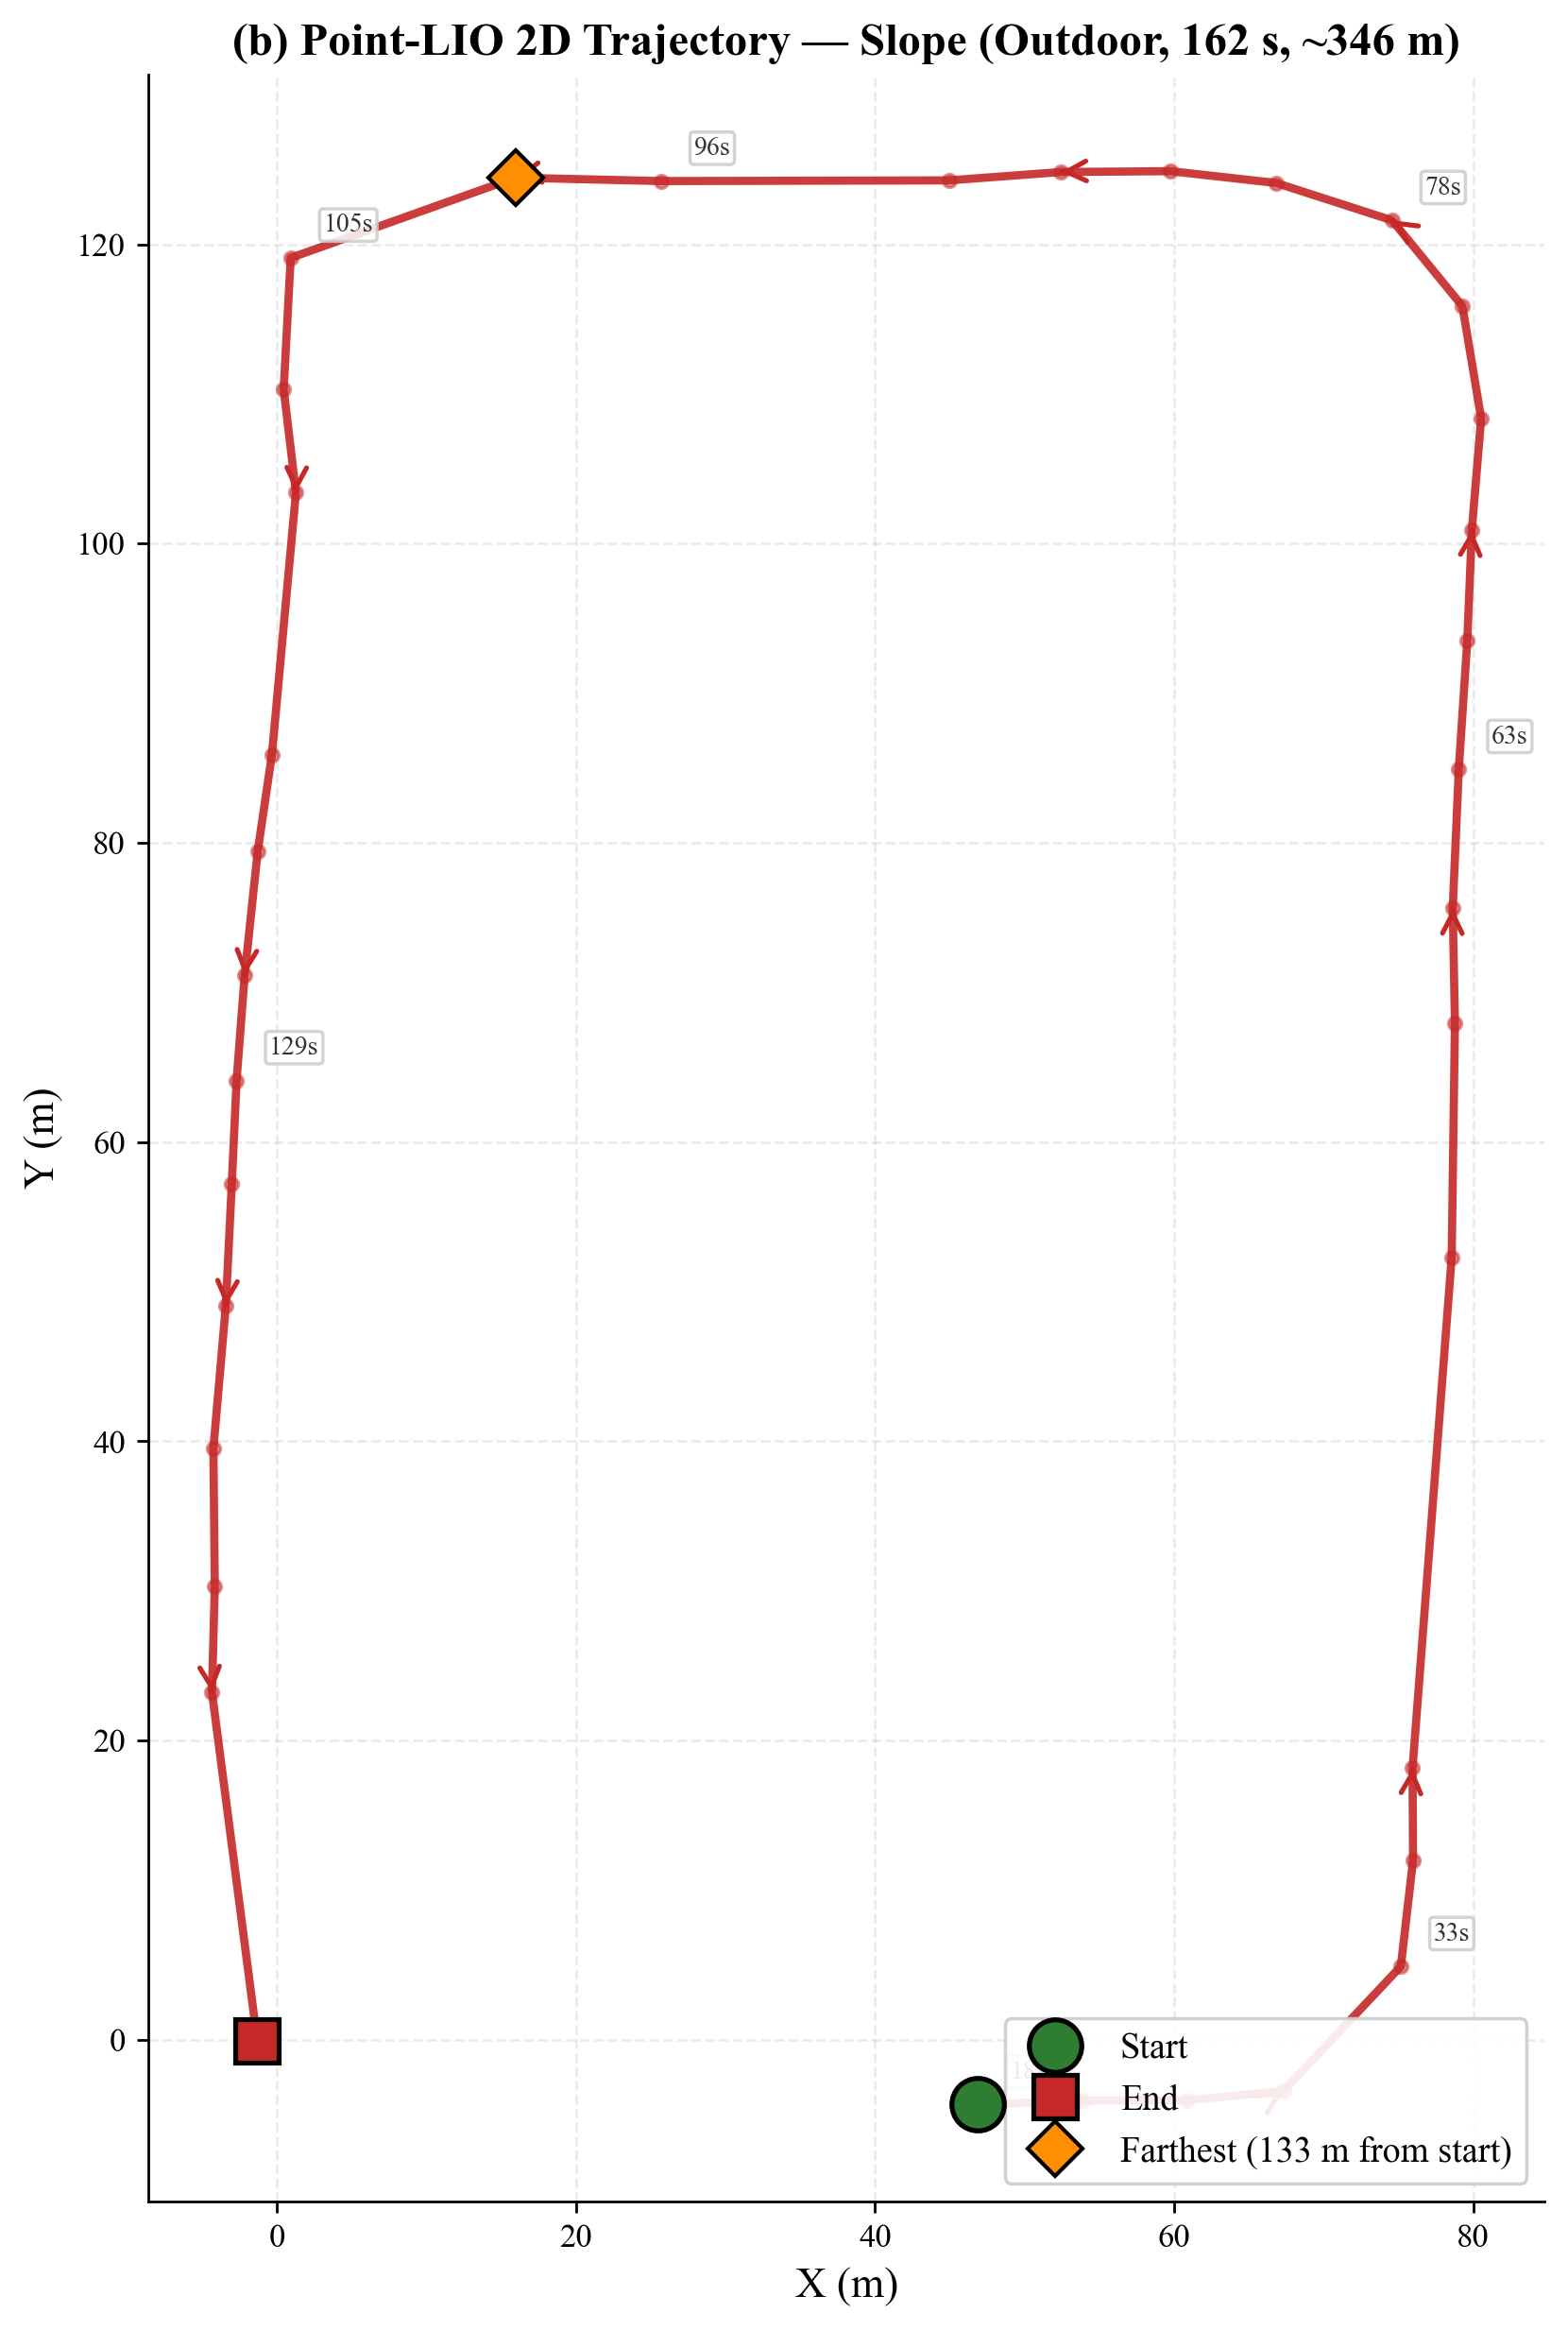
3b. 2D Trajectory — Slope (Outdoor, 162 s)
6

Slide 7
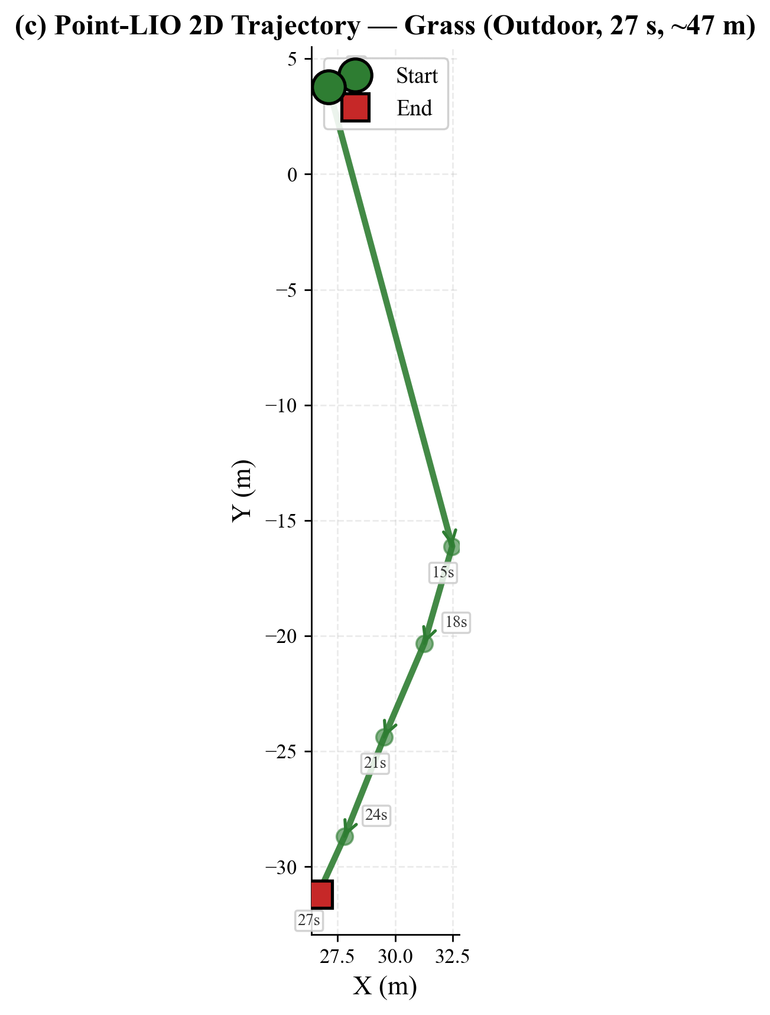
3c. 2D Trajectory — Grass (Outdoor, 27 s)
7

Slide 8
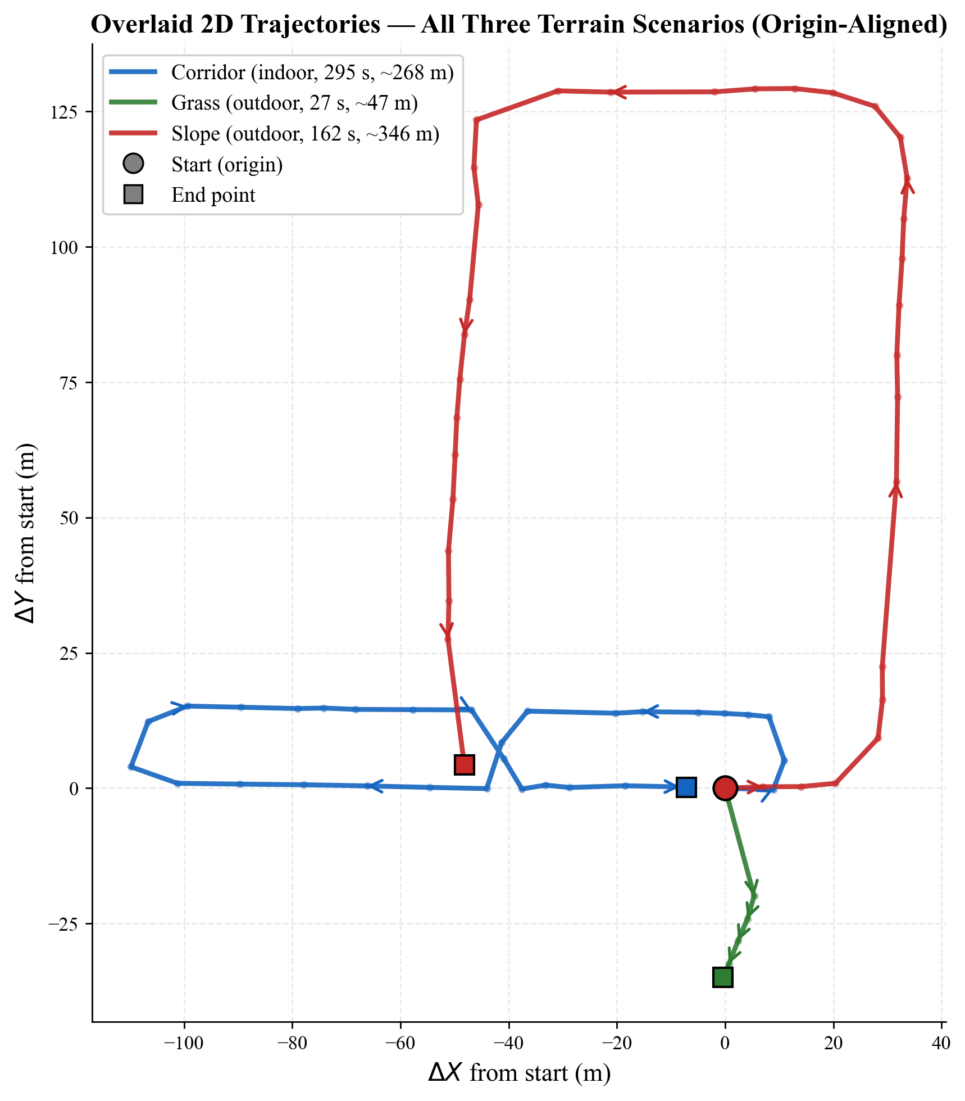
4. Overlaid Trajectory Comparison (Origin-Aligned)
8

Slide 9
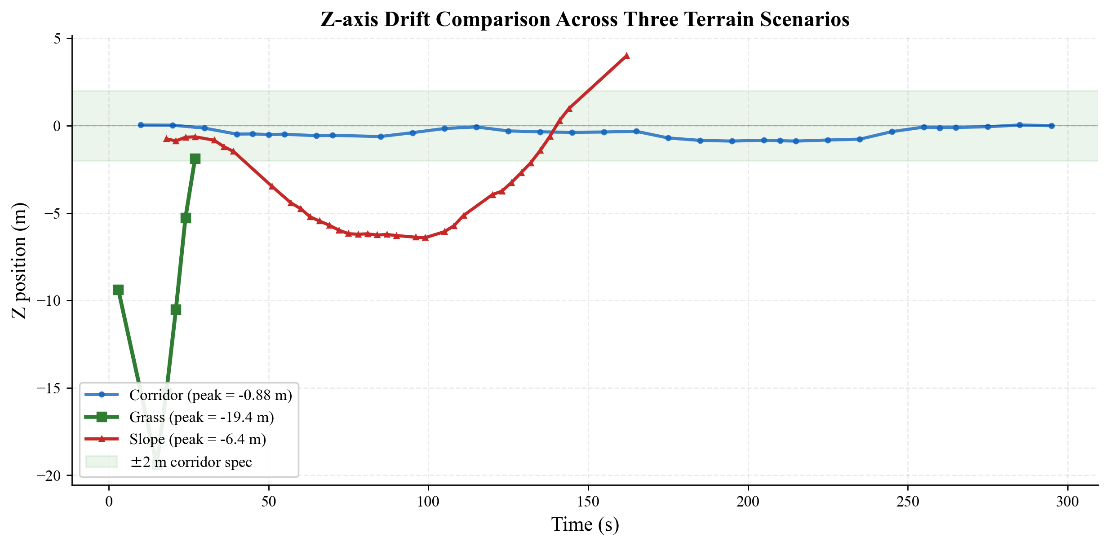
5. Z-axis Drift Comparison
Key finding: Z estimation accuracy degrades with terrain complexity (flat 0.9 m → slope 6.4 m → grass 19.4 m),
but Point-LIO maintains zero crashes across all scenarios.
9

Slide 10
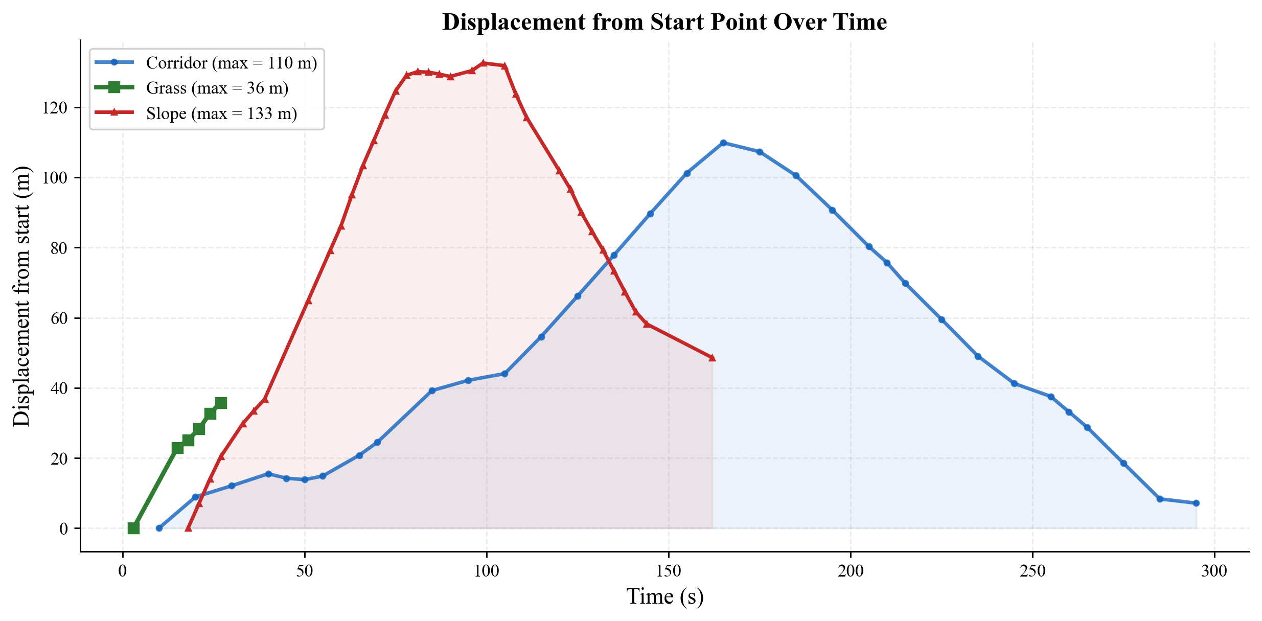
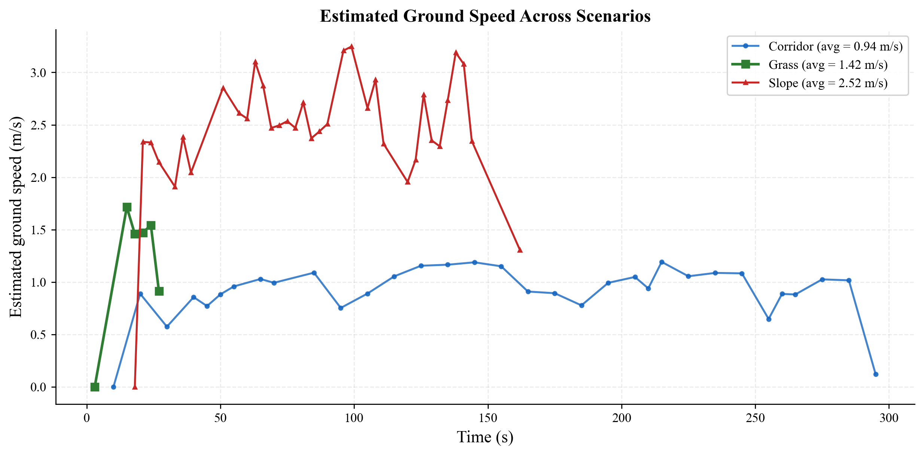
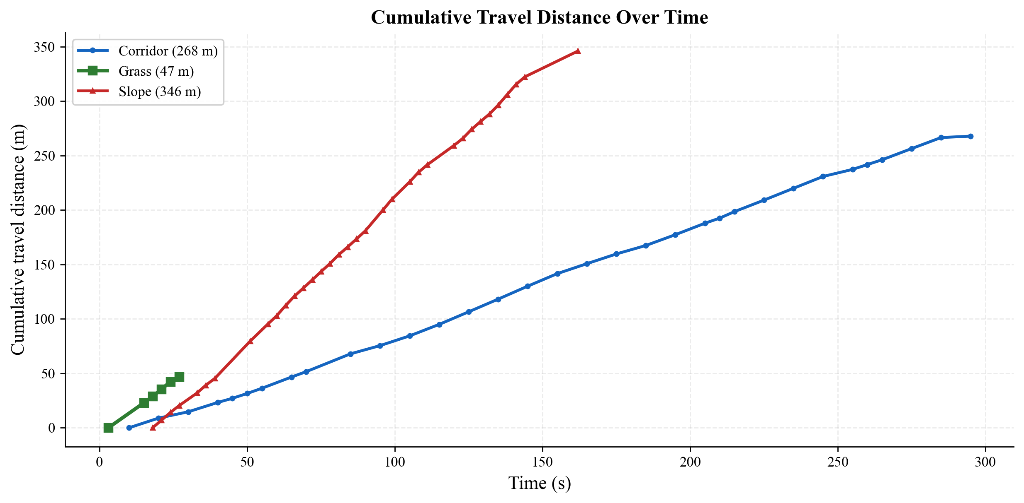
6. Displacement, Distance & Speed Profiles
10

Slide 11
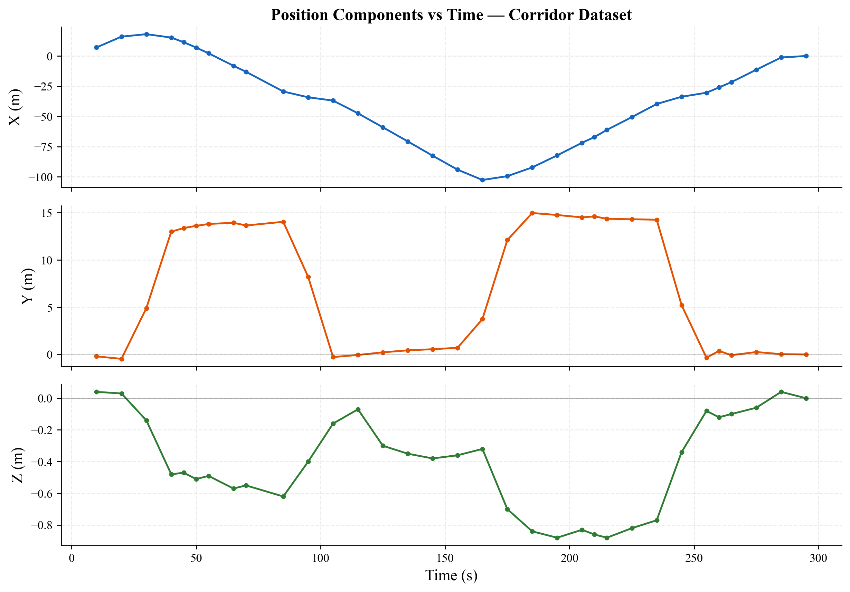
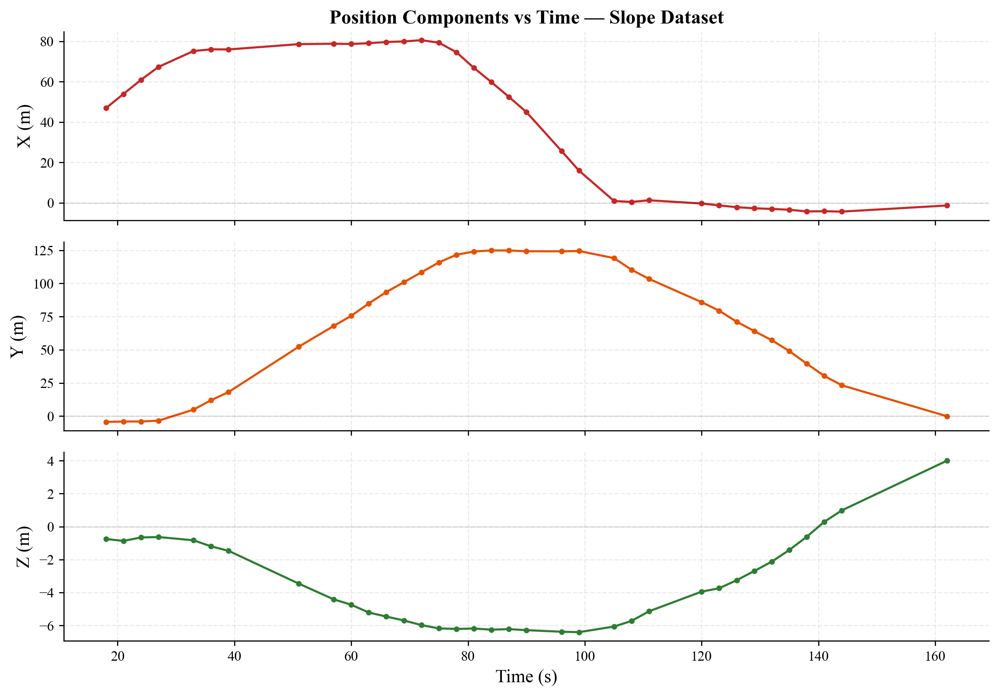
7. Position Components (X, Y, Z) vs Time
11

Slide 12
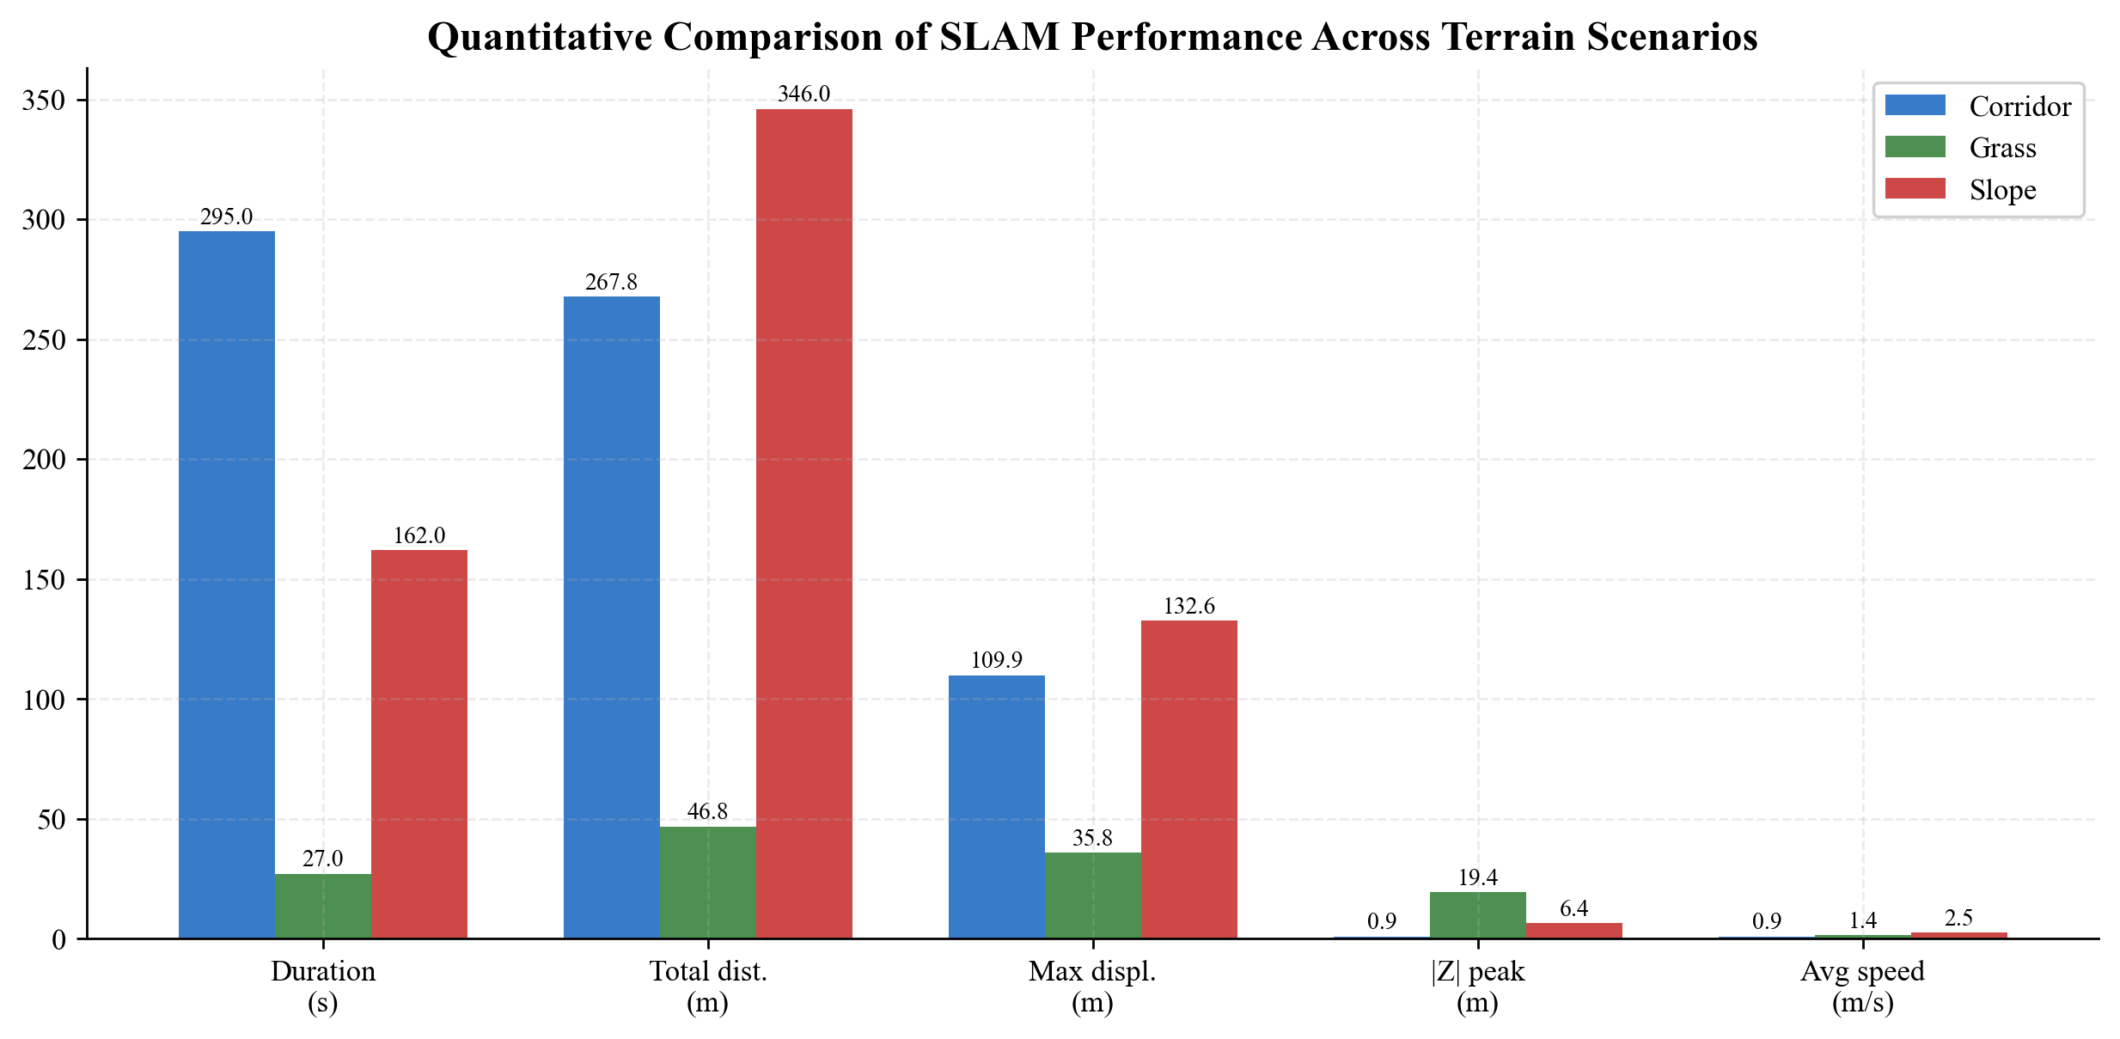
8. Quantitative Comparison
Metric | Corridor (indoor) | Grass (outdoor) | Slope (outdoor)
Result | PASS | PASS | PASS
Crashes | 0 | 0 | 0
Duration | 295 s | 27 s | 162 s
Total distance | ~268 m | ~47 m | ~346 m
Max displacement | 109.9 m | 35.8 m | 132.6 m
|Z| peak drift | 0.88 m | 19.4 m | 6.4 m
12

Slide 13
9a. Algorithm Comparison: Point-LIO vs Fast-LIO2
Dimension | Point-LIO | Fast-LIO2
Core algorithm | Point-wise update + iVox | Frame-wise update + iKD-Tree
Sensor support | Livox + Velodyne + Ouster | Livox + Velodyne (modified)
Corridor test | PASS (174 s) | PASS (234 s, full loop)
Z-axis drift (corridor) | 4.5 m peak | 0.9 m peak
Loop closure error | ~30 m (partial) | < 0.5 m
Static drift (Mid-360) | 0.006 m | 0.008 m
Odometry rate | 10.0 Hz | 10.5 Hz
Key finding
Both algorithms survive quadruped vibration,
but Fast-LIO2 achieves significantly better
Z-axis stability (0.9 m vs 4.5 m) and loop
closure accuracy on the corridor dataset.
Critical config
Fast-LIO2 requires lidar_filter_num = 1
(keep all points) for VLP-16 under vibration.
With filter_num = 3, divergence occurs at ~78 s.
Point-LIO tolerates aggressive downsampling.
13

Slide 14
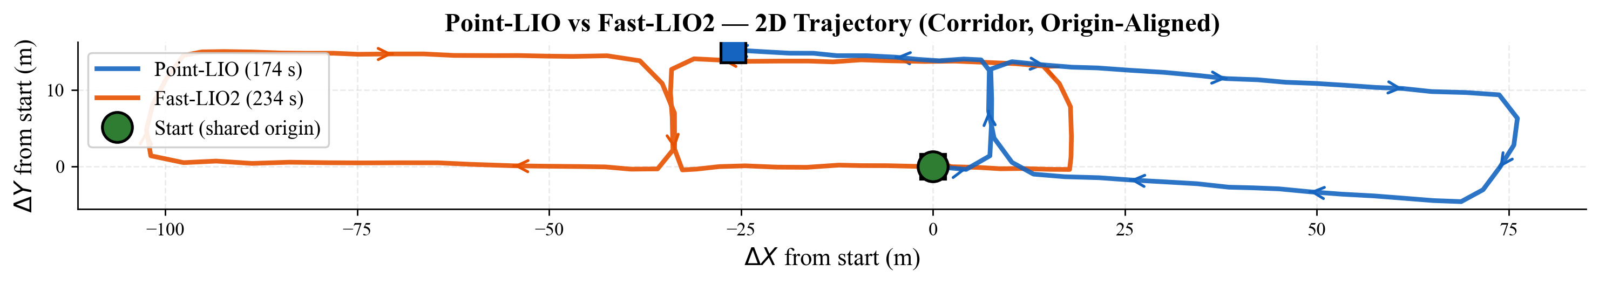
9b. Trajectory Comparison — Same Dataset
14

Slide 15
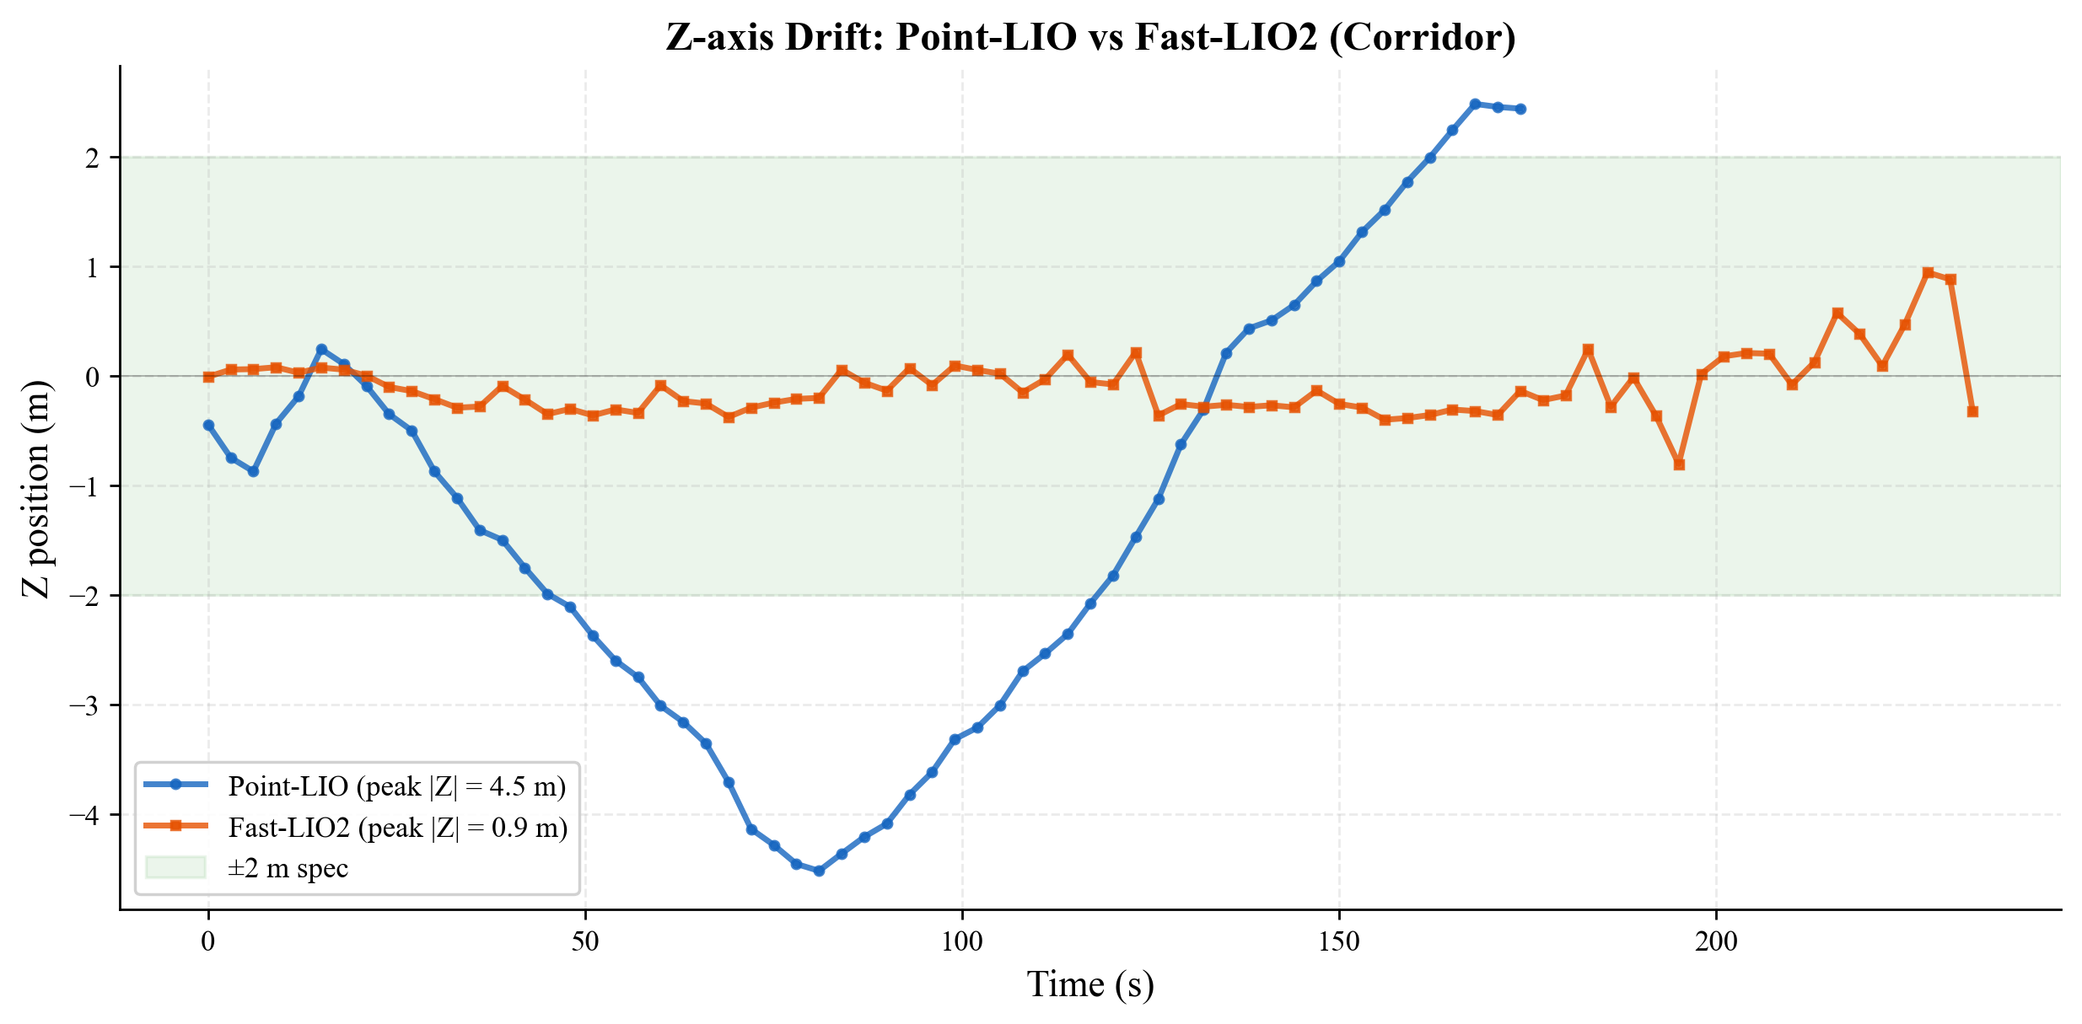
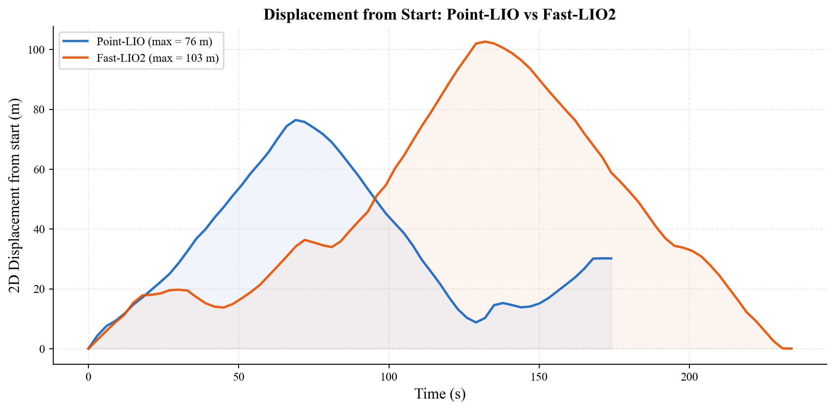
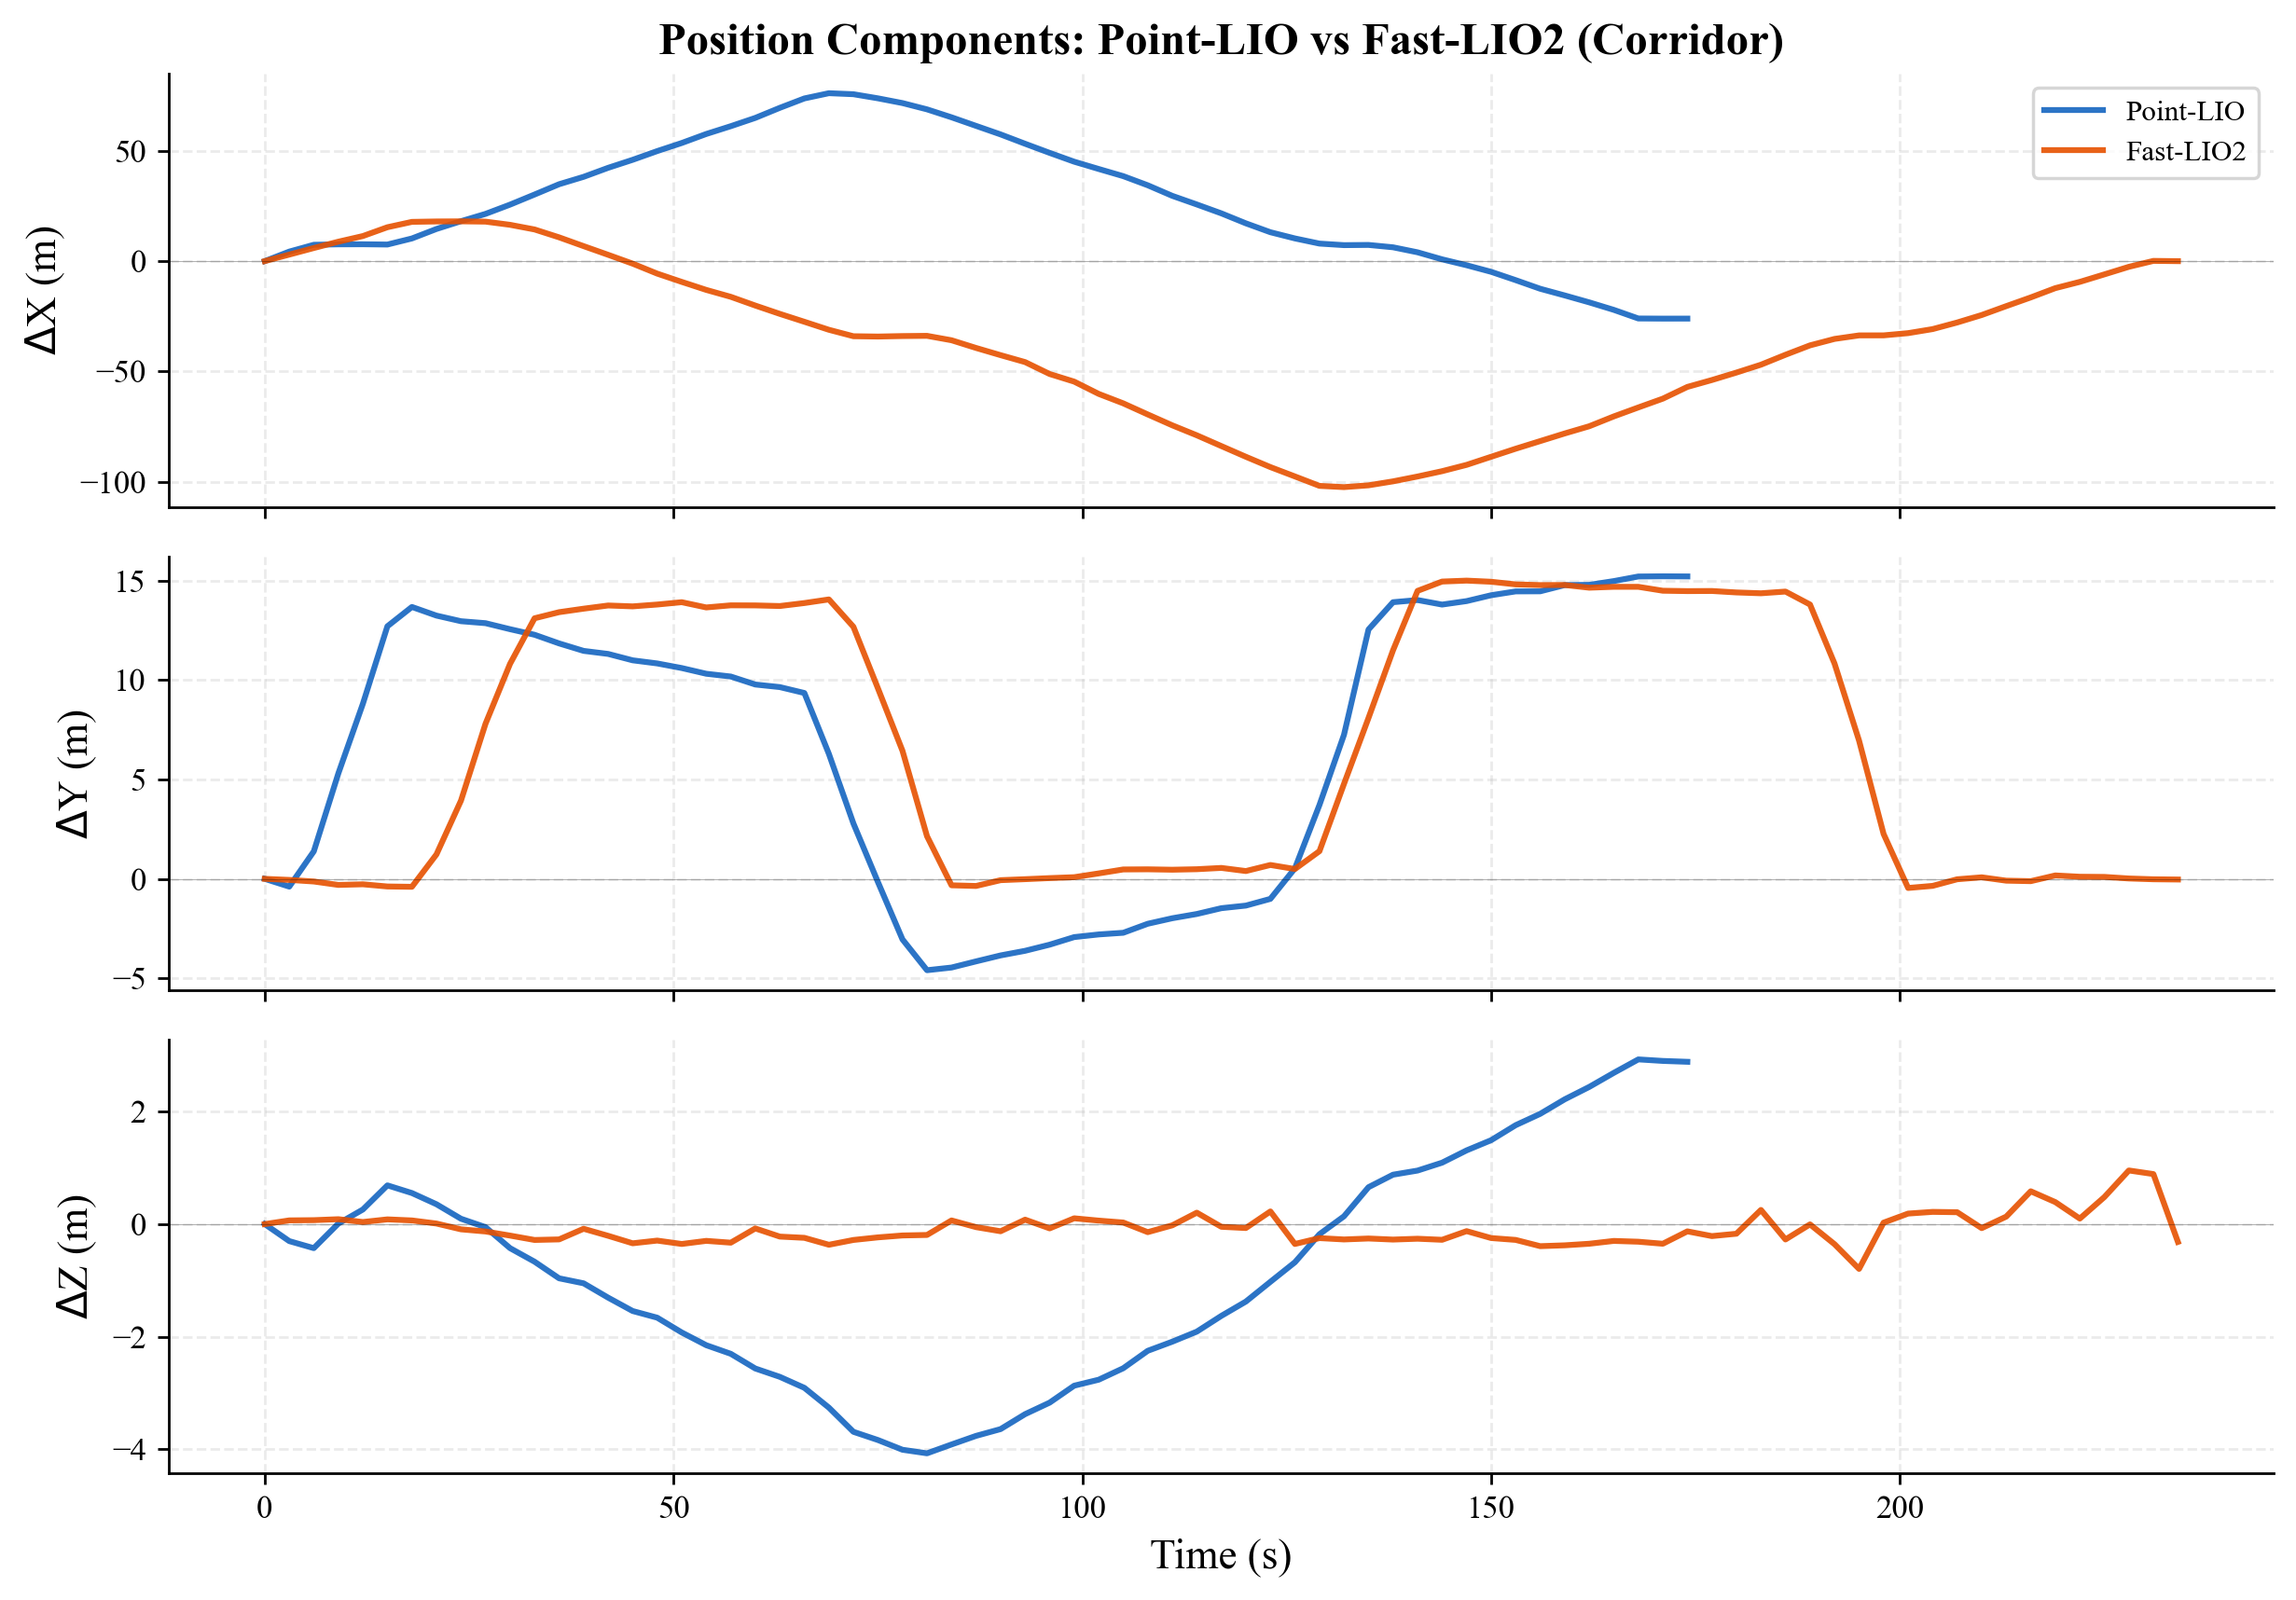
9c. Z-drift & Position Analysis Comparison
15

Slide 16
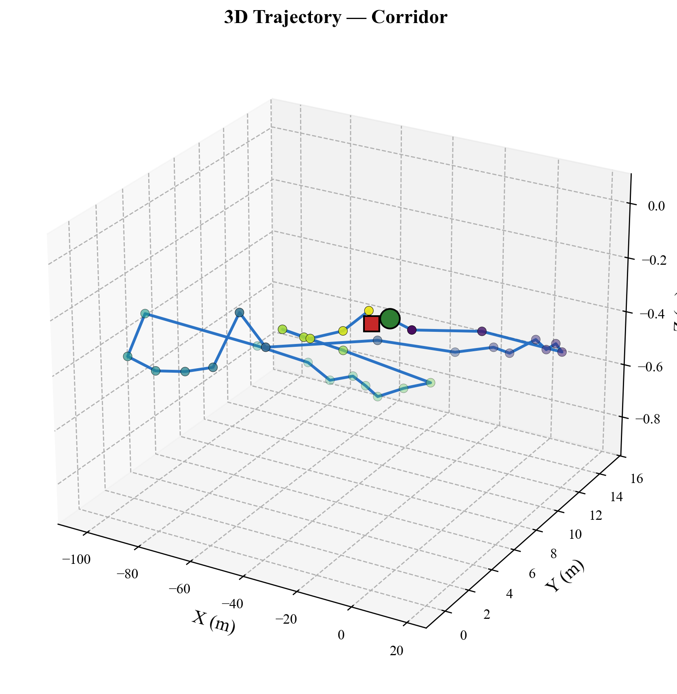
Appendix A. 3D Trajectory — Corridor
16

Slide 17
10. Conclusion
1. Both Point-LIO and Fast-LIO2 survive quadruped vibration
Zero crashes across 3 terrain scenarios (Point-LIO) and corridor (Fast-LIO2),
totaling 1000+ s of testing and 900+ m of travel distance.
2. Fast-LIO2 achieves superior Z-axis stability on corridor
Z drift: Fast-LIO2 peak 0.9 m vs Point-LIO peak 4.5 m (5x better).
Loop closure: Fast-LIO2 < 0.5 m error, Point-LIO ~30 m (partial monitoring).
3. Configuration is critical for vibration robustness
Fast-LIO2 requires lidar_filter_num = 1 (no downsampling) under vibration.
With filter_num = 3, catastrophic divergence at ~78 s. Point-LIO is more tolerant.
4. Point-LIO advantages: broader sensor support + faster init
Natively supports Livox, Velodyne, Ouster. ~1 s IMU init vs ~3 s.
Recommended as default for multi-sensor deployments.
5. Future work
- ATE/RPE with ground truth trajectories
- Outdoor terrain (grass, slope) dual-algorithm comparison
- Loop closure integration for Point-LIO Z drift reduction
17

Slide 18
Thank You
2 algorithms · 3 scenarios · 0 crashes · Z drift < 1 m (Fast-LIO2)
18

