Slide 1

Claude Cowork
Turn repetitive tasks into automation — no coding required
AI AUTOMATION PLATFORM • UAT & PROMOTE NOTIFICATION SYSTEM

Slide 2

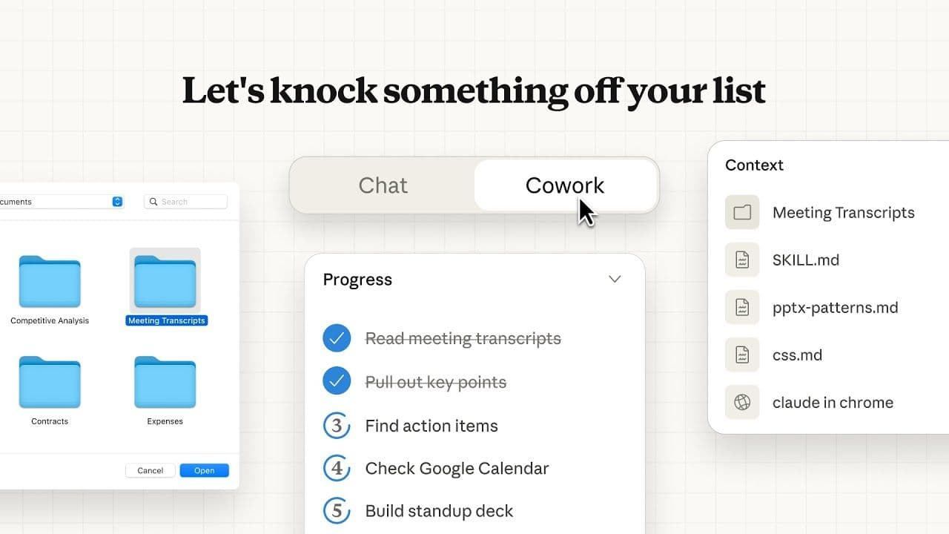
Claude Cowork?
What is
[PC]
[CO]
Desktop AI App
Tool Connectors
Runs natively on Windows with minimal administrative constraints.
Plug-and-play connections to Jira, Outlook, SharePoint, and Excel.
</>
[CL]
Natural Setup
Auto Schedule
Write rules in simple English or Thai inside the SKILL.md workflow file.
Trigger complex routine tasks seamlessly every morning with zero manual input.

Slide 3

Before Cowork: Daily Manual Friction
UAT & Promote
!
Calendar Drift:
Manually marking UAT and Promote release dates onto personal team planners.
!
High Oversight Risks:
Depending on team memory to review daily calendars for imminent milestones.
!
Information Hunting:
Searching through unconnected systems to extract valid delivery unit email directories.
!
Repetitive Email Drafting:
Manually pasting, styling, and drafting identical system communication alerts.
!
No Audit Trail:
High risk of duplicates, missed alerts, and zero structured run log reporting.

Slide 4

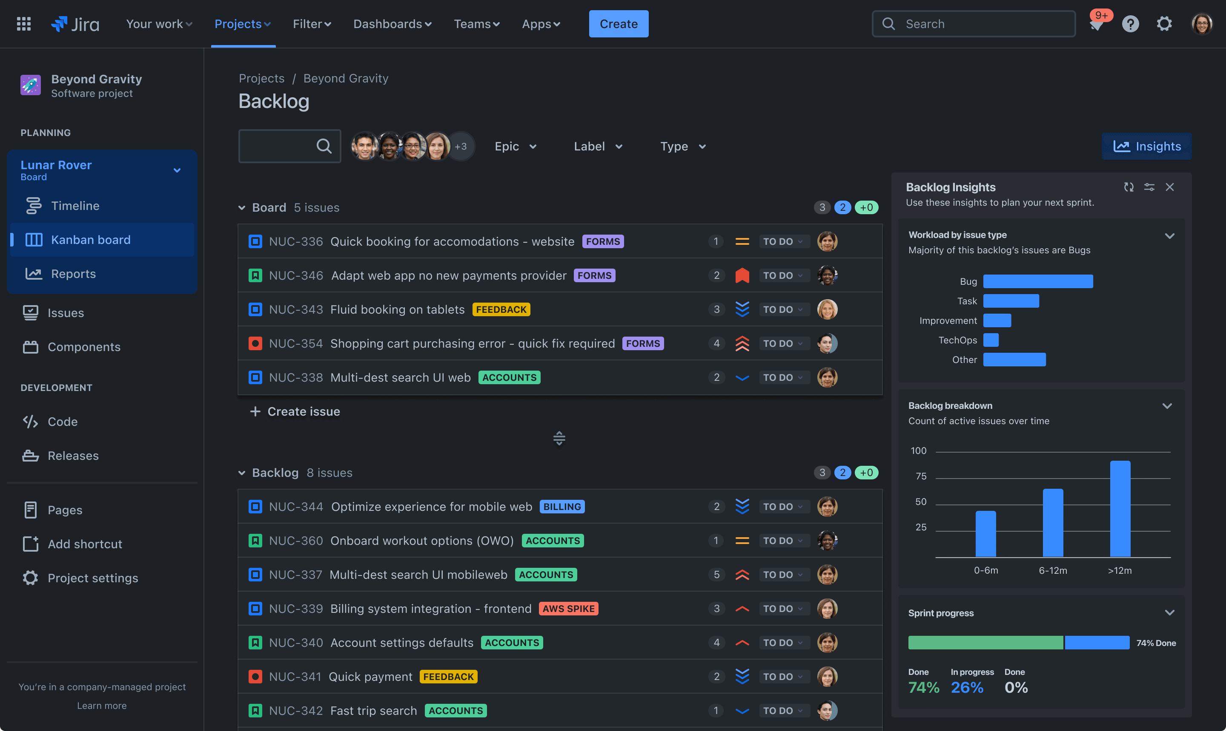
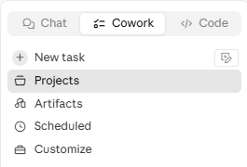
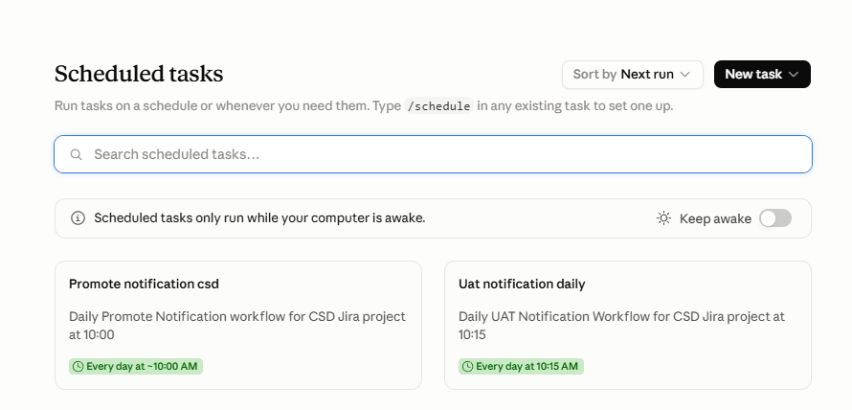
System Setup in 3 Simple Steps
+
+
+
INSERT SCREENSHOT
INSERT SCREENSHOT
INSERT SCREENSHOT
1. Connect Jira
2. Create Project
3. Set Schedule
Open Cowork Settings -> Connectors -> Select Atlassian and log in with your credentials.
Initialize a New Project -> Choose target local folder with predefined variables and xlsx logs.
/schedule 08:00 check UAT
Claude handles the rest.

Slide 5
Required Fields in Jira Epic
Date Fields (Most Critical)
Service Units & Task
Checkboxes to Select
✓
UAT Start Date
✓
Service Units Selection
✓
Account Services
Period time representation
Select teams involved in workflow run
✓
Counter Services
✓
UAT End Date
✓
Issuer Services
Period time representation
✓
Workflow Main Task
Main task details used in context template
✓
Investor Service
✓
Promote Date
Production release target date
✓
CA Service
✓
Distribution
Fill in these fields when creating a new Epic — the system pulls the data automatically.
https://setth.atlassian.net/jira/software/projects/CSD/boards/235/timeline?selectedIssue=CSD-408

Slide 6
UAT & Promote Workflows
UAT Notification
Promote Notification
01
ค้นหา Epic
01
ค้นหา Epic
คัดกรองจาก Jira เมื่อ UAT Start Date ใกล้มาถึงตามเกณฑ์ที่กำหนด
ค้นหา Epic ที่มี Promote Date ภายในกรอบเวลา 3 วัน
02
Lookup Email
02
Lookup Email
ดึง email แผนกผู้รับผิดชอบจาก Excel Map_User_Email.xlsx
ดึง email จาก Map_User_Email.xlsx ถึงผู้มีส่วนได้ส่วนเสียที่เกี่ยวข้อง
03
สร้าง Draft
03
สร้าง Draft
จัดเตรียม Subject, To, CC, และ HTML Body ใน Outlook
จัดเตรียม Subject, Recipients, CC, และ HTML Body ใน Outlook
04
Post Jira Comment
04
Complete Process
พิมพ์คอมเมนต์ยืนยัน UAT Notification Sent ใน Epic อัตโนมัติ
ปุ่มตัดลอก To, CC, และ HTML body ไปใช้งานใน Outlook ได้เลย

Slide 7
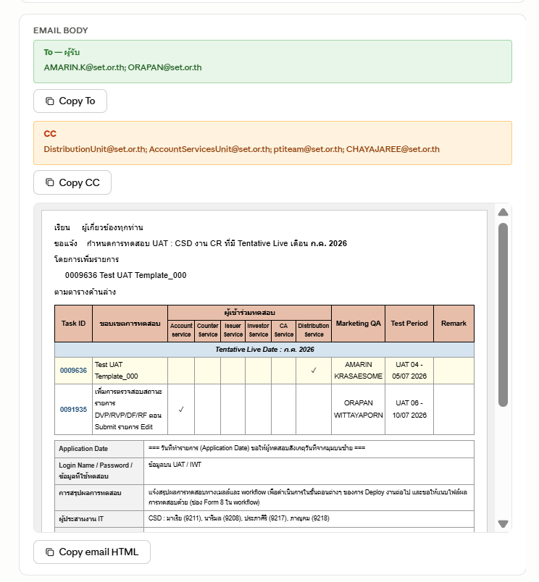
Automated Outcomes
Structured Communications
Transforms raw Jira data into structured outputs ready for instant stakeholder distribution.
Subject Headers: Formats system classifications alongside release dates cleanly.
Draft Recipients: Extracts and populates proper CC/BCC stakeholders dynamically.
Copy-to-Clipboard: One-click commands copy complete formatted payloads to Outlook.

Slide 8
Built-In Platform Skills
[SC]
/schedule
[DG]
/digest
[XL]
xlsx skill
Sets scheduled off-hours triggers effortlessly.
Gathers emails, tickets, and calendar tasks into bullet summaries.
Manipulates spreadsheets, formulas, and maps system datasets.
[DC]
docx skill
[PP]
pptx skill
[MS]
Microsoft 365
Compiles structured reports and specifications dynamically.
Auto-generates presentation decks from data sources.
Connects Outlook, SharePoint and calendar in natural language.

Slide 9
ลดงานซ้ำซาก เพิ่มประสิทธิภาพ
Eliminate repetitive overhead and focus on work that matters.
github.com/Kitkanaporn/Intern_web_Automation_003

