Slide 1


PUBLISHING EXPERIENCE: How to Write and Publish Research Papers
Le Hoang Thai
Department of Computer Science
Ho Chi Minh University of Science
Ho Chi Minh City, Vietnam
lhthai@fit.hcmus.edu.vn

Slide 2
How to write and publish a high-quality paper
Good Research
Evaluate quality of your contribution
Typical Structure of a Research Paper
Submit your manuscript
Le Hoang Thai, Assoc. Prof., PhD.

Slide 3
Good Research
Choose a promising topic: Top challenging problems in your research field.
Read topic surveys and study related works
Spend more time on the key references
Problem Statement, set up benchmark experimental Databases and implementation
In-depth analysis of empirical results
Find out a convincing case
Le Hoang Thai, Assoc. Prof., PhD.

Slide 4
How to Present a Convincing Case
What exactly is the problem being solved?
How are your ideas significant (to justify a paper)?
Is all related work referenced and reviewed?
Are the comparative studies with previous work convincing?
Has your system been implemented and used, and if so what did it demonstrate from the real world (for you and the reader to learn)?
Le Hoang Thai, Assoc. Prof., PhD.

Slide 5
In-Depth Analysis of Empirical Results
Enough details for your experiment settings (so that other researchers can verify and improve your results)
What were the alternatives considered at various points of your experiments? Why and how have you made the choices for your experiments?
Are the experimental results consistent and conclusive?
Can you fine-tune some key parameters to get better or worse results? If so, use figures and tables to show their impacts on your system performances
How do the experimental results correspond to the motivation of the paper?
What have you found surprising and tried to avoid in these experiments? How generally applicable are these lessons?
Le Hoang Thai, Assoc. Prof., PhD.

Slide 6





Evaluate quality of your contribution
Target conference ?
  http://thomsonreuters.com/products_services/science/science_products/a-z/conf_proceedings_citation_index/
Target Journal ? High Impact Journal, International Publisher
e.g AAAS (Science), Nature, Elsevier, Springer, RSC, JGE etc
  http://thomsonreuters.com/products_services/science/science_products/a-z/web_of_science/
Le Hoang Thai, Assoc. Prof., PhD.

Slide 7
Evaluate quality of your contribution
Always think about READER
  Assess the audience: To whom are you writing? Why will they be reading your writing?
  Assess the purpose: What should the reader take away?
Know your enemy: Check who are on the program committee or editorial board, and cite their relevant work with due credit
Follow the rules – length limits, formatting standards etc.
Language skills and the writing style are always important
Le Hoang Thai, Assoc. Prof., PhD.

Slide 8
Evaluate quality of your contribution
Two key components in a research paper:
  An explicit claim on your contribution on a research problem
  Evidence to support your claim
It is NOT enough to design yet another technique or system without convincing evaluation.
Le Hoang Thai, Assoc. Prof., PhD.

Slide 9
Evaluate quality of your contribution
Evaluate quality of your Contribution for the conference or Journal
  Advance knowledge in your research field with evidence
  Explain your ideas and make them accessible to others
    Your technique solves a problem for the first time
    Your technique performs better, in one or more of the following dimensions
You should avoid claiming too many dimensions, but should only one with in-depth evidence.
Le Hoang Thai, Assoc. Prof., PhD.

Slide 10
Typical Structure of a Research Paper
Title: Catchy and indicative of your research contribution. A text that has not yet been published
Abstract: A summary of the research problem, your claim, and the evidence
Le Hoang Thai, Assoc. Prof., PhD.

Slide 11
Typical Structure of a Research Paper
Introduction: Introduce your field of study, motivation, related work:
  A critical review on the rival approaches that supports the motivation.
  How to differentiate existing work with your own creative contributions
a re-statement of the abstract information, significance, an outline of the rest of the paper
Le Hoang Thai, Assoc. Prof., PhD.

Slide 12
Typical Structure of a Research Paper
Introduction: Introduce your field of study, motivation, related work:
  A critical review on the rival approaches that supports the motivation.
  How to differentiate existing work with your own creative contributions
a re-statement of the abstract information, significance, an outline of the rest of the paper
Don’t Include: Details of your study.
Le Hoang Thai, Assoc. Prof., PhD.

Slide 13
Typical Structure of a Research Paper
Problem statement and algorithm design: Explain your ideas in detail
Results: Evidence to support the claim of your research contribution
  Unless you can provide proofs for a theoretical paper on theorems, experimental results are always expected
Conclusion: A summary of the research contribution, a discussion on its significance, and a mention of future work.
Le Hoang Thai, Assoc. Prof., PhD.

Slide 14

Typical Structure of a Research Paper
Notice:
  Spend much more time on the introduction.
  Present a convincing case in detail
  Provide in-depth analysis of empirical results
Le Hoang Thai, Assoc. Prof., PhD.

Slide 15
Submit your manuscript
What Good Journal NEED?
  Novelty
  International not local
  Journal rules
  Pre-review
  Research Highlight
  Cover letter – explain the significant of the paper
  Suggestion of 3 reviewers
  Good references
  Good English
  PERFECT!
Le Hoang Thai, Assoc. Prof., PhD.

Slide 16
Journal Rules
Length
Formatting
  Subsections
  References (number/format)
  Order of sections
Le Hoang Thai, Assoc. Prof., PhD.

Slide 17
Pre-review
A critical part of the manuscript writing process.
Not only improves quality, but sends message to edit or/reviewers.
Shared first authorship? Senior authorship?
Everybody must agree
Le Hoang Thai, Assoc. Prof., PhD.

Slide 18
Cover letter
For editor only, usually not reviewers
Critical for high impact journals.
Compare:
Dear Editor,
Please find attached a manuscript entitled
„...“to be considered for publication in your
journal.
Yours sincerely...
Le Hoang Thai, Assoc. Prof., PhD.

Slide 19
Cover letter
Example:
We solicited pre-reviews from a number of world leaders in this subject (see Acknowledgements). All were enthusiastic, not only for the exciting results, but also for the methodology, which they felt marked a long-awaited turning point from the use of food webs as descriptive tools, to their use as replicated units for hypothesis testing. We are confident that this manuscript, when accepted, will be widely and frequently cited for many years.
Yours sincerely
Le Hoang Thai, Assoc. Prof., PhD.

Slide 20
Research Highlight
Highlights are a short collection of bullet points that convey the core findings and provide readers with a quick textual overview of the article.
Le Hoang Thai, Assoc. Prof., PhD.

Slide 21
Research Highlight
Example:
Learning and Instruction, Volume 21, Issue 6, December 2011, 746-756
Highlights
Fading of a script alone does not foster domain-general strategy knowledge.
Performance of the strategy declines during the fading of a script.
Monitoring by a peer keeps performance of the strategy up during script fading.
Performance of a strategy after fading fosters domain-general strategy knowledge.
Fading and monitoring by a peer combined foster domain-general strategy knowledge.
Le Hoang Thai, Assoc. Prof., PhD.

Slide 22
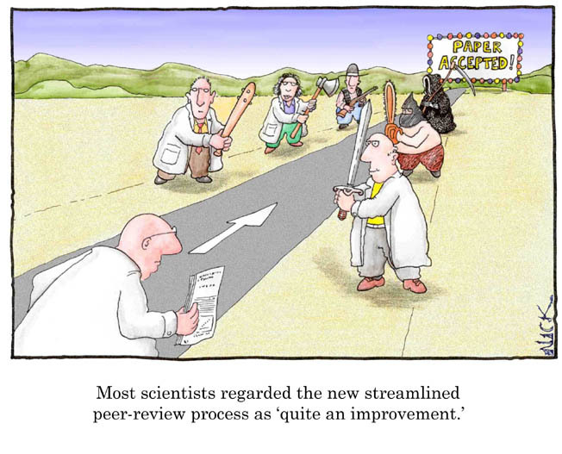
Review process
Le Hoang Thai, Assoc. Prof., PhD.

Slide 23
Reviewers selection
Researcher in your research field –find through SCOPUS/ISI
Researchers who knew your work – through citation on your previous research
Try to avoid people who already published with you
Local and international
Le Hoang Thai, Assoc. Prof., PhD.

Slide 24
Types of response
Accept
without
revision
Reject
following
revision
Reject
without
revision
Minor
revisions
Major
revisions
Good
Bad
Le Hoang Thai, Assoc. Prof., PhD.

Slide 25
Reviewer responses
Criticism is meant to be constructive and overall peer review should improve your work
Some reviews can even be very hurtful
DON’T TAKE IT PERSONALLY
Respond to all the criticisms that you consider valid, but be prepared to rebut any that you think are pointless, or just plain wrong.
Le Hoang Thai, Assoc. Prof., PhD.

Slide 26
Post-review changes
Again a cover letter is needed
Compare:
Please find attached a revised version of our manuscript. We have addressed all of the reviewers‘concerns.
Yours sincerely
Le Hoang Thai, Assoc. Prof., PhD.

Slide 27
Post-review changes
Example:
Dear Editor,
Thank you very much for your consideration of our manuscript and request for a revised version. We have copy and pasted all reviewers’ comments below, and address each one individually. As you will see, we have made every attempt to incorporate these suggestions as thoroughly as possible. Unfortunately, the reviewers requested additional analyses and material, which added length to the manuscript.
Several ideas are presented in the first paragraph of the introduction and it would be clearer if this large paragraph was divided according to the main idea discussed. Also, the topic of the second paragraph is broached in one part of the first paragraph and these discussions should be merged.
Le Hoang Thai, Assoc. Prof., PhD.

Slide 28
Post-review changes
Example:
We have now restructured the introduction as suggested by
the reviewer.
3) That habitats could vary in temporal turnover (a major point later on in the paper) is not brought up in the introduction, or at least not brought up clearly, it should be. Also, it might be helpful for the authors to mention or discuss some of the reasons why temporal turnover in diversity might occur (e.g., strong seasonality, etc.) We have now emphasized this point more in the introduction (P.3 L.8, P.3 L.16 -P.4 L.1, also Hypothesis 1).
Le Hoang Thai, Assoc. Prof., PhD.

Slide 29
Post-review changes
Avoid the temptation to be argumentative (even when the reviewer is wrong).
Make all requested changes unless you have a significant reason not to.
If you don’t agree, try to cite references to support your argument.
Le Hoang Thai, Assoc. Prof., PhD.

Slide 30

Accepted, what to do?
You will need to upload a final version with publication quality figures.
After some time, proofs will be sent.
Start thinking about the next manuscript...
Le Hoang Thai, Assoc. Prof., PhD.

Slide 31
References
Le Hoang Thai, “PUBLISHING EXPERIENCE: How to Write and Publish Research Papers”, 2013 Springer SEA eBooks Seminar, University of Science,Vietnam National University HCM, 27 August, 2013.
Le Hoang Thai, Assoc. Prof., PhD.

Slide 32

THANKS FOR YOUR ATTENTION
Le Hoang Thai, Assoc. Prof., PhD.

Slide 33

Le Hoang Thai, Assoc. Prof., PhD.

