Slide 1

The Technology Value Stream
Understanding Lead Time, Processing Time, and DevOps Ideals
Crystal Long
CSD 380 DevOps
October 2025

Slide 2


What Is the Technology Value Stream?
Describes how ideas move from concept to customer value.
Stages: plan → build → test → deploy → operate → learn.
Goal: reduce waste, increase speed, and improve feedback loops.

Slide 3

Defining Lead Time vs. Processing Time
Lead Time: from request to delivery or completion.
Processing Time: time spent actively working on a task.
Example: requesting a record vs. time clerk works on it.
DevOps reduces lead time by removing bottlenecks.

Slide 4
Common Scenario: Deployment Lead Times of Months
Traditional environments take weeks or months due to manual steps.
Many handoffs between teams cause delays.
Actual coding is fast, but approvals and testing slow deployment.
Results: higher risk, frustration, and cost.

Slide 5
Why Long Lead Times Are a Problem
Slow response to customer needs.
Large, risky releases instead of frequent updates.
More time fixing problems, less delivering value.
Creates tension between development and operations.

Slide 6
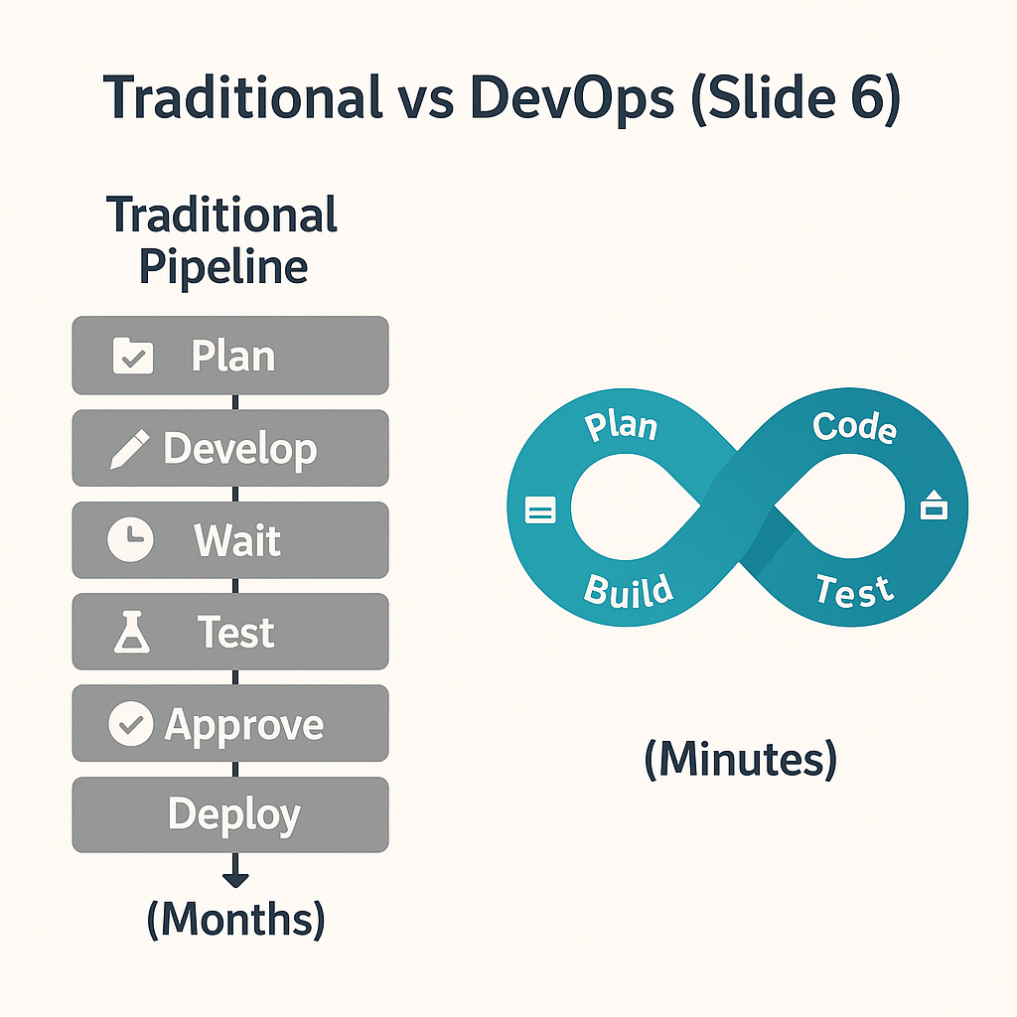
Traditional vs. DevOps Deployment Pipeline
Traditional Pipeline:
Plan → Develop → Wait → Test → Approve → Deploy (Months)
DevOps Pipeline:
Plan → Code → Build → Test → Deploy (Minutes)
Manual, slow, risk-prone process
Automated, fast, and reliable

Slide 7
The DevOps Ideal: Deployment in Minutes
DevOps enables rapid, automated deployment with CI/CD.
Small code changes move from test to production quickly.
Lead times drop from months to minutes.
Allows faster innovation, feedback, and recovery.

Slide 8
Key Practices That Enable Short Lead Times
Automation of builds, tests, and deployments.
Continuous Integration & Continuous Delivery (CI/CD).
Monitoring and feedback loops after each release.
Collaboration across Dev, Ops, and QA.

Slide 9

References
Kim, G., Humble, J., Debois, P., Willis, J., & Allspaw, J. (2016). The DevOps Handbook: How to Create World-Class Agility, Reliability, & Security in Technology Organizations. IT Revolution Press.

