Slide 1
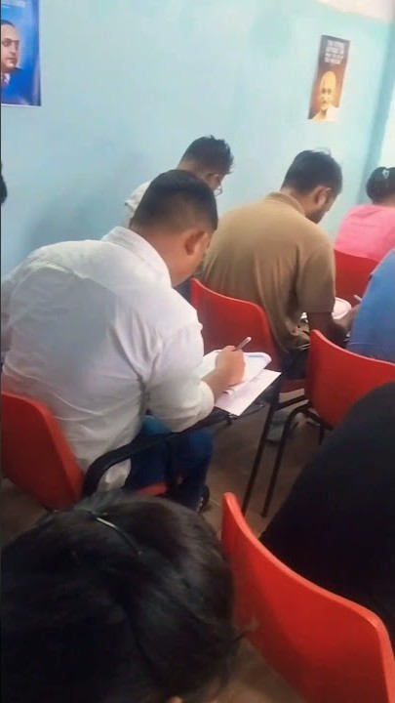

A digital platform built to convert interest into action
Admissions · Free resources · Physical books · Library · Promotions · Analytics
Five-week launch proposal
Prepared for Impact Career Tutorials

Slide 2
THE OPPORTUNITY
One connected journey, not a collection of pages
The website should help a student decide, act, and receive a timely response while giving staff control of daily operations.
01
02
03
Discover
Take action
Follow through
Search-friendly course pages, verified proof, faculty, resources and clear programme comparisons.
Enquire, unlock a resource, buy a physical book, apply for the library, or continue on WhatsApp.
Staff receive structured leads, orders and applications with status, ownership, follow-up and reporting.

Slide 3
EXPERIENCE QUALITY
Designed deliberately for every important screen
Phones, iPads and other tablets, laptops, and large displays receive equal design and testing attention.
Mobile
iPad / tablet
Laptop / desktop
Touch-friendly admin · readable forms · no horizontal overflow · fast on weaker connections · keyboard accessible

Slide 4
LAUNCH SCOPE
Six modules working as one platform
Each module has a public experience, a staff workflow, and measurable outcomes.
01
02
03
Courses & enquiries
Free resources
Physical books
Programme clarity, CTAs, one lead history and staff follow-up.
Search, gated access, consent and fast PDF delivery.
Catalogue, cart, Razorpay, availability, orders and WhatsApp order updates.
04
05
06
Library
Promotions
Analytics & SEO
Plans, facilities, rules, application and staff review.
Scheduled banners, inline campaigns, targeting and expiry.
Conversion funnels, Search Console and crawlable content.

Slide 5
STAFF OPERATIONS
A small admin built around the work people actually do
No heavyweight CRM. Staff see what needs attention and complete the next action quickly.
TODAY
A
One lead history
New or updated leads
12
Assign and contact
Repeat submissions update the same person while preserving every enquiry.
Follow-ups due
5
Call or WhatsApp
Paid orders
4
Pack and dispatch
B
Visible exceptions
Library applications
7
Review details
Payment mismatch, overdue follow-up and failed actions are surfaced.

Slide 6
PROMOTIONS
Campaign control without asking a developer
Staff can plan a course launch or book offer, target the right pages, and measure the result.
1
2
3
4
5
Draft
Preview
Schedule
Publish
Measure
Announcement bar
Inline campaign card
One restrained modal
No stacked popups, false scarcity or distracting auto-rotation

Slide 7
MEASUREMENT
A business dashboard the owner can understand
PostHog shows where interest comes from, what people do next, and where they abandon. Personal lead details stay in the admin.
1,842
Visitors
126
Qualified actions
42
WhatsApp handoffs
18
Paid orders
Course enquiry funnel
Course viewed
100%
What this answers
CTA clicked
41%
• Which course pages create enquiries?
• Which promotion creates orders?
• Where does checkout lose people?
• Which channels create real action?
Form started
27%
Lead submitted
19%
Illustrative dashboard — final figures come from live usage

Slide 8
SEARCH VISIBILITY
Build evidence and improve local discovery over time
The launch creates a strong technical foundation. Ongoing local growth is measured separately and cannot honestly guarantee a fixed rank.
01
02
03
At launch
Ongoing
Measured by
Crawlable course and book pages
Unique metadata and structured data
Sitemap and Search Console
Consistent business details
Business Profile posts and photos
Genuine review workflow
Local content and citations
Monthly query and conversion review
Search impressions and clicks
Profile calls and directions
Enquiries by landing page
Qualified actions, not vanity traffic

Slide 9
DELIVERY
Five weeks, with clear review points
The schedule begins after the advance, approved starting content, and required account access are received.
01
02
03
04
05
Direction
Public platform
Commerce
Operations
Launch
Requirements freeze, content audit, main journeys and visual approval.
Courses, enquiries, resources and responsive system.
Books, cart, checkout and library applications.
Admin, promotions, orders, leads and analytics.
SEO, content entry, testing, training and production release.
Client feedback requested within two business days at each approval point

Slide 10
INVESTMENT
A complete five-week launch
The scope includes design, implementation, operational workflows, analytics, deployment and staff handoff.
01
02
PROJECT INVESTMENT
Approve scope
Share inputs
₹37,500
Confirm inclusions, exclusions and content limits.
Provide content, accounts, policies and catalogue data.
50% to begin · 30% at working preview · 20% at production acceptance
03
04
Begin delivery
Review weekly
Five-week target subject to timely content, approvals and provider verification.
Advance payment reserves the five-week production window.
Short decisions keep scope and schedule controlled.

Slide 11
POSTHOG REFERENCE
Useful official examples to open during the meeting
These explain the exact capabilities. The ICT dashboard will be simpler and tailored to admissions, resources, books and promotions.
Product analytics
Funnels
Events, trends and meaningful actions
See each conversion step and where people abandon
Dashboards
Session replay
Keep recurring metrics in one owner view
Watch privacy-masked journeys to find UX problems
Web analytics
Pricing
Traffic sources, pages, devices and referrers
Current free allowances and usage pricing
Tip: open Funnels and Session Replay before the meeting and keep them in browser tabs.

