Slide 1
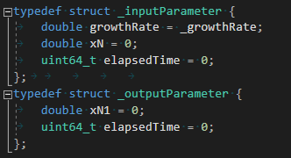
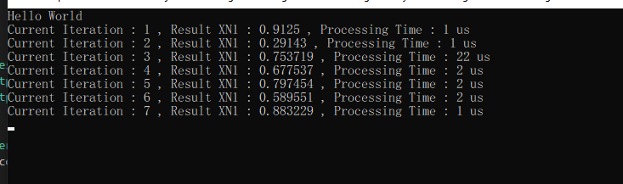
Master
Processor
SetBuffer
Buffer
Calculate X_{n+1}
X_{n+1} = rX_{n}(1-X_{n})
transfer Method
Print
Buffer
transfer Method
Format การ print

