Slide 1
ggplot(data = <data>, mapping = aes(<mappings>)) +
<layer>()

Slide 2
ggplot(<data>, aes(<mappings>)) +
<layer>() +
<layer>() +
<layer>()
Each layer inherits aesthestic mappings and data

Slide 3
ggplot(<data>, aes(<mappings>)) +
<layer>(aes(<mappings>)) +
<layer>(data = <data>) +
<layer>(aes(<mappings>), <data>)
Either aesthestic and/or data can be overwritten

Slide 4
ggplot(data = <data>, mapping = aes(x = <x>, y = <y>, <other mappings>))

Slide 5
aes(x = Sepal.Length, y = Sepal.Width, color = Species)
iris
Sepal.Length Sepal.Width Petal.Length Petal.Width Species

Slide 6
scale_<aesthestic>_<scale>

Slide 7
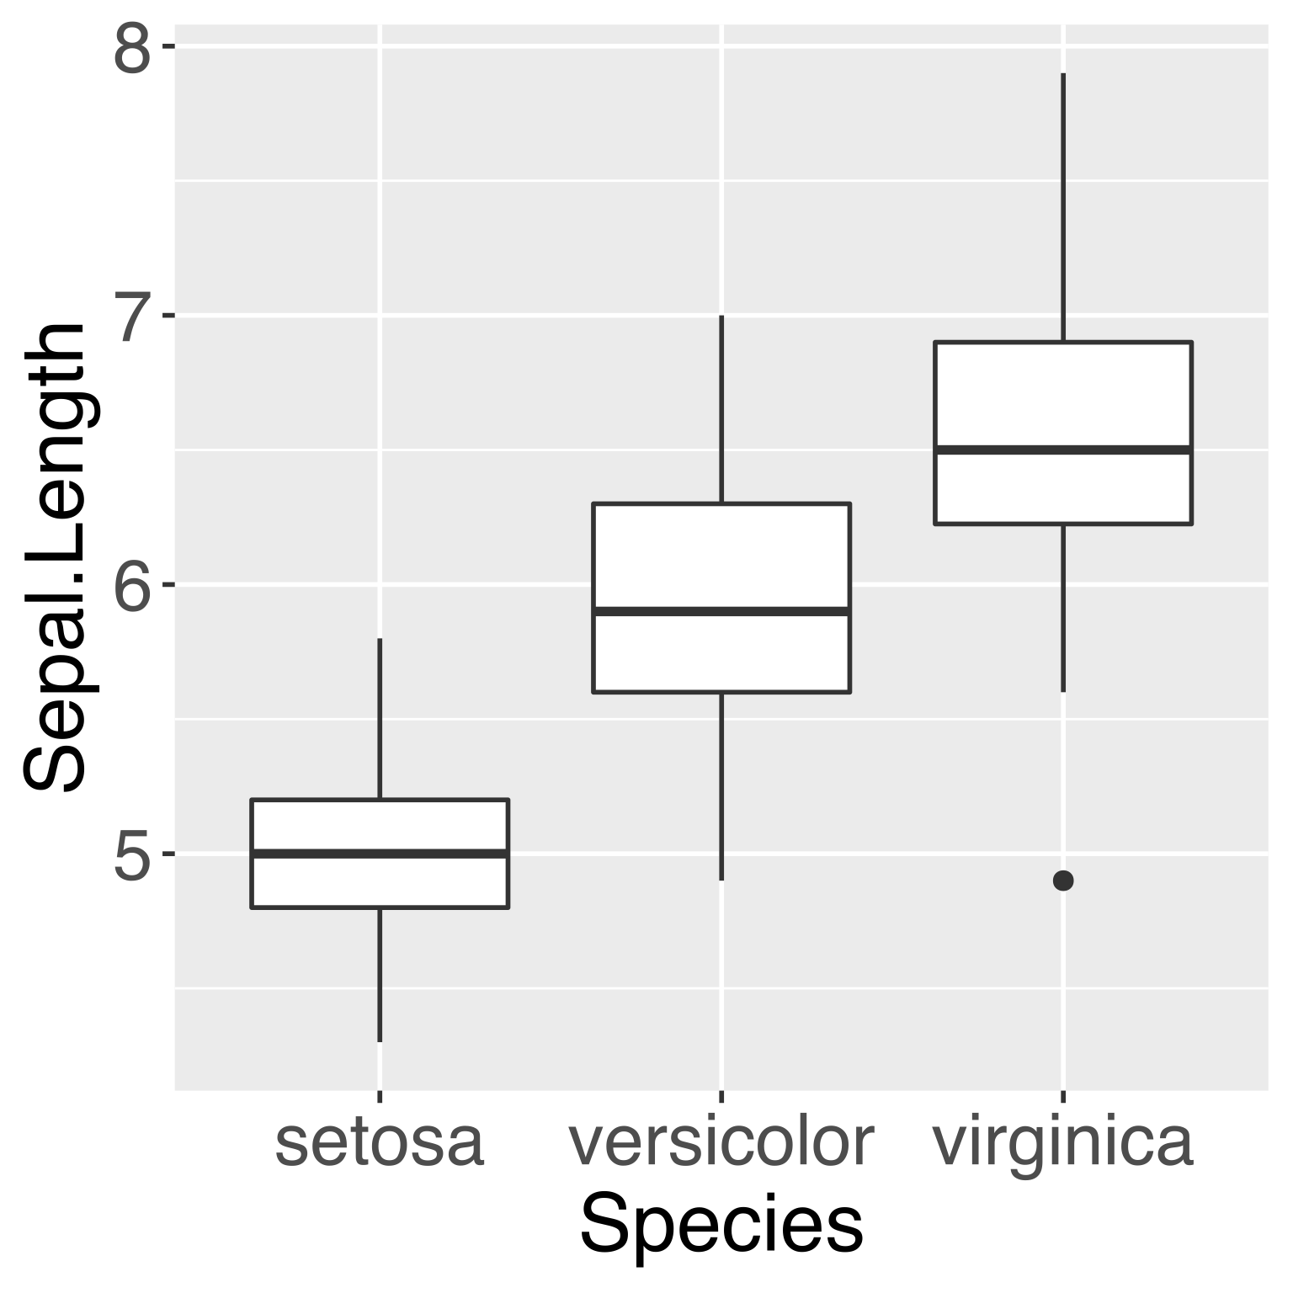
Test

