Slide 1

Project Title –Air open data
Student Name : Mahesh
AICTE-ID=INTERNSHIP_17546440516895be537820f
GIT HUB LINK=https://github.com/Kittu268/Data_Analytics.git

Slide 2

PROBLEM STATEMENT
To uncover actionable insights from the Airbnb Open Data for New York City by analyzing listing patterns, pricing strategies, host behavior, and customer satisfaction metrics. This project aims to support data-driven decision-making for stakeholders in the short- term rental market.

Slide 3


Project Description
This project explores the dynamics of short-term rentals in New York City using the Airbnb Open Data. By analyzing thousands of listings, host profiles, and guest reviews, the goal is to uncover patterns that influence pricing, popularity, and customer satisfaction across different neighborhoods and property types.
The analysis focuses on:
Identifying the most popular room types and high- density areas
Comparing pricing strategies across neighborhood groups
Investigating host behavior, including listing count and review quality
Exploring correlations between price, location, property age, and review sentiment
Highlighting top-performing hosts and availability trends

Slide 4

WHO ARE THE END USERS?
1. Airbnb Hosts
Want to optimize pricing, availability, and reviews
Can use insights to improve listing performance and guest satisfaction
2. Prospective Hosts
Curious about which neighborhoods and room types perform best
Can use trends to decide where and how to list their property
▪
▪
▪
▪
▪
3. Airbnb Platform Analysts
Interested in market dynamics, host behavior, and pricing strategies
Use data to improve platform recommendations and policies
▪
▪
▪
4. Travelers & Guests
Indirect beneficiaries—better host practices lead to better experiences
May use public dashboards to compare neighborhoods or prices
▪
▪
▪
5. Urban Planners & Local Government
Can analyze Airbnb’s impact on housing, tourism, and neighborhood development
Use insights to guide zoning, regulation, or tourism strategy
▪
▪
▪
Hospitality Industry Stakeholders
Competing hotels, property managers, and tourism boards
Use Airbnb data to benchmark performance and adapt strategies
Data Science Recruiters & Portfolio Reviewers
Evaluate your ability to extract insights, visualize trends, and communicate findings
Your project showcases technical depth and product sense
▪
▪
▪
▪
▪
▪

Slide 5


Technology Used
pandas: This was the core library used for data manipulation and analysis. We used pandas DataFrames to load, clean, and transform the data. Functions
like read_excel(), head(), info(), isnull(), sum(), len(), sort_values(), dropna(), replace(), value_c ounts(), groupby(), mean(), corr(), and describe() are all part of pandas and were essential for
inspecting, cleaning, and summarizing the data.
matplotlib.pyplot: This is a fundamental plotting library in Python. We used it to create figures and axes for our visualizations, as well as customize elements like titles, labels, and ticks (plt.figure(), plt.title(), plt.xlabel(), plt.ylabel(), plt.xticks(), plt.tight_layout(), plt.show()).
seaborn: Built on top of matplotlib, seaborn provides a high-level interface for creating attractive and informative statistical graphics. We used seaborn to generate the bar charts (barplot()), scatter plots (scatterplot()), and histograms (histplot()) to visualize the data and our findings.
10/5/2025 Annual Review

Slide 6
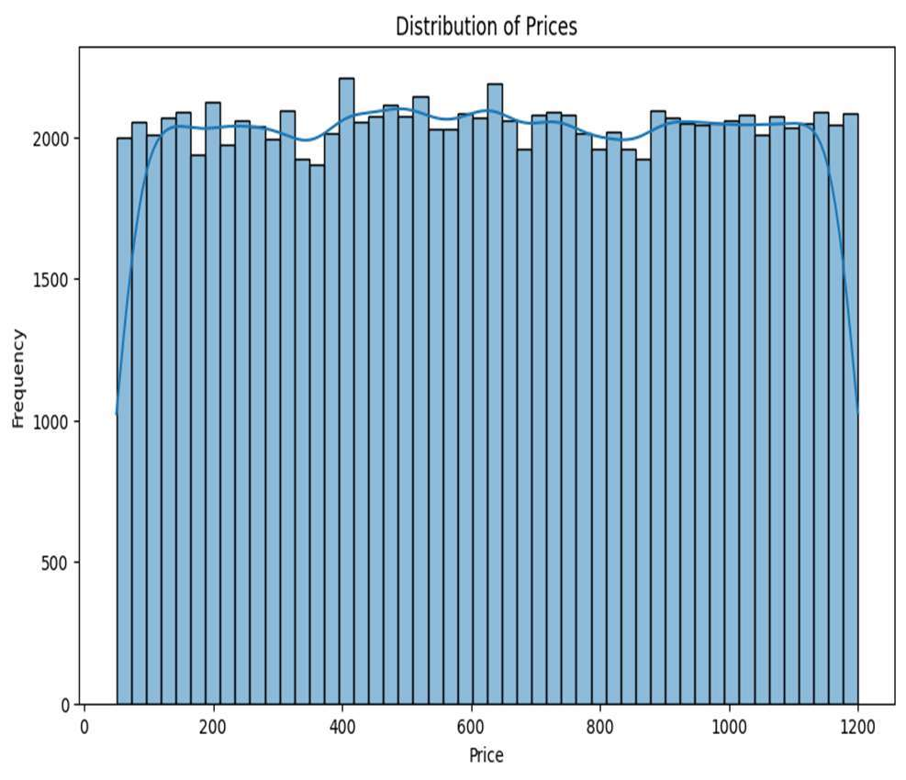
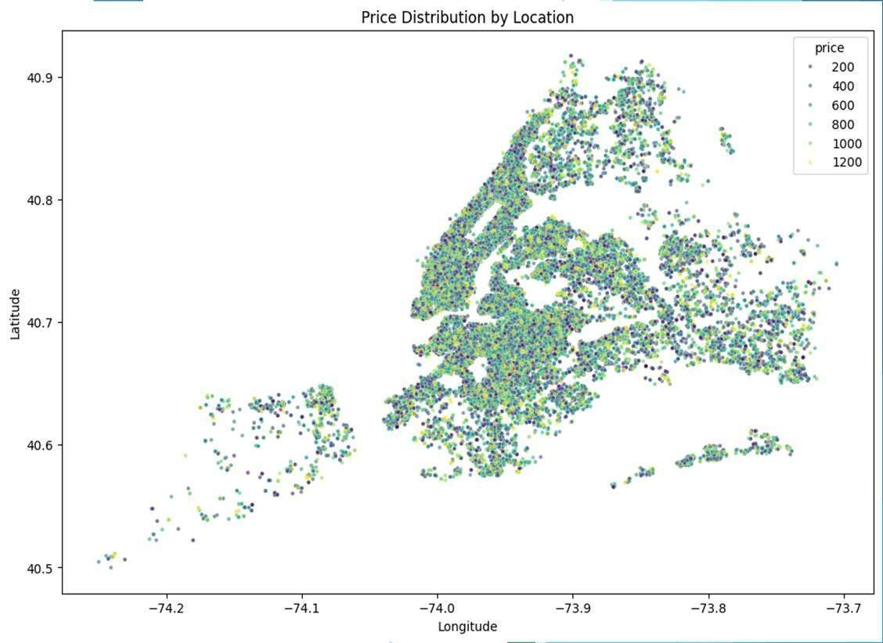
RESULTS
Distribution of Prices
Price Distribution by Location
Demo Link
10/5/2025
An
nual Review

Slide 7
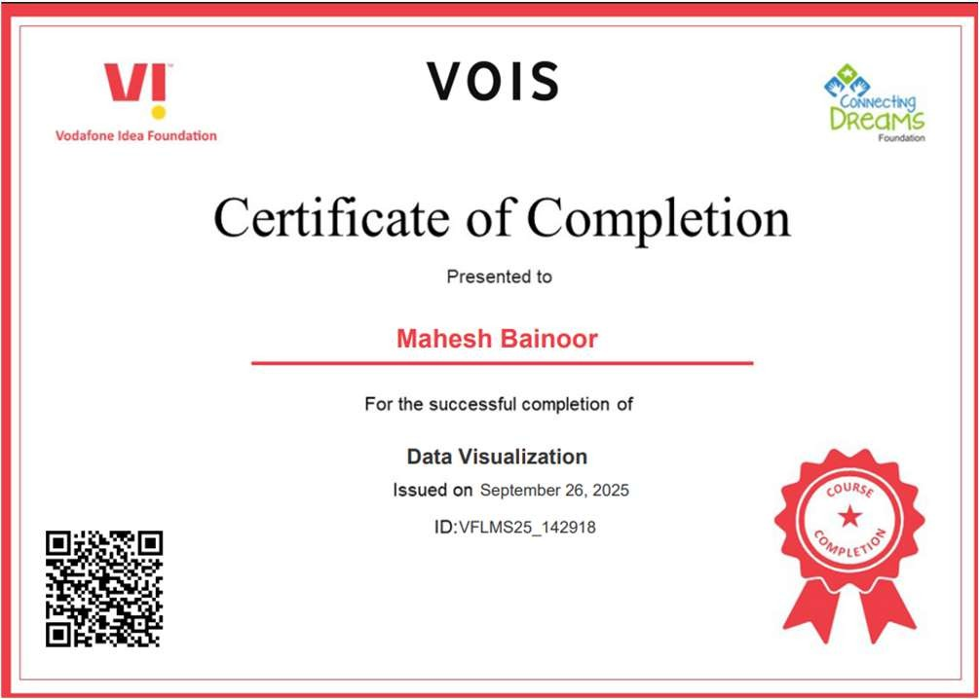
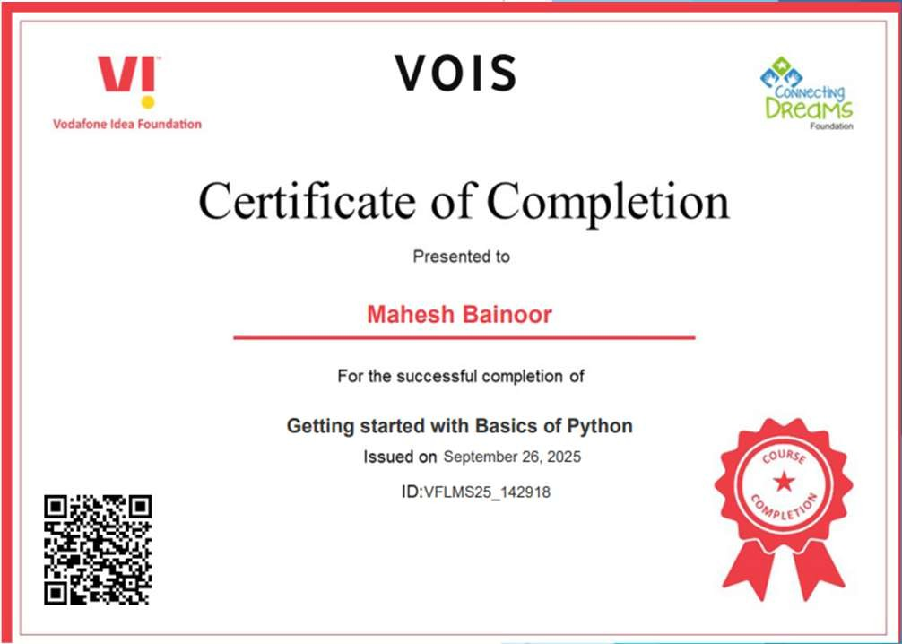

Thank you
.
.

