Slide 1
CSCI 544
Midterm Review Session
10/5/18

Slide 2
You Voted...
CKY = 7
Parameterization and lexicalization (in parsing) (4)
Linear models and features in LMs (4)
Perceptron and logistic regression (4)
Don't forget about
FSAs
Dependency Parsing
Probability
POS tagging
Morphology
Intro material

Slide 3
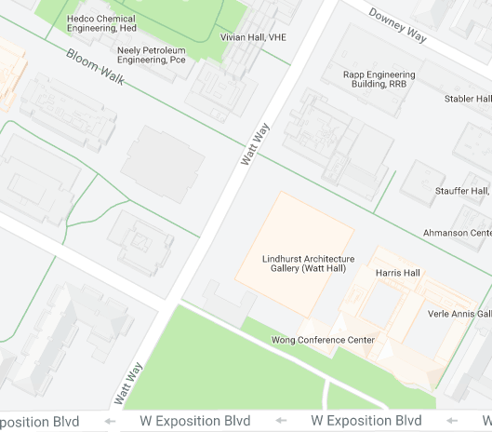
Remember To Go To The Right Classroom
Check Blackboard for your room assignment.
It will be anonymized, e.g. "jo**ay" is me (jonmay)
If you go to the wrong room there may not be an exam for you!!
SAL 101
HAR 101

