Slide 1
CSCI 544
Midterm Review Session
10/5/18

Slide 2
You Voted...
CKY = 7
Parameterization and lexicalization (in parsing) (4)
Linear models and features in LMs (4)
Perceptron and logistic regression (4)
Don't forget about
FSAs
Dependency Parsing
Probability
POS tagging
Morphology
Intro material

Slide 3
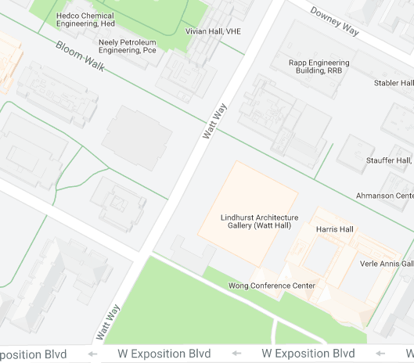
Remember To Go To The Right Classroom
Check Blackboard for your room assignment.
It will be anonymized, e.g. "jo**ay" is me (jonmay)
If you go to the wrong room there may not be an exam for you!!
SAL 101
HAR 101

Slide 4

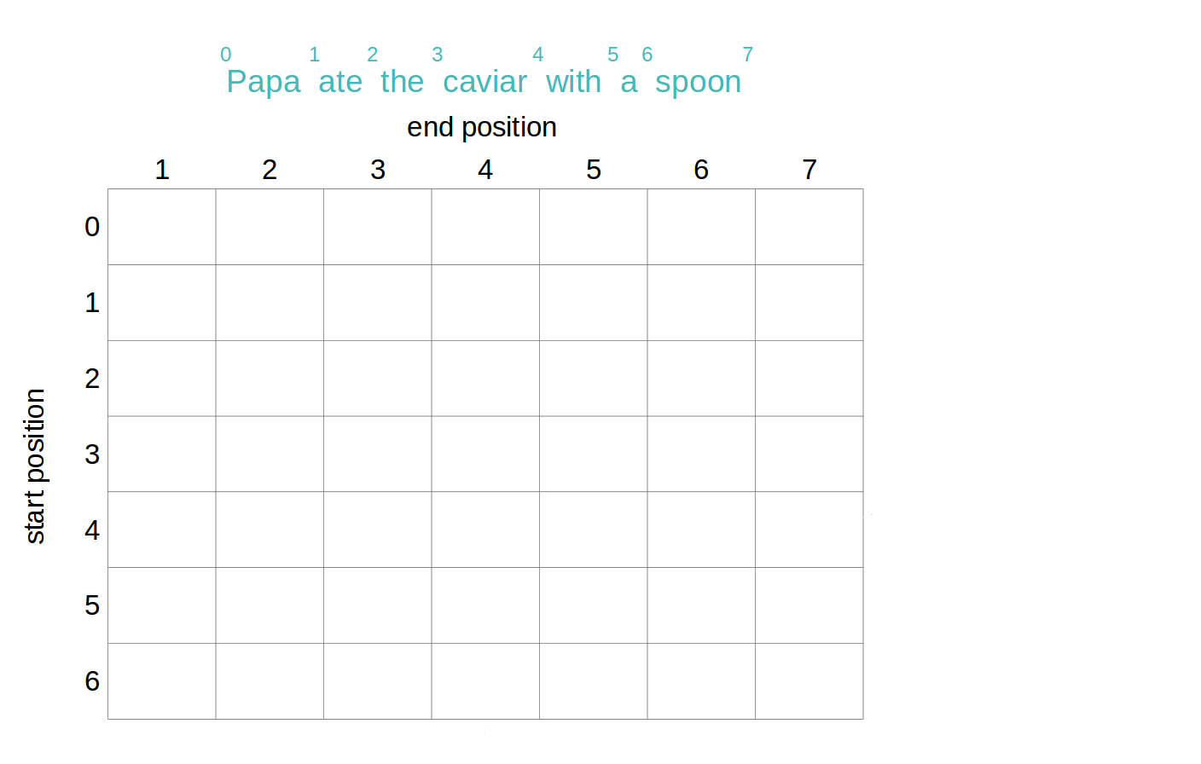
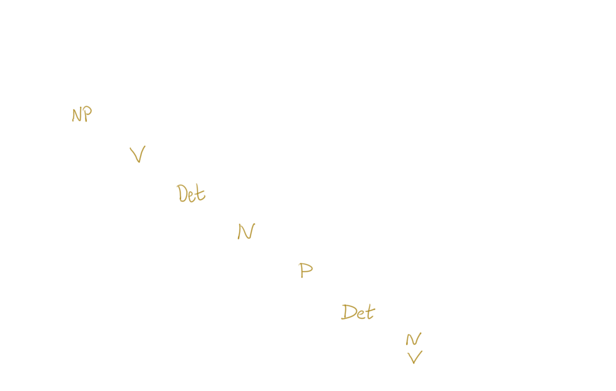
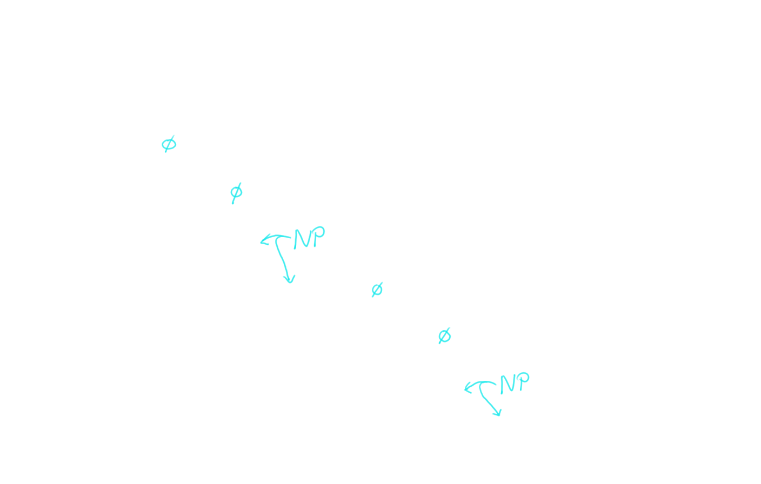
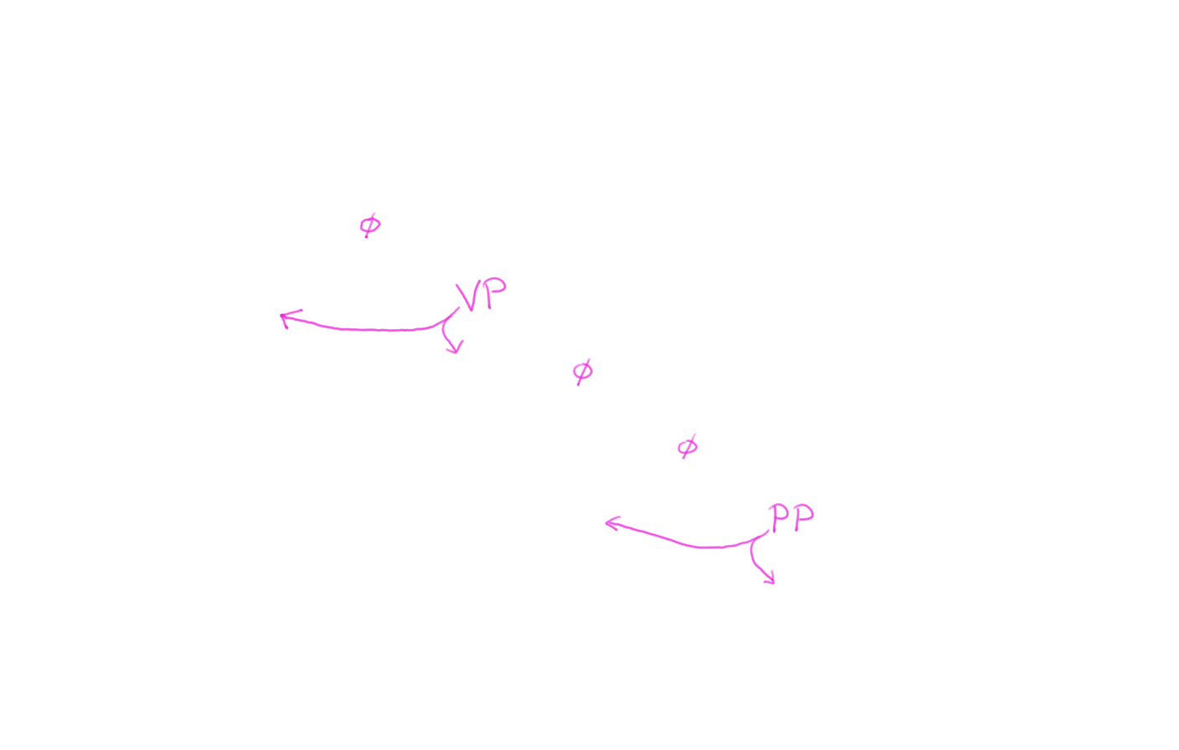
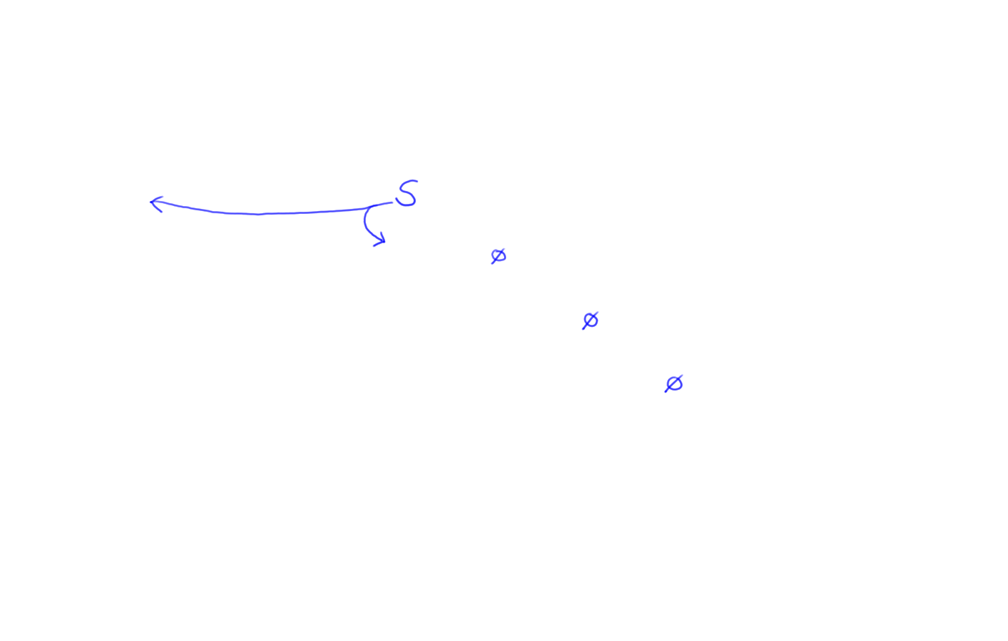
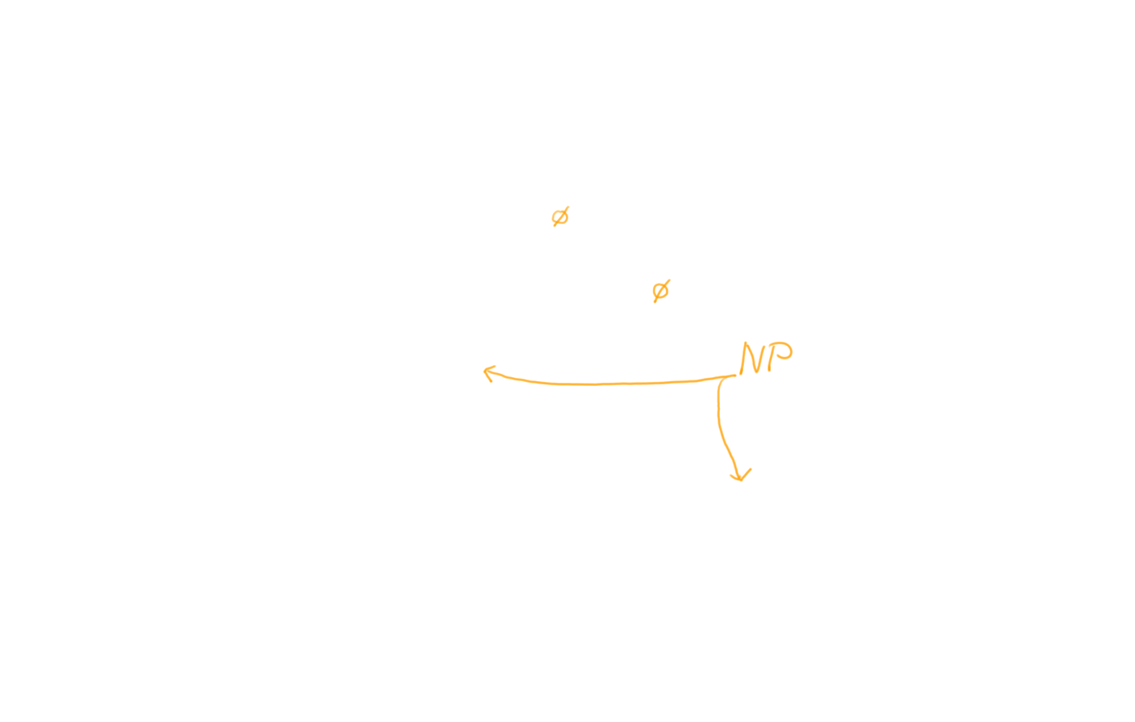
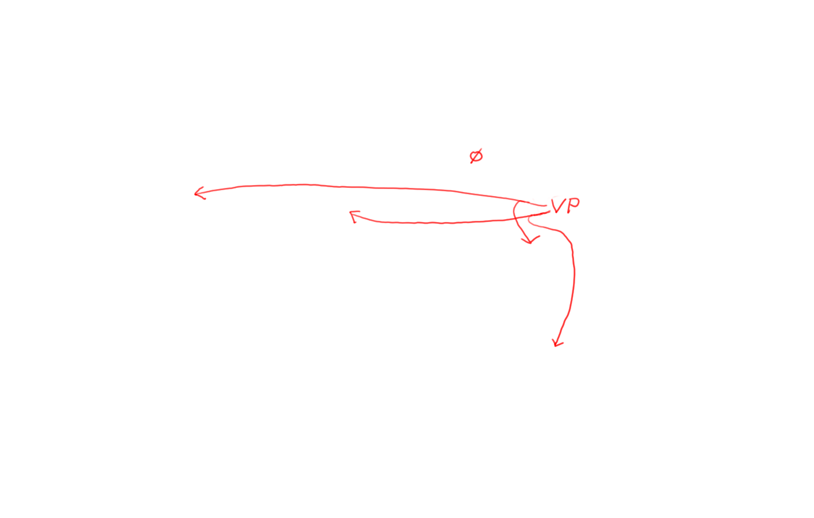
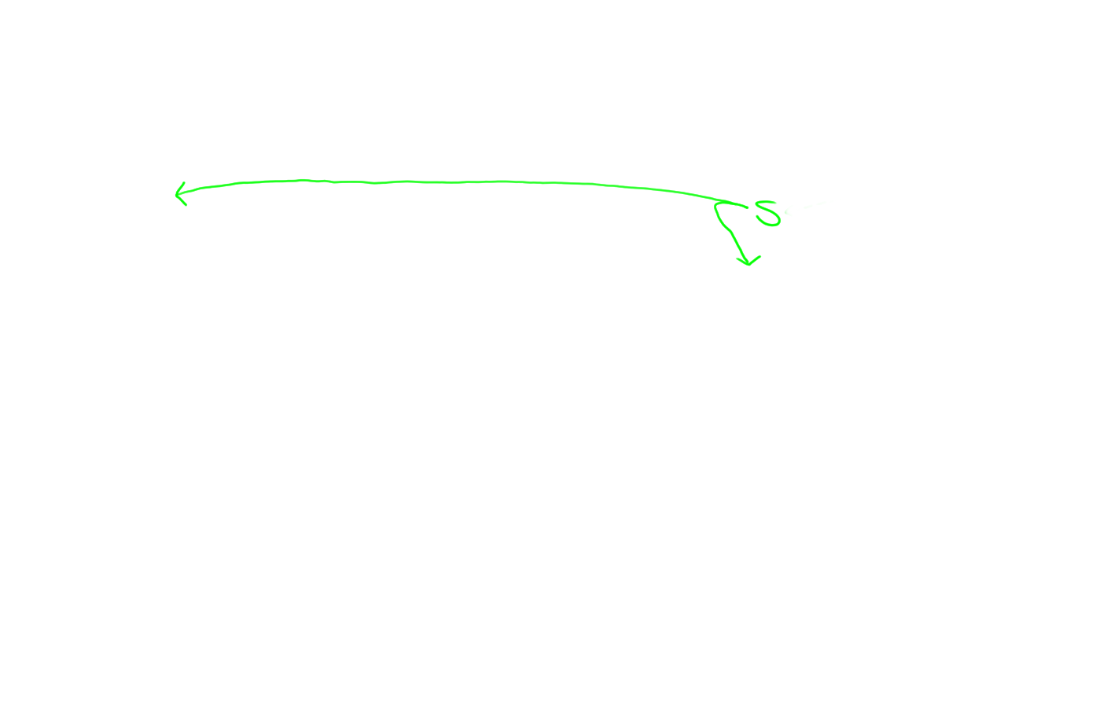
Avoid duplicate work: Build width-1, then width-2, etc.
S → NP VP
NP → Det N
NP → NP PP
VP → V NP
VP → VP PP
PP → P NP
NP → Papa
N → caviar
N → spoon
V → spoon
V → ate
P → with
Det → the
Det → a
Notes:
Pause and have people write the psuedo code

Slide 5
time 1 flies 2 like 3 an 4 arrow 5
0 | NP 3 Vst 3
1 |  | NP 4 VP 4
2 |  |  | P 2 V 5
3 |  |  |  | Det 1
4 |  |  |  |  | N 8
1 S → NP VP
6 S → Vst NP
2 S → S PP
1 VP → V NP
2 VP → VP PP
1 NP → Det N
2 NP → NP PP
3 NP → NP NP
0 PP → P NP
Notes:
Scores lower the better

Slide 6
time 1 flies 2 like 3 an 4 arrow 5
0 | NP 3 Vst 3
1 |  | NP 4 VP 4
2 |  |  | P 2 V 5
3 |  |  |  | Det 1
4 |  |  |  |  | N 8
1 S → NP VP
6 S → Vst NP
2 S → S PP
1 VP → V NP
2 VP → VP PP
1 NP → Det N
2 NP → NP PP
3 NP → NP NP
0 PP → P NP

Slide 7
time 1 flies 2 like 3 an 4 arrow 5
0 | NP 3 Vst 3 | NP 10
1 |  | NP 4 VP 4
2 |  |  | P 2 V 5
3 |  |  |  | Det 1
4 |  |  |  |  | N 8
1 S → NP VP
6 S → Vst NP
2 S → S PP
1 VP → V NP
2 VP → VP PP
1 NP → Det N
2 NP → NP PP
3 NP → NP NP
0 PP → P NP

Slide 8
time 1 flies 2 like 3 an 4 arrow 5
0 | NP 3 Vst 3 | NP 10 S 8
1 |  | NP 4 VP 4
2 |  |  | P 2 V 5
3 |  |  |  | Det 1
4 |  |  |  |  | N 8
1 S → NP VP
6 S → Vst NP
2 S → S PP
1 VP → V NP
2 VP → VP PP
1 NP → Det N
2 NP → NP PP
3 NP → NP NP
0 PP → P NP

Slide 9
time 1 flies 2 like 3 an 4 arrow 5
0 | NP 3 Vst 3 | NP 10 S 8 S 13
1 |  | NP 4 VP 4
2 |  |  | P 2 V 5
3 |  |  |  | Det 1
4 |  |  |  |  | N 8
1 S → NP VP
6 S → Vst NP
2 S → S PP
1 VP → V NP
2 VP → VP PP
1 NP → Det N
2 NP → NP PP
3 NP → NP NP
0 PP → P NP

Slide 10
time 1 flies 2 like 3 an 4 arrow 5
0 | NP 3 Vst 3 | NP 10 S 8 S 13
1 |  | NP 4 VP 4
2 |  |  | P 2 V 5
3 |  |  |  | Det 1
4 |  |  |  |  | N 8
1 S → NP VP
6 S → Vst NP
2 S → S PP
1 VP → V NP
2 VP → VP PP
1 NP → Det N
2 NP → NP PP
3 NP → NP NP
0 PP → P NP

Slide 11
time 1 flies 2 like 3 an 4 arrow 5
0 | NP 3 Vst 3 | NP 10 S 8 S 13
1 |  | NP 4 VP 4
2 |  |  | P 2 V 5
3 |  |  |  | Det 1 | NP 10
4 |  |  |  |  | N 8
1 S → NP VP
6 S → Vst NP
2 S → S PP
1 VP → V NP
2 VP → VP PP
1 NP → Det N
2 NP → NP PP
3 NP → NP NP
0 PP → P NP

Slide 12
time 1 flies 2 like 3 an 4 arrow 5
0 | NP 3 Vst 3 | NP 10 S 8 S 13
1 |  | NP 4 VP 4
2 |  |  | P 2 V 5
3 |  |  |  | Det 1 | NP 10
4 |  |  |  |  | N 8
1 S → NP VP
6 S → Vst NP
2 S → S PP
1 VP → V NP
2 VP → VP PP
1 NP → Det N
2 NP → NP PP
3 NP → NP NP
0 PP → P NP

Slide 13
time 1 flies 2 like 3 an 4 arrow 5
0 | NP 3 Vst 3 | NP 10 S 8 S 13
1 |  | NP 4 VP 4
2 |  |  | P 2 V 5 |  | PP 12
3 |  |  |  | Det 1 | NP 10
4 |  |  |  |  | N 8
1 S → NP VP
6 S → Vst NP
2 S → S PP
1 VP → V NP
2 VP → VP PP
1 NP → Det N
2 NP → NP PP
3 NP → NP NP
0 PP → P NP

Slide 14
time 1 flies 2 like 3 an 4 arrow 5
0 | NP 3 Vst 3 | NP 10 S 8 S 13
1 |  | NP 4 VP 4
2 |  |  | P 2 V 5 |  | PP 12 VP 16
3 |  |  |  | Det 1 | NP 10
4 |  |  |  |  | N 8
1 S → NP VP
6 S → Vst NP
2 S → S PP
1 VP → V NP
2 VP → VP PP
1 NP → Det N
2 NP → NP PP
3 NP → NP NP
0 PP → P NP

Slide 15
time 1 flies 2 like 3 an 4 arrow 5
0 | NP 3 Vst 3 | NP 10 S 8 S 13
1 |  | NP 4 VP 4
2 |  |  | P 2 V 5 |  | PP 12 VP 16
3 |  |  |  | Det 1 | NP 10
4 |  |  |  |  | N 8
1 S → NP VP
6 S → Vst NP
2 S → S PP
1 VP → V NP
2 VP → VP PP
1 NP → Det N
2 NP → NP PP
3 NP → NP NP
0 PP → P NP

Slide 16
time 1 flies 2 like 3 an 4 arrow 5
0 | NP 3 Vst 3 | NP 10 S 8 S 13
1 |  | NP 4 VP 4 |  |  | NP 18
2 |  |  | P 2 V 5 |  | PP 12 VP 16
3 |  |  |  | Det 1 | NP 10
4 |  |  |  |  | N 8
1 S → NP VP
6 S → Vst NP
2 S → S PP
1 VP → V NP
2 VP → VP PP
1 NP → Det N
2 NP → NP PP
3 NP → NP NP
0 PP → P NP

Slide 17
time 1 flies 2 like 3 an 4 arrow 5
0 | NP 3 Vst 3 | NP 10 S 8 S 13
1 |  | NP 4 VP 4 |  |  | NP 18 S 21
2 |  |  | P 2 V 5 |  | PP 12 VP 16
3 |  |  |  | Det 1 | NP 10
4 |  |  |  |  | N 8
1 S → NP VP
6 S → Vst NP
2 S → S PP
1 VP → V NP
2 VP → VP PP
1 NP → Det N
2 NP → NP PP
3 NP → NP NP
0 PP → P NP

Slide 18
time 1 flies 2 like 3 an 4 arrow 5
0 | NP 3 Vst 3 | NP 10 S 8 S 13
1 |  | NP 4 VP 4 |  |  | NP 18 S 21 VP 18
2 |  |  | P 2 V 5 |  | PP 12 VP 16
3 |  |  |  | Det 1 | NP 10
4 |  |  |  |  | N 8
1 S → NP VP
6 S → Vst NP
2 S → S PP
1 VP → V NP
2 VP → VP PP
1 NP → Det N
2 NP → NP PP
3 NP → NP NP
0 PP → P NP

Slide 19
time 1 flies 2 like 3 an 4 arrow 5
0 | NP 3 Vst 3 | NP 10 S 8 S 13
1 |  | NP 4 VP 4 |  |  | NP 18 S 21 VP 18
2 |  |  | P 2 V 5 |  | PP 12 VP 16
3 |  |  |  | Det 1 | NP 10
4 |  |  |  |  | N 8
1 S → NP VP
6 S → Vst NP
2 S → S PP
1 VP → V NP
2 VP → VP PP
1 NP → Det N
2 NP → NP PP
3 NP → NP NP
0 PP → P NP

Slide 20
time 1 flies 2 like 3 an 4 arrow 5
0 | NP 3 Vst 3 | NP 10 S 8 S 13 |  |  | NP 24
1 |  | NP 4 VP 4 |  |  | NP 18 S 21 VP 18
2 |  |  | P 2 V 5 |  | PP 12 VP 16
3 |  |  |  | Det 1 | NP 10
4 |  |  |  |  | N 8
1 S → NP VP
6 S → Vst NP
2 S → S PP
1 VP → V NP
2 VP → VP PP
1 NP → Det N
2 NP → NP PP
3 NP → NP NP
0 PP → P NP

Slide 21
time 1 flies 2 like 3 an 4 arrow 5
0 | NP 3 Vst 3 | NP 10 S 8 S 13 |  |  | NP 24 S 22
1 |  | NP 4 VP 4 |  |  | NP 18 S 21 VP 18
2 |  |  | P 2 V 5 |  | PP 12 VP 16
3 |  |  |  | Det 1 | NP 10
4 |  |  |  |  | N 8
1 S → NP VP
6 S → Vst NP
2 S → S PP
1 VP → V NP
2 VP → VP PP
1 NP → Det N
2 NP → NP PP
3 NP → NP NP
0 PP → P NP

Slide 22
time 1 flies 2 like 3 an 4 arrow 5
0 | NP 3 Vst 3 | NP 10 S 8 S 13 |  |  | NP 24 S 22 S 27
1 |  | NP 4 VP 4 |  |  | NP 18 S 21 VP 18
2 |  |  | P 2 V 5 |  | PP 12 VP 16
3 |  |  |  | Det 1 | NP 10
4 |  |  |  |  | N 8
1 S → NP VP
6 S → Vst NP
2 S → S PP
1 VP → V NP
2 VP → VP PP
1 NP → Det N
2 NP → NP PP
3 NP → NP NP
0 PP → P NP

Slide 23
time 1 flies 2 like 3 an 4 arrow 5
0 | NP 3 Vst 3 | NP 10 S 8 S 13 |  |  | NP 24 S 22 S 27
1 |  | NP 4 VP 4 |  |  | NP 18 S 21 VP 18
2 |  |  | P 2 V 5 |  | PP 12 VP 16
3 |  |  |  | Det 1 | NP 10
4 |  |  |  |  | N 8
1 S → NP VP
6 S → Vst NP
2 S → S PP
1 VP → V NP
2 VP → VP PP
1 NP → Det N
2 NP → NP PP
3 NP → NP NP
0 PP → P NP

Slide 24
time 1 flies 2 like 3 an 4 arrow 5
0 | NP 3 Vst 3 | NP 10 S 8 S 13 |  |  | NP 24 S 22 S 27 NP 24
1 |  | NP 4 VP 4 |  |  | NP 18 S 21 VP 18
2 |  |  | P 2 V 5 |  | PP 12 VP 16
3 |  |  |  | Det 1 | NP 10
4 |  |  |  |  | N 8
1 S → NP VP
6 S → Vst NP
2 S → S PP
1 VP → V NP
2 VP → VP PP
1 NP → Det N
2 NP → NP PP
3 NP → NP NP
0 PP → P NP

Slide 25
time 1 flies 2 like 3 an 4 arrow 5
0 | NP 3 Vst 3 | NP 10 S 8 S 13 |  |  | NP 24 S 22 S 27 NP 24 S 27
1 |  | NP 4 VP 4 |  |  | NP 18 S 21 VP 18
2 |  |  | P 2 V 5 |  | PP 12 VP 16
3 |  |  |  | Det 1 | NP 10
4 |  |  |  |  | N 8
1 S → NP VP
6 S → Vst NP
2 S → S PP
1 VP → V NP
2 VP → VP PP
1 NP → Det N
2 NP → NP PP
3 NP → NP NP
0 PP → P NP

Slide 26
time 1 flies 2 like 3 an 4 arrow 5
0 | NP 3 Vst 3 | NP 10 S 8 S 13 |  |  | NP 24 S 22 S 27 NP 24 S 27 S 22
1 |  | NP 4 VP 4 |  |  | NP 18 S 21 VP 18
2 |  |  | P 2 V 5 |  | PP 12 VP 16
3 |  |  |  | Det 1 | NP 10
4 |  |  |  |  | N 8
1 S → NP VP
6 S → Vst NP
2 S → S PP
1 VP → V NP
2 VP → VP PP
1 NP → Det N
2 NP → NP PP
3 NP → NP NP
0 PP → P NP

Slide 27
time 1 flies 2 like 3 an 4 arrow 5
0 | NP 3 Vst 3 | NP 10 S 8 S 13 |  |  | NP 24 S 22 S 27 NP 24 S 27 S 22 S 27
1 |  | NP 4 VP 4 |  |  | NP 18 S 21 VP 18
2 |  |  | P 2 V 5 |  | PP 12 VP 16
3 |  |  |  | Det 1 | NP 10
4 |  |  |  |  | N 8
1 S → NP VP
6 S → Vst NP
2 S → S PP
1 VP → V NP
2 VP → VP PP
1 NP → Det N
2 NP → NP PP
3 NP → NP NP
0 PP → P NP

Slide 28
S
Follow backpointers …
time 1 flies 2 like 3 an 4 arrow 5
0 | NP 3 Vst 3 | NP 10 S 8 S 13 |  |  | NP 24 S 22 S 27 NP 24 S 27 S 22 S 27
1 |  | NP 4 VP 4 |  |  | NP 18 S 21 VP 18
2 |  |  | P 2 V 5 |  | PP 12 VP 16
3 |  |  |  | Det 1 | NP 10
4 |  |  |  |  | N 8
1 S → NP VP
6 S → Vst NP
2 S → S PP
1 VP → V NP
2 VP → VP PP
1 NP → Det N
2 NP → NP PP
3 NP → NP NP
0 PP → P NP

Slide 29
S
time 1 flies 2 like 3 an 4 arrow 5
0 | NP 3 Vst 3 | NP 10 S 8 S 13 |  |  | NP 24 S 22 S 27 NP 24 S 27 S 22 S 27
1 |  | NP 4 VP 4 |  |  | NP 18 S 21 VP 18
2 |  |  | P 2 V 5 |  | PP 12 VP 16
3 |  |  |  | Det 1 | NP 10
4 |  |  |  |  | N 8
NP
VP
1 S → NP VP
6 S → Vst NP
2 S → S PP
1 VP → V NP
2 VP → VP PP
1 NP → Det N
2 NP → NP PP
3 NP → NP NP
0 PP → P NP

Slide 30
S
time 1 flies 2 like 3 an 4 arrow 5
0 | NP 3 Vst 3 | NP 10 S 8 S 13 |  |  | NP 24 S 22 S 27 NP 24 S 27 S 22 S 27
1 |  | NP 4 VP 4 |  |  | NP 18 S 21 VP 18
2 |  |  | P 2 V 5 |  | PP 12 VP 16
3 |  |  |  | Det 1 | NP 10
4 |  |  |  |  | N 8
NP
VP
VP
PP
1 S → NP VP
6 S → Vst NP
2 S → S PP
1 VP → V NP
2 VP → VP PP
1 NP → Det N
2 NP → NP PP
3 NP → NP NP
0 PP → P NP

Slide 31
S
time 1 flies 2 like 3 an 4 arrow 5
0 | NP 3 Vst 3 | NP 10 S 8 S 13 |  |  | NP 24 S 22 S 27 NP 24 S 27 S 22 S 27
1 |  | NP 4 VP 4 |  |  | NP 18 S 21 VP 18
2 |  |  | P 2 V 5 |  | PP 12 VP 16
3 |  |  |  | Det 1 | NP 10
4 |  |  |  |  | N 8
NP
VP
VP
PP
P
NP
1 S → NP VP
6 S → Vst NP
2 S → S PP
1 VP → V NP
2 VP → VP PP
1 NP → Det N
2 NP → NP PP
3 NP → NP NP
0 PP → P NP

Slide 32
S
time 1 flies 2 like 3 an 4 arrow 5
0 | NP 3 Vst 3 | NP 10 S 8 S 13 |  |  | NP 24 S 22 S 27 NP 24 S 27 S 22 S 27
1 |  | NP 4 VP 4 |  |  | NP 18 S 21 VP 18
2 |  |  | P 2 V 5 |  | PP 12 VP 16
3 |  |  |  | Det 1 | NP 10
4 |  |  |  |  | N 8
NP
VP
VP
PP
P
NP
Det
N
1 S → NP VP
6 S → Vst NP
2 S → S PP
1 VP → V NP
2 VP → VP PP
1 NP → Det N
2 NP → NP PP
3 NP → NP NP
0 PP → P NP

Slide 33
Which entries do we need?
time 1 flies 2 like 3 an 4 arrow 5
0 | NP 3 Vst 3 | NP 10 S 8 S 13 |  |  | NP 24 S 22 S 27 NP 24 S 27 S 22 S 27
1 |  | NP 4 VP 4 |  |  | NP 18 S 21 VP 18
2 |  |  | P 2 V 5 |  | PP 12 VP 16
3 |  |  |  | Det 1 | NP 10
4 |  |  |  |  | N 8
1 S → NP VP
6 S → Vst NP
2 S → S PP
1 VP → V NP
2 VP → VP PP
1 NP → Det N
2 NP → NP PP
3 NP → NP NP
0 PP → P NP

Slide 34
Which entries do we need?
time 1 flies 2 like 3 an 4 arrow 5
0 | NP 3 Vst 3 | NP 10 S 8 S 13 |  |  | NP 24 S 22 S 27 NP 24 S 27 S 22 S 27
1 |  | NP 4 VP 4 |  |  | NP 18 S 21 VP 18
2 |  |  | P 2 V 5 |  | PP 12 VP 16
3 |  |  |  | Det 1 | NP 10
4 |  |  |  |  | N 8
1 S → NP VP
6 S → Vst NP
2 S → S PP
1 VP → V NP
2 VP → VP PP
1 NP → Det N
2 NP → NP PP
3 NP → NP NP
0 PP → P NP
Notes:
S 8 (0,2) is NP VP
S 13 (0, 2) is Vst NP

Slide 35
Not worth keeping …
time 1 flies 2 like 3 an 4 arrow 5
0 | NP 3 Vst 3 | NP 10 S 8 S 13 |  |  | NP 24 S 22 S 27 NP 24 S 27 S 22 S 27
1 |  | NP 4 VP 4 |  |  | NP 18 S 21 VP 18
2 |  |  | P 2 V 5 |  | PP 12 VP 16
3 |  |  |  | Det 1 | NP 10
4 |  |  |  |  | N 8
1 S → NP VP
6 S → Vst NP
2 S → S PP
1 VP → V NP
2 VP → VP PP
1 NP → Det N
2 NP → NP PP
3 NP → NP NP
0 PP → P NP
Notes:
Two rules can be applied for the same combinations of spans, but some are better than others.

Slide 36
… since it just breeds worse options
time 1 flies 2 like 3 an 4 arrow 5
0 | NP 3 Vst 3 | NP 10 S 8 S 13 |  |  | NP 24 S 22 S 27 NP 24 S 27 S 22 S 27
1 |  | NP 4 VP 4 |  |  | NP 18 S 21 VP 18
2 |  |  | P 2 V 5 |  | PP 12 VP 16
3 |  |  |  | Det 1 | NP 10
4 |  |  |  |  | N 8
1 S → NP VP
6 S → Vst NP
2 S → S PP
1 VP → V NP
2 VP → VP PP
1 NP → Det N
2 NP → NP PP
3 NP → NP NP
0 PP → P NP

Slide 37
Keep only best-in-class!
time 1 flies 2 like 3 an 4 arrow 5
0 | NP 3 Vst 3 | NP 10 S 8 S 13 |  |  | NP 24 S 22 S 27 NP 24 S 27 S 22 S 27
1 |  | NP 4 VP 4 |  |  | NP 18 S 21 VP 18
2 |  |  | P 2 V 5 |  | PP 12 VP 16
3 |  |  |  | Det 1 | NP 10
4 |  |  |  |  | N 8
inferior stock
1 S → NP VP
6 S → Vst NP
2 S → S PP
1 VP → V NP
2 VP → VP PP
1 NP → Det N
2 NP → NP PP
3 NP → NP NP
0 PP → P NP

Slide 38
Keep only best-in-class!
(and its backpointers so you can recover best parse)
time 1 flies 2 like 3 an 4 arrow 5
0 | NP 3 Vst 3 | NP 10 S 8 |  |  | NP 24 S 22
1 |  | NP 4 VP 4 |  |  | NP 18 S 21 VP 18
2 |  |  | P 2 V 5 |  | PP 12 VP 16
3 |  |  |  | Det 1 | NP 10
4 |  |  |  |  | N 8
1 S → NP VP
6 S → Vst NP
2 S → S PP
1 VP → V NP
2 VP → VP PP
1 NP → Det N
2 NP → NP PP
3 NP → NP NP
0 PP → P NP

Slide 39
Chart (CKY) Parsing
phrase(X,I,J) :- rewrite(X,W), word(W,I,J).
phrase(X,I,J) :- rewrite(X,Y,Z), phrase(Y,I,Mid), phrase(Z,Mid,J).
goal :- phrase(start_symbol, 0, sentence_length).
39

Slide 40
Weighted Chart Parsing (“min cost”)
phrase(X,I,J)min= rewrite(X,W) + word(W,I,J).
phrase(X,I,J)min= rewrite(X,Y,Z) + phrase(Y,I,Mid) + phrase(Z,Mid,J).
goal min= phrase(start_symbol, 0, sentence_length).
40
Notes:
Take the minumum

Slide 41
Weighted Chart Parsing (“min cost”)
phrase(X,I,J)min= rewrite(X,W) + word(W,I,J).
phrase(X,I,J)min= rewrite(X,Y,Z) + phrase(Y,I,Mid) + phrase(Z,Mid,J).
goal min= phrase(start_symbol, 0, sentence_length).
41
Notes:
Take the minumum

Slide 42
Probabilistic Chart Parsing (“max prob”)
phrase(X,I,J)max= rewrite(X,W) * word(W,I,J).
phrase(X,I,J)max= rewrite(X,Y,Z) * phrase(Y,I,Mid) * phrase(Z,Mid,J).
goal max= phrase(start_symbol, 0, sentence_length).
42

Slide 43
time 1 flies 2 like 3 an 4 arrow 5
0 | NP 3 Vst 3 | NP 10 S 8 S 13 |  |  | NP 24 S 22 S 27 NP 24 S 27 S 22 S 27
1 |  | NP 4 VP 4 |  |  | NP 18 S 21 VP 18
2 |  |  | P 2 V 5 |  | PP 12 VP 16
3 |  |  |  | Det 1 | NP 10
4 |  |  |  |  | N 8
2⁻⁸
2⁻²
multiply to get 2⁻²²
1 S → NP VP
6 S → Vst NP
2 S → S PP
1 VP → V NP
2 VP → VP PP
1 NP → Det N
2 NP → NP PP
3 NP → NP NP
0 PP → P NP
2⁻¹²

Slide 44
Need only best-in-class to get best parse
time 1 flies 2 like 3 an 4 arrow 5
0 | NP 3 Vst 3 | NP 10 S 8 S 13 |  |  | NP 24 S 22 S 27 NP 24 S 27 S 22 S 27
1 |  | NP 4 VP 4 |  |  | NP 18 S 21 VP 18
2 |  |  | P 2 V 5 |  | PP 12 VP 16
3 |  |  |  | Det 1 | NP 10
4 |  |  |  |  | N 8
2⁻⁸
2⁻²
2⁻¹³
multiply to get 2⁻²²
1 S → NP VP
6 S → Vst NP
2 S → S PP
1 VP → V NP
2 VP → VP PP
1 NP → Det N
2 NP → NP PP
3 NP → NP NP
0 PP → P NP
2⁻¹²

Slide 45
Why probabilities not weights?
We just saw probabilities are really just a special case of weights …
… but we can estimate them from training data by counting and smoothing! Yay!
Warning: What kind of training corpus do we need (if we want to estimate rule probabilities simply by counting and smoothing)?
Probabilities tell us how likely our best parse actually is:
Might improve user interface (e.g. ask for clarification if not sure)
Might help when learning the rule probabilities (later in course)
Should help combination with other systems
Text understanding: Even if the 3rd-best parse is 40x less probable syntactically, might still use it if it’s> 40x more probable semantically
Ambiguity-preserving translation: If the top 3 parses are all probable, try to find a translation that would be ok regardless of which is correct

Slide 46
A slightly different task
Been asking: What is probability of generating a given tree?
To pick tree with highest prob: useful in parsing.
But could also ask: What is probability of generating a given string with the generator?
To pick string with highest prob: useful in speech recognition, as substitute for an n-gram model.
(“Put the file in the folder” vs. “Put the file and the folder”)
To get prob of generating string, must add up probabilities of all trees for the string …

Slide 47
Could just add up the parse probabilities
time 1 flies 2 like 3 an 4 arrow 5
0 | NP 3 Vst 3 | NP 10 S 8 S 13 |  |  | NP 24 S 22 S 27 NP 24 S 27 S 22 S 27
1 |  | NP 4 VP 4 |  |  | NP 18 S 21 VP 18
2 |  |  | P 2 V 5 |  | PP 12 VP 16
3 |  |  |  | Det 1 | NP 10
4 |  |  |  |  | N 8
oops, back to finding exponentially many parses
2⁻²²
2⁻²⁷
1 S → NP VP
6 S → Vst NP
2 S → S PP
1 VP → V NP
2 VP → VP PP
1 NP → Det N
2 NP → NP PP
3 NP → NP NP
0 PP → P NP
2⁻²⁷
2⁻²²
2⁻²⁷

Slide 48
Any more efficient way?
time 1 flies 2 like 3 an 4 arrow 5
0 | NP 3 Vst 3 | NP 10 S S 2⁻¹³ |  |  | NP 24 S 22 S 27 NP 24 S 27 S S
1 |  | NP 4 VP 4 |  |  | NP 18 S 21 VP 18
2 |  |  | P 2 V 5 |  | PP 2⁻¹² VP 16
3 |  |  |  | Det 1 | NP 10
4 |  |  |  |  | N 8
2⁻⁸
1 S → NP VP
6 S → Vst NP
2⁻² S → S PP
1 VP → V NP
2 VP → VP PP
1 NP → Det N
2 NP → NP PP
3 NP → NP NP
0 PP → P NP
2⁻²²
2⁻²⁷

Slide 49
Add as we go … (the “inside algorithm”)
time 1 flies 2 like 3 an 4 arrow 5
0 | NP 3 Vst 3 | NP 10 S |  |  | NP 24 S 22 S 27 NP 24 S 27 S
1 |  | NP 4 VP 4 |  |  | NP 18 S 21 VP 18
2 |  |  | P 2 V 5 |  | PP 2⁻¹² VP 16
3 |  |  |  | Det 1 | NP 10
4 |  |  |  |  | N 8
2⁻⁸+2⁻¹³
1 S → NP VP
6 S → Vst NP
2⁻² S → S PP
1 VP → V NP
2 VP → VP PP
1 NP → Det N
2 NP → NP PP
3 NP → NP NP
0 PP → P NP
2⁻²²
+2⁻²⁷

Slide 50
Add as we go … (the “inside algorithm”)
time 1 flies 2 like 3 an 4 arrow 5
0 | NP 3 Vst 3 | NP 10 S |  |  | NP S
1 |  | NP 4 VP 4 |  |  | NP 18 S 21 VP 18
2 |  |  | P 2 V 5 |  | PP 2⁻¹² VP 16
3 |  |  |  | Det 1 | NP 10
4 |  |  |  |  | N 8
2⁻²²
+2⁻²⁷
2⁻⁸+2⁻¹³
2⁻²²
+2⁻²⁷
+2⁻²⁷
1 S → NP VP
6 S → Vst NP
2⁻² S → S PP
1 VP → V NP
2 VP → VP PP
1 NP → Det N
2 NP → NP PP
3 NP → NP NP
0 PP → P NP
+(2⁻²²
+2⁻²⁷)

Slide 51
Probabilistic Chart Parsing (“max prob”)
phrase(X,I,J)max= rewrite(X,W) * word(W,I,J).
phrase(X,I,J)max= rewrite(X,Y,Z) * phrase(Y,I,Mid) * phrase(Z,Mid,J).
goal max= phrase(start_symbol, 0, sentence_length).
51

Slide 52
The “Inside Algorithm”
phrase(X,I,J) += rewrite(X,W) * word(W,I,J).
phrase(X,I,J) += rewrite(X,Y,Z) * phrase(Y,I,Mid) * phrase(Z,Mid,J).
goal += phrase(start_symbol, 0, sentence_length).
52

Slide 53
Chart Parsing: Recognition algorithm
phrase(X,I,J):- rewrite(X,W), word(W,I,J).
phrase(X,I,J):- rewrite(X,Y,Z), phrase(Y,I,Mid), phrase(Z,Mid,J).
goal :- phrase(start_symbol, 0, sentence_length).
53

Slide 54
Chart Parsing: Viterbi algorithm (min-cost)
phrase(X,I,J)min= rewrite(X,W) + word(W,I,J).
phrase(X,I,J)min= rewrite(X,Y,Z) + phrase(Y,I,Mid) + phrase(Z,Mid,J).
goal min= phrase(start_symbol, 0, sentence_length).
54

Slide 55
Chart Parsing: Viterbi algorithm (max-prob)
phrase(X,I,J)max= rewrite(X,W) * word(W,I,J).
phrase(X,I,J)max= rewrite(X,Y,Z) * phrase(Y,I,Mid) * phrase(Z,Mid,J).
goal max= phrase(start_symbol, 0, sentence_length).
55

Slide 56
Chart Parsing: Inside algorithm
phrase(X,I,J) += rewrite(X,W) * word(W,I,J).
phrase(X,I,J) += rewrite(X,Y,Z) * phrase(Y,I,Mid) * phrase(Z,Mid,J).
goal += phrase(start_symbol, 0, sentence_length).
56

Slide 57
Generalization: Semiring-Weighted Chart Parsing
phrase(X,I,J) ⊕= rewrite(X,W) ⊗ word(W,I,J).
phrase(X,I,J) ⊕= rewrite(X,Y,Z) ⊗ phrase(Y,I,Mid) ⊗ phrase(Z,Mid,J).
goal ⊕= phrase(start_symbol, 0, sentence_length).
57

Slide 58
Unweighted CKY: Recognition algorithm
initialize all entries of chart to false
for i := 1 to n
for each rule R of the form X → word[i]
chart[X,i-1,i] ||= in_grammar(R)
for width := 2 to n
for start := 0 to n-width
Define end := start + width
for mid := start+1 to end-1
for each rule R of the form X → Y Z
chart[X,start,end] ||= in_grammar(R) && chart[Y,start,mid] && chart[Z,mid,end]
return chart[ROOT,0,n]
Pay attention to the orange code …
600.465 - Intro to NLP - J. Eisner
58
Notes:
58

Slide 59
Weighted CKY: Viterbi algorithm (min-cost)
initialize all entries of chart to ∞
for i := 1 to n
for each rule R of the form X → word[i]
chart[X,i-1,i] min= weight(R)
for width := 2 to n
for start := 0 to n-width
Define end := start + width
for mid := start+1 to end-1
for each rule R of the form X → Y Z
chart[X,start,end] min= weight(R) + chart[Y,start,mid] + chart[Z,mid,end]
return chart[ROOT,0,n]
Pay attention to the orange code …
600.465 - Intro to NLP - J. Eisner
59
Notes:
59

Slide 60
Probabilistic CKY: Inside algorithm
initialize all entries of chart to 0
for i := 1 to n
for each rule R of the form X → word[i]
chart[X,i-1,i] += prob(R)
for width := 2 to n
for start := 0 to n-width
Define end := start + width
for mid := start+1 to end-1
for each rule R of the form X → Y Z
chart[X,start,end] += prob(R) * chart[Y,start,mid] * chart[Z,mid,end]
return chart[ROOT,0,n]
Pay attention to the orange code …
600.465 - Intro to NLP - J. Eisner
60
Notes:
60

Slide 61
Semiring-weighted CKY: General algorithm
initialize all entries of chart to ⓪
for i := 1 to n
for each rule R of the form X → word[i]
chart[X,i-1,i] ⊕= semiring_weight(R)
for width := 2 to n
for start := 0 to n-width
Define end := start + width
for mid := start+1 to end-1
for each rule R of the form X → Y Z
chart[X,start,end] ⊕= semiring_weight(R) ⊗ chart[Y,start,mid] ⊗ chart[Z,mid,end]
return chart[ROOT,0,n]
⊗ is like “and”/∀: combines all of several pieces into an X
⊕ is like “or”/∃: considers the alternative ways to build the X
600.465 - Intro to NLP - J. Eisner
61
Notes:
61

Slide 62
Weighted CKY, general version
initialize all entries of chart to ⓪
for i := 1 to n
for each rule R of the form X → word[i]
chart[X,i-1,i] ⊕= semiring_weight(R)
for width := 2 to n
for start := 0 to n-width
Define end := start + width
for mid := start+1 to end-1
for each rule R of the form X → Y Z
chart[X,start,end] ⊕= semiring_weight(R) ⊗ chart[Y,start,mid] ⊗ chart[Z,mid,end]
return chart[ROOT,0,n]
 | Output | ⊕ | ⊗ | ⓪
total prob (inside) | [0,1] | + | × | 0
min weight | [0,∞] | min | + | ∞
recognizer | {true,false} | or | and | false

Slide 63
Some Weight Semirings
 | weights | ⊕ | ⊗ | ⓪ | ①
total prob (inside) | [0,1] | + | × | 0 | 1
max prob | [0,1] | max | × | 0 | 1
min weight = -log(max prob) | [0,∞] | min | + | ∞ | 0
log(total prob) | [-∞,0] | log+ | + | -∞ | 0
recognizer | {true,false} | or | and | false | true
log
Semiring elements are log-probabilities lp, lq; helps prevent underflow
lp ⊗ lq = log(exp(lp)×exp(lq)) = lp+lq
lp ⊕ lq = log(exp(lp)+exp(lq)), denoted log+(lp,lq)

Slide 64
Other Uses of Semirings
The semiring weight of a constituent, Chart[X,i,k], is a flexible bookkeeping device.
If you want to build up information about larger constituents from smaller ones, design a semiring:
Probability of best parse, or its log
Number of parses
Total probability of all parses, or its log
The gradient of the total log-probability with respect to the parameters (use this to optimize the grammar weights)
The entropy of the probability distribution over parses
The 5 most probable parses

Slide 65
The Semiring Axioms
public interface Semiring<K extends Semiring> {
public K oplus(K k); // ⊕
public K otimes(K k); // ⊗
public K zero(); // ⓪
public K one(); // ①
}
An implementation of Semiring must satisfy the semiring axioms:
Commutativity of ⊕: a ⊕ b = b ⊕ a
Associativity: (a ⊕ b) ⊕ c = a ⊕ (b ⊕ c), (a ⊗ b) ⊗ c = a ⊗ (b ⊗ c)
Distributivity: a ⊗ (b ⊕ c) = (a ⊗ b) ⊕ (a ⊗ c), (b ⊕ c) ⊗ a = (b ⊗ a) ⊕ (c ⊗ a)
Identities: a ⊕ ⓪ = ⓪ ⊕ a = a, a ⊗ ① = ① ⊗ a = a
Annihilation: a ⊗ ⓪ = ⓪
Otherwise the parser won’t work correctly.

Slide 66
Problems with vanilla PCFGs
Using the approach just described (“vanilla PCFG”), a CKY parser scores about 73% F1. State of the art parsers are in the mid-90s
Why so bad?

Slide 67
Parameterization …
phrase(X,I,J) += rewrite(X,W) * word(W,I,J).
phrase(X,I,J) += rewrite(X,Y,Z) * phrase(Y,I,Mid) * phrase(Z,Mid,J).
goal += phrase(start_symbol, 0, sentence_length).
rewrite(X,Y,Z)’s value represents the rule probability p(Y Z | X).
This could be defined by a formula instead of a number.
Simple conditional log-linear model (each rule has 4 features):
urewrite(X,Y,Z) *= exp(weight_xy(X,Y)). % exp θ_{xy,X,Y}
urewrite(X,Y,Z) *= exp(weight_xz(X,Z)).
urewrite(X,Y,Z) *= exp(weight_yz(Y,Z)).
urewrite(X) += urewrite(X,Y,Z) for all Y and Z. % normalizing constant
rewrite(X,Y,Z) = urewrite(X,Y,Z) / urewrite(X). % p(X → Y Z | X)
67

Slide 68
Parameterization …
phrase(X,I,J) += rewrite(X,W) * word(W,I,J).
phrase(X,I,J) += rewrite(X,Y,Z) * phrase(Y,I,Mid) * phrase(Z,Mid,J).
goal += phrase(start_symbol, 0, sentence_length).
rewrite(X,Y,Z)’s value represents the rule probability p(Y Z | X).
Simple conditional log-linear model …
What if the program uses the unnormalized probability urewrite instead of rewrite?
Different model! Each parse has an overall unnormalized prob: uprob(Parse) = exp(total weight of all features in the parse)
Can still normalize at the end: p(Parse | sentence) = uprob(parse) / Z where Z is the sum of all uprob(Parse)
68

Slide 69
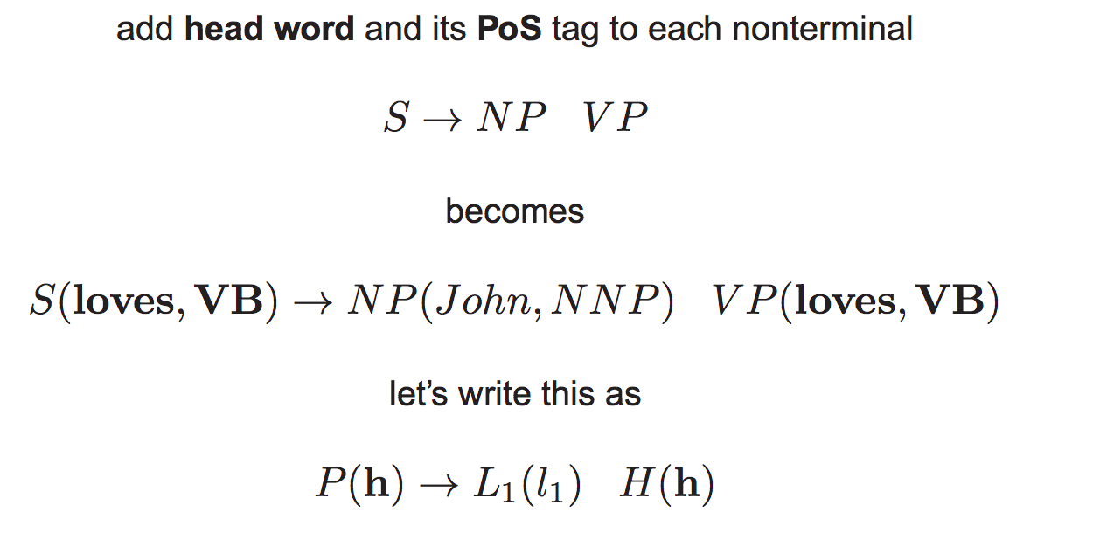
Lexicalization of Rules
Notes:
Papa ate the cake with chopsticks
Papa ate the cake with stawberries

Slide 70
Other Useful Category Splits
Mark base NPs (NPs that do not contain other NPs)
Parent annotation on preterminals
Subdivide IN, CC, “have” vs “be” auxiliary
See “Accurate Unlexicalized Parsing” (Klein & Manning, 2003)
Notes:
IN: Preposition or subordinating conjunction
CC: Coordinating conjunction

Slide 71
Summary
PCFG parsing
Inside Algorithm
Semirings
Parameterization
Lexicalization

Slide 72
Feature Engineering for WSD
𝛟(x)
w₁
w₂
3
bias | 1
capitalized? | 0 | -3.0 | -6/2
#wordsBefore | 6 | .22 | .15
#wordsAfter | 3 | -.01 | .03
relativeOffset | 0.66 | 1.00 | .85
leftWord=about | 1 | 0 | 0
leftWord=best | 0 | -2.0 | 3.0
rightWord=rates | 1 | 5.0 | -1.2
rightWord=in | 0 | -1 | -0.5
Wall | 1 | .8 | -.4
Street | 1 | 2.0 | .3
vets | 1 | ... | ...
best | 0
in | 0
Wall Street | 1
Street vets | 1
vets raise | 1
2.4
X = Wall Street vets raise concerns about interest rates , politics
less important
argmax_{c} w_{c}^{T}𝛟(x)
Important!
Sure, let's just come up with
weights from some other source!
How about just choosing whatever
weights make the classifier better?

Slide 73
Perceptron: An Error-Driven Learner/Classifier
import numpy as np
from classifier import feats, classify
w = np.zeros(|feats|)
for i in range(iterations):
for t in range(datasize):
x, y = select(X, Y)
# run current classifier
y' = classify(x, w)
if y' != y:
w += feats(x, y)-feats(x, y')
return w
C is a subroutine of L
X
Y
L
C
def classify(x, w):
scores = []
for y in labelspace:
scores.append(np.dot(w, feats(x,y)))
return argmax(scores)

Slide 74
What's Going On Here (I)?
X = Wall Street vets raise concerns about interest rates , politics
if y' != y:
w += feats(x, y)-feats(x, y')
If the wrong decision was made...
Extra weight is given to features that should have fired (but didn't)
extra penalty is given to features that did fire (but shouldn't have).
Features that wouldn't have fired anyway are left alone
𝛟(x,1)
𝛟(x,2)
w
bias ^ y=1 | 1 | 0 | 0.3
bias ^ y=2 | 0 | 1 | 0.7
Wall ^ y=1 | 1 | 0 | .8
Wall ^ y=2 | 0 | 1 | -.2
this ^ y=1 | 0 | 0 | 2.2
1.3
-.3
1.8
-1.2
2.2

Slide 75
What's Going On Here (II)?
Each (x, y) is a point in |feature|-dimensional space.
Weights define a hyperplane (line) along which score is zero
Perceptron moves the line to encourage correct items to be positive distance away

Slide 76
What's Going On Here (III)?
Let's say we have pair (x, y). Perceptron chooses argmax_{y'} w^{T}𝛟(x,y'); let the chosen y' be y*.
Ideally y*=y; since we choose the argmax, we know that w^{T}𝛟(x,y*)-w^{T}𝛟(x,y) >= 0. That value is called the loss; the bigger it is the worse our classifier is.
We get to choose w. Specifically we'd like to find argmin_{w'}w^{'T}𝛟(x,y*)-w'^{T}𝛟(x,y). This is a differentiable and continuous function, so take the derivative and move away from it.

Slide 77
Loss Gradient for Perceptron
𝓁_{perceptron} = wT𝛟(x,y*)-w^{T}𝛟(x,y) unless the two are equal, then it's 0.
remember, w is a vector, so the gradient is taken for each member
however each variable appears exactly twice in the expanded equation
∂/∂w 𝓁_{perceptron} = 𝛟(x,y*)-𝛟(x,y) (unless the two are equal...)
And we want a negative step, so 𝛟(x,y)-𝛟(x,y*) (unless the two are equal)
Notes:
TODO: graph of what we're minimizing! (negative slope of equation where y = loss,

Slide 78
Other Perceptron Notes
Since it's not closed-form like NB, weights need to be iteratively updated for some length of time. How long? Black art.
What order to process the data? Probably randomly shuffle, but experimentally determined
Avoiding overfitting
Averaging: Keep track of all weight vectors learned, then average them
Early stopping: Check performance on a dev set, then stop when it stops improving
Support Vector Machine (SVM): Variant of perceptron trying to get the separating hyperplane farthest away from all points.

Slide 79
Perceptron Vs. Naive Bayes
Perceptron
Naive Bayes
Discriminative model; can only classify given x
Not probabilistic
Iterative solution
No independence assumption; arbitrary feats
Best for more accuracy (esp. SVM), medium data, more feats
Can overfit
Generative model; can be used to estimate P(x) or generate x from y
Probabilistic
Closed-form solution
Overlapping features violate independence assumption
Best for speed, lowish data, simple features

Slide 80
Can We Use All These Weights and Still Be Probabilistic?
Being probabilistic allows us to quantify our uncertainty, work in pipelines, but the arbitrary weights of perceptron are freeing. Any way to have the best of both worlds?
Recall, that the Naive Bayes objective, P(X|Y)P(Y) = P(X, Y), which is also P(Y|X)P(X)
In classification we're given X; we don't really need to worry about it. So if we don't want to be generative (since we're not making the Naive Bayes Assumption) we just need a good model for P(Y|X)
We have a score function for the event Y, X... w^{T}𝛟(x,y)...what can we do?

Slide 81
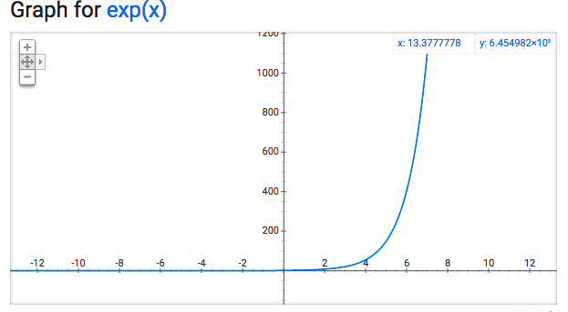
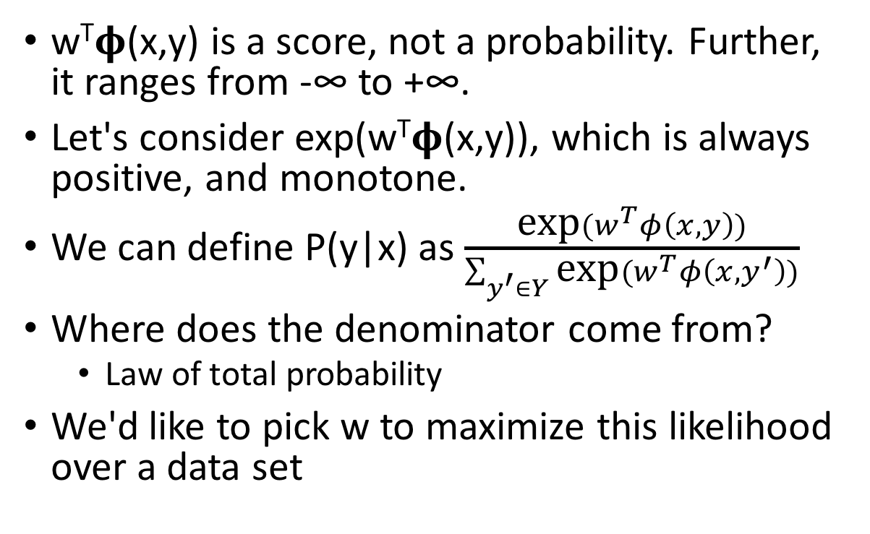
Making the score function probabilistic
w^{T}𝛟(x,y) is a score, not a probability. Further, it ranges from -∞ to +∞.
Let's consider exp(w^{T}𝛟(x,y)), which is always positive, and monotone.
We can define P(y|x) as $\frac{\text{exp}(w^{T}φ\left(x, y\right))}{\sum_{y^{′}∈Y}{\text{exp}(w^{T}φ\left(x, y^{′}\right))}}$
Where does the denominator come from?
Law of total probability
We'd like to pick w to maximize this likelihood over a data set
These slides based on notes of Jacob Eisenstein

Slide 82
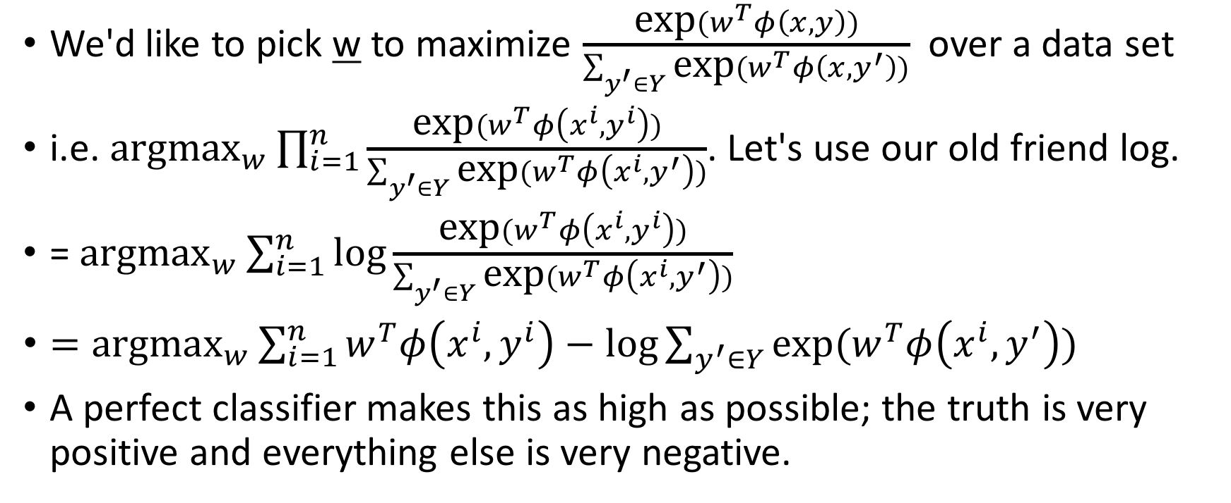
Maximizing Likelihood = Maximizing log likelihood
We'd like to pick w to maximize $\frac{\text{exp}(w^{T}φ\left(x, y\right))}{\sum_{y^{′}∈Y}{\text{exp}(w^{T}φ\left(x, y^{′}\right))}}$ over a data set
i.e. ${\text{argmax}}_{w}\prod_{i=1}^{n}{\frac{\text{exp}(w^{T}φ\left(x^{i}, y^{i}\right))}{\sum_{y^{′}∈Y}{\text{exp}(w^{T}φ\left(x^{i}, y^{′}\right))}}}$. Let's use our old friend log.
= ${\text{argmax}}_{w}\sum_{i=1}^{n}{\text{log}\frac{\text{exp}(w^{T}φ\left(x^{i}, y^{i}\right))}{\sum_{y^{′}∈Y}{\text{exp}(w^{T}φ\left(x^{i}, y^{′}\right))}}}$
$={\text{argmax}}_{w}\sum_{i=1}^{n}{w^{T}φ\left(x^{i}, y^{i}\right)−\text{log}\sum_{y^{′}∈Y}{\text{exp}(w^{T}φ\left(x^{i}, y^{′}\right))}}$
A perfect classifier makes this as high as possible; the truth is very positive and everything else is very negative.

Slide 83
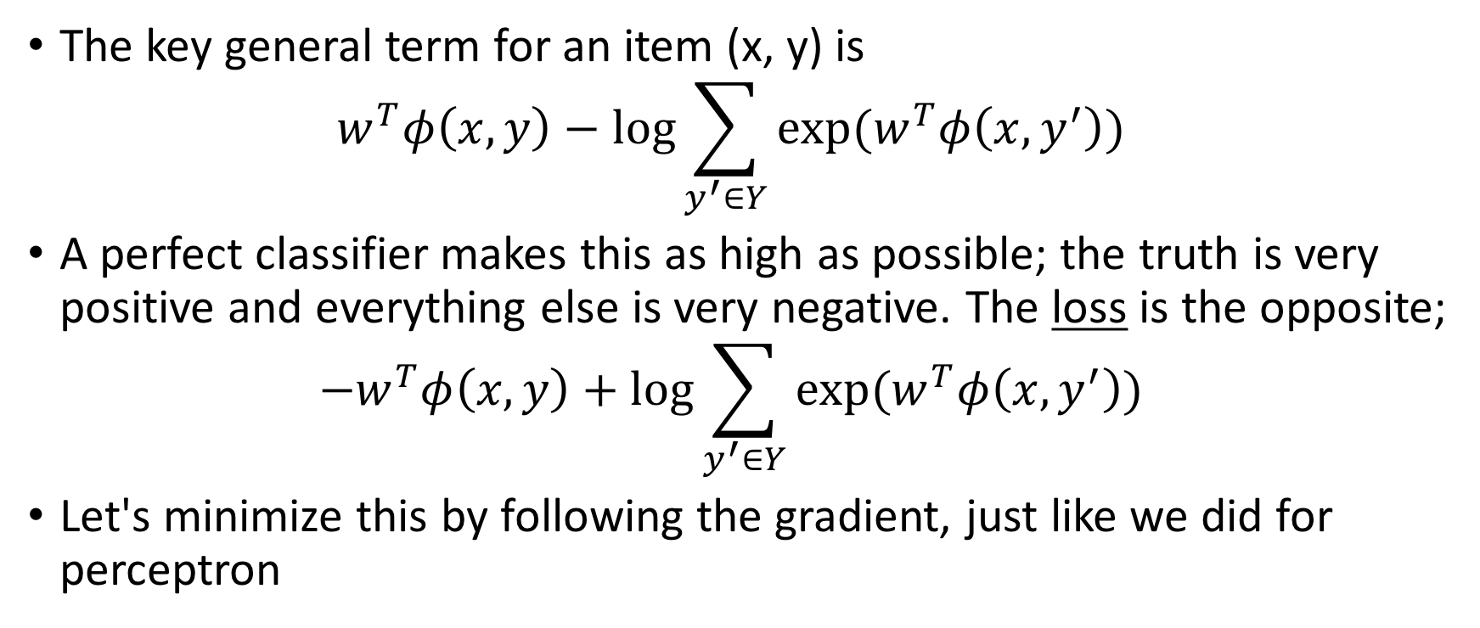
Maximizing Log Likelihood = Minimizing Log Loss
The key general term for an item (x, y) is $w^{T}φ\left(x, y\right)−\text{log}\sum_{y^{′}∈Y}{\text{exp}(w^{T}φ\left(x, y^{′}\right))}$
A perfect classifier makes this as high as possible; the truth is very positive and everything else is very negative. The loss is the opposite; ${−w}^{T}φ\left(x, y\right)+\text{log}\sum_{y^{′}∈Y}{\text{exp}(w^{T}φ\left(x, y^{′}\right))}$
Let's minimize this by following the gradient, just like we did for perceptron

Slide 84
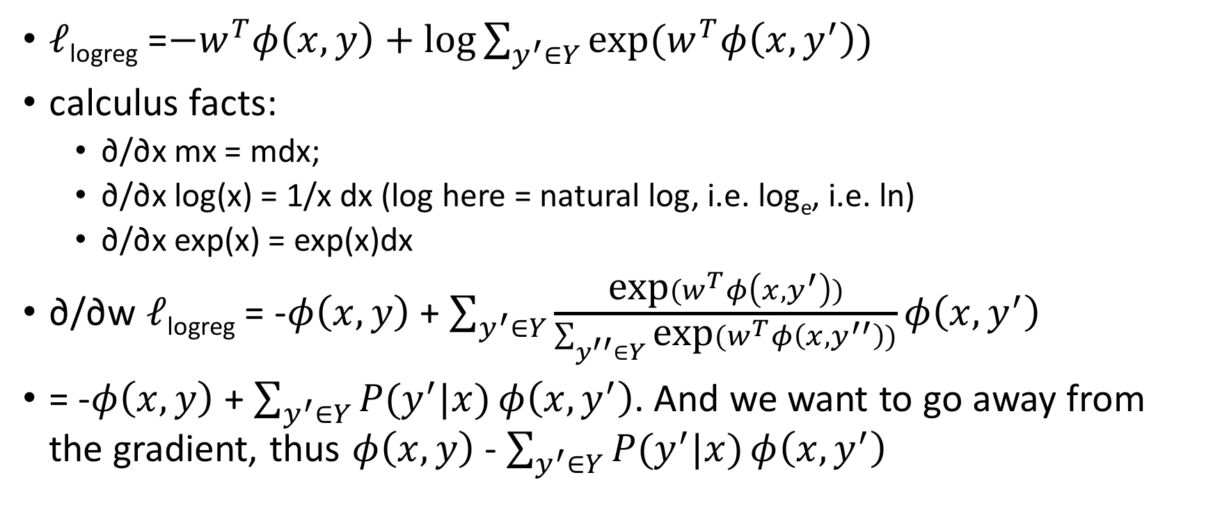
Loss Gradient for Logistic Regression (aka Maximum Entropy)
𝓁_{logreg} =${−w}^{T}φ\left(x, y\right)+\text{log}\sum_{y^{′}∈Y}{\text{exp}(w^{T}φ\left(x, y^{′}\right))}$
calculus facts:
∂/∂x mx = mdx;
∂/∂x log(x) = 1/x dx (log here = natural log, i.e. log_{e}, i.e. ln)
∂/∂x exp(x) = exp(x)dx
∂/∂w 𝓁_{logreg} = -$φ\left(x, y\right)$ + $\sum_{y^{′}∈Y}{\frac{\text{exp}(w^{T}φ\left(x, y^{′}\right))}{\sum_{y^{′′}∈Y}{\text{exp}(w^{T}φ\left(x, y^{′′}\right))}}}φ\left(x, y^{′}\right)$
= -$φ\left(x, y\right)$ + $\sum_{y^{′}∈Y}{P(y^{′}|x)}φ\left(x, y^{′}\right)$. And we want to go away from the gradient, thus $φ\left(x, y\right)$ - $\sum_{y^{′}∈Y}{P(y^{′}|x)}φ\left(x, y^{′}\right)$

Slide 85

Gradient Update of Logistic Regression vs Perceptron
Perceptron: w+=𝛟(x,y)-𝛟(x,y*); considers the single wrong decision, move away by constant amount
Logreg: $w+=φ\left(x, y\right)$ - $\sum_{y^{′}∈Y}{P(y^{′}|x)}φ\left(x, y^{′}\right)$; consider every alternative decision, move away by the model's confidence in that amount

Slide 86
Perceptron Vs. Logistic Regression
Perceptron
Logistic Regression
Discriminative model
Not probabilistic
Iterative solution
No independence assumption
Easy to write
Medium-fast to learn
Can overfit
Discriminative model
Probabilistic
Iterative solution
No independence assumption
Slow to write
Slow to learn
Foundation of deep learning optimization
Can overfit

Slide 87
Conclusions
We have seen how training data and supervised learning can produce a better classifier
Classifier takes an input (such as a text document) and predicts an output (such as a class label)
Learner takes training data and produces (statistics necessary for) the classifier

Slide 88
Conclusions
Because most pieces of text are unique, it's not very practical to assume the one being classified is in the training data
though it is in the library of Babel!
We need to make modeling assumptions that help the learner to generalize to unseen inputs
The Naive Bayes model and Bag of Words assumption are a simple, fast probabilistic approach to text classification
The Perceptron allows more arbitrary features at the cost of slower learning and a requirement of more data
Logistic Regression adds probabilities back into the arbitrary feature and weight capability of perceptron
Notes:
Logistic model: logit = log(p/(1-p) ) is linear combination of variables (features). Regression because there is some true prob and we're trying to find it exactly.

