Slide 1
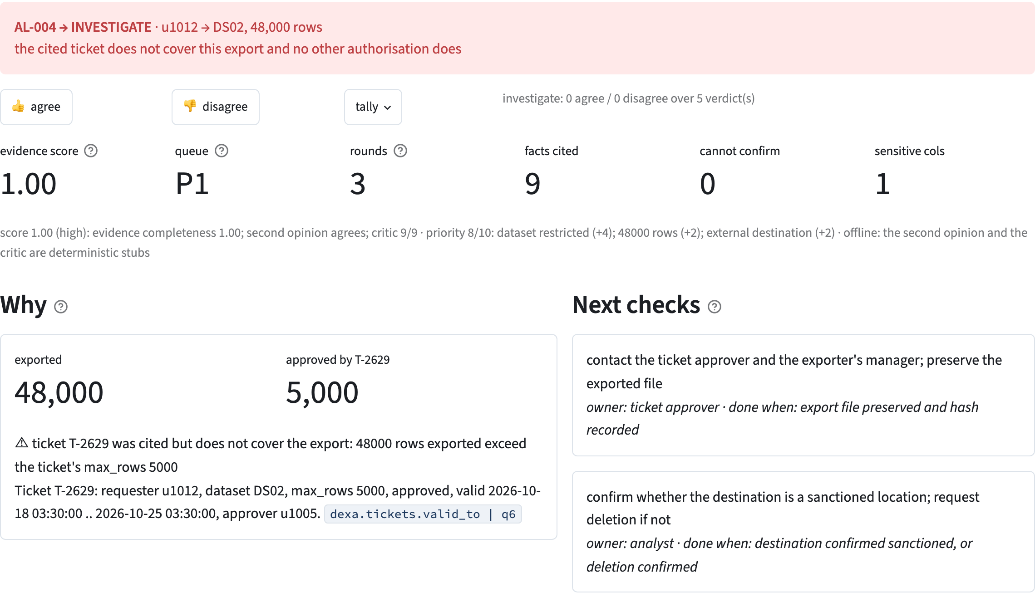
ExportWhy
Was this data export authorised?
The investigation, with its evidence.
≡
export log
§
access policy
✓
approval tickets
Verdict · cited evidence · conflicts · what could not be confirmed · next checks
Open Agent Hackathon 2026 · Track 2: The Agent That Can Explain Why
Notes:
Introduce the product through what the analyst receives: an investigation they can inspect and act on. No company name: the product is the name.

Slide 2
An approved ticket does not necessarily cover the export
03:30 · account u1012 · payment data · external bucket
48,000
5,000
×
×
vs
rows exported
rows approved by T-2629
Export log
Access policy
Approval tickets
what happened
what is allowed
what was approved
✓
The ticket is genuine and approved
!
It covers one tenth of what was exported
A
Finding that out means lining up three records that do not know about each other.
the analyst, for every alert, by hand
Synthetic demonstration scenario AL-004
Notes:
Authorisation requires matching the account, dataset, volume and validity window to the actual export. A ticket that exists and is approved is not, on its own, proof that it covers this export.

Slide 3
Built for the analyst deciding what happens next
THE ANALYST'S JOB
▦
Target customers
✓
Check authorisation
Security operations and data-protection teams with export alerts, access policies and ticketed approvals
Does the approval cover this account, dataset, volume and time?
?
Assess evidence
Is the export uncovered, or is evidence still missing?
A
Primary user
→
Choose the next action
Investigate further, collect evidence or request human review?
The analyst investigating DLP or insider-risk alerts. Closing the alert stays their call.
≡
Support later review
Can another person inspect the evidence behind the finding?
Notes:
ExportWhy supports the investigation. Closing the alert and taking action remain the analyst's responsibility. Analyst time saved, missed uncovered exports and willingness to pay are not measured yet; they are the pilot targets on slide 12, not results.

Slide 4
From investigation tasks to usable findings
CUSTOMER TASK
EXPORTWHY CAPABILITY
WHAT THE ANALYST RECEIVES
✓
Check approval scope
Compare account, dataset, volume, time, status
Matches and conflicts
↻
Continue when the ticket fails
Search other tickets and standing exceptions
A broader authorisation check
⌕
Inspect the reasoning
Table, column and query step on every evidence line
Traceable findings
?
Understand uncertainty
List gaps and evidence not retrieved
Next checks, with owners
⟲
Retain context and corrections
Cross-alert history, analyst feedback records
Memory for later investigations
Queries are column-scoped and every report records its access footprint · suggested owners are assigned by the analyst
Notes:
Each row is a job the analyst already does by hand. The capability column is what the agent does; the last column is what lands in front of the analyst.

Slide 5
The product: verdict, evidence, next action
1
1
Read the finding
verdict, reason, queue priority
2
Check the evidence
the conflict and the cited ticket line
2
3
3
Choose the next step
owner and done-when on each check
Base verdicts compliant · investigate · cannot-confirm
Unresolved disagreement needs-human
The evidence/review score is a heuristic, not a probability of correctness
Notes:
Follow the analyst's reading order: the Why panel says why the ticket does not cover the export, the ticket line under it carries the citation, Next checks says what to do and who. Do not tour the controls.

Slide 6
Existing products and our focus
Microsoft Purview
DLP Triage Agent
Mimecast Mihra
Investigation Agent
ExportWhy
Triages supported DLP alerts into Needs attention / Less urgent / Not categorized
Announced for Incydr (beta): triage, context, explanation of its reasoning, next-step recommendations
One question: does the authorisation cover this export? Logs, policy and tickets through Zetaris; cited findings, conflicts, gaps, access footprint
OUR DESIGN FOCUS
Field-level authorisation checks
Federated evidence retrieval
Constrained model review
✓
⋈
⊓
A comparison of documented capabilities and product focus, not a head-to-head evaluation · sources: Microsoft Learn (Purview DLP Triage Agent), Mimecast announcement
Notes:
None of the parts is new on its own; the combination, running as one investigation, is the point. Do not say nobody does this. The constrained-review choice is motivated by Alert-Bench (NeurIPS 2026 AIWILD workshop): in the agent configurations it benchmarked, a revision stage overturned more correct decisions than it repaired.

Slide 7
Architecture: business records become traceable findings
USED DURING THE INVESTIGATION
⟲
Meterless H-MEM
export logs
access policy
approval tickets
findings, provenance, analyst feedback
◷
Meterless World Model
Zetaris one SQL schema · cross-source joins
entities and their event history
◈
Nightshift → NVIDIA Nemotron
drafting, second opinion, review
INVESTIGATION ROLES
Planner
Retriever
Evaluator
Reporter
Critic
TECHNICAL STACK
Python
PostgreSQL ×3
Zetaris
Streamlit
CLI / HTTP
pytest
Docker
report · UI · trace of every query and model call
Live investigations run over three independent PostgreSQL sample databases · offline mode uses a SQLite twin and deterministic model stubs
Notes:
Business evidence enters through Zetaris first; then the verdict and the report are formed. Web information is not used to determine export authorisation.

Slide 8
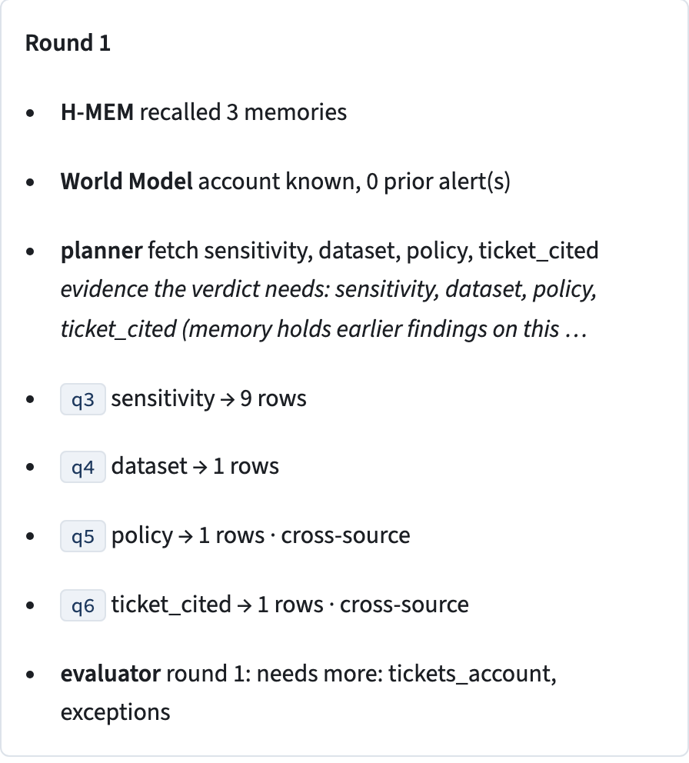
The evidence decides what to retrieve next
Identify alert
and account
Dataset, policy,
cited ticket
Scope mismatch
detected
Other tickets
and exceptions
History and
destination
Verdict, opinion,
review
Evaluator → Planner fetch what is still needed
Critic → Reporter revise, review again
CONTROL BOUNDARIES
§
Rules establish the base verdict
=
SQL drafts run only when identical to the vetted template
H
Unresolved model disagreement goes to human review
↩
Failed or unavailable review falls back to a deterministic summary
◷
3 rounds · 9 model calls · 480 s budget, checked before every call
the real AL-004 trace, round 1
Notes:
Show the combination working in one investigation: cross-source checks, evidence requests, constrained model review and traceable reporting. The rules check the authorisation conditions; the model gives a second opinion and helps write the explanation.

Slide 9
Zetaris: authorisation evidence across three systems
⊕
Three databases as JDBC data sources
one access point for the investigation
logs
policy
tickets
≡
One schema for logs, policy and tickets
a consistent query interface for every role
one schema dexa
⋈
Cross-source policy and cited-ticket joins
export events and authorisation records checked together
the agent writes SQL here, never a direct connection
#
Results returned per query
the agent numbers each step and cites it on the evidence line
13 / 13
Grounding pattern: facts from Zetaris first, then an answer that traces back to the evidence.
alerts on the federated backend, one saved trace each
Notes:
The customer value is checking facts that live apart, and following the query record back to the basis. This implements the organiser's grounding pattern: query Zetaris for the facts first, then produce an answer that can be traced back to the evidence.

Slide 10
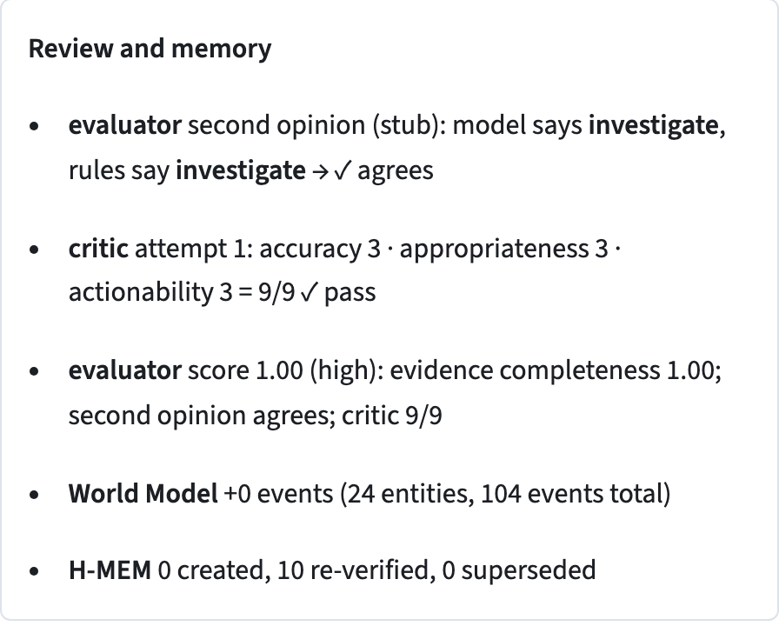
Meterless and Nemotron: context, corrections and review
⟲
Meterless H-MEM
◷
Meterless World Model
◈
Nightshift → NVIDIA Nemotron
Keeps findings, provenance and analyst corrections for later investigations
Connects the current alert to the account's earlier activity
Drafts SQL, gives an independent second opinion, drafts and reviews the summary
Shown: a fact marked wrong, its confidence change, the ledger entry
Shown: an earlier alert on the same account inside the current investigation
Shown: the AL-004 model-call records and the 6/9 → 9/9 revision
MODEL BOUNDARIES
✕
The model cannot turn a rules-based block into compliant
↩
A summary that fails review is replaced by a deterministic one
Recorded model ids: nvidia/nemotron-3-ultra-550b-a55b
nvidia/nemotron-3.5-super-vl-120b-a12b · nvidia/nemotron-3.5-lightning-30b-a3b
H-MEM and World Model are Python implementations of the specifications, checked with the conformance cases · every successful model call keeps its routed model and receipt
Notes:
Each component backs a feature the user can see: remembering history, keeping corrections, reviewing the explanation. Offline runs use a deterministic stub for the second opinion and the Critic, labelled (stub) in the report; the model's part is shown on the recorded live runs.

Slide 11
What we have validated
13 / 13
13 / 13
verdicts match on live Zetaris, stub model
with Nemotron drafting the SQL
156 / 156
231 s · 7 calls
twelve generated seeds, offline
AL-004 live run, Critic 6/9 → 9/9
FAILURE BEHAVIOUR IS VISIBLE
!
An unreachable critical source is reported, never guessed around
◷
A spent budget names the evidence it did not retrieve
about 96% fewer sensitive-column reads, identical verdicts
H
Unresolved model disagreement goes to human review
64 tests pass
Synthetic sources and policies, ten generated scenarios · production accuracy, analyst time saved and customer ROI are not measured yet · routing and latency vary
Notes:
The results establish behaviour within the tested scenarios; ground truth is generated with the data, so 156/156 measures consistency, not real-world detection. Customer impact is the next validation step.

Slide 12
Next: validate the workflow with a security team
Prototype today
Historical-case pilot
Workflow integration
✓
cross-source authorisation checks
›
connect real logs, identity, approvals
›
case creation and assignment
✓
cited findings and gaps
›
de-identified past investigations
›
evidence-pack write-back
✓
investigation memory, feedback
›
measure evidence quality and analyst effort
›
more alert families on the same loop
✓
failure fallbacks
PILOT INVITATION
choose one export-alert workflow and evaluate together
⌕
Can the evidence be found?
✓
Can the finding be checked?
→
Does the next step help the analyst?
ExportWhy authorisation decisions with evidence and visible gaps
Notes:
End on the one-liner. Phase two items are targets, not results: nothing in the pilot list is measured today.

