Slide 1
Project report on the Online Retail
By Kitwana Shebabetsi Ezechiel

Slide 2
Overview
This analysis is based on the online retail that operate in most countries of the globe. The dataset we’ve got is for only two years (2010 and 2011).

Slide 3
Data cleaning
in the ‘Quantity’ column that have values less than 1. (the remaining have to be greater than or equal to 1)
in the ‘UnitPrice’ column that have values less than 0. (all the remaining had to be either 0 or greater than 0)
add the ‘Revenue’ column to the dataset. This was necessary because most of the visuals are related to the ‘Revenue’.

Slide 4
Analysis: Overview
The whole visualizations were done using Power BI.
4 different questions for the visualizations:
Question1: The monthly total revenue in 2011
Question2: the top 10 countries by revenue and quantity (excludes United Kingdom)
Question3: The top 10 customers by revenue
Question4: Each country with their respective number of accumulated product items.

Slide 5
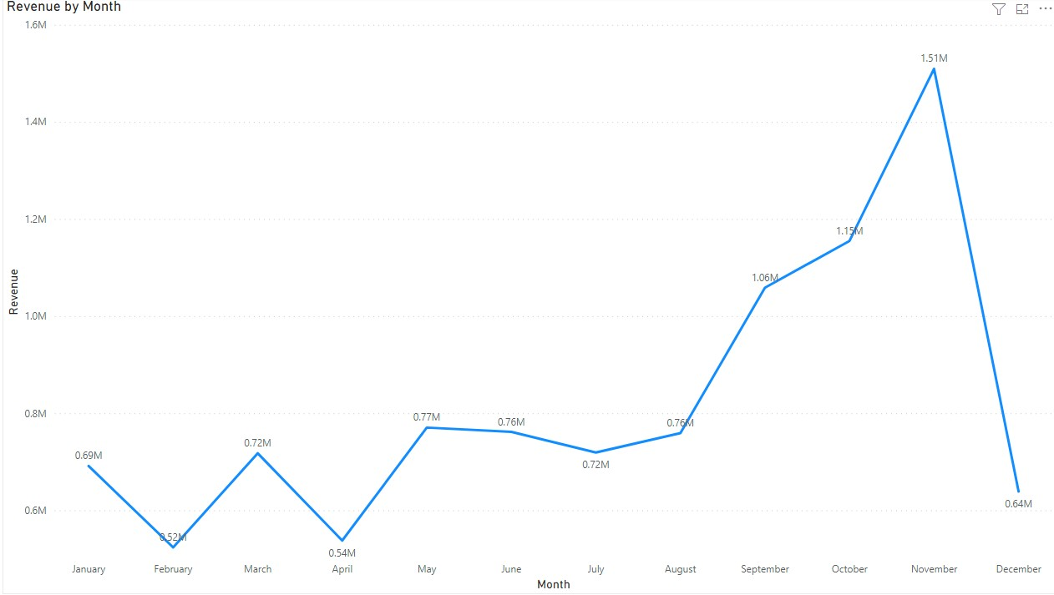
Analysis: Question1 Statement: The monthly total revenue in 2011
Insights:
The month that generated the biggest revenue in 2011 is November with a total of $1.51M
The revenue constantly started increasing from August till November, but we can also see that after November, the revenue dramatically when down to $0.64M in December.
The month that generated the lead revenue is February, with a total sale of $0.54M.

Slide 6
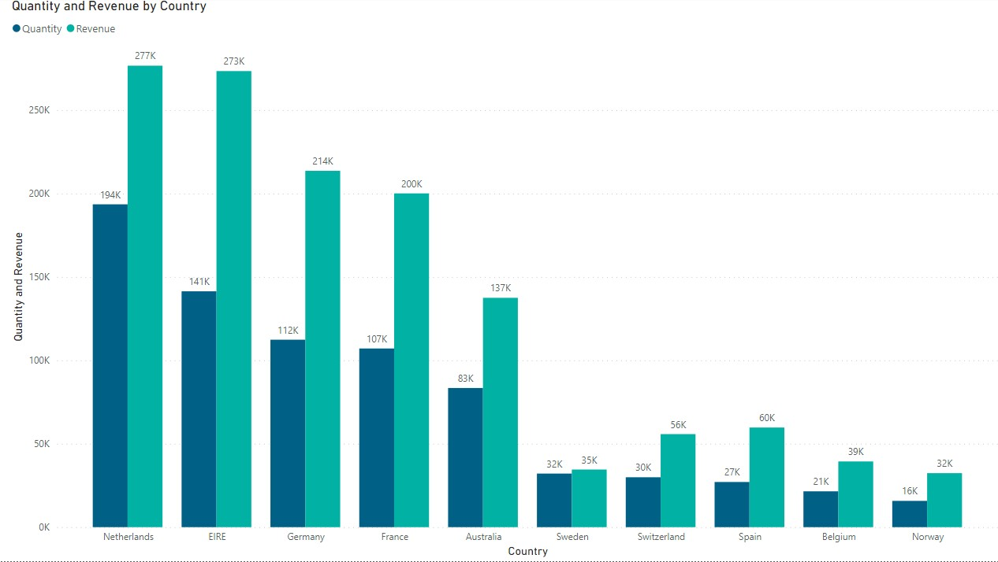
Analysis: Question2 Statement: : the top 10 countries by revenue and quantity (excludes United Kingdom)
Insights:
The first country with the biggest revenue and quantity is Netherlands with over $277K for the revenue and accumulated quantity of over 194 items.
The last country in the top 10 counties had almost 16k accumulated items and the revenue of over $32k (Norway)

Slide 7
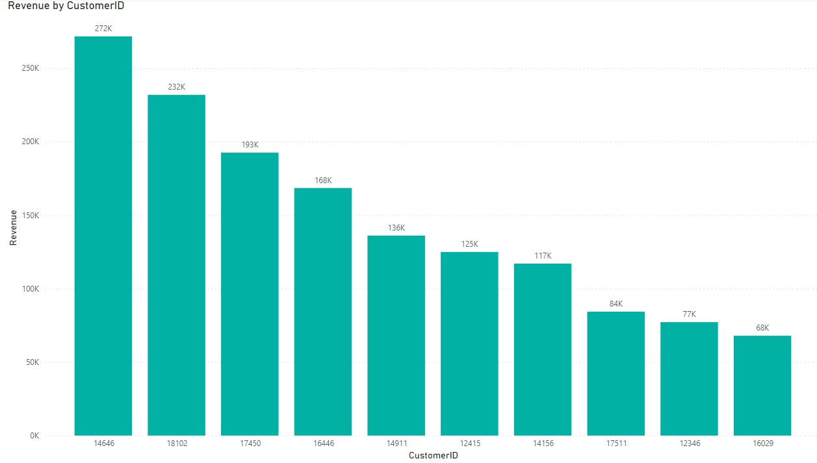
Analysis: Question3 Statement: The top 10 customers by revenue
Insights:
The customer that made the company the biggest revenue of almost $272K has the ID (146464). Followed by the one from whom the company made $232K of revenue.
The last in the top 10 customers had the company made nearly $68K of revenue.

Slide 8
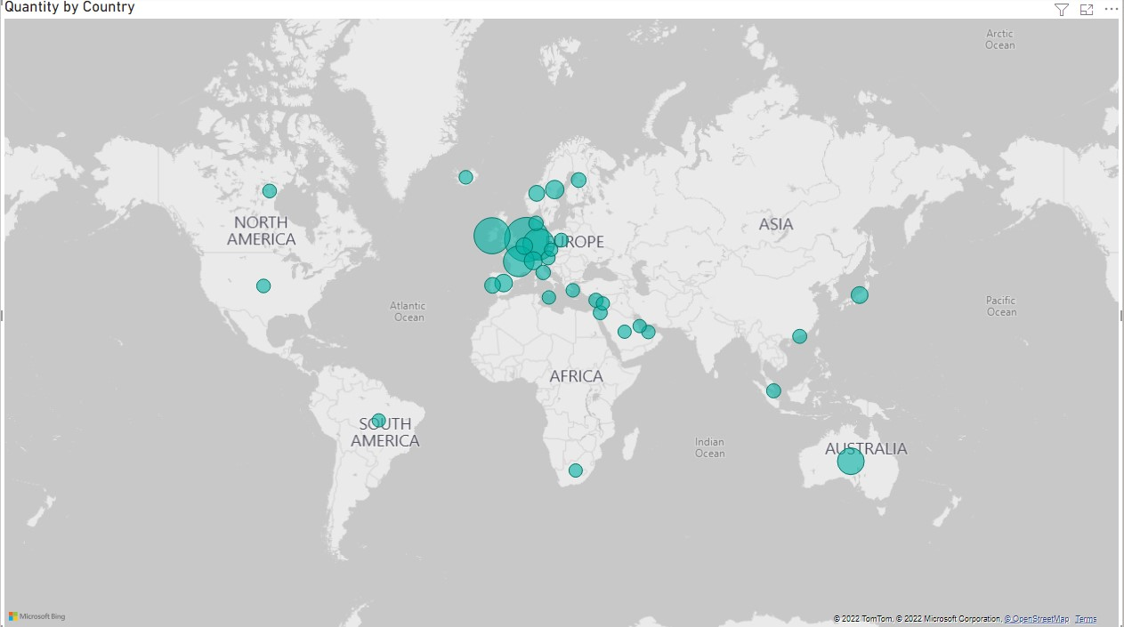
Analysis: Question4 Statement: Each country with their respective number of accumulated product items
Insights:
As we saw in the clustered bar chart, the country with the most accumulated product is Netherlands followed by EIRE then France then Germany respectively.
Based on the map representation, we can see that most countries that by the products are from Europe.

Slide 9
Limitation: Missing attributes
The customers are not represented by names (or company’s name)
There is no latitude and longitude in the country attribute in order to easily precise the location of each country on the map.

Slide 10
Analysis: Conclusion and recommendation
The company should target the month of August to November, that’s the season were there’s the most sales.
The biggest consideration of countries is in Europe, because it generated the most number of product sold.

Slide 11
Thank you!
Any Question, please ?

