Slide 1
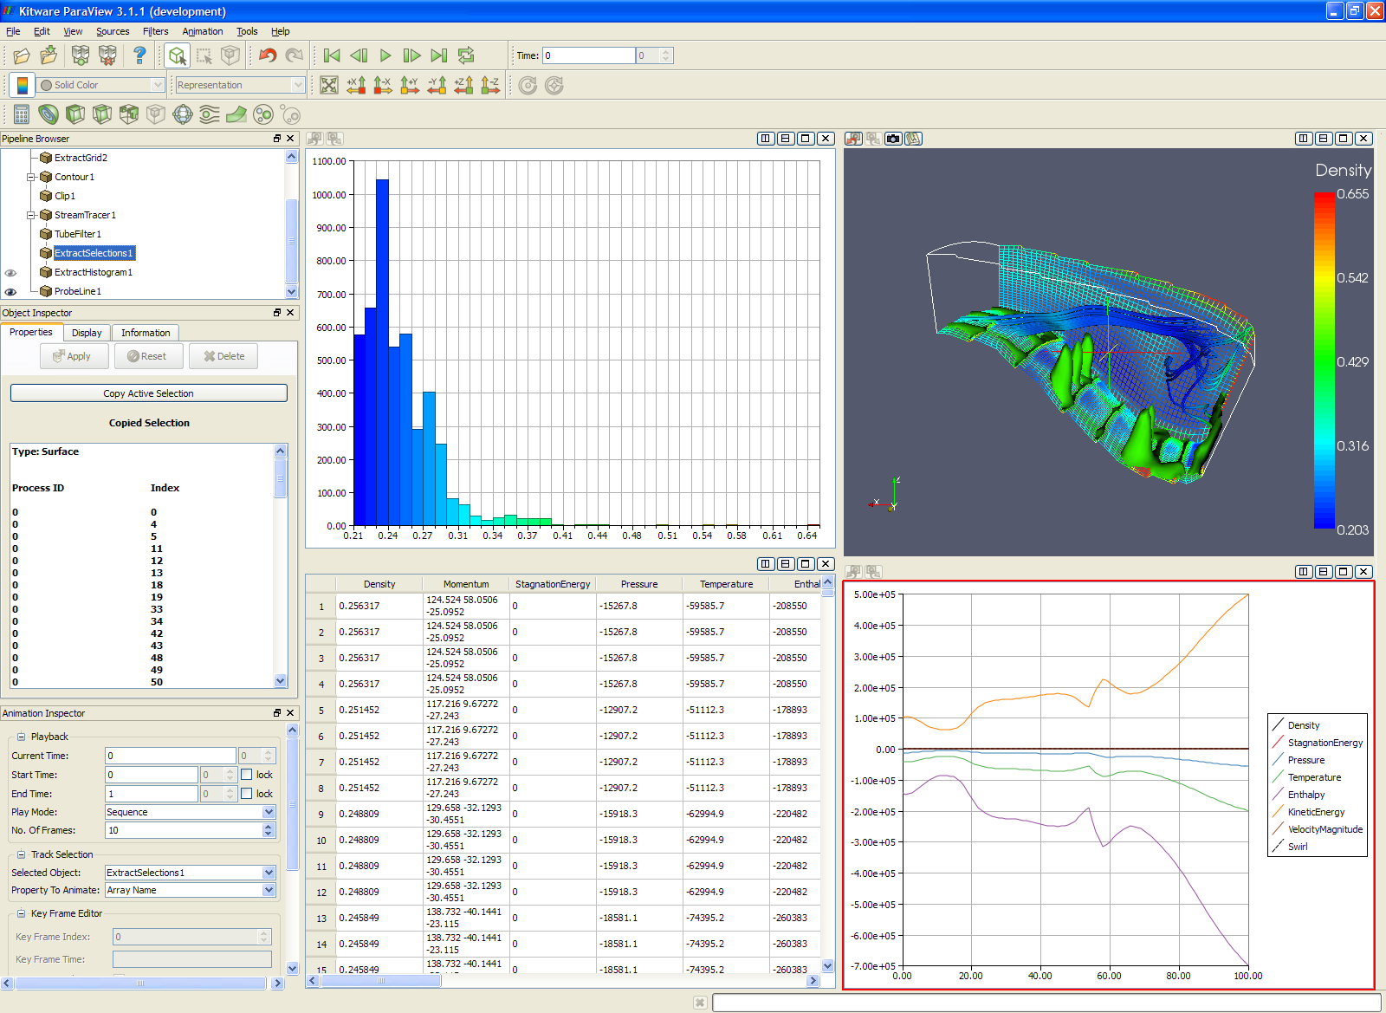
Filters Menu
Sources Menu
Animation Toolbar
Bar Chart View
View Configuration Buttons
Load/Save Data Buttons
Common Filters Toolbar
Pipeline Browser
3D View
Object Inspector
Animation Inspector
Spreadsheet View
XY Plot View

