Slide 1
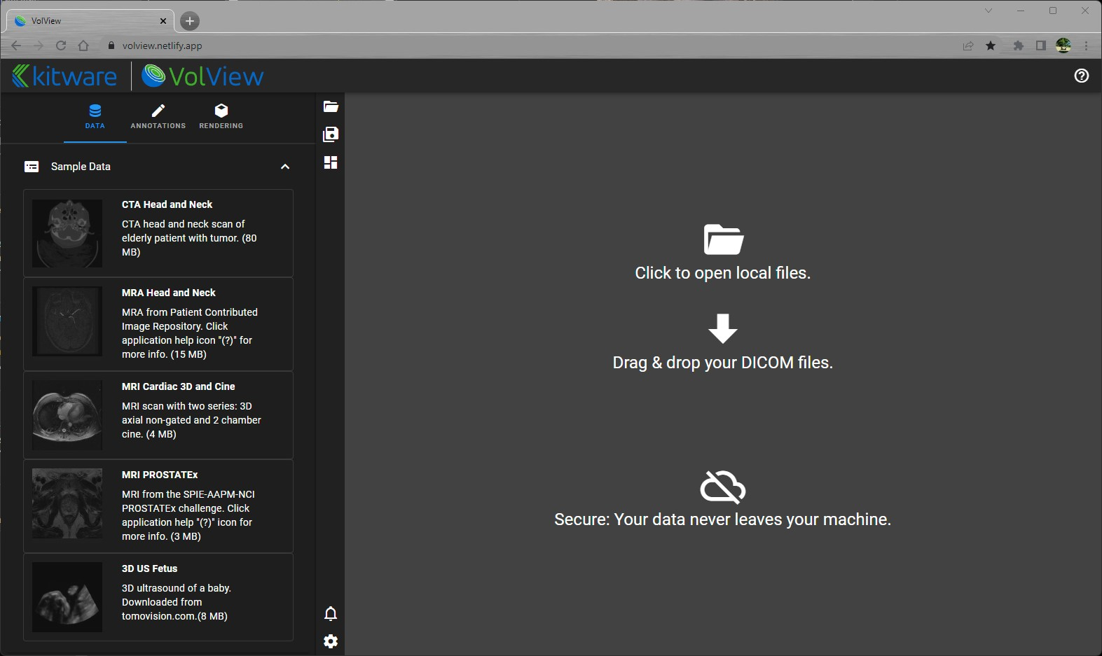
Tabs
Load / Save State
Central Window
Sample Data
Notifications and Settings

Slide 2
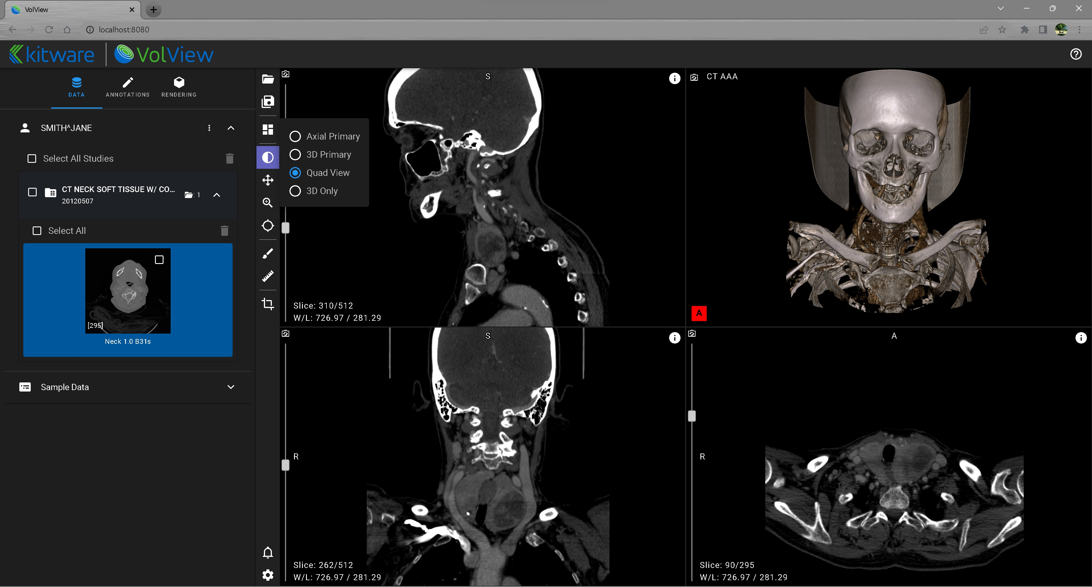
Layout

Slide 3
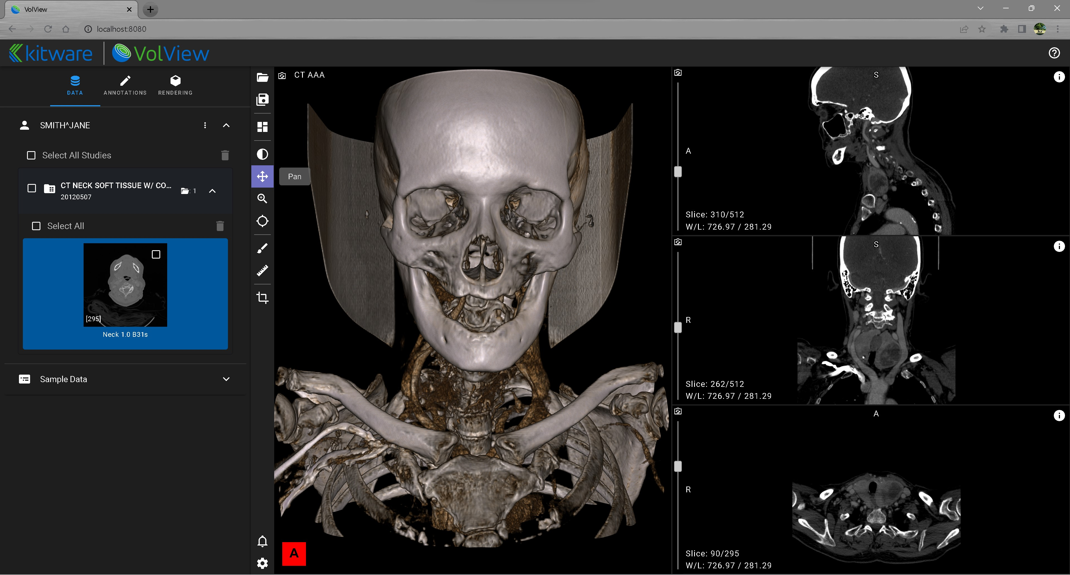
Window/Level
Pan
Zoom
Crosshairs

Slide 4
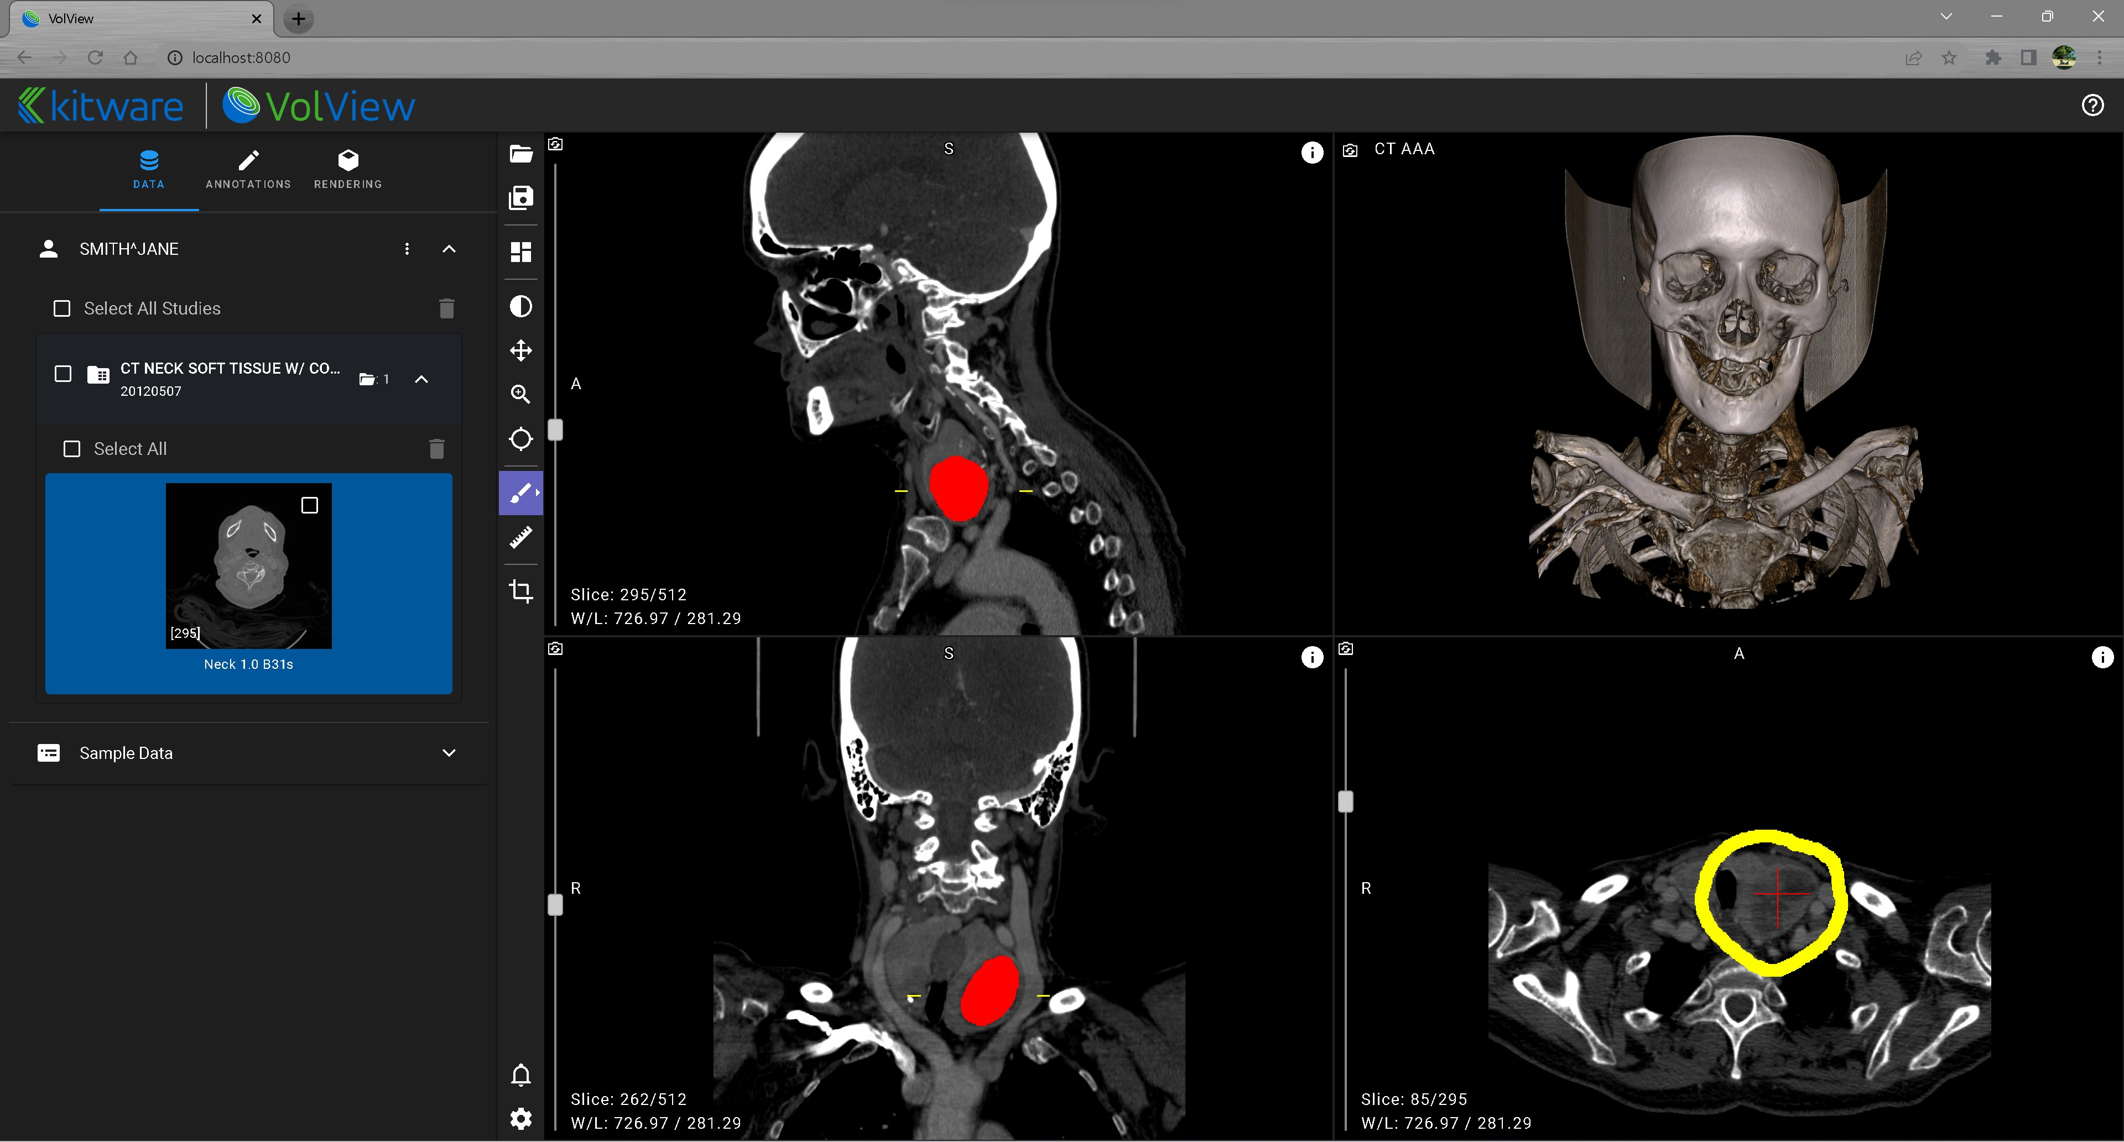
Paint
Ruler

Slide 5
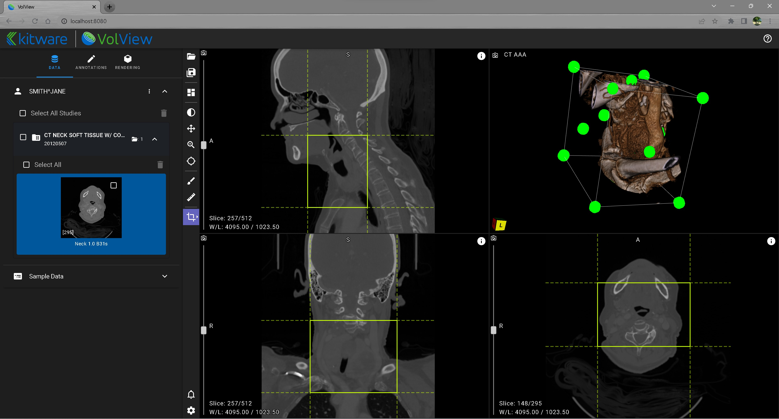
Crop

Slide 6
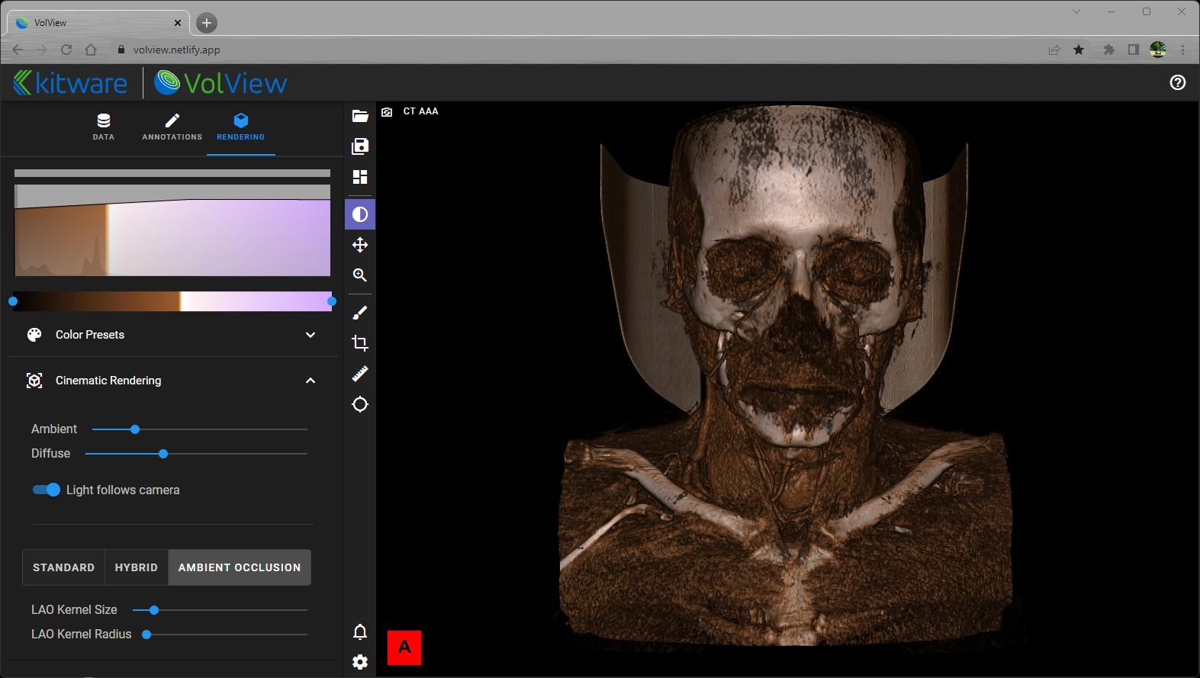
Click and drag left mouse button right/left in this area to change tissue opacity.
Histogram, Opacity, Color

Slide 7
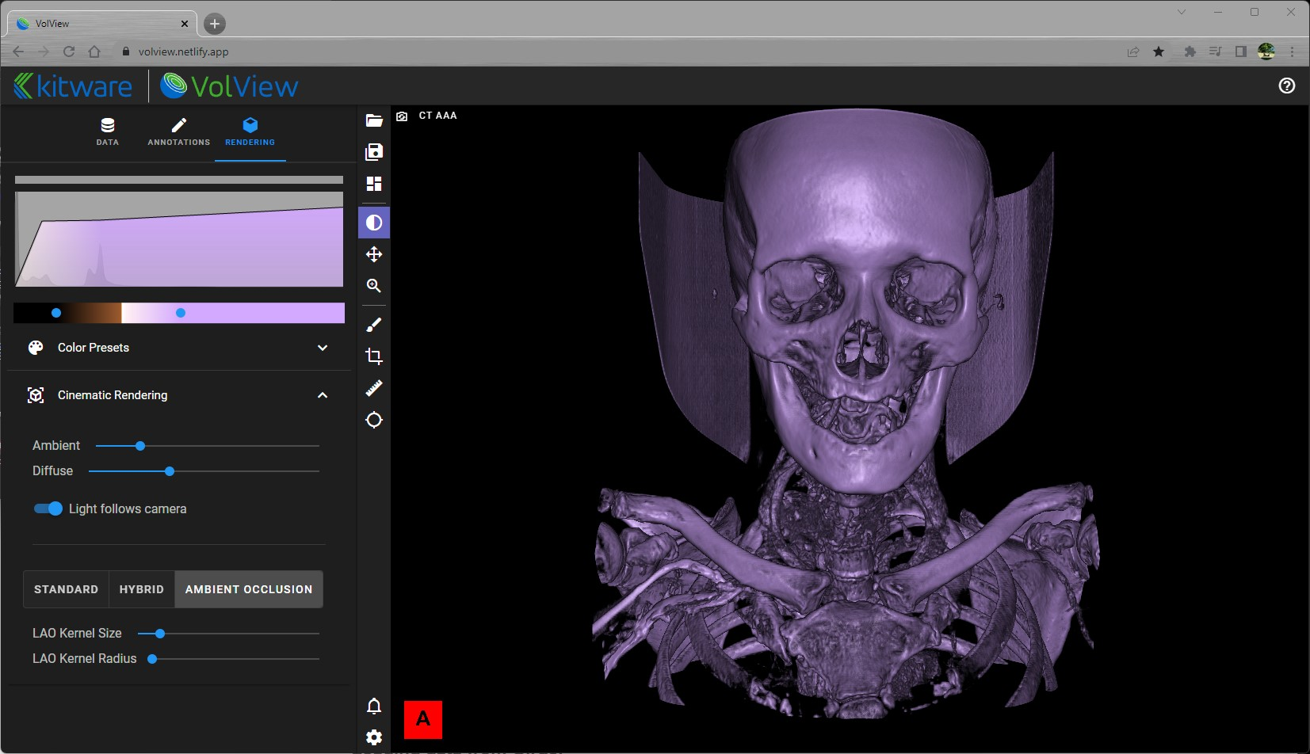
Color range
Adjust blue markers to change the range of the colors assigned to tissues.

