Slide 1
VTKm at Scale: Experiences from a Recent In Situ Research Project
Presenter: Dave Pugmire
24 April 2019
2019 DOE Computer Graphics Forum
Pacific Grove, CA

Slide 2

Based on ISC 2019 Paper:

Slide 3
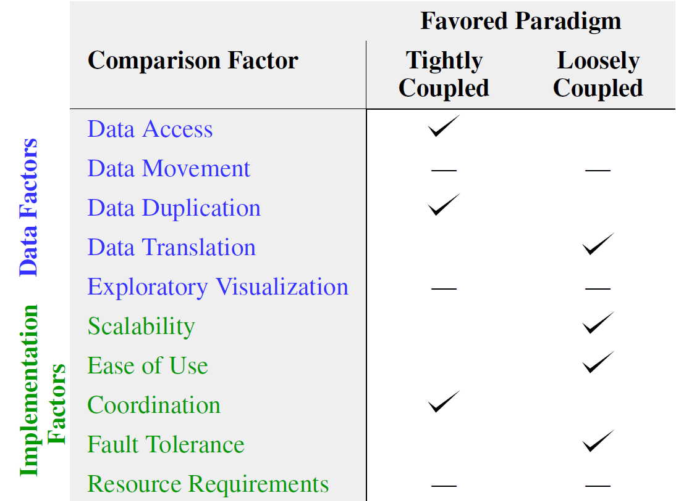
ISAV15 Position Paper: In Situ Comparison Factors
In-line
In-transit
Notes:
At ISAV15 my co authors and I developed a set of ten comparison factors for comparing tight vs loose in situ. We asserted that some factors would more favor tight coupling while others would favor loose coupling.
The winners that we chose for each of these categories was met with extreme skepticism from the attendees, specifically where in-transit was winning in scalability. Due to this contention, we decided that this would be a great topic to take on for my dissertation.

Slide 4
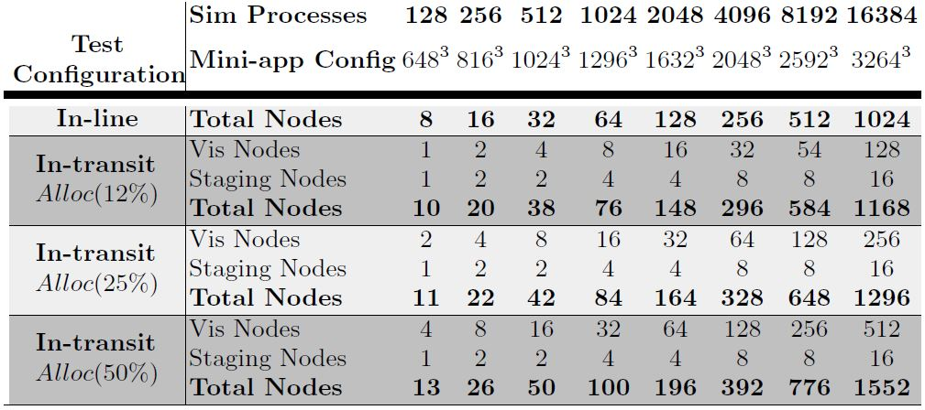
Workflow Configurations
Largest Case:
16,384 Simulation Processes
34,359,738,368 Total Cells
Notes:
Tests were performed on Titan, using CPU only, due to miniapp only using CPU.
Weak scaling study: 128^3 cells per process

Slide 5
Total Workflow Times (100 Sim Steps)
Notes:
- Baseline sim only is at the bottom
- In-line :: sim stalls until visualization is complete
- In-transit :: sim is stalled while data are transferred (and while waiting for previous vis to finish)
- Delay(0) – alloc(50) is required to keep up with simulation
- Delay(20) – all in-transit are nearly equal, so even fewer resources could be `used while keeping up
Delay 20 is like doing every 5 steps

Slide 6

Total Simulation Cost
$$Cost=TotalTime x TotalNodes$$

Slide 7
ISAV15 Position Paper: In Situ Comparison Factors
In-line
In-transit
_{Cost}
Notes:
Coming back to our comparison factors, what we have seen in this study, is that there are a lot of places where both paradigms are about equal…

Slide 8
Summary
In-line Visualization
VTK-m filter | Run by | Nodes | Machine | When
Recenter | Kress | 1024 | Titan | Fall 2018
Isocontour | Kress | 1024 | Titan | Fall 2018
Render | Kress | 1024 | Titan | Fall 2018
In-transit Visualization
VTK-m filter | Run by | Nodes | Machine | When
Recenter | Kress | 128-512 | Titan | Fall 2018
Isocontour | Kress | 128-512 | Titan | Fall 2018
Render | Kress | 128-512 | Titan | Fall 2018

