Slide 1
VTK-m Overview
VTK-m Code Sprint
September 1-2, 2015
Kenneth Moreland
Sandia National Laboratories

Slide 2


Acknowledgements
This material is based upon work supported by the U.S. Department of Energy, Office of Science, Office of Advanced Scientific Computing Research, under Award Numbers 10-014707, 12-015215, and 14-017566.

Slide 3
VTK-m Combining Dax, PISTON, EAVL

Slide 4
Motivation

Slide 5
Supercomputers!
A clear trend in supercomputing is ever increasing parallelism
Clock increases are long gone
“The Free Lunch Is Over” (Herb Sutter)
 | Jaguar – XT5 | Titan – XK7 | Exascale*
Cores | 224,256 | 299,008 and 18,688 gpu | 1 billion
Concurrency | 224,256 way | 70 – 500 million way | 10 – 100 billion way
Memory | 300 Terabytes | 700 Terabytes | 128 Petabytes
*Source: Scientific Discovery at the Exascale, Ahern, Shoshani, Ma, et al.

Slide 6
“Everybody who learns concurrency thinks they understand it, ends up finding mysterious races they thought weren’t possible, and discovers that they didn’t actually understand it yet after all.” Herb Sutter
Notes:
VTK-m goals all work together to help reduce the amount of concurrency developers need to handle. Reduce worrying about

Slide 7
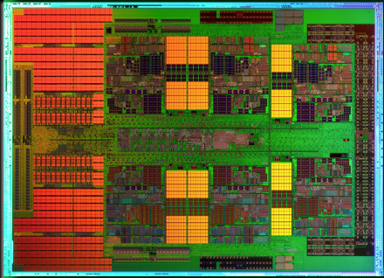
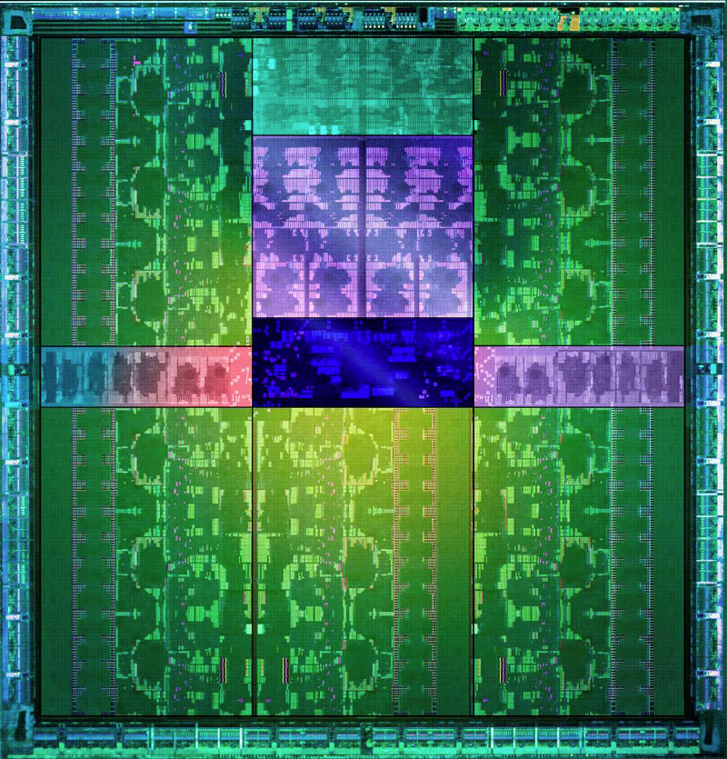
1mm
AMD x86
Full x86 Core
+ Associated Cache
6 cores per die
MPI-Only feasible
1 x86
core
1 Kepler
“core”
NVIDIA GPU
2,880 cores collected in 15 SMX
Shared PC, Cache, Mem Fetches
Reduced control logic
MPI-Only not feasible
Notes:
Why do future architectures pose a problem? After all, we’ve claimed scalable visualization for years.
Becomes somewhat clear when looking at the processor dies.
The x86 core is a complicated device featuring 30 years of components to make your code run faster
An accelerator core, in contrast, is significantly stripped down. In the GPU, really just some arithmetic units
You cannot treat them like a symmetric multiprocessor. They are more like SIMD (but not quite as restrictive).
Running on accelerators is not simply “scaling up” your code
AMD Magny-Cours. Half of 12 core shown.
NVIDIA Kepler GK110. 15 SMX streaming multiprocessor extreme, 192 cores per SMX. 2,880 total cores.

Slide 8
The Main Use Cases for VTK-m
Use
I heard VTK-m has an isosurface filter. I want to use it in my software
Develop
I want to make a new filter that computes fields in the same way as my simulation that works well on multicore devices
Research
I have a new idea for a way to do visualization on multicore devices

Slide 9
Getting Started

Slide 10
Prerequisites
Always required:
git
CMake (2.10 or newer)
Boost 1.48.0 (or newer)
Linux, Mac OS X, or MSVC
For CUDA backend:
CUDA Toolkit 7+
Thrust (comes with CUDA)
For Intel Threading Building Blocks backend:
TBB library

Slide 11
Getting VTK-m
http://m.vtk.org → Building VTK-m
Clone from the git repository
https://gitlab.kitware.com/vtk/vtk-m.git
git clone http://gitlab.kitware.com/vtk/vtk-m.git
mkdir vtk-m-build
cd vtk-m-build
ccmake ../vtk-m
make
ctest

Slide 12
Configuring VTK-m
http://m.vtk.org → Building VTK-m
Create a build directory
Run ccmake (or cmake-gui) pointing back to source directory
git clone http://gitlab.kitware.com/vtk/vtk-m.git
mkdir vtk-m-build
cd vtk-m-build
ccmake ../vtk-m

Slide 13
Important Configuration Parameters
Variable | Description
VTKm_ENABLE_CUDA | Enable CUDA backend. Requires CUDA Toolkit.
VTKm_ENABLE_OPENMP | Enable OpenMP backend. Requires OpenMP compiler support (not Clang). (Coming soon.)
VTKm_ENABLE_TBB | Enable Intel Threading Building Blocks backend. Requires the TBB library.
VTKm_ENABLE_TESTING | Turn on header, unit, and benchmark tests.
VTKm_ENABLE_BENCHMARKS | Turn on additional timing tests.
VTKm_USE_64BIT_IDS | Enable 64bit index support. Older CUDA cards might not support 64 bit integers.
VTKm_USE_DOUBLE_PRECISION | Precision to use in floating point numbers when no other precision can be inferred. Older CUDA cards might not support 64 bit floats.
CMAKE_BUILD_TYPE | Debug, RelWithDebInfo, or Release
CMAKE_INSTALL_PREFIX | Location to install headers

Slide 14
Building VTK-m
http://m.vtk.org → Building VTK-m
Run make (or use your favorite IDE)
Run tests (“make test” or “ctest”)
Parallel builds (-j flag) work, too
Good idea to use them as building VTK-m can take a while
git clone http://gitlab.kitware.com/vtk/vtk-m.git
mkdir vtk-m-build
cd vtk-m-build
ccmake ../vtk-m
make
ctest

Slide 15
More Information
We know, documentation is sparse
http://m.vtk.org
A user’s guide is on its way. We are also working on a textbook.
Doxygen: http://m.vtk.org/documentation/

Slide 16
System Overview

Slide 17
VTK-m Framework
Control Environment
Execution Environment
vtkm::cont
vtkm::exec
Notes:
The VTK-m framework is divided into two distinct environments each with their own API.
The control environment a serial environment that is used to establish data and set up parallel jobs.
This is the interface used to connect VTK-m to applications and other code.
The API for the control environment is located in the namespace vtkm::cont.
The execution environment is the parallel environment where the actual data processing is done.
Internally, the control environment spawns parallel jobs in the execution environment.
The API for the execution environment is located in the namespace vtkm::exec.
These two environments mirror the typical hardware configuration of general purpose CPU and accelerator coprocessor.
But also work fine when both are integrated.

Slide 18
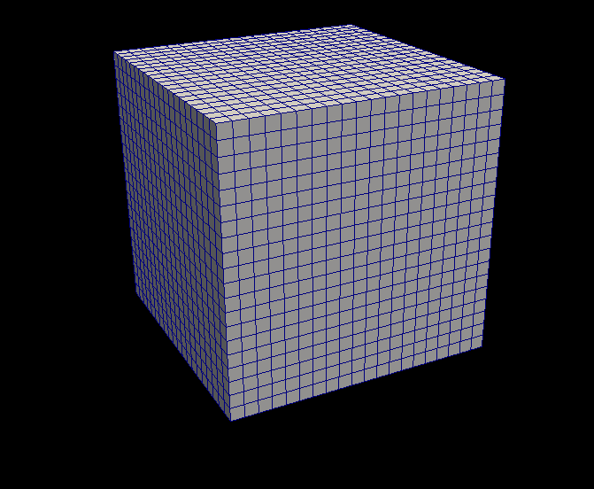
VTK-m Framework
Control Environment
Data Set
Array Handle
Invoke
Execution Environment
vtkm::cont
vtkm::exec
Notes:
When processing data in VTK-m, you first establish the data topology through the control environment.
This is done through very basic grid topology structures and adaptable array handles.

Slide 19
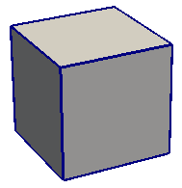
VTK-m Framework
Control Environment
Data Set
Array Handle
Invoke
Execution Environment
Cell Operations
Field Operations
Basic Math
Make Cells
Worklet
vtkm::cont
vtkm::exec
Notes:
Then from the control environment you can invoke an algorithm on your data.
Internally, this will decompose the data into constitute pieces, transfer data as necessary, and invoke a parallel algorithm.
Algorithms in the execution environment are built using worklets.
Worklets are serial functors that operate on one constituent element.
The execution API provides the basic operations for cells, interpolations, derivatives, and other math.
Worklets come in different types with different abilities.

Slide 20
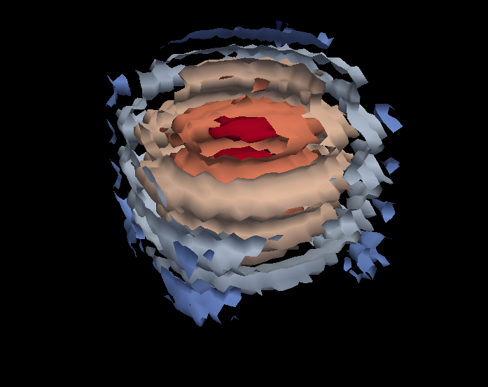
VTK-m Framework
Control Environment
Data Set
Array Handle
Invoke
Execution Environment
Cell Operations
Field Operations
Basic Math
Make Cells
Worklet
vtkm::cont
vtkm::exec
Notes:
And eventually the results are passed back to the control environment.

Slide 21
VTK-m Framework
Control Environment
Data Set
Array Handle
Invoke
Execution Environment
Cell Operations
Field Operations
Basic Math
Make Cells
Device Adapter
Allocate
Transfer
Schedule
Sort
…
Worklet
vtkm::cont
vtkm::exec
Notes:
These two environments, particularly the execution environment, are meant to work on a variety of architectures.
To manage this portability, we have a unit called a device adapter that sits between these two environments.
The device adapter provides the basic memory management, scheduling, and algorithms needed to run on a parallel device.

Slide 22
Device Adapter Contents
Tag (struct DeviceAdapterFoo { };)
Execution Array Manager
Schedule
Scan
Sort
Other Support algorithms
Stream compact, copy, parallel find, unique
Control Environment
Execution Environment
Transfer
Schedule
worklet
worklet
worklet
functor
worklet
worklet
worklet
worklet
functor
Compute
8
3
5
5
3
6
0
7
4
0
8
11
16
21
24
30
30
37
41
41
8
3
5
5
3
6
0
7
4
0
Compute
0
0
3
3
4
5
5
6
7
8

Slide 23
Defining Data

Slide 24
Basic Data Types
vtkm::Float32, vtkm::Float64, vtkm::FloatDouble
Portable typedefs for floating point types
VTK-m code should use these over float, double
vtkm::Int64, vtkm::UInt64, vtkm::Int32, vtkm::UInt32, vtkm::Int16, vtkm::UInt16, vtkm::Int8, vtkm::UInt8
Likewise typedefs for integer types
vtkm::Id, vtkm::IdComponent
Special integer used throughout VTK-m for indexing
Width specified by CMAKE_USE_64BIT_IDS variable
vtkm::Vec<type,size>
Short array of static type and length

Slide 25
Array Handle
Array Handle
x₀
y₀
z₀
x₁
y₁
z₁
x₂
y₂
z₂

Slide 26
Array Handle Storage
Array Handle
Array of Structs Storage
x₀
y₀
z₀
x₁
y₁
z₁
x₂
y₂
z₂
x₀
y₀
z₀
x₁
y₁
z₁
x₂
y₂
z₂

Slide 27
Array Handle Storage
Array Handle
Array of Structs Storage
x₀
y₀
z₀
x₁
y₁
z₁
x₂
y₂
z₂
x₀
y₀
z₀
x₁
y₁
z₁
x₂
y₂
z₂
Array Handle
x₀
x₁
x₂
Struct of Arrays Storage
y₀
y₁
y₂
x₀
y₀
z₀
x₁
y₁
z₁
x₂
y₂
z₂
z₀
z₁
z₂

Slide 28
Array Handle Storage
Array Handle
Array of Structs Storage
x₀
y₀
z₀
x₁
y₁
z₁
x₂
y₂
z₂
x₀
y₀
z₀
x₁
y₁
z₁
x₂
y₂
z₂
Array Handle
x₀
x₁
x₂
Struct of Arrays Storage
y₀
y₁
y₂
x₀
y₀
z₀
x₁
y₁
z₁
x₂
y₂
z₂
z₀
z₁
z₂
Array Handle
vtkCellArray Storage
v₀
v₁
v₂
v₃
v₄
v₅
v₆
v₇
v₈
3
v₀
v₁
v₂
3
v₃
v₄
v₅
3
v₆
v₇
v₈

Slide 29
Fancy Array Handles
Array Handle
Constant Storage
c
c
c
c
c
c
c
c
c
c
Array Handle
Uniform Point Coord Storage
f(i,j,k) = [o_{x} + s_{x} i, o_{y} + s_{y} j, o_{z} + s_{z} k]
x₀
y₀
z₀
x₁
y₁
z₁
x₂
y₂
z₂
Array Handle
8
5
5
0
5
2
0
3
5
Array Handle
Permutation Storage
x₈
x₅
x₅
x₀
x₅
x₂
x₀
x₃
x₅
Array Handle
x₀
x₁
x₂
x₃
x₄
x₅
x₆
x₇
x₈

Slide 30
Array Handle Resource Management
Control Environment
Array Handle
Contains
Storage
Uses

Slide 31
Array Handle Resource Management
Control Environment
Execution Environment
Transfer
Array Handle
Contains
Storage
Implements
Device Adapter
Uses

Slide 32
Array Handle Resource Management
Control Environment
Execution Environment
f(x)
Transfer
f(x)
Array Handle
Contains
Storage
Implements
Device Adapter
Uses

Slide 33
ArrayHandle
vtkm::cont::ArrayHandle<type> manages an “array” of data
Acts like a reference-counted smart pointer to an array
Manages transfer of data between control and execution
Can allocate data for output
Relevant methods
GetNumberOfValues()
GetPortalConstControl()
ReleaseResources(), ReleaseResourcesExecution()
Functions to create an ArrayHandle
vtkm::cont::make_ArrayHandle(const T*array,vtkm::Id size)
vtkm::cont::make_ArrayHandle(const std::vector<T>&vector)
Both of these do a shallow (reference) copy.
Do not let the original array be deleted or vector to go out of scope!

Slide 34
Fancy Array Handles
ArrayHandleCompositeVector: Zips components of source arrays to compose vector values
ArrayHandleConstant: An array with a single constant value
ArrayHandleCounting: An array that starts at an index and counts up
ArrayHandleImplicit: Each entry of the array is the value returned from the provided functor
ArrayHandlePermutation: Rearranges the entries in one ArrayHandle by the indices of another ArrayHandle
ArrayHandleTransform: Modifies the values of one ArrayHandle by feeding them through a provided functor
ArrayHandleUniformPointCoordinates: Defines the point coordinates from a uniform rectilinear grid
ArrayHandleZip: An array of Pair with values coming from two provided arrays

Slide 35
Other Important ArrayHandle Features We’re Skipping
Storage template parameter
Selects array layout for zero-copy semantics
Supports implicit and derived arrays (all those fancy array handles)
Generic array interface for data through an ArrayPortal
In principle like an STL iterator, but simpler
Type of object returned from GetPortalConstControl
Can exist in execution environment (depends on definition)

Slide 36
DynamicArrayHandle
DynamicArrayHandle is a magic untyped reference to an ArrayHandle
Statically holds a list of potential types and storages the contained array might have
Can be changed with ResetTypeList and ResetStorageList
Changing these lists requires creating a new object
Parts of VTK-m will automatically staticly cast a DynamicArrayHandle as necessary
Requires the actual type to be in the list of potential types

Slide 37
Data Model
vtkm::cont::CellSet
vtkm::cont::DataSet
*
vtkm::cont::Field
*
vtkm::cont::CoordinateSystem
*

Slide 38
A DataSet Has
1 or more CellSet
Defines the connectivity of the cells
Examples include a regular grid of cells or explicit connection indices
0 or more Field
Holds an ArrayHandle containing field values
Field also has metadata such as the name, the topology association (point, cell, face, etc), and which cell set the field is attached to
0 or more CoordinateSystem
Really just a Field with a special meaning
Contains helpful features specific to common coordinate systems

Slide 39
Structured Cell Set
k
j
i
Notes:
Points and cells can be index with either multidimensional or flat indices
Can be 1, 2, or 3 dimensions

Slide 40
Structured Cell Set
Cell
k
j
i
Point
Notes:
By providing a non-uniform coordinate system, the mesh can be bent in space into a curvilinear grid

Slide 41
Example: Making a Structured Grid
vtkm::cont::DataSet dataSet;
const vtkm::Id nVerts = 18;
const vtkm::Id3 dimensions(3, 2, 3);
// Build cell set
vtkm::cont::CellSetStructured<3> cellSet("cells");
cellSet.SetPointDimensions(dimensions);
dataSet.AddCellSet(cellSet);
// Make coordinate system
vtkm::cont::ArrayHandleUniformPointCoordinates coordinates(dimensions);
dataSet.AddCoordinateSystem(vtkm::cont::CoordinateSystem("coordinates", 1, coordinates));
// Add point scalar data
vtkm::Float32 vars[nVerts] = {…}; dataSet.AddField(Field("pointvar", 1, vtkm::cont::Field::ASSOC_POINTS, vars, nVerts));
// Add cell scalar
vtkm::Float32 cellvar[4] = {…};
dataSet.AddField(Field("cellvar", 1, vtkm::cont::Field::ASSOC_CELL_SET,
"cells", cellvar, 4));

Slide 42
Explicit Connectivity Cell Set
Map Cell to
Connectivity
Shapes
Num Indices
Connectivity
TETRA
4
0
0
TETRA
4
4
1
HEDAHEDRON
8
8
2
WEDGE
6
16
3
HEXAHEDRON
8
22
0
HEXAHEDRON
8
30
2
TETRA
4
38
1
4
5
6
7
8
Notes:
No example. Explicit data sets build the same as structured except for the cell set. You provide the shapes, num indices, and connectivity arrays.

Slide 43
Running Worklets

Slide 44
Invoking Worklets
Each worklet has a type (e.g. Map Field, Generate Topology, etc.)
Inherits from a corresponding vtkm::worklet::Worklet* class (e.g. WorkletMapField, WorkletMapTopology, etc.)
Each worklet type has a corresponding dispatcher
Name matches the worklet type (e.g. vtkm::worklet::DispatcherMapField)
All dispatchers take worklet type as first template argument.
All dispatchers take a worklet instance on its constructor (or construct a new one).
All dispatcher have an Invoke method that runs the worklet on a given set of parameters.

Slide 45
Example: Invoking a Worklet
void RunElevation(vtkm::cont::DataSet &dataSet)
{
vtkm::worklet::PointElevation pointElevationWorklet;
pointElevationWorklet.SetLowPoint(vtkm::Vec<vtkm::Float64,3>(0.0, 0.0, 0.0);
pointElevationWorklet.SetHighPoint(vtkm::Vec<vtkm::Float64,3>(1.0, 1.0, 1.0);
vtkm::worklet::DispatcherMapField<vtkm::worklet::PointElevation>
dispatcher(pointElevationWorklet);
vtkm::cont::ArrayHandle<vtkm::Float32> elevationOutput;
dispatcher.Invoke(dataSet.GetCoordinateSystem().GetData(), elevationOutput);
dataset.AddField(vtkm::cont::Field("elevation", 1, vtkm::cont::Field::ASSOC_POINTS,
elevationOutput));
}

Slide 46
Anatomy of a Worklet

Slide 47
struct Sine: public vtkm::worklet::WorkletMapField {
typedef void ControlSignature(FieldIn<>, FieldOut<>);
typedef _2 ExecutionSignature(_1);
template<typename T>
VTKM_EXEC_EXPORT
T operator()(T x) const {
return vtkm::Sin(x);
}
};

Slide 48
struct Sine: public vtkm::worklet::WorkletMapField {
typedef void ControlSignature(FieldIn<>, FieldOut<>);
typedef _2 ExecutionSignature(_1);
template<typename T>
VTKM_EXEC_EXPORT
T operator()(T x) const {
return vtkm::Sin(x);
}
};

Slide 49
struct Sine: public vtkm::worklet::WorkletMapField {
typedef void ControlSignature(FieldIn<>, FieldOut<>);
typedef _2 ExecutionSignature(_1);
template<typename T>
VTKM_EXEC_EXPORT
T operator()(T x) const {
return vtkm::Sin(x);
}
};

Slide 50
struct Sine: public vtkm::worklet::WorkletMapField {
typedef void ControlSignature(FieldIn<>, FieldOut<>);
typedef _2 ExecutionSignature(_1);
template<typename T>
VTKM_EXEC_EXPORT
T operator()(T x) const {
return vtkm::Sin(x);
}
};

Slide 51
struct Sine: public vtkm::worklet::WorkletMapField {
typedef void ControlSignature(FieldIn<>, FieldOut<>);
typedef _2 ExecutionSignature(_1);
template<typename T>
VTKM_EXEC_EXPORT
T operator()(T x) const {
return vtkm::Sin(x);
}
};

Slide 52
struct Sine: public vtkm::worklet::WorkletMapField {
typedef void ControlSignature(FieldIn<>, FieldOut<>);
typedef _2 ExecutionSignature(_1);
template<typename T>
VTKM_EXEC_EXPORT
T operator()(T x) const {
return vtkm::Sin(x);
}
};

Slide 53
struct Sine: public vtkm::worklet::WorkletMapField {
typedef void ControlSignature(FieldIn<>, FieldOut<>);
typedef _2 ExecutionSignature(_1);
template<typename T>
VTKM_EXEC_EXPORT
T operator()(T x) const {
return vtkm::Sin(x);
}
};

Slide 54
struct Sine: public vtkm::worklet::WorkletMapField {
typedef void ControlSignature(FieldIn<>, FieldOut<>);
typedef _2 ExecutionSignature(_1);
template<typename T>
VTKM_EXEC_EXPORT
T operator()(T x) const {
return vtkm::Sin(x);
}
};
Execution Environment
Control Environment
vtkm::cont::ArrayHandle<vtkm::Float32> inputHandle =
vtkm::cont::make_ArrayHandle(input);
vtkm::cont::ArrayHandle<vtkm::Float32> sineResult;
vtkm::worklet::DispatcherMapField<Sine> dispatcher;
dispatcher.Invoke(inputHandle, sineResult);

Slide 55
struct Sine: public vtkm::worklet::WorkletMapField {
typedef void ControlSignature(FieldIn<>, FieldOut<>);
typedef _2 ExecutionSignature(_1);
template<typename T>
VTKM_EXEC_EXPORT
T operator()(T x) const {
return vtkm::Sin(x);
}
};
Execution Environment
Control Environment
vtkm::cont::ArrayHandle<vtkm::Float32> inputHandle =
vtkm::cont::make_ArrayHandle(input);
vtkm::cont::ArrayHandle<vtkm::Float32> sineResult;
vtkm::worklet::DispatcherMapField<Sine> dispatcher;
dispatcher.Invoke(inputHandle, sineResult);

Slide 56
struct Sine: public vtkm::worklet::WorkletMapField {
typedef void ControlSignature(FieldIn<>, FieldOut<>);
typedef _2 ExecutionSignature(_1);
template<typename T>
VTKM_EXEC_EXPORT
T operator()(T x) const {
return vtkm::Sin(x);
}
};
Execution Environment
Control Environment
vtkm::cont::ArrayHandle<vtkm::Float32> inputHandle =
vtkm::cont::make_ArrayHandle(input);
vtkm::cont::ArrayHandle<vtkm::Float32> sineResult;
vtkm::worklet::DispatcherMapField<Sine> dispatcher;
dispatcher.Invoke(inputHandle, sineResult);

Slide 57
struct Sine: public vtkm::worklet::WorkletMapField {
typedef void ControlSignature(FieldIn<>, FieldOut<>);
typedef _2 ExecutionSignature(_1);
template<typename T>
VTKM_EXEC_EXPORT
T operator()(T x) const {
return vtkm::Sin(x);
}
};
Execution Environment
Control Environment
vtkm::cont::ArrayHandle<vtkm::Float32> inputHandle =
vtkm::cont::make_ArrayHandle(input);
vtkm::cont::ArrayHandle<vtkm::Float32> sineResult;
vtkm::worklet::DispatcherMapField<Sine> dispatcher;
dispatcher.Invoke(inputHandle, sineResult);

Slide 58
struct Sine: public vtkm::worklet::WorkletMapField {
typedef void ControlSignature(FieldIn<>, FieldOut<>);
typedef _2 ExecutionSignature(_1);
template<typename T>
VTKM_EXEC_EXPORT
T operator()(T x) const {
return vtkm::Sin(x);
}
};

Slide 59
struct Zip2: public vtkm::worklet::WorkletMapField {
typedef void ControlSignature(
FieldIn<vtkm::TypeListTagScalar>,
FieldIn<vtkm::TypeListTagScalar>,
FieldOut<vtkm::TypeListTagFieldVec2>);
typedef void ExecutionSignature(_1, _2, _3);
typedef<typename T1, typename T2, typename V>
VTKM_EXEC_EXPORT
void operator()(T1 x, T2 y, V &result) const {
result = V(x, y);
}
};

Slide 60
struct ImagToPolar: public vtkm::worklet::WorkletMapField {
typedef void ControlSignature(
FieldIn<vtkm::TypeListTagScalar>,
FieldIn<vtkm::TypeListTagScalar>,
FieldOut<vtkm::TypeListTagScalar>,
FieldOut<vtkm::TypeListTagScalar>);
typedef void ExecutionSignature(_1, _2, _3, _4);
template<typename RealType,
typename ImaginaryType,
typename MagnitudeType,
typename PhaseType>
VTKM_EXEC_EXPORT
void operator()(RealType real,
ImaginaryType imag,
MagnitudeType &magnitude,
PhaseType &phase) const {
magnitude = vtkm::Sqrt(real*real + imag*imag);
phase = vtkm::ATan2(imaginary, real);
}
};

Slide 61
struct Advect: public vtkm::worklet::WorkletMapField {
typedef void ControlSignature(
FieldIn<vtkm::TypeListTagFieldVec3>,
FieldIn<vtkm::TypeListTagFieldVec3>,
FieldIn<vtkm::TypeListTagFieldVec3>,
FieldOut<vtkm::TypeListTagFieldVec3>,
FieldOut<vtkm::TypeListTagFieldVec3>,
FieldOut<vtkm::TypeListTagScalar>,
FieldOut<vtkm::TypeListTagScalar>);
typedef void ExecutionSignature(
_1, _2, _3, _4, _5, _6, _7);
template<typename T1, typename T2, ...>
VTKM_EXEC_EXPORT
void operator()(T1 startPosition,
T2 startVelocity,
T3 acceleration,
T4 &endPosition,
T5 &endVelocity,
T6 &rotation,
T7 &angularVelocity) const {
... }
};

Slide 62
Creating Worklets

Slide 63
Worklet Types
WorkletMapField: Applies worklet on each value in an array.
WorkletMapTopology: Takes from and to topology elements (e.g. point to cell or cell to point). Applies worklet on each “to” element. Worklet can access field data from both “from” and “to” elements. Can output to “to” elements.
Many more to come…

Slide 64
Elements of a Worklet
Subclass of one of the base worklet types (from previous slide)
Typedefs for ControlSignature and ExecutionSignature
A parenthesis operator
Must have VTKM_EXEC_EXPORT
Input parameters are by value or const reference
Output parameters are by reference
The method must be declared const
1
struct ImagToPolar: public vtkm::worklet::WorkletMapField {
typedef void ControlSignature(FieldIn<vtkm::TypeListTagScalar>,
FieldIn<vtkm::TypeListTagScalar>,
FieldOut<vtkm::TypeListTagScalar>,
FieldOut<vtkm::TypeListTagScalar>);
typedef void ExecutionSignature(_1, _2, _3, _4);
template<typename T1, typename T2, typename T3, typename T4>
VTKM_EXEC_EXPORT
void operator()(T1 real, T2 imaginary,
T3 &magnitude, T4 &phase) const {
2
3.1
3.2
3.4
3.3

Slide 65
Worklet Arguments
Argument type based on concept defined in ControlSignature
A field in the same domain (e.g. FieldIn in a WorkletMapField or FieldInTo in a WorkletMapTopology)
Base type in the corresponding array (e.g. vtkm::Float32)
A field associated with the “from” topology (e.g. FieldInFrom in a WorkletMapTopology)
An object that has overloaded operator[] to behave like array or vtkm::Vec.
Also has ComponentType typedef and GetNumberOfComponents method.

Slide 66
Working with Cells

Slide 67
Cell Shapes
VTK-m cell shapes copy those of VTK
Basic shapes defined in vtkm/CellShape.h
Every cell shape has an enum identifier
e.g. vtkm::CELL_SHAPE_TRIANGLE, vtkm::CELL_SHAPE_HEXAHEDRON
Every cell shape has a tag struct
e.g. vtkm::CellShapeTagTriangle, vtkm::CellShapeTagHexahedron
All cell shape tags have a member Id set to the identifier
vtkm::CellShapeTagTriangle::Id == vtkm::CELL_SHAPE_TRIANGLE
For a constant cell shape identifier, can get tag with vtkm::CellShapeIdToTag
vtkm::CellShapeIdToTag<CELL_SHAPE_TRIANGLE>::Tag is typedef’ed to vtkm::CellShapeTagTriangle

Slide 68
Generic Cell Shape
vtkm::CellShapeTagGeneric is a special shape tag
Has no corresponding integer identifier
Id field set at runtime
Can write specialized cell functions on generic shapes using vtkmGenericCellShapeMacro

Slide 69
Cell Traits
Defined in vtkm/CellTraits.h
vtkm::CellTraits<> template provides static cell information
TOPOLOGICAL_DIMENSIONS: 3 for polyhedra, 2 for polygons, 1 for lines, 0 for vertices
TopologicalDimensionsTag: Set to vtkm::CellTopologicalDimensionsTag<TOPOLOGICAL_DIMENSIONS>
IsSizedFixed: Set to vtkm::CellTraitsTagSizeFixed if there is a static number of points, vtkm::CellTraitsTagSizeVariable otherwise
NUM_POINTS: Set to the number of points in the cell. Only defined if the size is fixed

Slide 70
Using Cell Shapes in Worklets
Use the ExecutionSignature tag CellShape
Defined in worklet types that support it (e.g. WorkletMapTopology)
struct MyWorklet : public vtkm::worklet::WorkletMapTopology<vtkm::TopologyElementTagPoint,
vtkm::TopologyElementTagCell>
{
typedef void ControlSignature(TopologyIn topology,
FieldInFrom<Scalar> inField,
FieldOut<Scalar> outCells)
typedef _3 ExecutionSignature(CellShape, _2);
template<typename CellShapeTag, typename InValues>
VTKM_EXEC_EXPORT
T operator()(CellShapeTag shape, const InValues &inValues) const
{
// Operate using shape...

Slide 71
Cell Operations
#include <vtkm/exec/ParametricCoordinates.h>
Convert between world coordinates and parametric coordinates (locations in the cell are always in the range [0,1])
#include <vtkm/exec/CellInterpolate.h>
Given a group of field coordinates and a parametric coordinate, interpolates the field to that point.
#include <vtkm/exec/CellDerivative.h>
Given a group of field coordinates and a parametric coordinate, computes the derivative (gradient) of the field at that point.

Slide 72
Error Handling

Slide 73
Errors Signaled with Exceptions
On error, VTK-m toolkit throws a subclass of vtkm::cont::Error
#include <vtkm/cont/Error.h>
int main(int argc, char **argv)
{
try
{
// Do something cool with VTK-m
// ...
}
catch (vtkm::cont::Error error)
{
std::cout << error.GetMessage() << std::endl;
return 1;
}
return 0;
}

Slide 74
Types of Errors
vtkm::cont::ErrorControlAssert
VTK-m fails an assertion. This might be a bad parameter value (such as an index out of range) with the check removed in release builds.
vtkm::cont::ErrorControlBadType
A VTK-m encounters an unexpected, invalid, or unknown type.
vtkm::cont::ErrorControlBadValue
A VTK-m function or method encounters an invalid value.
vtkm::cont::ErrorControlInternal
VTK-m detects an internal state that should never be reached. This error usually indicates a bug in VTK-m or, at best, VTK-m failed to detect an invalid input.
vtkm::cont::ErrorControlOutOfMemory
A VTK-m function or method tries to allocate an array and fails.

Slide 75
Reporting Errors in Worklets
Exceptions cannot be thrown in the execution environment
Not supported in CUDA. Problematic with multiple threads.
All worklets have a method named RaiseError
Call this method with a message string.
In the control environment, a vtkm::cont::ErrorExecution will be thrown with the given message
Behaves as if the error was thrown in the worklet
Be aware, raising an error might not actually halt any execution.
VTKM_EXEC_EXPORT
T operator()(T x) const
{
if (x < 0)
{
this->RaiseError("Cannot take square root of negative number.");
}
return vtkm::math::Sqrt(x);
}

Slide 76
Asserts
VTKM_ASSERT_CONT defined in vtkm/cont/Assert.h
Behaves like POSIX assert except that it throws vtkm::cont::ErrorControlAssert instead of exiting the program.
Will be removed when NDEBUG is defined.
CMake adds this to Release builds.
VTKM_ASSERT_EXEC defined in vtkm/exec/Assert.h
Takes a second argument that is a worklet.
Behaves like POSIX assert except that it throws VTKM::cont::ErrorExecution instead of exiting the program.
Will be removed when NDEBUG is defined.
CMake adds this to Release builds.

Slide 77
Timers

Slide 78
Timing Parallel Code
vtkm::cont::Timer safely times parallel VTK-m algorithms
Starts on construction or Reset. Reports on GetElapsedTime.
vtkm::cont::Timer<> timer;
dispatcher.Invoke(
grid.GetCoordinateSystem().GetData()GetPointCoordinates(),
results);
// This call makes sure data is pulled back to the host
// in a host/device architecture.
results.GetPortalConstControl();
vtkm::Float32 elapsedTime = timer.GetElapsedTime();

