Slide 1
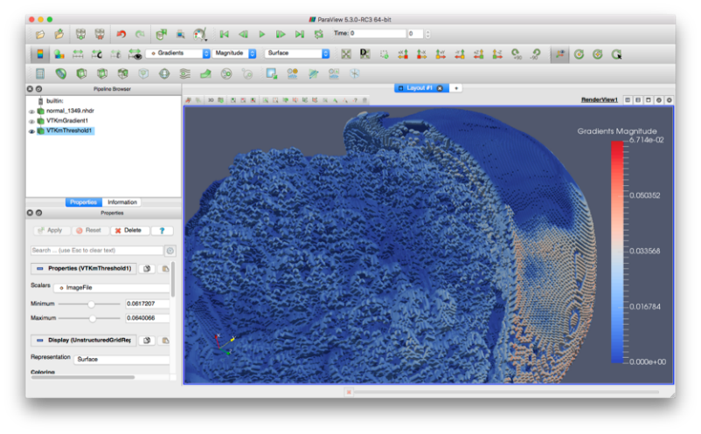





Scientific Discovery via Visualization Using Accelerated Computing
Scientific Achievement
VTK-m updates scientific visualization software to run on the accelerated processors (like GPU and Xeon Phi) driving the most powerful HPC systems.
Significance and Impact
If we fail to update our scientific visualization software to run efficiently on modern HPC systems, we will lose the tools required to make scientific discoveries.
Research Details
Initial research was fragmented into 3 separate projects.
SDAV brought the PIs together to engage and to transition to the unified software used today.
ParaView 5.3 and VisIt 2.11 offer VTK-m acceleration.
Upcoming VTK 8.0 will offer VTK-m accelerated filters.
In situ tools demonstrated on Titan with thousands of GPUS.
ParaView using VTK-m acceleration to visualize data from a supernova simulation.
Sewell, et al. Proceedings of the Ultrascale Visualization Workshop, November 2012, DOI 10.1109/SC.Companion.2012.36.
Moreland, et al. IEEE Computer Graphics and Applications, Volume 36, Number 3, May/June 2016, DOI 10.1109/MCG.2016.48.
VTK-m
In Situ with Catalyst/ PyFR batch mode on Titan with 5000 GPUS
VTK-m
1.0.0 Released
VTK-m
Live In Situ with Catalyst/ PyFR
VTK-m
Added
to VTK
and ParaView
VTK-m started
by merging EAVL, Dax, and Piston
VTK-m
Added
to VisIt
EAVL, Dax, and Piston being developed
12
13
14
15
16
17
Notes:
We are updating our HPC scientific visualization tools to enable scientists to make discoveries from large-scale simulation data. DOE HPC system design is undergoing a revolution that incorporates new “accelerator” processor technology, such as NVIDIA GPU and Intel Xeon Phi, that require a major redesign of software. Visualization software is particularly difficult as it involves complex data structures with many data dependencies that must be coordinated across computing threads. Early work beginning around 2010 started independently in three projects, named EAVL, Dax, and Piston, which had no coordination between them. The SDAV SciDAC institute brought together the PIs to enable this coordination. The eventual result of this coordination was a plan and agreement to replace these unconnected products with a single software framework, which was named VTK-m. This plan was proposed, accepted, and implemented under ASCR research funding in coordination with SDAV. The roadmap for VTK-m includes an integration with the existing scientific visualization software so that we can continue the leverage the 100’s of thousands of man hours that have gone into these projects over many years. Today, the initial functionality of VTK-m is available in the latest versions of ParaView and VisIt, and VTK-m will be available in the next major release of VTK. VTK-m has also been demonstrated at scale to perform an in situ visualization on the Titan supercomputer with 5000 GPU processors. The project page is at http://m.vtk.org.

