Slide 1
VTK-m Overview
Intel Design Review

Slide 2
VTK-m Combining Dax, PISTON, EAVL

Slide 3
System Overview

Slide 4
VTK-m Framework
Control Environment
Execution Environment
vtkm::cont
vtkm::exec
Notes:
The VTK-m framework is divided into two distinct environments each with their own API.
The control environment a serial environment that is used to establish data and set up parallel jobs.
This is the interface used to connect VTK-m to applications and other code.
The API for the control environment is located in the namespace vtkm::cont.
The execution environment is the parallel environment where the actual data processing is done.
Internally, the control environment spawns parallel jobs in the execution environment.
The API for the execution environment is located in the namespace vtkm::exec.
These two environments mirror the typical hardware configuration of general purpose CPU and accelerator coprocessor.
But also work fine when both are integrated.

Slide 5
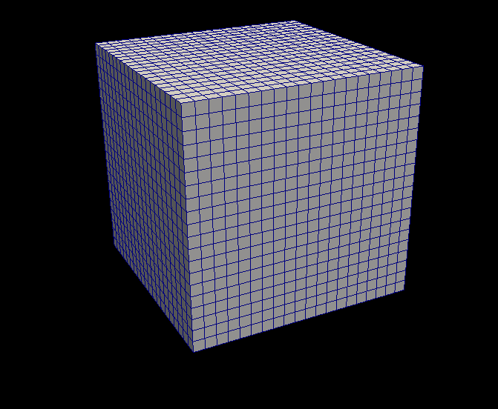
VTK-m Framework
Control Environment
Grid Topology
Array Handle
Invoke
Execution Environment
vtkm::cont
vtkm::exec
Notes:
When processing data in VTK-m, you first establish the data topology through the control environment.
This is done through very basic grid topology structures and adaptable array handles.

Slide 6
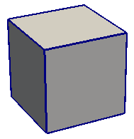
VTK-m Framework
Control Environment
Grid Topology
Array Handle
Invoke
Execution Environment
Cell Operations
Field Operations
Basic Math
Make Cells
Worklet
vtkm::cont
vtkm::exec
Notes:
Then from the control environment you can invoke an algorithm on your data.
Internally, this will decompose the data into constitute pieces, transfer data as necessary, and invoke a parallel algorithm.
Algorithms in the execution environment are built using worklets.
Worklets are serial functors that operate on one constituent element.
The execution API provides the basic operations for cells, interpolations, derivatives, and other math.
Worklets come in different types with different abilities.

Slide 7
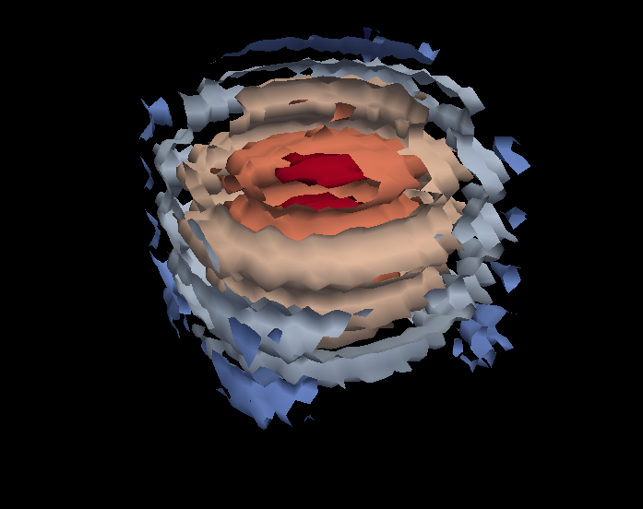
VTK-m Framework
Control Environment
Grid Topology
Array Handle
Invoke
Execution Environment
Cell Operations
Field Operations
Basic Math
Make Cells
Worklet
vtkm::cont
vtkm::exec
Notes:
And eventually the results are passed back to the control environment.

Slide 8
VTK-m Framework
Control Environment
Grid Topology
Array Handle
Invoke
Execution Environment
Cell Operations
Field Operations
Basic Math
Make Cells
Device Adapter
Allocate
Transfer
Schedule
Sort
…
Worklet
vtkm::cont
vtkm::exec
Notes:
These two environments, particularly the execution environment, are meant to work on a variety of architectures.
To manage this portability, we have a unit called a device adapter that sits between these two environments.
The device adapter provides the basic memory management, scheduling, and algorithms needed to run on a parallel device.

Slide 9
Device Adapter Contents
Tag (struct DeviceAdapterFoo { };)
Execution Array Manager
Schedule
Scan
Sort
Other Support algorithms
Stream compact, copy, parallel find, unique
Control Environment
Execution Environment
Transfer
Schedule
worklet
worklet
worklet
functor
worklet
worklet
worklet
worklet
functor
Compute
8
3
5
5
3
6
0
7
4
0
8
11
16
21
24
30
30
37
41
41
8
3
5
5
3
6
0
7
4
0
Compute
0
0
3
3
4
5
5
6
7
8

Slide 10
Defining Data

Slide 11
Array Handle
Array Handle
x₀
y₀
z₀
x₁
y₁
z₁
x₂
y₂
z₂

Slide 12
Array Handle Storage
Array Handle
Array of Structs Storage
x₀
y₀
z₀
x₁
y₁
z₁
x₂
y₂
z₂
x₀
y₀
z₀
x₁
y₁
z₁
x₂
y₂
z₂

Slide 13
Array Handle Storage
Array Handle
Array of Structs Storage
x₀
y₀
z₀
x₁
y₁
z₁
x₂
y₂
z₂
x₀
y₀
z₀
x₁
y₁
z₁
x₂
y₂
z₂
Array Handle
x₀
x₁
x₂
Struct of Arrays Storage
y₀
y₁
y₂
x₀
y₀
z₀
x₁
y₁
z₁
x₂
y₂
z₂
z₀
z₁
z₂

Slide 14
Array Handle Storage
Array Handle
Array of Structs Storage
x₀
y₀
z₀
x₁
y₁
z₁
x₂
y₂
z₂
x₀
y₀
z₀
x₁
y₁
z₁
x₂
y₂
z₂
Array Handle
x₀
x₁
x₂
Struct of Arrays Storage
y₀
y₁
y₂
x₀
y₀
z₀
x₁
y₁
z₁
x₂
y₂
z₂
z₀
z₁
z₂
Array Handle
vtkCellArray Storage
v₀
v₁
v₂
v₃
v₄
v₅
v₆
v₇
v₈
3
v₀
v₁
v₂
3
v₃
v₄
v₅
3
v₆
v₇
v₈

Slide 15
Fancy Array Handles
Array Handle
Constant Storage
c
c
c
c
c
c
c
c
c
c
Array Handle
Uniform Point Coord Storage
f(i,j,k) = [o_{x} + s_{x} i, o_{y} + s_{y} j, o_{z} + s_{z} k]
x₀
y₀
z₀
x₁
y₁
z₁
x₂
y₂
z₂
Array Handle
8
5
5
0
5
2
0
3
5
Array Handle
Permutation Storage
x₈
x₅
x₅
x₀
x₅
x₂
x₀
x₃
x₅
Array Handle
x₀
x₁
x₂
x₃
x₄
x₅
x₆
x₇
x₈

Slide 16
Array Handle Resource Management
Control Environment
Array Handle
Contains
Storage
Uses

Slide 17
Array Handle Resource Management
Control Environment
Execution Environment
Transfer
Array Handle
Contains
Storage
Implements
Device Adapter
Uses

Slide 18
Array Handle Resource Management
Control Environment
Execution Environment
f(x)
Transfer
f(x)
Array Handle
Contains
Storage
Implements
Device Adapter
Uses

Slide 19
Data Model
vtkm::cont::CellSet
vtkm::cont::DataSet
*
vtkm::cont::Field
*
vtkm::cont::CoordinateSystem
*

Slide 20
A DataSet Has
1 or more CellSet
Defines the connectivity of the cells
Examples include a regular grid of cells or explicit connection indices
0 or more Field
Holds an ArrayHandle containing field values
Field also has metadata such as the name, the topology association (point, cell, face, etc), and which cell set the field is attached to
0 or more CoordinateSystem
Really just a Field with a special meaning
Contains helpful features specific to common coordinate systems

Slide 21
Structured Cell Set
k
j
i
Notes:
Points and cells can be index with either multidimensional or flat indices
Can be 1, 2, or 3 dimensions

Slide 22
Structured Cell Set
Cell
k
j
i
Point
Notes:
By providing a non-uniform coordinate system, the mesh can be bent in space into a curvilinear grid

Slide 23
Example: Making a Structured Grid
vtkm::cont::DataSet dataSet;
const vtkm::Id nVerts = 18;
const vtkm::Id3 dimensions(3, 2, 3);
// Build cell set
vtkm::cont::CellSetStructured<3> cellSet("cells");
cellSet.SetPointDimensions(dimensions);
dataSet.AddCellSet(cellSet);
// Make coordinate system
vtkm::cont::ArrayHandleUniformPointCoordinates coordinates(dimensions);
dataSet.AddCoordinateSystem(vtkm::cont::CoordinateSystem("coordinates", 1, coordinates));
// Add point scalar data
vtkm::Float32 vars[nVerts] = {…}; dataSet.AddField(Field("pointvar", 1, vtkm::cont::Field::ASSOC_POINTS, vars, nVerts));
// Add cell scalar
vtkm::Float32 cellvar[4] = {…};
dataSet.AddField(Field("cellvar", 1, vtkm::cont::Field::ASSOC_CELL_SET,
"cells", cellvar, 4));

Slide 24
Explicit Connectivity Cell Set
Map Cell to
Connectivity
Shapes
Num Indices
Connectivity
TETRA
4
0
0
TETRA
4
4
1
HEDAHEDRON
8
8
2
WEDGE
6
16
3
HEXAHEDRON
8
22
0
HEXAHEDRON
8
30
2
TETRA
4
38
1
4
5
6
7
8
Notes:
No example. Explicit data sets build the same as structured except for the cell set. You provide the shapes, num indices, and connectivity arrays.

Slide 25
Anatomy of a Worklet

Slide 26
struct Sine: public vtkm::worklet::WorkletMapField {
typedef void ControlSignature(FieldIn<>, FieldOut<>);
typedef _2 ExecutionSignature(_1);
template<typename T>
VTKM_EXEC_EXPORT
T operator()(T x) const {
return vtkm::math::Sin(x);
}
};

Slide 27
struct Sine: public vtkm::worklet::WorkletMapField {
typedef void ControlSignature(FieldIn<>, FieldOut<>);
typedef _2 ExecutionSignature(_1);
template<typename T>
VTKM_EXEC_EXPORT
T operator()(T x) const {
return vtkm::math::Sin(x);
}
};

Slide 28
struct Sine: public vtkm::worklet::WorkletMapField {
typedef void ControlSignature(FieldIn<>, FieldOut<>);
typedef _2 ExecutionSignature(_1);
template<typename T>
VTKM_EXEC_EXPORT
T operator()(T x) const {
return vtkm::math::Sin(x);
}
};

Slide 29
struct Sine: public vtkm::worklet::WorkletMapField {
typedef void ControlSignature(FieldIn<>, FieldOut<>);
typedef _2 ExecutionSignature(_1);
template<typename T>
VTKM_EXEC_EXPORT
T operator()(T x) const {
return vtkm::math::Sin(x);
}
};

Slide 30
struct Sine: public vtkm::worklet::WorkletMapField {
typedef void ControlSignature(FieldIn<>, FieldOut<>);
typedef _2 ExecutionSignature(_1);
template<typename T>
VTKM_EXEC_EXPORT
T operator()(T x) const {
return vtkm::math::Sin(x);
}
};

Slide 31
struct Sine: public vtkm::worklet::WorkletMapField {
typedef void ControlSignature(FieldIn<>, FieldOut<>);
typedef _2 ExecutionSignature(_1);
template<typename T>
VTKM_EXEC_EXPORT
T operator()(T x) const {
return vtkm::math::Sin(x);
}
};

Slide 32
struct Sine: public vtkm::worklet::WorkletMapField {
typedef void ControlSignature(FieldIn<>, FieldOut<>);
typedef _2 ExecutionSignature(_1);
template<typename T>
VTKM_EXEC_EXPORT
T operator()(T x) const {
return vtkm::math::Sin(x);
}
};

Slide 33
struct Sine: public vtkm::worklet::WorkletMapField {
typedef void ControlSignature(FieldIn<>, FieldOut<>);
typedef _2 ExecutionSignature(_1);
template<typename T>
VTKM_EXEC_EXPORT
T operator()(T x) const {
return vtkm::math::Sin(x);
}
};
Execution Environment
Control Environment
vtkm::cont::ArrayHandle<vtkm::Float32> inputHandle =
vtkm::cont::make_ArrayHandle(input);
vtkm::cont::ArrayHandle<vtkm::Float32> sineResult;
vtkm::worklet::DispatcherMapField<Sine> dispatcher;
dispatcher.Invoke(inputHandle, sineResult);

Slide 34
struct Sine: public vtkm::worklet::WorkletMapField {
typedef void ControlSignature(FieldIn<>, FieldOut<>);
typedef _2 ExecutionSignature(_1);
template<typename T>
VTKM_EXEC_EXPORT
T operator()(T x) const {
return vtkm::math::Sin(x);
}
};
Execution Environment
Control Environment
vtkm::cont::ArrayHandle<vtkm::Float32> inputHandle =
vtkm::cont::make_ArrayHandle(input);
vtkm::cont::ArrayHandle<vtkm::Float32> sineResult;
vtkm::worklet::DispatcherMapField<Sine> dispatcher;
dispatcher.Invoke(inputHandle, sineResult);

Slide 35
struct Sine: public vtkm::worklet::WorkletMapField {
typedef void ControlSignature(FieldIn<>, FieldOut<>);
typedef _2 ExecutionSignature(_1);
template<typename T>
VTKM_EXEC_EXPORT
T operator()(T x) const {
return vtkm::math::Sin(x);
}
};
Execution Environment
Control Environment
vtkm::cont::ArrayHandle<vtkm::Float32> inputHandle =
vtkm::cont::make_ArrayHandle(input);
vtkm::cont::ArrayHandle<vtkm::Float32> sineResult;
vtkm::worklet::DispatcherMapField<Sine> dispatcher;
dispatcher.Invoke(inputHandle, sineResult);

Slide 36
struct Sine: public vtkm::worklet::WorkletMapField {
typedef void ControlSignature(FieldIn<>, FieldOut<>);
typedef _2 ExecutionSignature(_1);
template<typename T>
VTKM_EXEC_EXPORT
T operator()(T x) const {
return vtkm::math::Sin(x);
}
};
Execution Environment
Control Environment
vtkm::cont::ArrayHandle<vtkm::Float32> inputHandle =
vtkm::cont::make_ArrayHandle(input);
vtkm::cont::ArrayHandle<vtkm::Float32> sineResult;
vtkm::worklet::DispatcherMapField<Sine> dispatcher;
dispatcher.Invoke(inputHandle, sineResult);

Slide 37
struct Sine: public vtkm::worklet::WorkletMapField {
typedef void ControlSignature(FieldIn<>, FieldOut<>);
typedef _2 ExecutionSignature(_1);
template<typename T>
VTKM_EXEC_EXPORT
T operator()(T x) const {
return vtkm::math::Sin(x);
}
};

Slide 38
struct Zip2: public vtkm::worklet::WorkletMapField {
typedef void ControlSignature(
FieldIn<vtkm::TypeListTagScalar>,
FieldIn<vtkm::TypeListTagScalar>,
FieldOut<vtkm::TypeListTagFieldVec2>);
typedef void ExecutionSignature(_1, _2, _3);
typedef<typename T1, typename T2, typename V>
VTKM_EXEC_EXPORT
void operator()(T1 x, T2 y, V &result) const {
result = V(x, y);
}
};

Slide 39
struct ImagToPolar: public vtkm::worklet::WorkletMapField {
typedef void ControlSignature(
FieldIn<vtkm::TypeListTagScalar>,
FieldIn<vtkm::TypeListTagScalar>,
FieldOut<vtkm::TypeListTagScalar>,
FieldOut<vtkm::TypeListTagScalar>);
typedef void ExecutionSignature(_1, _2, _3, _4);
template<typename RealType,
typename ImaginaryType,
typename MagnitudeType,
typename PhaseType>
VTKM_EXEC_EXPORT
void operator()(RealType real,
ImaginaryType imag,
MagnitudeType &magnitude,
PhaseType &phase) const {
magnitude = vtkm::math::Sqrt(real*real + imag*imag);
phase = vtkm::math::ATan2(imaginary, real);
}
};

Slide 40
struct Advect: public vtkm::worklet::WorkletMapField {
typedef void ControlSignature(
FieldIn<vtkm::TypeListTagFieldVec3>,
FieldIn<vtkm::TypeListTagFieldVec3>,
FieldIn<vtkm::TypeListTagFieldVec3>,
FieldOut<vtkm::TypeListTagFieldVec3>,
FieldOut<vtkm::TypeListTagFieldVec3>,
FieldOut<vtkm::TypeListTagScalar>,
FieldOut<vtkm::TypeListTagScalar>);
typedef void ExecutionSignature(
_1, _2, _3, _4, _5, _6, _7);
template<typename T1, typename T2, ...>
VTKM_EXEC_EXPORT
void operator()(T1 startPosition,
T2 startVelocity,
T3 acceleration,
T4 &endPosition,
T5 &endVelocity,
T6 &rotation,
T7 &angularVelocity) const {
... }
};

Slide 41
Worklet Invocation

Slide 42
Dispatcher Invoke Operations
Convert polymorphic types to static types
Check types
Dispatcher-specific operations
Find domain length
Build index arrays
Transport data from control to execution
Run worklet invoke kernel
Fetch thread-specific data
Invoke worklet
Push thread-specific data
Specified by
signature tags

Slide 43
Dispatcher Invoke Operations
DispatcherMapField<Sine> dispatcher;
dispatcher.Invoke(inputHandle, sineResult);
Convert polymorphic types to static types
Check types
Dispatcher-specific operations
Find domain length
Build index arrays
Transport data from control to execution
Run worklet invoke kernel
Fetch thread-specific data
Invoke worklet
Push thread-specific data

Slide 44
Dispatcher Invoke Operations
DispatcherMapField<Sine> dispatcher;
dispatcher.Invoke(inputHandle, sineResult);
Convert polymorphic types to static types
Check types
Dispatcher-specific operations
Find domain length
Build index arrays
Transport data from control to execution
Run worklet invoke kernel
Fetch thread-specific data
Invoke worklet
Push thread-specific data
DynamicArrayHandle
DynamicArrayHandle

Slide 45
Dispatcher Invoke Operations
DispatcherMapField<Sine> dispatcher;
dispatcher.Invoke(inputHandle, sineResult);
Convert polymorphic types to static types
Check types
Dispatcher-specific operations
Find domain length
Build index arrays
Transport data from control to execution
Run worklet invoke kernel
Fetch thread-specific data
Invoke worklet
Push thread-specific data
ArrayHandle<float>
ArrayHandle<float>

Slide 46

Dispatcher Invoke Operations
DispatcherMapField<Sine> dispatcher;
dispatcher.Invoke(inputHandle, sineResult);
Convert polymorphic types to static types
Check types
Dispatcher-specific operations
Find domain length
Build index arrays
Transport data from control to execution
Run worklet invoke kernel
Fetch thread-specific data
Invoke worklet
Push thread-specific data
ArrayHandle<float>
ArrayHandle<float>

Slide 47
Dispatcher Invoke Operations
DispatcherMapField<Sine> dispatcher;
dispatcher.Invoke(inputHandle, sineResult);
Convert polymorphic types to static types
Check types
Dispatcher-specific operations
Find domain length
Build index arrays
Transport data from control to execution
Run worklet invoke kernel
Fetch thread-specific data
Invoke worklet
Push thread-specific data
= 10,000
ArrayHandle<float>
ArrayHandle<float>

Slide 48
Dispatcher Invoke Operations
DispatcherMapField<Sine> dispatcher;
dispatcher.Invoke(inputHandle, sineResult);
Convert polymorphic types to static types
Check types
Dispatcher-specific operations
Find domain length
Build index arrays
Transport data from control to execution
Run worklet invoke kernel
Fetch thread-specific data
Invoke worklet
Push thread-specific data
= 10,000
ArrayPortal
ArrayPortal

Slide 49
Dispatcher Invoke Operations
DispatcherMapField<Sine> dispatcher;
dispatcher.Invoke(inputHandle, sineResult);
Convert polymorphic types to static types
Check types
Dispatcher-specific operations
Find domain length
Build index arrays
Transport data from control to execution
Run worklet invoke kernel
Fetch thread-specific data
Invoke worklet
Push thread-specific data
= 10,000
ArrayPortal
ArrayPortal

Slide 50
Dispatcher Invoke Operations
DispatcherMapField<Sine> dispatcher;
dispatcher.Invoke(inputHandle, sineResult);
Convert polymorphic types to static types
Check types
Dispatcher-specific operations
Find domain length
Build index arrays
Transport data from control to execution
Run worklet invoke kernel
Fetch thread-specific data
Invoke worklet
Push thread-specific data
= 10,000
ArrayPortal
ArrayPortal
arg1 = 1.57
arg2

Slide 51
Dispatcher Invoke Operations
DispatcherMapField<Sine> dispatcher;
dispatcher.Invoke(inputHandle, sineResult);
Convert polymorphic types to static types
Check types
Dispatcher-specific operations
Find domain length
Build index arrays
Transport data from control to execution
Run worklet invoke kernel
Fetch thread-specific data
Invoke worklet
Push thread-specific data
= 10,000
ArrayPortal
ArrayPortal
arg1 = 1.57
arg2
= worklet( );

Slide 52
Dispatcher Invoke Operations
DispatcherMapField<Sine> dispatcher;
dispatcher.Invoke(inputHandle, sineResult);
Convert polymorphic types to static types
Check types
Dispatcher-specific operations
Find domain length
Build index arrays
Transport data from control to execution
Run worklet invoke kernel
Fetch thread-specific data
Invoke worklet
Push thread-specific data
= 10,000
ArrayPortal
ArrayPortal
arg2 = 1
arg1 = 1.57
= worklet( );

Slide 53
Dispatcher Invoke Operations
DispatcherMapField<Sine> dispatcher;
dispatcher.Invoke(inputHandle, sineResult);
Convert polymorphic types to static types
Check types
Dispatcher-specific operations
Find domain length
Build index arrays
Transport data from control to execution
Run worklet invoke kernel
Fetch thread-specific data
Invoke worklet
Push thread-specific data
= 10,000
ArrayPortal
ArrayPortal
arg2 = 1
arg1 = 1.57

Slide 54
Open Questions
What backend is best for Phi?
Had some scaling issues with TBB on KNC past ~50 threads
OpenMP on KNC performed even worse (possibly bad scan/sort)
About that vector processing…
We really don’t want to deal directly with intrinsics
You have to specify those on the innermost loop, which really slows down development. Want to specify on shared outer loops.
We want a C++ extension that allows us to launch a kernel function on both multiple cores and the vector processor
Vector processing should handle branching
If all vector operations on the same branch, vector fully utilized.
If vector operations branch, degrade gracefully.

