Slide 1
VTK-m Overview
NVIDIA Design Review

Slide 2
VTK-m Combining Dax, PISTON, EAVL

Slide 3
VTK-m Framework
Control Environment
Execution Environment
vtkm::cont
vtkm::exec
Notes:
The VTK-m framework is divided into two distinct environments each with their own API.
The control environment a serial environment that is used to establish data and set up parallel jobs.
This is the interface used to connect VTK-m to applications and other code.
The API for the control environment is located in the namespace vtkm::cont.
The execution environment is the parallel environment where the actual data processing is done.
Internally, the control environment spawns parallel jobs in the execution environment.
The API for the execution environment is located in the namespace vtkm::exec.
These two environments mirror the typical hardware configuration of general purpose CPU and accelerator coprocessor.
But also work fine when both are integrated.

Slide 4
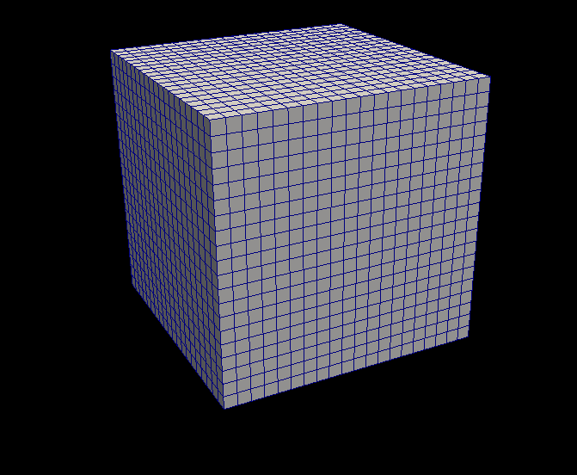
VTK-m Framework
Control Environment
Grid Topology
Array Handle
Invoke
Execution Environment
vtkm::cont
vtkm::exec
Notes:
When processing data in VTK-m, you first establish the data topology through the control environment.
This is done through very basic grid topology structures and adaptable array handles.

Slide 5
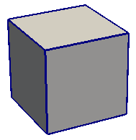
VTK-m Framework
Control Environment
Grid Topology
Array Handle
Invoke
Execution Environment
Cell Operations
Field Operations
Basic Math
Make Cells
Worklet
vtkm::cont
vtkm::exec
Notes:
Then from the control environment you can invoke an algorithm on your data.
Internally, this will decompose the data into constitute pieces, transfer data as necessary, and invoke a parallel algorithm.
Algorithms in the execution environment are built using worklets.
Worklets are serial functors that operate on one constituent element.
The execution API provides the basic operations for cells, interpolations, derivatives, and other math.
Worklets come in different types with different abilities.

Slide 6
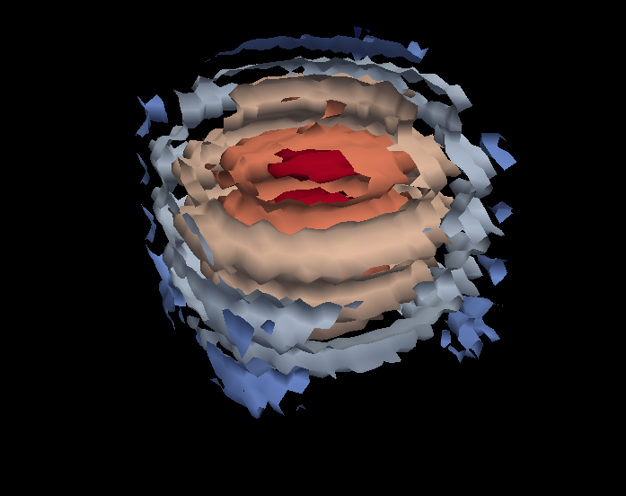
VTK-m Framework
Control Environment
Grid Topology
Array Handle
Invoke
Execution Environment
Cell Operations
Field Operations
Basic Math
Make Cells
Worklet
vtkm::cont
vtkm::exec
Notes:
And eventually the results are passed back to the control environment.

Slide 7
VTK-m Framework
Control Environment
Grid Topology
Array Handle
Invoke
Execution Environment
Cell Operations
Field Operations
Basic Math
Make Cells
Device Adapter
Allocate
Transfer
Schedule
Sort
…
Worklet
vtkm::cont
vtkm::exec
Notes:
These two environments, particularly the execution environment, are meant to work on a variety of architectures.
To manage this portability, we have a unit called a device adapter that sits between these two environments.
The device adapter provides the basic memory management, scheduling, and algorithms needed to run on a parallel device.

Slide 8
Device Adapter Contents
Tag (struct DeviceAdapterFoo { };)
Execution Array Manager
Schedule
Scan
Sort
Other Support algorithms
Stream compact, copy, parallel find, unique
Control Environment
Execution Environment
Transfer
Schedule
worklet
worklet
worklet
functor
worklet
worklet
worklet
worklet
functor
Compute
8
3
5
5
3
6
0
7
4
0
8
11
16
21
24
30
30
37
41
41
8
3
5
5
3
6
0
7
4
0
Compute
0
0
3
3
4
5
5
6
7
8

Slide 9
Device Adapter Contents
Tag (struct DeviceAdapterFoo { };)
Execution Array Manager
Schedule
Scan
Sort
Other Support algorithms
Stream compact, copy, parallel find, unique
Control Environment
Execution Environment
Transfer
Schedule
worklet
thrust has nice 1D array index map
could really use a 3D array index map
worklet
worklet
functor
worklet
worklet
worklet
worklet
functor
Compute
8
3
5
5
3
6
0
7
4
0
8
11
16
21
24
30
30
37
41
41
8
3
5
5
3
6
0
7
4
0
Compute
0
0
3
3
4
5
5
6
7
8

Slide 10
Array Handle
Array Handle
x₀
y₀
z₀
x₁
y₁
z₁
x₂
y₂
z₂

Slide 11
Array Handle Storage
Array Handle
Array of Structs Storage
x₀
y₀
z₀
x₁
y₁
z₁
x₂
y₂
z₂
x₀
y₀
z₀
x₁
y₁
z₁
x₂
y₂
z₂

Slide 12
Array Handle Storage
Array Handle
Array of Structs Storage
x₀
y₀
z₀
x₁
y₁
z₁
x₂
y₂
z₂
x₀
y₀
z₀
x₁
y₁
z₁
x₂
y₂
z₂
Array Handle
x₀
x₁
x₂
Struct of Arrays Storage
y₀
y₁
y₂
x₀
y₀
z₀
x₁
y₁
z₁
x₂
y₂
z₂
z₀
z₁
z₂

Slide 13
Array Handle Storage
Array Handle
Array of Structs Storage
x₀
y₀
z₀
x₁
y₁
z₁
x₂
y₂
z₂
x₀
y₀
z₀
x₁
y₁
z₁
x₂
y₂
z₂
Array Handle
x₀
x₁
x₂
Struct of Arrays Storage
y₀
y₁
y₂
x₀
y₀
z₀
x₁
y₁
z₁
x₂
y₂
z₂
z₀
z₁
z₂
Array Handle
vtkCellArray Storage
v₀
v₁
v₂
v₃
v₄
v₅
v₆
v₇
v₈
3
v₀
v₁
v₂
3
v₃
v₄
v₅
3
v₆
v₇
v₈

Slide 14
Fancy Array Handles
Array Handle
Constant Storage
c
c
c
c
c
c
c
c
c
c
Array Handle
Uniform Point Coord Storage
f(i,j,k) = [o_{x} + s_{x} i, o_{y} + s_{y} j, o_{z} + s_{z} k]
x₀
y₀
z₀
x₁
y₁
z₁
x₂
y₂
z₂
Array Handle
8
5
5
0
5
2
0
3
5
Array Handle
Permutation Storage
x₈
x₅
x₅
x₀
x₅
x₂
x₀
x₃
x₅
Array Handle
x₀
x₁
x₂
x₃
x₄
x₅
x₆
x₇
x₈

Slide 15
Array Handle Resource Management
Control Environment
Array Handle
Contains
Storage
Uses

Slide 16
Array Handle Resource Management
Control Environment
Execution Environment
Transfer
Array Handle
Contains
Storage
Implements
Device Adapter
Uses

Slide 17
Array Handle Resource Management
Control Environment
Execution Environment
f(x)
Transfer
f(x)
Array Handle
Contains
Storage
Implements
Device Adapter
Uses

Slide 18
struct Sine: public vtkm::worklet::WorkletMapField {
typedef void ControlSignature(FieldIn<>, FieldOut<>);
typedef _2 ExecutionSignature(_1);
template<typename T>
VTKM_EXEC_EXPORT
T operator()(T x) const {
return vtkm::math::Sin(x);
}
};

Slide 19
struct Sine: public vtkm::worklet::WorkletMapField {
typedef void ControlSignature(FieldIn<>, FieldOut<>);
typedef _2 ExecutionSignature(_1);
template<typename T>
VTKM_EXEC_EXPORT
T operator()(T x) const {
return vtkm::math::Sin(x);
}
};

Slide 20
struct Sine: public vtkm::worklet::WorkletMapField {
typedef void ControlSignature(FieldIn<>, FieldOut<>);
typedef _2 ExecutionSignature(_1);
template<typename T>
VTKM_EXEC_EXPORT
T operator()(T x) const {
return vtkm::math::Sin(x);
}
};

Slide 21
struct Sine: public vtkm::worklet::WorkletMapField {
typedef void ControlSignature(FieldIn<>, FieldOut<>);
typedef _2 ExecutionSignature(_1);
template<typename T>
VTKM_EXEC_EXPORT
T operator()(T x) const {
return vtkm::math::Sin(x);
}
};

Slide 22
struct Sine: public vtkm::worklet::WorkletMapField {
typedef void ControlSignature(FieldIn<>, FieldOut<>);
typedef _2 ExecutionSignature(_1);
template<typename T>
VTKM_EXEC_EXPORT
T operator()(T x) const {
return vtkm::math::Sin(x);
}
};

Slide 23
struct Sine: public vtkm::worklet::WorkletMapField {
typedef void ControlSignature(FieldIn<>, FieldOut<>);
typedef _2 ExecutionSignature(_1);
template<typename T>
VTKM_EXEC_EXPORT
T operator()(T x) const {
return vtkm::math::Sin(x);
}
};

Slide 24
struct Sine: public vtkm::worklet::WorkletMapField {
typedef void ControlSignature(FieldIn<>, FieldOut<>);
typedef _2 ExecutionSignature(_1);
template<typename T>
VTKM_EXEC_EXPORT
T operator()(T x) const {
return vtkm::math::Sin(x);
}
};

Slide 25
struct Sine: public vtkm::worklet::WorkletMapField {
typedef void ControlSignature(FieldIn<>, FieldOut<>);
typedef _2 ExecutionSignature(_1);
template<typename T>
VTKM_EXEC_EXPORT
T operator()(T x) const {
return vtkm::math::Sin(x);
}
};
Execution Environment
Control Environment
vtkm::cont::ArrayHandle<vtkm::Float32> inputHandle =
vtkm::cont::make_ArrayHandle(input);
vtkm::cont::ArrayHandle<vtkm::Float32> sineResult;
vtkm::worklet::DispatcherMapField<Sine> dispatcher;
dispatcher.Invoke(inputHandle, sineResult);

Slide 26
struct Sine: public vtkm::worklet::WorkletMapField {
typedef void ControlSignature(FieldIn<>, FieldOut<>);
typedef _2 ExecutionSignature(_1);
template<typename T>
VTKM_EXEC_EXPORT
T operator()(T x) const {
return vtkm::math::Sin(x);
}
};
Execution Environment
Control Environment
vtkm::cont::ArrayHandle<vtkm::Float32> inputHandle =
vtkm::cont::make_ArrayHandle(input);
vtkm::cont::ArrayHandle<vtkm::Float32> sineResult;
vtkm::worklet::DispatcherMapField<Sine> dispatcher;
dispatcher.Invoke(inputHandle, sineResult);

Slide 27
struct Sine: public vtkm::worklet::WorkletMapField {
typedef void ControlSignature(FieldIn<>, FieldOut<>);
typedef _2 ExecutionSignature(_1);
template<typename T>
VTKM_EXEC_EXPORT
T operator()(T x) const {
return vtkm::math::Sin(x);
}
};
Execution Environment
Control Environment
vtkm::cont::ArrayHandle<vtkm::Float32> inputHandle =
vtkm::cont::make_ArrayHandle(input);
vtkm::cont::ArrayHandle<vtkm::Float32> sineResult;
vtkm::worklet::DispatcherMapField<Sine> dispatcher;
dispatcher.Invoke(inputHandle, sineResult);

Slide 28
struct Sine: public vtkm::worklet::WorkletMapField {
typedef void ControlSignature(FieldIn<>, FieldOut<>);
typedef _2 ExecutionSignature(_1);
template<typename T>
VTKM_EXEC_EXPORT
T operator()(T x) const {
return vtkm::math::Sin(x);
}
};
Execution Environment
Control Environment
vtkm::cont::ArrayHandle<vtkm::Float32> inputHandle =
vtkm::cont::make_ArrayHandle(input);
vtkm::cont::ArrayHandle<vtkm::Float32> sineResult;
vtkm::worklet::DispatcherMapField<Sine> dispatcher;
dispatcher.Invoke(inputHandle, sineResult);

Slide 29
struct Sine: public vtkm::worklet::WorkletMapField {
typedef void ControlSignature(FieldIn<>, FieldOut<>);
typedef _2 ExecutionSignature(_1);
template<typename T>
VTKM_EXEC_EXPORT
T operator()(T x) const {
return vtkm::math::Sin(x);
}
};

Slide 30
struct Zip2: public vtkm::worklet::WorkletMapField {
typedef void ControlSignature(
FieldIn<vtkm::TypeListTagScalar>,
FieldIn<vtkm::TypeListTagScalar>,
FieldOut<vtkm::TypeListTagFieldVec2>);
typedef void ExecutionSignature(_1, _2, _3);
typedef<typename T1, typename T2, typename V>
VTKM_EXEC_EXPORT
void operator()(T1 x, T2 y, V &result) const {
result = V(x, y);
}
};

Slide 31
struct ImagToPolar: public vtkm::worklet::WorkletMapField {
typedef void ControlSignature(
FieldIn<vtkm::TypeListTagScalar>,
FieldIn<vtkm::TypeListTagScalar>,
FieldOut<vtkm::TypeListTagScalar>,
FieldOut<vtkm::TypeListTagScalar>);
typedef void ExecutionSignature(_1, _2, _3, _4);
template<typename RealType,
typename ImaginaryType,
typename MagnitudeType,
typename PhaseType>
VTKM_EXEC_EXPORT
void operator()(RealType real,
ImaginaryType imag,
MagnitudeType &magnitude,
PhaseType &phase) const {
magnitude = vtkm::math::Sqrt(real*real + imag*imag);
phase = vtkm::math::ATan2(imaginary, real);
}
};

Slide 32
struct Advect: public vtkm::worklet::WorkletMapField {
typedef void ControlSignature(
FieldIn<vtkm::TypeListTagFieldVec3>,
FieldIn<vtkm::TypeListTagFieldVec3>,
FieldIn<vtkm::TypeListTagFieldVec3>,
FieldOut<vtkm::TypeListTagFieldVec3>,
FieldOut<vtkm::TypeListTagFieldVec3>,
FieldOut<vtkm::TypeListTagScalar>,
FieldOut<vtkm::TypeListTagScalar>);
typedef void ExecutionSignature(
_1, _2, _3, _4, _5, _6, _7);
template<typename T1, typename T2, ...>
VTKM_EXEC_EXPORT
void operator()(T1 startPosition,
T2 startVelocity,
T3 acceleration,
T4 &endPosition,
T5 &endVelocity,
T6 &rotation,
T7 &angularVelocity) const {
... }
};

Slide 33
Dispatcher Invoke Operations
Convert polymorphic types to static types
Check types
Dispatcher-specific operations
Find domain length
Build index arrays
Transport data from control to execution
Run worklet invoke kernel
Fetch thread-specific data
Invoke worklet
Push thread-specific data
Specified by
signature tags

Slide 34
Dispatcher Invoke Operations
DispatcherMapField<Sine> dispatcher;
dispatcher.Invoke(inputHandle, sineResult);
Convert polymorphic types to static types
Check types
Dispatcher-specific operations
Find domain length
Build index arrays
Transport data from control to execution
Run worklet invoke kernel
Fetch thread-specific data
Invoke worklet
Push thread-specific data

Slide 35
Dispatcher Invoke Operations
DispatcherMapField<Sine> dispatcher;
dispatcher.Invoke(inputHandle, sineResult);
Convert polymorphic types to static types
Check types
Dispatcher-specific operations
Find domain length
Build index arrays
Transport data from control to execution
Run worklet invoke kernel
Fetch thread-specific data
Invoke worklet
Push thread-specific data
DynamicArrayHandle
DynamicArrayHandle

Slide 36
Dispatcher Invoke Operations
DispatcherMapField<Sine> dispatcher;
dispatcher.Invoke(inputHandle, sineResult);
Convert polymorphic types to static types
Check types
Dispatcher-specific operations
Find domain length
Build index arrays
Transport data from control to execution
Run worklet invoke kernel
Fetch thread-specific data
Invoke worklet
Push thread-specific data
ArrayHandle<float>
ArrayHandle<float>

Slide 37

Dispatcher Invoke Operations
DispatcherMapField<Sine> dispatcher;
dispatcher.Invoke(inputHandle, sineResult);
Convert polymorphic types to static types
Check types
Dispatcher-specific operations
Find domain length
Build index arrays
Transport data from control to execution
Run worklet invoke kernel
Fetch thread-specific data
Invoke worklet
Push thread-specific data
ArrayHandle<float>
ArrayHandle<float>

Slide 38
Dispatcher Invoke Operations
DispatcherMapField<Sine> dispatcher;
dispatcher.Invoke(inputHandle, sineResult);
Convert polymorphic types to static types
Check types
Dispatcher-specific operations
Find domain length
Build index arrays
Transport data from control to execution
Run worklet invoke kernel
Fetch thread-specific data
Invoke worklet
Push thread-specific data
= 10,000
ArrayHandle<float>
ArrayHandle<float>

Slide 39
Dispatcher Invoke Operations
DispatcherMapField<Sine> dispatcher;
dispatcher.Invoke(inputHandle, sineResult);
Convert polymorphic types to static types
Check types
Dispatcher-specific operations
Find domain length
Build index arrays
Transport data from control to execution
Run worklet invoke kernel
Fetch thread-specific data
Invoke worklet
Push thread-specific data
= 10,000
ArrayPortal
ArrayPortal

Slide 40
Dispatcher Invoke Operations
DispatcherMapField<Sine> dispatcher;
dispatcher.Invoke(inputHandle, sineResult);
Convert polymorphic types to static types
Check types
Dispatcher-specific operations
Find domain length
Build index arrays
Transport data from control to execution
Run worklet invoke kernel
Fetch thread-specific data
Invoke worklet
Push thread-specific data
= 10,000
ArrayPortal
ArrayPortal

Slide 41
Dispatcher Invoke Operations
DispatcherMapField<Sine> dispatcher;
dispatcher.Invoke(inputHandle, sineResult);
Convert polymorphic types to static types
Check types
Dispatcher-specific operations
Find domain length
Build index arrays
Transport data from control to execution
Run worklet invoke kernel
Fetch thread-specific data
Invoke worklet
Push thread-specific data
= 10,000
ArrayPortal
ArrayPortal
arg1 = 1.57
arg2

Slide 42
Dispatcher Invoke Operations
DispatcherMapField<Sine> dispatcher;
dispatcher.Invoke(inputHandle, sineResult);
Convert polymorphic types to static types
Check types
Dispatcher-specific operations
Find domain length
Build index arrays
Transport data from control to execution
Run worklet invoke kernel
Fetch thread-specific data
Invoke worklet
Push thread-specific data
= 10,000
ArrayPortal
ArrayPortal
arg1 = 1.57
arg2
= worklet( );

Slide 43
Dispatcher Invoke Operations
DispatcherMapField<Sine> dispatcher;
dispatcher.Invoke(inputHandle, sineResult);
Convert polymorphic types to static types
Check types
Dispatcher-specific operations
Find domain length
Build index arrays
Transport data from control to execution
Run worklet invoke kernel
Fetch thread-specific data
Invoke worklet
Push thread-specific data
= 10,000
ArrayPortal
ArrayPortal
arg2 = 1
arg1 = 1.57
= worklet( );

Slide 44
Dispatcher Invoke Operations
DispatcherMapField<Sine> dispatcher;
dispatcher.Invoke(inputHandle, sineResult);
Convert polymorphic types to static types
Check types
Dispatcher-specific operations
Find domain length
Build index arrays
Transport data from control to execution
Run worklet invoke kernel
Fetch thread-specific data
Invoke worklet
Push thread-specific data
= 10,000
ArrayPortal
ArrayPortal
arg2 = 1
arg1 = 1.57

Slide 45
Reporting Errors in Worklets
Exceptions cannot be thrown in the execution environment
Not supported in CUDA. Problematic with multiple threads.
All worklets have a method named RaiseError
Call this method with a message string.
In the control environment, a vtkm::cont::ErrorExecution will be thrown with the given message
Behaves as if the error was thrown in the worklet
Be aware, raising an error might not actually halt any execution.
VTKM_EXEC_EXPORT
T operator()(T x) const
{
if (x < 0)
{
this->RaiseError("Cannot take square root of negative number.");
}
return vtkm::math::Sqrt(x);
}

Slide 46
How interop worked in Dax
#include <dax/opengl/TransferToOpenGL.h>
Use dax::opengl::TransferToOpenGL to create an OpenGL buffer object containing the same data as an ArrayHandle
Does the right thing regardless of CUDA or some other backend
DAX_CONT_EXPORT
void BindPointCoordinates(
dax::cont::ArrayHandle <dax::Vector3> pointArray)
{
GLuint oglPointBuffer;
glGenBuffers(1, &oglPointBuffer);
dax::opengl::TransferToOpenGL(pointArray, oglPointBuffer);
glEnableClientState(GL_VERTEX_ARRAY);
glBindBuffer(GL_ARRAY_BUFFER, oglPointBuffer);
glVertexPointer(3, GL_FLOAT , 0, NULL);
}

Slide 47
Explicit Connectivity Data Set
First pass at a data set (to be one of several)
Still a work in progress
Simple implementation
Arrays transport themselves to execution environment
class ExplicitConnectivity
{
public:
// Helper methods...
ArrayHandle Shapes;
ArrayHandle NumIndices;
ArrayHandle Connectivity;
ArrayHandle MapCellToConnectivityIndex;
};

Slide 48
Explicit Connectivity Data Set
Map Cell to
Connectivity
Shapes
Num Indices
Connectivity
TETRA
4
0
0
TETRA
4
4
1
HEDAHEDRON
8
8
2
WEDGE
6
16
3
HEXAHEDRON
8
22
0
HEXAHEDRON
8
30
2
TETRA
4
38
1
4
5
6
7
8

Slide 49
Explicit Connectivity Open Questions
How should zoo elements be handled in CUDA threads
Solution 1: Use runtime conditions
How well will CUDA handle conditional methods/looping
If all threads have the same cell shape?
If all threads have different cell shapes?
What is the best way to branch conditional code (like interpolation)?
Case statement? If/else clauses? Virtual methods?
Solution 2: Reorder cells to collect by cell type. Execute each cell type in different kernel
Potentially removes branching, but adds large overhead on reordering cells
Does not help for random access search structures
Should there be a specialized unstructured grid of uniform type?
Probably depends on how well general structure works with single type

Slide 50
Explicit Connectivity Open Questions
Could streaming ever work?
Streaming Shapes, NumIndices, and MapCellToConnectivityIndex straightforward
Streaming Connectivity array tricky
How can you stream point field information
Could be the lion’s share of data
Will upcoming CUDA features solve any of these problems for us?

Slide 51
Other Questions
Runtime polymorphic types
We jump through a lot of hoops to statically type everything in a device kernel
How necessary is this in the latest CUDA architecture
Would we be just as good calling a virtual method to load/store every datum?
We would still need to resolve to core types (bad to have to convert everything to double)
Would that typing be better inside or outside the kernel?

