Slide 1
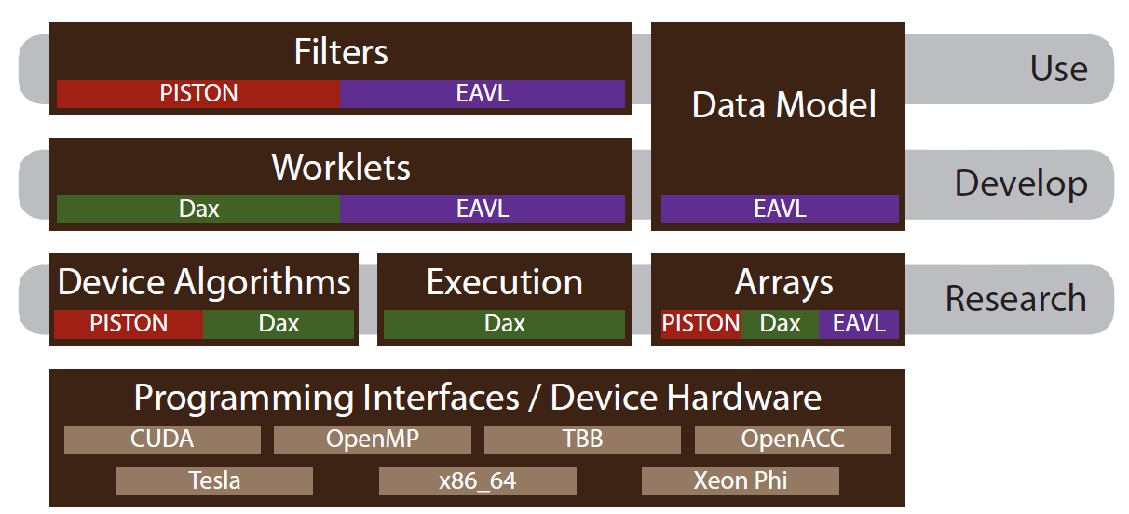
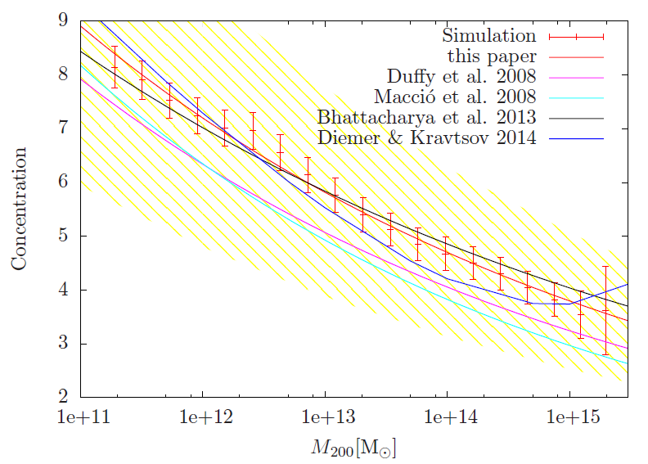
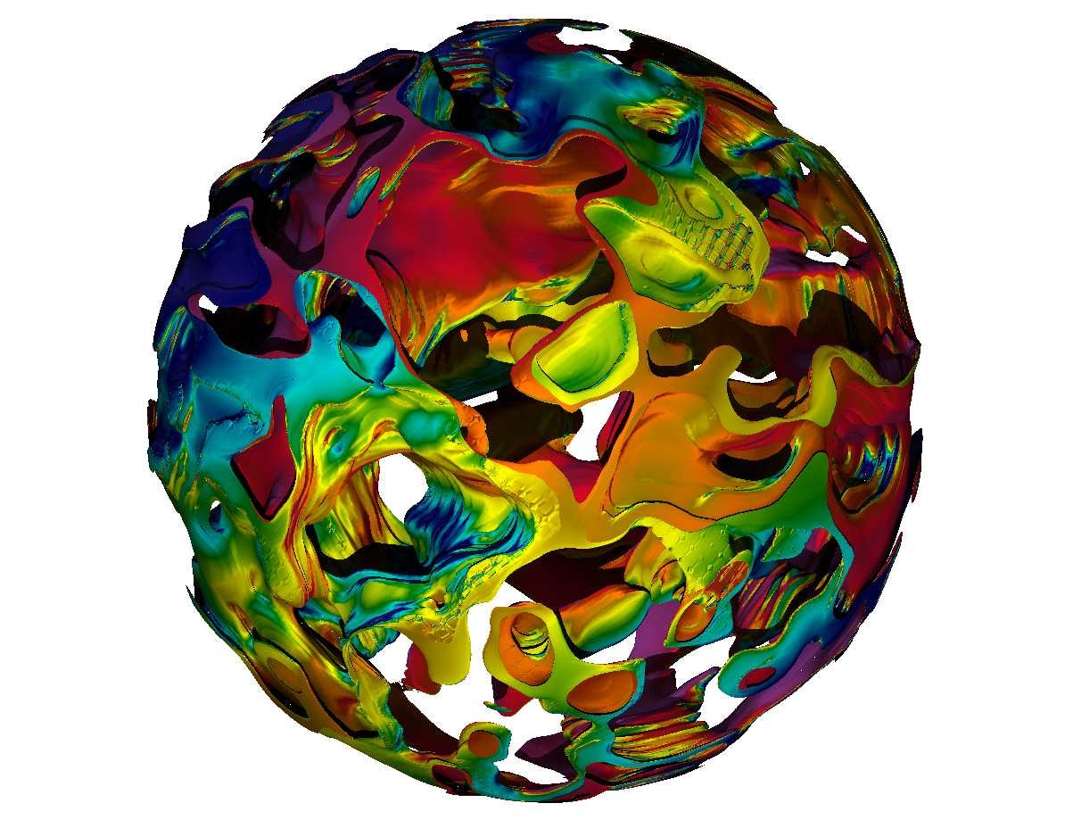
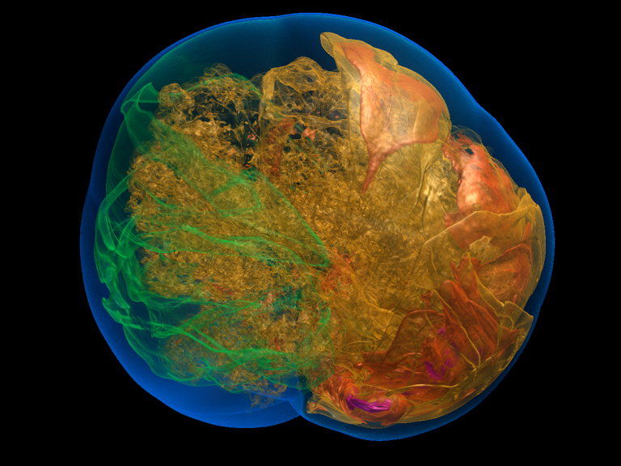
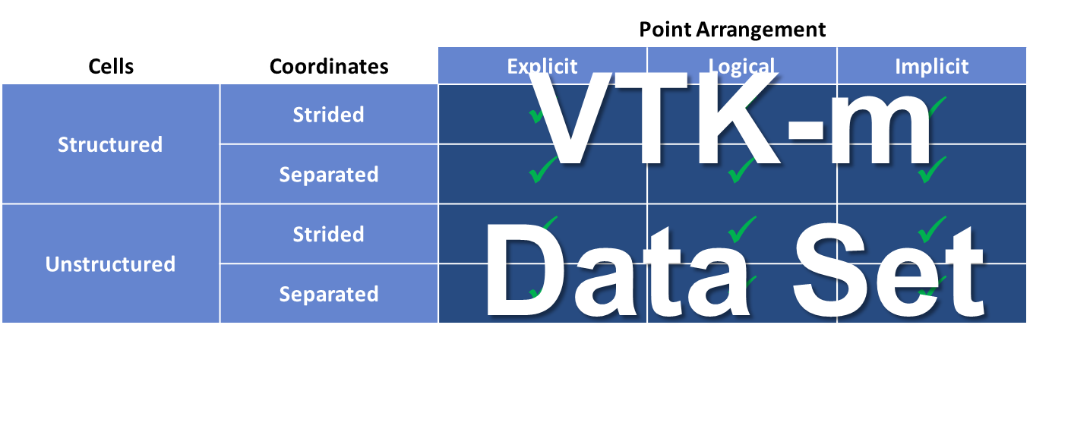
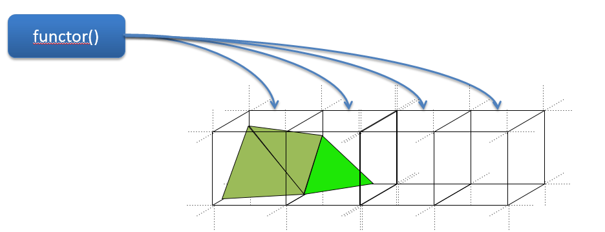
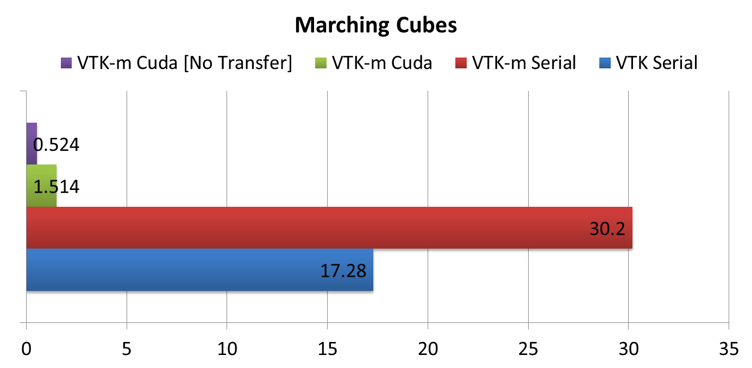
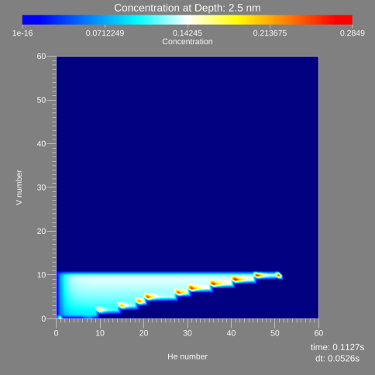
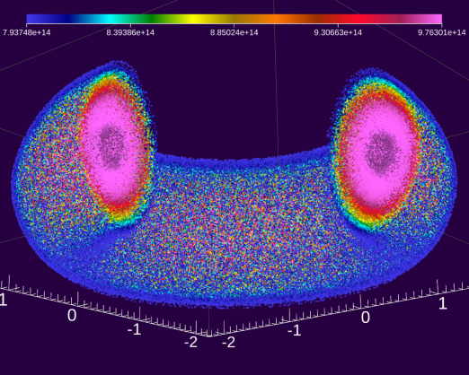
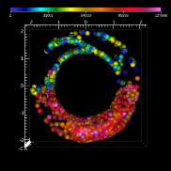
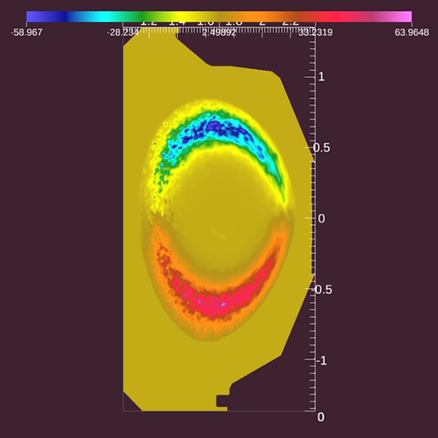


The Scalable Data Management, Analysis, and Visualization Institute http://sdav-scidac.org
VTK-m: Accelerating the Visualization Toolkit for Multi-core and Many-core Architectures
Ken Moreland, Sandia National Laboratory
Robert Maynard and Berk Geveci, Kitware
Jeremy Meredith and Dave Pugmire, Oak Ridge National Laboratory
Christopher Sewell, Li-ta Lo, and James Ahrens, Los Alamos National Laboratory
Hank Childs and Matt Larsen, University of Oregon
Kwan-Liu Ma and Hendrik Schroots, University of California at Davis
VTK-m Goals
Cosmology Applications
Hardware-Agnostic Ray Tracing
A single place for the visualization community to collaborate, contribute, and leverage massively threaded algorithms
Reduce the challenges of writing highly concurrent algorithms by using data parallel algorithms
Make it easier for simulation codes to take advantage these parallel visualization and analysis tasks on a wide range of current and next-generation hardware
Unify efforts in this area from Sandia (Dax), Oak Ridge (EAVL), and Los Alamos (PISTON)
Halo finding and halo center finding algorithms were written using PISTON, one of VTK-m’s constituent projects
On Titan, this enabled centers to be found on the GPU ~50x faster than using the pre-existing algorithms on the CPU (with one rank per node)
This work allowed halo analysis to be completed on all time steps of a very large 8192³ particle data set across 16,384 nodes on Titan for which analysis using the existing CPU algorithms was not feasible
The portability of VTK-m allowed us to run the same code on an Intel Xeon Phi
This is the first time that the c-M relation has been measured from a single simulation volume over such an extended mass range
To appear in the Astrophysical Journal: “The Q Continuum Simulation: Harnessing the Power of GPU Accelerated Supercomputers”.
VTK-m's hardware-agnostic approach gives comparable performance to hardware-specific approaches
Since VTK-m is implemented in a hardware-agnostic way, we wanted to understand the corresponding sacrifice in performance
We implemented a ray-traced renderer, which is computationally intensive and uses many unstructured memory accesses
We then compared VTK-m's performance to NVIDIA's OptiX and Intel's Embree, two "guaranteed not to exceed" ray-tracing standards that are developed by teams of professionals
Our study found that VTK-m performance was always within a factor of two of industry standards, and even outperformed them in some cases
We concluded that VTK-m hardware-agnostic approach is viable -our single implementation performed comparably to multiple hardware-specific implementations
Ray-traced rendering of 6.2M triangles generated from SPECFEM3D. The data represents wave speed perturbations measured by seismograms and was provided by Oak Ridge National Laboratory.
VTK-m infrastructure and use cases, with contributions from Dax, EAVL, and PISTON predecessor projects
Concentration-mass relation over the full mass range covered by the Q Continuum simulation at redshift z = 0 (points with error bars) and the predictions from various groups. The yellow shaded region shows the intrinsic scatter. All predictions and the simulation results are well within that scatter.
VTK-m Status
Project infrastructure
Code repository: https://gitlab.kitware.com/vtk/vtk-m
Project webpage: http://m.vtk.org
Features
Core Types
Statically Typed Arrays
Dynamically Typed Arrays
Device Interface (Serial, CUDA, TBB; OpenMP in progress)
Field and Topology Worklet and Dispatcher
Data Model
Allows clients to construct data sets from cell and point arrangements that exactly match their original data
In effect, this allows for hybrid and novel mesh types
Filters
Isosurface for structured grids
Statistical filters (histograms, moments, etc.)
In development: stream lines, stream surfaces, tetrahedralization
In-situ Applications
Tightly coupled in-situ with EAVL, one of VTK-m’s constituent projects
Efficient in-situ visualization and analysis
Light weight, zero-dependency library
Zero-copy references to host simulation
Heterogeneous memory support for accelerators
Flexible data model supports non-physical data types
Example: scientific and performance visualization, tightly coupled EAVL with SciDAC Xolotl plasma surface simulation
Loosely coupled in-situ with EAVL
Application de-coupled from visualization using ADIOS and Data Spaces
EAVL plug-in reads data from staging nodes
System nodes running EAVL perform visualization operations and rendering
Example: field and particle data, EAVL in-situ with XGC SciDAC simulation via ADIOS and Data Spaces
Advanced Visualization Usability Study
Implementation of both ray-casting and cell projection volume rendering algorithms using Dax, one of VTK-m’s constituent projects
Complied for CUDA, OpenMP, and Intel’s Thread Building Blocks
Comparative performance study on NVIDIA Titan X GPU, Intel Xeon, and Intel Xeon Phi
VTK-m implementation in progress
Volume rendering of type Ia supernova simulation data set using ray-casting. Cell projection implementation using data parallel primitives renders comparable image in near sub-second times.
VTK-m Data Model
Functional programming paradigm
Acknowledgement
This material is based upon work supported by the U.S. Department of Energy, Office of Science, Office of Advanced Scientific Computing Research, Scientific Discovery through Advanced Computing (SciDAC) program under the Institute of Scalable Data Management, Analysis and Visualization (SDAV).
VTK-m Isosurface Performance (preliminary results)
EAVL in-situ with Xolotl
EAVL in-situ with XGC
LA-UR-15-25242

