Slide 1
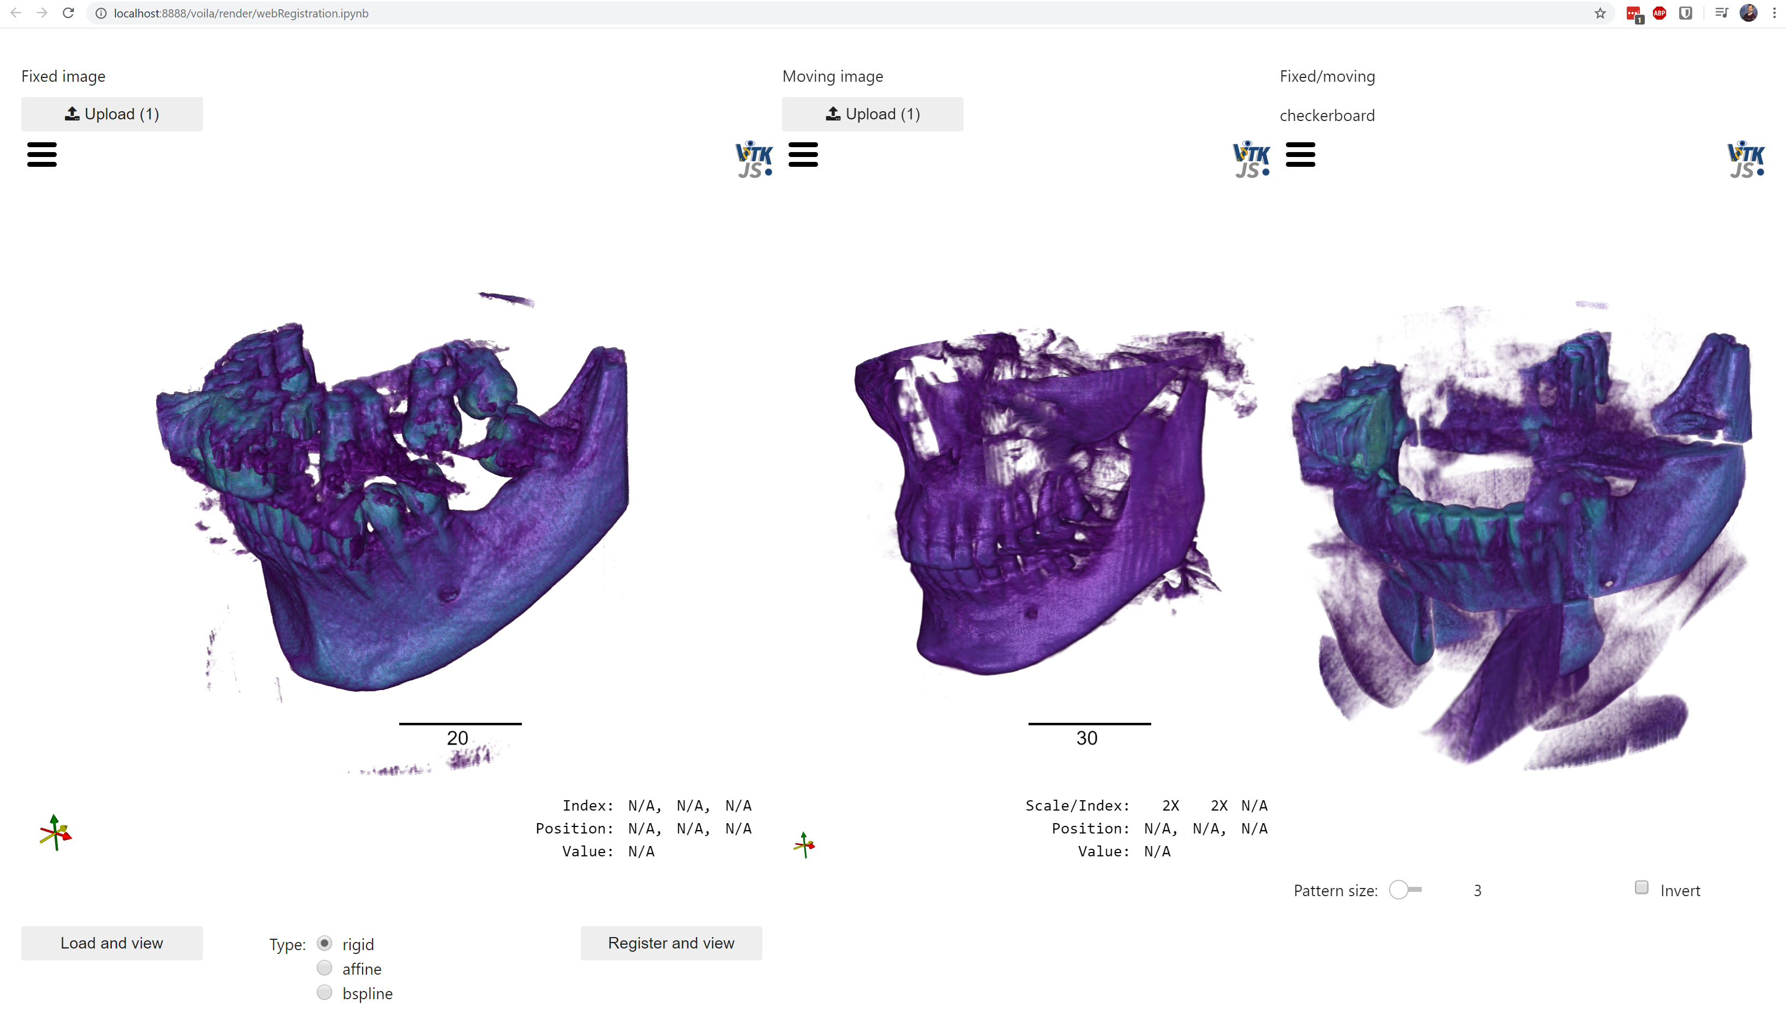
Web-based Registration Tools Based on ITKElastix Dženan Zukić & Matt McCormick
Web-based tools
No need to install
No user-side maintenance
Reaches wider audience
Open source @ GitHub
InsightSoftwareConsortium/ITKElastix
InsightSoftwareConsortium/itkwidgets
KitwareMedical/HASI
pip install itk-elastix
C++ with Python wrapping
Limitations and future work
Very large images
Domain customizations
Supported by NIH grant 1R44AR074375-01A1.
Thanks to Stefan Klein, Marius Staring, Kasper Marstal, Niels Dekker and all of Elastix team.

