Slide 1
Crop Yield Outlook
Predicting how likely a good yield is, from the crop, the location and the season
Shivani Srivastava | 23BDS0085
Predictive Analysis | Supporting component: leaf disease identification
GitHub profile: github.com/Kiwi-Supreme
Project code: github.com/Kiwi-Supreme/CropYield
Notes:
Introduce the problem: farmers and planners want to know, before or early in a season, whether a crop is likely to do well.

Slide 2
What the system does
Three inputs from the user, one answer they can act on
1 Crop
Yield model
trained on 2001-2017
district records
P(Good) P(Average) P(Poor)
2 Location (state, district)
Expected yield (kg/ha) with a range
3 Season (Kharif / Rabi)
The main reasons behind it
Objective: detect crop disease from leaf images and predict how good the crop yield will be, using weather and satellite data.
Focus: the yield outlook is the main result. Leaf disease identification supports it where leaf photos are available.
Why it helps: farmers and planners can see risk early and decide on irrigation, inputs and scouting.
Crop Yield Outlook | Predictive Analysis
2
Notes:
Stress that the main deliverable is the yield outlook. Disease detection supports it.

Slide 3
How the pieces fit together
A main yield pipeline and a supporting disease pipeline that feeds back into it
Main: yield outlook
Crop + location + season
user input
Seasonal features
weather, NDVI, climate normals
Classifier + regressor
Random Forest / XGBoost / Logistic
Likelihood of Good, Average, Poor
plus expected yield
Supporting: leaf disease
Leaf photo
taken while scouting
MobileNetV2 CNN
transfer learning
Disease class
share of infected leaves
Adjusted outlook
assumed yield loss applied
Only maize has leaf images in PlantVillage, so the combined step is demonstrated for maize.
Crop Yield Outlook | Predictive Analysis
3
Notes:
Walk through the top row first, then the bottom row, then the link between them.

Slide 4
Data
Four public sources, all downloaded and cached in the project
Data | Source | Content | Used for
Crop yields | ICRISAT district database | 13 crops, 47 districts, 2001-2017 | Target: how good a yield was
Weather | NASA POWER (daily) | Rain, temperature, humidity, solar | Seasonal weather features
Vegetation | MODIS NDVI, 16-day, 250 m | Greenness around each district centre | Seasonal satellite features
Leaf images | PlantVillage, maize classes | 3,852 photos, 4 classes | Disease CNN
Sentinel-2 vs MODIS: the proposal names Sentinel-2, which only starts in 2015. MODIS gives the same NDVI index back to 2000, so it was used for training.
Final table: 8,394 rows, one per crop, district, season and year (6,451 for training, 1,943 for testing).
Crop Yield Outlook | Predictive Analysis
4
Notes:
Mention that Sentinel-2 starts in 2015, so MODIS NDVI is used to get a 2001-2017 history.

Slide 5
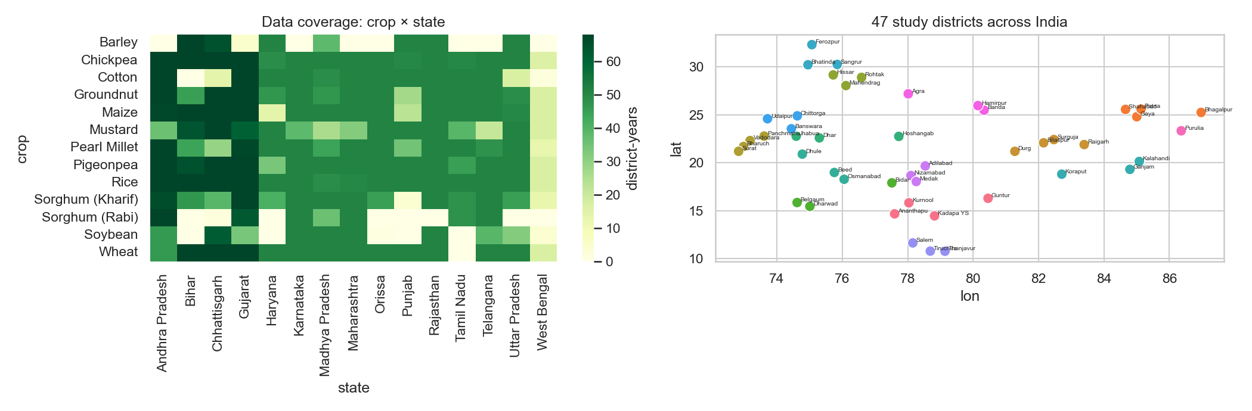
Study area and coverage
47 districts in 15 states, 13 crops
Left: number of district-years per crop and state. Right: location of the districts.
Crop Yield Outlook | Predictive Analysis
5
Notes:
Point out that coverage differs by crop: wheat is mostly northern, cotton western, and so on.

Slide 6
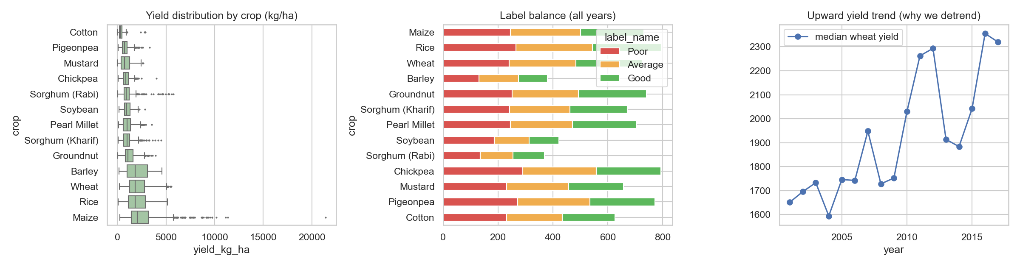
Defining a “good” yield
Good has to mean good for that crop, and yields rise over time
Remove the trend. better seeds and inputs lift yields every year, so each yield is divided by its crop's trend.
Split into thirds. for each crop, the bottom third of trend-adjusted yields is Poor, the middle Average, the top third Good.
Training years only. thresholds come from 2001-2013, so no test year influences the labels.
Location matters. thirds are taken across districts, so a naturally productive district is often Good, and weather moves it up or down.
Yield by crop, label balance, and the upward trend that the labels correct for.
Crop Yield Outlook | Predictive Analysis
6
Notes:
Explain tercile labels: each crop's bottom third is Poor, middle Average, top third Good.

Slide 7
What the model sees
67 inputs built for each crop, district, season and year
Group | Examples | Why
Season weather | Total rain, rain by season stage, dry spell, rainy days, temperature, hot days, humidity, sunshine | Water and heat at the right stage drive yield
Satellite (NDVI) | Average, peak and lowest greenness, timing of the peak, early-season greenness | Shows how well the crop actually grew
Anomalies | Each of the above minus the district's normal | Is this season unusual for this place?
Location | Latitude, longitude, state | Captures climate and soil differences
Past yield level | District's earlier trend-adjusted yield for the crop | Productive districts stay productive
Crop | One-hot for 13 crops | Crops respond differently
Past yield uses leave-one-year-out inside training years, so a row never sees its own yield.
Crop Yield Outlook | Predictive Analysis
7
Notes:
The anomaly features tell the model how unusual this season is for this district.

Slide 8
Method and evaluation
Chronological split: train on the past, test on years the model has not seen
Split. train 2001-2013 (6,451 rows), test 2014-2017 (1,943 rows), about an 80/20 split in time.
Baseline. predict each district's most common past label for the crop. Any model must beat this.
Models. Logistic Regression, Random Forest (tuned), XGBoost.
Tuning. grid search validated on 2010-2013, fitting only on earlier years.
Regression. a Random Forest regressor gives the expected yield.
Metrics used
Task | Metrics
Poor / Average / Good | Accuracy, precision, recall, F1, confusion matrix, AUC
Probability quality | Log-loss, calibration of P(Good)
Expected yield | MAE, RMSE, R²
Crop Yield Outlook | Predictive Analysis
8
Notes:
A random split would leak neighbouring years into the test set, so the split is by time.

Slide 9
Results: classification
Best model: Logistic Regression, accuracy 65.6% against a 62.3% location baseline
Model | AUC | Log-loss
Baseline (location history) | - | -
Logistic Regression | 0.83 | 0.78
Random Forest | 0.82 | 0.80
XGBoost | 0.83 | 0.81
Random Forest (tuned) | 0.82 | 0.79
Test set: 1,943 crop-district-seasons from 2014-2017. Random guessing would give 33%.
Crop Yield Outlook | Predictive Analysis
9
Notes:
Read the table, then explain that AUC measures ranking ability, which is why it matters for a likelihood.

Slide 10
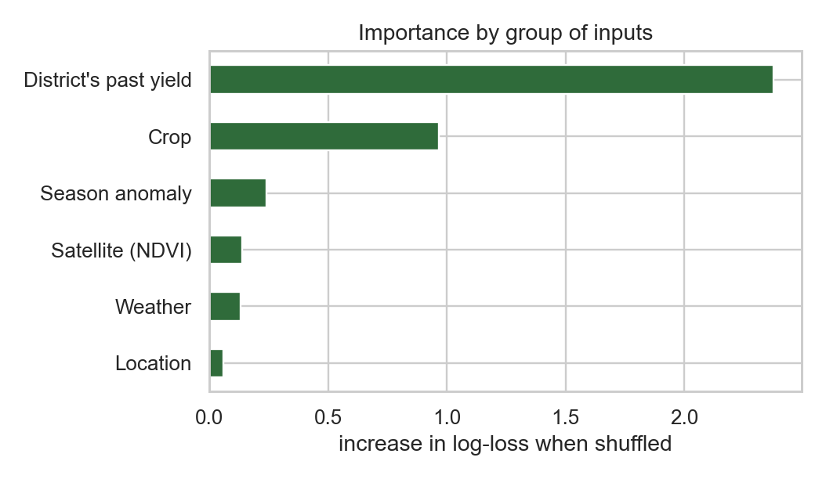
When to trust a prediction
Accuracy rises with the model's confidence
Model confidence at least | Share of cases | Accuracy
0% | 100% | 66%
50% | 89% | 68%
60% | 66% | 73%
70% | 46% | 79%
80% | 29% | 85%
Use confident predictions. the more certain the model, the more often it is right.
Be cautious on Average. the middle class is the hardest to separate.
History dominates. the district's own past yield matters most; weather and NDVI add a modest gain on top.
Permutation importance on the test years, by group of inputs.
Crop Yield Outlook | Predictive Analysis
10
Notes:
A farmer cares how far to trust a 70 percent Good. This table answers that directly.

Slide 11
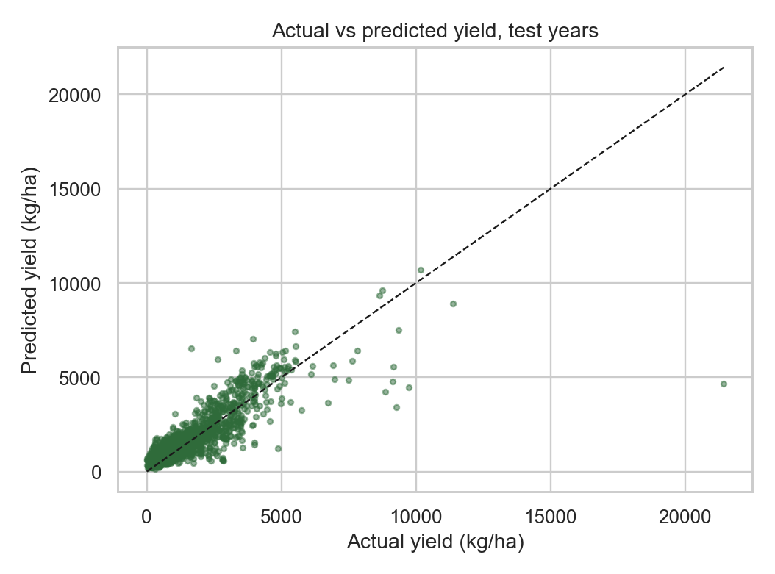
Expected yield (kg/ha)
Better than the district’s past average on RMSE and R² (0.70 vs 0.66), about equal on MAE
Metric | Random Forest | District's past average
MAE (kg/ha) | 422 | 414
RMSE (kg/ha) | 742.16 | 792.43
R² | 0.70 | 0.66
Range, not just a number. each estimate comes with an 80% range from the model's spread.
Scenarios. dry, normal and wet seasons use real past seasons of that district.
Crop Yield Outlook | Predictive Analysis
11
Notes:
Be honest: the regressor is not far better than the district's own past average. The value is in the weather response and the range.

Slide 12
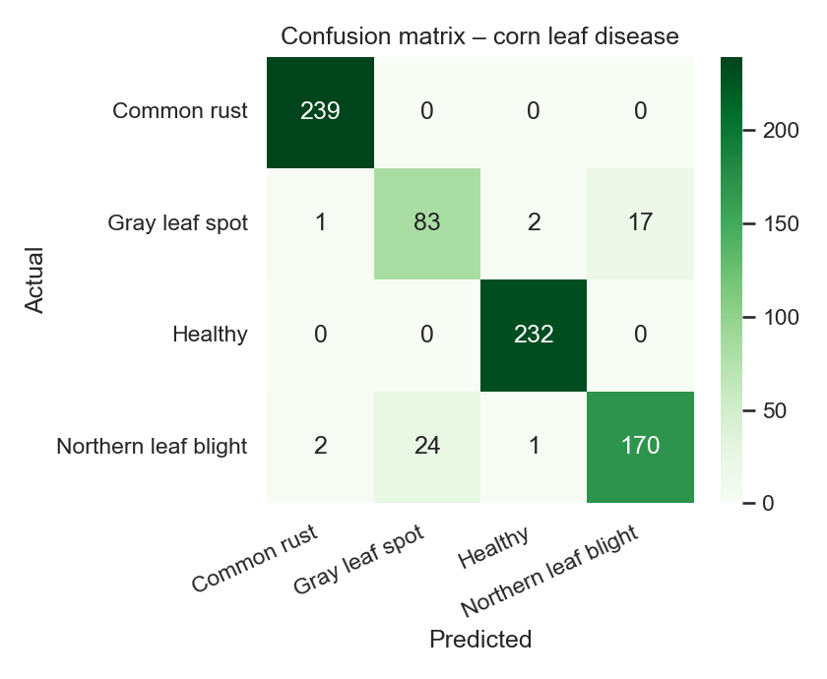
Supporting component: leaf disease
MobileNetV2 transfer learning reaches 93.9% on held-out maize leaves
Data. 3,852 PlantVillage maize leaves: gray leaf spot, common rust, northern leaf blight, healthy.
Model. ImageNet MobileNetV2, new classification head, then the last block fine-tuned.
Test. 771 unseen photos, 80/20 stratified split.
Caution. lab-style photos on plain backgrounds. Several photos of one leaf may sit on both sides of the split, so field accuracy will be lower.
Confusion matrix on the held-out leaves.
Crop Yield Outlook | Predictive Analysis
12
Notes:
Mention that PlantVillage photos are lab-style and near-duplicates may cross the split, so field accuracy will be lower.

Slide 13
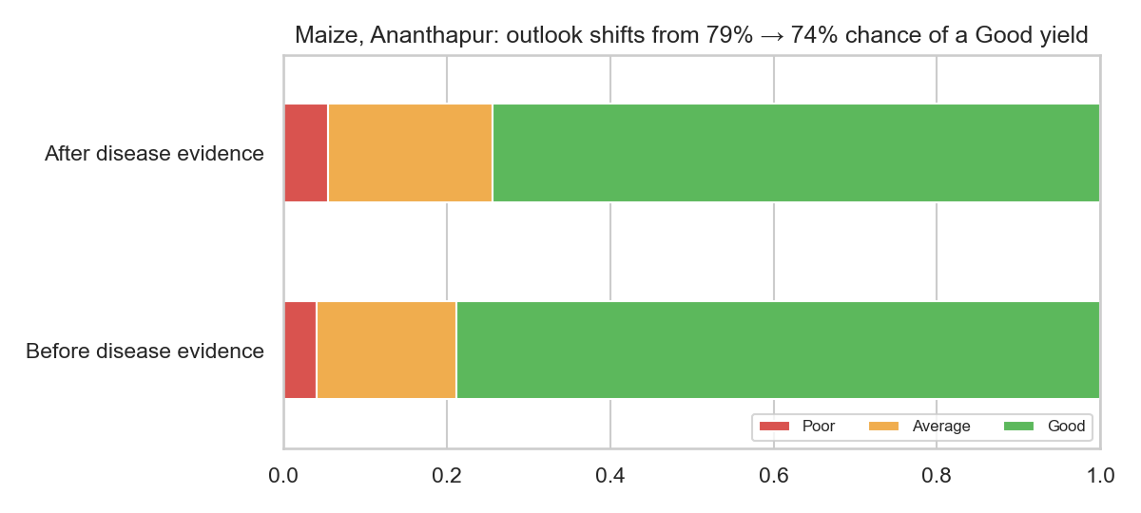
Connecting the two components
The satellite flag is only a weak signal at district level; leaf photos add the missing detail
Link 1: satellite warning, tested on real maize data
Peak NDVI | Seasons | Poor | Good
NDVI normal/high | 620 | 33% | 32%
NDVI stress flag (z < -1) | 112 | 38% | 30%
Correlation of NDVI anomaly with yield anomaly: r = 0.03. Flagged seasons are Poor only slightly more often, so district-level NDVI is a noisy warning.
Link 2: disease evidence adjusts the outlook
Scout and classify leaves, then count the share infected.
Share times an assumed loss per disease gives an expected yield loss.
The loss factors are demo assumptions, not fitted from data.
Maize in Ananthapur: outlook before and after disease evidence (assumed loss 7%).
Crop Yield Outlook | Predictive Analysis
13
Notes:
Be clear which link is measured on data (the satellite check) and which uses assumed loss factors (the disease adjustment).

Slide 14
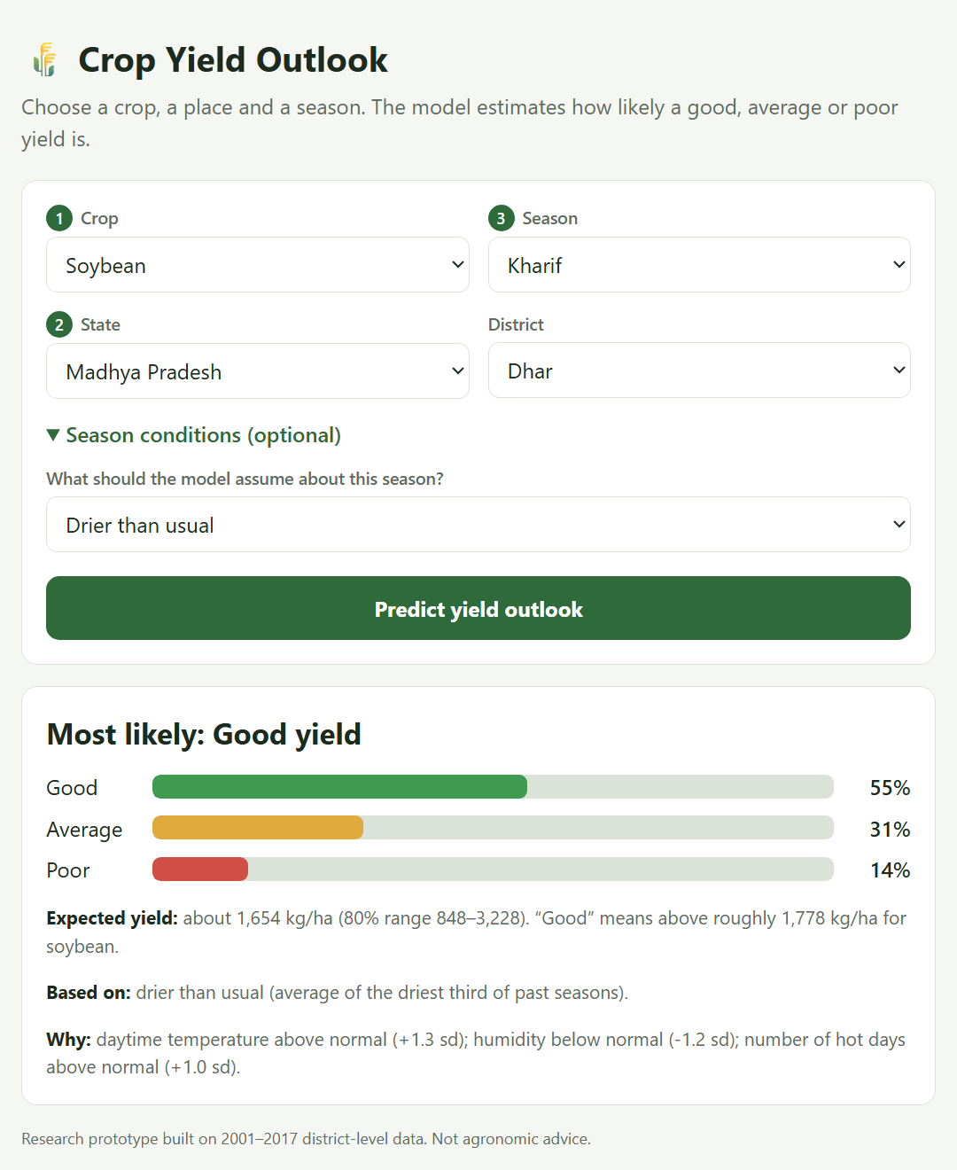
Using it
Pick a crop, a place and a season in the web page and read the result
Three inputs. crop, state and district, season (set from the crop).
Optional. a dry or wet season, a past year to replay, or a leaf disease seen on maize.
Output. probability bars, the most likely class, expected yield with a range, and the reasons.
Run it. python server.py, then open localhost:8000.
Crop Yield Outlook | Predictive Analysis
14
Notes:
Run the page live if possible: python server.py, then open localhost:8000.

Slide 15
Limitations and next steps
Limitations
Next steps
District-level yields, not field-level, and one small NDVI box per district.
Season conditions are unknown in advance, so typical / dry / wet scenarios stand in for a forecast.
Labels are relative to each crop's spread across districts.
Disease link uses assumed losses. No public data ties leaf photos to yields.
Lab-style leaf photos will score lower in a real field.
Add a weather forecast so the season is not a scenario.
Use Sentinel-2 or field-level NDVI for recent years.
Collect field data with disease severity and yield together to fit the loss factors.
Add more districts and crops and a mid-season update as NDVI arrives.
Crop Yield Outlook | Predictive Analysis
15
Notes:
Say these plainly; they are part of an honest result.

Slide 16
Summary
The product: crop + location + season in, probability of a Good, Average or Poor yield out, with an expected yield and reasons.
The evidence: Logistic Regression reaches 65.6% accuracy and 0.83 AUC on 2014-2017, against 62.3% for a location-only baseline.
The support: a MobileNetV2 CNN identifies maize leaf diseases at 93.9% on held-out photos, and feeds an adjusted outlook.
The caution: results are district-level and tested on four years. Confident predictions are the ones to rely on.
Code and notebooks: github.com/Kiwi-Supreme/CropYield
Crop Yield Outlook | Predictive Analysis
16
Notes:
Close with the main result and the honest caveats.

