Slide 1

B.Tech (CSE)
| BCSE497J - Project-I
AI-Assisted Generation of CUDA-Based Molecular Dynamics Simulations from Natural-Language Descriptions
Team members:
Shivani Srivastava (23BDS0085)
<<Name>> (<<Reg.No.>>)
Faculty guide :
Dr. Vijayasherly V

Slide 2

Approval Mail From Guide
Get the approval for the following points from your guide through mail before 01-09-2026.(sample attached below)

Slide 3
Aim
To develop an AI-assisted molecular dynamics simulation framework that allows users to describe simulation requirements in natural language, automatically interprets and configures those requirements, and reduces the effort required to build and run molecular dynamics simulations — enabling users to focus more on scientific research and understanding rather than manually writing simulation code and configurations.

Slide 4
Abstract
Setting up a molecular dynamics (MD) simulation traditionally demands both deep physics knowledge and low-level, high-performance programming expertise — a combination that puts GPU-accelerated MD out of reach for many students and researchers who understand the science but not the systems programming underneath it. This project proposes an AI-assisted MD framework in which a local Small Language Model (SLM) reads a plain-English description of a desired simulation, extracts the physical parameters and settings it implies, and automatically configures a simulation accordingly — letting the user focus on the scientific question rather than the mechanics of setting one up.
The language component's role is deliberately restricted to understanding intent and extracting structured parameters; it never generates or modifies simulation physics itself, which is instead handled by a fixed, hand-verified simulation engine. The intended computational direction for this framework is GPU/CUDA acceleration. As a working demonstration, a CPU-based C++ prototype has been implemented — supporting Lennard-Jones and Hard-Sphere models, multiple boundary conditions, and solid/liquid/gas states — with real trajectories shown through an interactive 3D visualization, validating the pipeline end to end.

Slide 5


Literature Review
Paper / Author | Objective | Methodology | Pros / Cons | Key Relevance
Frenkel & Smit (2002) | Establish classical MD algorithms | Lennard-Jones potential, Verlet integrators, PBC | Pro: foundational. Con: no automation | Physical basis for this project's engine
Plimpton, J. Comput. Phys. (1995) — LAMMPS | Scalable parallel MD | Spatial domain decomposition | Pro: mature, scalable. Con: no NL interface | Motivates a simpler NL entry point
Abraham et al., SoftwareX (2015) — GROMACS | High-performance biomolecular MD | Multi-level CPU+GPU parallelism | Pro: highly optimized. Con: manual scripting | Raw performance alone doesn't solve configuration effort
Stone et al., J. Comput. Chem. (2007) | Early GPU acceleration of MD | CUDA force/energy kernels | Pro: large GPU speedups. Con: deep CUDA expertise needed | Direct precedent for this project's CUDA direction
Anderson et al., J. Comput. Phys. (2008) — HOOMD-blue | Fully GPU-resident MD engine | Custom CUDA kernels for whole loop | Pro: no CPU bottleneck. Con: complex internals | Reference architecture for a CUDA port
Eastman et al., PLOS Comput. Biol. (2017) — OpenMM 7 | Flexible GPU-accelerated MD toolkit | Modular plugins over CUDA/OpenCL | Pro: flexible, adopted. Con: still API-driven | Even flexible toolkits stop at an API, not language
Behler & Parrinello, PRL (2007) | Learn interatomic potentials via neural nets | NN-fitted potential energy surfaces | Pro: near-quantum accuracy. Con: needs large datasets | Contrast: ML inside physics vs. this project's ML outside physics
Butler et al., Nature (2018) | Survey ML across molecular/materials science | Literature review | Pro: broad, well-cited. Con: not automation-specific | General context for ML's role in this space
Noé et al., Annu. Rev. Phys. Chem. (2020) | Survey ML methods for MD | Review of ML-for-MD techniques | Pro: comprehensive. Con: physics-internal ML only | Confirms NL interfaces for MD remain unexplored
White et al., arXiv:2302.11382 (2023) | Catalog reusable prompt-design patterns | Pattern-based prompt engineering | Pro: improves reliability. Con: needs downstream validation | Basis for constraining language output to a fixed schema
M. Bran et al., Nat. Mach. Intell. (2024) — ChemCrow | LLM agent calling verified chemistry tools | LLM + tool-calling architecture | Pro: keeps LLM out of computation. Con: limited by tool coverage | Mirrors this project's core design: extraction vs. verified execution
Boiko et al., Nature (2023) — Coscientist | LLM-driven planning of real experiments | LLM orchestrating external tools | Pro: real tasks via NL. Con: reliability depends on tools called | Evidence NL-driven scientific workflows are a credible direction

Slide 6
Research Gap
GPU-accelerated MD toolkits (LAMMPS, GROMACS, OpenMM, HOOMD-blue) are powerful but assume the user already knows how to configure a simulation, or write CUDA for custom behavior — no natural-language entry point exists anywhere in this stack.
General-purpose LLMs can generate code, but nothing constrains the generated code to be physically correct — unconstrained LLM-generated low-level/parallel code is known to be unreliable.
Emerging LLM-tool-use systems (ChemCrow, Coscientist) show natural language can drive real scientific workflows when the LLM is restricted to calling verified tools — but this pattern hasn't been applied to GPU-accelerated MD specifically.
This project addresses that gap: a local language-understanding component restricted to parameter extraction only, paired with a fixed, hand-verified simulation engine, with GPU/CUDA acceleration as the intended target.

Slide 7


Objectives
Design a structured parameter schema capturing a full MD simulation request — particle count, density/temperature, interaction model, state of matter, boundary/container settings.
Build a local language-understanding component converting natural language into this schema, with no external AI API — validated here with a rule-based extractor, a full local SLM identified as the target upgrade.
Implement a validation layer checking physical feasibility before any simulation runs.
Demonstrate the complete natural-language → configured → executed → visualized pipeline on a CPU-based prototype, proving the pipeline design is sound.
Establish a simulation engine architecture whose core computation is structured for a future CUDA/GPU port, carrying the accessibility gains to large-scale simulation.
Identified: Sustainable Development Goals — SDG 9 (Primary), SDG 4 (Secondary) | Outcomes: Product (Working Prototype / Proof of Concept)

Slide 8
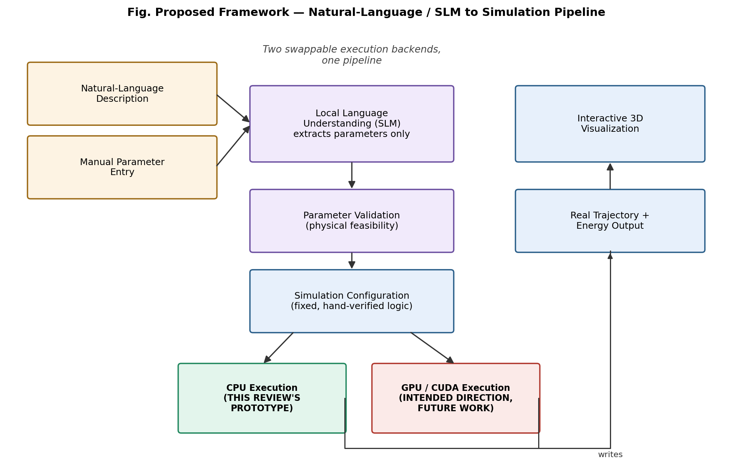
Framework/Architecture/Block Diagram
The pipeline is designed so the execution backend is swappable: the CPU engine built for this review demonstrates the full pipeline end-to-end, while the same configuration format is intended to drive a CUDA-accelerated engine for large-scale runs. The language-understanding step's role is fixed regardless of backend — it only ever produces parameters, never simulation code.

Slide 9
Functional Requirements
Accept a plain-English simulation description and extract structured parameters locally, with no external AI API.
Accept manual parameter entry as an equivalent alternative to natural-language input.
Validate all parameters, from either input path, against physical feasibility before configuring a simulation.
Translate validated parameters into a complete simulation configuration automatically, without the user writing simulation code.
Prototype: execute the configured simulation on CPU (Lennard-Jones / Hard-Sphere, periodic or container boundaries).
Record real trajectories and energy, and present them through an interactive 3D visualization.
Future scope: keep the configuration format backend-agnostic, so it can drive a CUDA/GPU engine without redesign.

Slide 10
Modules
Natural-Language Understanding Module — local, offline; interprets intent. (Prototype: rule-based. Target: local SLM.)
Parameter Validation Module — checks physical feasibility for either input path.
Simulation Configuration Module — turns validated parameters into a ready-to-run setup; where “the user stops writing code” happens.
Simulation Execution Module — runs the configuration. (Prototype: CPU/C++, this review. Target: CUDA/GPU.)
Output & Visualization Module — captures real trajectory/energy data and renders an interactive 3D view.

Slide 11
Experiments and Results
Full pipeline demonstrated end-to-end: description → extracted parameters → validated configuration → executed CPU simulation → real 3D visualization, no manual coding step.
21 automated tests confirm parameter extraction and validation behave correctly across both manual and natural-language input paths.
CPU prototype physics verified correct — periodic (NVE) runs conserve total energy to within 0.5 reduced units; Hard-Sphere collisions conserve kinetic energy almost exactly.
Solid, liquid, and gas requests produce visibly distinct, physically appropriate behavior — confirming NL state descriptions map onto real configuration, not cosmetic presets.
Not yet demonstrated: GPU/CUDA execution (hardware not available) and a full local SLM (prototype uses a rule-based stand-in for this pipeline stage).

Slide 12
Conclusion
This project demonstrates that a natural-language, AI-assisted front end to MD simulation is achievable without compromising physical correctness — by strictly separating “understanding intent” from “computing the physics.”
A working CPU-based prototype validates this pipeline end-to-end: description or manual input → automatic configuration → real simulation → real 3D results.
The broader goal — accessible, GPU-accelerated MD without deep CUDA expertise — remains the project's intended direction, with this prototype establishing the architecture it will be built on.

Slide 13
References
[1] D. Frenkel and B. Smit, Understanding Molecular Simulation: From Algorithms to Applications, 2nd ed. San Diego, CA: Academic Press, 2002.
[2] S. Plimpton, “Fast parallel algorithms for short-range molecular dynamics,” J. Comput. Phys., vol. 117, no. 1, pp. 1-19, 1995.
[3] M. J. Abraham et al., “GROMACS: High performance molecular simulations through multi-level parallelism from laptops to supercomputers,” SoftwareX, vol. 1-2, pp. 19-25, 2015.
[4] J. E. Stone et al., “Accelerating molecular modeling applications with graphics processors,” J. Comput. Chem., vol. 28, no. 16, pp. 2618-2640, 2007.
[5] J. A. Anderson, C. D. Lorenz, and A. Travesset, “General purpose molecular dynamics simulations fully implemented on graphics processing units,” J. Comput. Phys., vol. 227, no. 10, pp. 5342-5359, 2008.
[6] P. Eastman et al., “OpenMM 7: Rapid development of high performance algorithms for molecular dynamics,” PLOS Comput. Biol., vol. 13, no. 7, 2017.
[7] J. Behler and M. Parrinello, “Generalized neural-network representation of high-dimensional potential-energy surfaces,” Phys. Rev. Lett., vol. 98, 146401, 2007.
[8] K. T. Butler, D. W. Davies, H. Cartwright, O. Isayev, and A. Walsh, “Machine learning for molecular and materials science,” Nature, vol. 559, pp. 547-555, 2018.
[9] F. Noé, A. Tkatchenko, K.-R. Müller, and C. Clementi, “Machine learning for molecular simulation,” Annu. Rev. Phys. Chem., vol. 71, pp. 361-390, 2020.
[10] J. White et al., “A prompt pattern catalog to enhance prompt engineering with ChatGPT,” arXiv:2302.11382, 2023.
[11] A. M. Bran, S. Cox, O. Schilter, C. Baldassari, A. D. White, and P. Schwaller, “Augmenting large language models with chemistry tools,” Nature Machine Intelligence, 2024.
[12] D. A. Boiko, R. MacKnight, B. Kline, and G. Gomes, “Autonomous chemical research with large language models,” Nature, vol. 624, pp. 570-578, 2023.
[13] NVIDIA Corporation, CUDA C++ Programming Guide, Release 12.5, NVIDIA, 2024.

