Slide 1
Resume Analyser
Resume Analysis and Job Compatibility Prediction Using Machine Learning
Subject: Machine Learning
Presented by: Shivani Srivastava(23BDS0085) | Megana Subhas(23BDS0110)
Guide: Dr. Gopinath MP
14 October 2026

Slide 2
Problem statement
Too many resumes. A single opening can attract hundreds of applications, and screening them by hand is slow and inconsistent.
Keyword filters are brittle. A filter looking for "budgeting" misses a candidate who wrote "financial planning".
Candidates get no feedback. A rejection does not say which required skills or experience were missing.
Scores are hard to trust. Many screening tools return a number with no explanation of how it was reached.
Notes:
Why screening is hard for recruiters and opaque for candidates.

Slide 3
Proposed solution
Resume Analyser reads a resume and a job description using NLP and machine learning, and returns:
Role prediction: which of 24 job categories the resume fits best, with a confidence.
Compatibility score: a calibrated probability that the resume fits the job.
Candidate ranking: an ordered shortlist when several resumes are uploaded for one job.
Explanation: what raised or lowered the score, and which required skills are missing.
Notes:
One system with four outputs; every score is explained.

Slide 4
Research objectives covered
Resume parsing: extract skills, education, experience and certifications.
Semantic matching: compare resume and job meaning with sentence embeddings, not only keywords.
Compatibility prediction: train a supervised model on resume-job pairs.
Candidate ranking: learn to order candidates for a job (learning to rank).
Explainability: show which features drove each score.
Evaluation: compare against baselines; run ablation, calibration and a bias check.

Slide 5
Methodology
Collect data: Kaggle resume dataset, cleaned and de-duplicated.
Parse resumes: mine a skill list from the resumes' own Skills sections; extract education and years of experience.
Create training pairs: generate job descriptions and graded relevance labels (0 to 3).
Engineer features: 18 numeric features for every resume-job pair.
Train and compare: baselines, logistic regression, LightGBM classifier and ranker; calibrate probabilities.
Explain and deploy: TreeSHAP contributions and a Flask web app with an HTML/CSS/JavaScript frontend.
Notes:
Six stages from data to a working web app.

Slide 6
Pipeline
Feature extraction
Resume
(PDF / DOCX / TXT)
LightGBM compatibility model
Skill and profile parsing
18 resume-job pair features
Sentence embeddings
calibrated score + explanation
Job description
(text)
LambdaRank ranker
TF-IDF vectors
ranked candidate list
Separately, a TF-IDF + Linear SVM classifier predicts the resume's role (24 categories).
Notes:
Left to right: inputs, feature extraction, pair features, then the two models.

Slide 7
Tools and technologies
Area | Tools
Language | Python
Machine learning | scikit-learn, LightGBM
NLP | TF-IDF, Sentence-Transformers (all-MiniLM-L6-v2)
Data handling | Pandas, NumPy, SciPy, joblib
Resume parsing | pypdf, python-docx, regular expressions
Web app | Flask (REST API), HTML, CSS, JavaScript
Dataset access | KaggleHub

Slide 8
About the dataset
Source: Kaggle Resume Dataset (snehaanbhawal).
Size: 2,481 unique resumes after removing duplicates.
Labels: 24 job categories, e.g. Information Technology, HR, Finance, Engineering, Healthcare, Designer, Sales, Aviation.
Content: plain resume text with sections such as Summary, Skills, Experience and Education.
Missing pieces: the dataset has no job descriptions and no resume-job match labels, so we created them (next slide).
Notes:
Kaggle Resume Dataset by snehaanbhawal.

Slide 9
Creating training pairs (weak supervision)
Example job description (same format as the generated ones)
Relevance label of a resume-job pair
Finance Analyst
Requirements: 3+ years of relevant experience, a bachelor's degree. Strong skills in accounting, budgeting, financial reporting and auditing. Familiarity with accounts payable is a plus.
Label | Meaning
3 | Same category
2 | Closely related (e.g. Accountant and Finance)
1 | Same broad family
0 | Unrelated
Skills in each job description are mined from training resumes of one category
Train and test jobs use different skill pools
Resumes are split by candidate (80 / 20)
"Compatible" means label 2 or 3.
28,800 training pairs, 11,520 test pairs.
Notes:
Be upfront: synthetic job descriptions and category-derived labels. This is what makes training possible without manual labelling.

Slide 10
How the role classifier is trained
Labelled resumes
2,481 resumes, 24 categories
Clean and split
80% train, 20% test
TF-IDF features
words and word pairs
Compare 5 models
5-fold CV, macro-F1
Tune and calibrate
Linear SVM wins
Final test
71.4% accuracy
5 models (Logistic Regression, Linear SVM, Naive Bayes, Random Forest, KNN)
Every step here uses the dataset's real labels. The test set is touched only once, at the end.
Notes:
Supervised learning with the dataset's real category labels. Five models compared with cross-validation; Linear SVM won; one final test on the held-out 20%.

Slide 11
How the compatibility model is trained
Training resumes
1,984 real resumes
Mine skills
419 skills from resumes
Generate jobs
720 train, 288 test
Pair and label
0 to 3 by category
18 features
for each resume-job pair
Train 2 models
score and ranking
Real dataset
Generated by me
Computed or trained
Then LightGBM is calibrated (isotonic) on separate jobs, LambdaRank orders candidates per job, and TreeSHAP explains each score.
Notes:
Weak supervision: the dataset has no job descriptions or match labels, so the dashed steps were created. Real labels are the future-scope step.

Slide 12
EDA: resumes per category
Notes:
Fairly balanced; Agriculture, Automobile and BPO are small, so macro-F1 is used.

Slide 13
EDA: resume length
Average length is about 790 words; most resumes have 250 to 1,000 words
Some run past 2,000 words, more than a sentence model reads at once
Resumes have a clear structure: Summary, Skills, Experience, Education
The Skills sections became our skill list
Notes:
Long resumes motivated chunked embeddings.

Slide 14
Feature engineering: 18 features
Group | Features
Semantic | Embedding cosine similarity of resume and job
Keyword | TF-IDF cosine similarity
Skills | Required-skill coverage, matched and missing counts, Jaccard overlap, number of skills on each side
Experience | Candidate years, required years, ratio, gap, meets requirement (yes/no)
Education | Candidate level, required level, gap, meets requirement (yes/no)
Skills come from a 419-skill list mined from the resumes' own Skills sections. Experience is read from stated years and dated job ranges; education level from degree keywords.

Slide 15
NLP techniques used
Text cleaning: lowercasing, tokenization, stop-word removal.
TF-IDF: unigrams and bigrams with sublinear term frequency; used for the role classifier and as a similarity feature.
Sentence embeddings: all-MiniLM-L6-v2; each resume is split into chunks and the chunk vectors are averaged.
Skill extraction: longest-match lookup against the mined skill list.
Profile parsing: education level, years of experience and certifications with rules and regular expressions.
Keyword gaps: important job terms (by TF-IDF weight) that never appear in the resume.

Slide 16
Results: role classifier
Best model: Linear SVM on TF-IDF (tuned with GridSearchCV).
Test accuracy: 71.4%, macro-F1 0.67 on held-out resumes.
Strongest classes: Designer, Information Technology and HR (F1 about 0.9).
Notes:
24 classes, so random guessing is about 4%.

Slide 17
Results: compatibility and ranking
Model | ROC-AUC | NDCG@10
Keyword overlap (baseline) | 0.694 | 0.645
TF-IDF cosine (baseline) | 0.769 | 0.643
Embedding cosine (baseline) | 0.759 | 0.626
Logistic Regression | 0.807 | 0.670
LightGBM classifier (calibrated) | 0.804 | 0.699
LambdaRank ranker | 0.802 | 0.677
ROC-AUC 0.80 vs 0.77 for the best baseline
NDCG@10 of 0.70: relevant candidates rank near the top
Calibrated probabilities (expected calibration error 0.018)
Test candidates and test jobs were never seen in training
Evaluated on synthetic job descriptions with category-derived relevance labels; test candidates and jobs were not seen in training.
Notes:
Trained models beat every keyword/similarity baseline.

Slide 18
Importance of each feature
Ablation study
Group removed | ROC-AUC
None (full model) | 0.806
Embeddings | 0.779
TF-IDF | 0.789
Skills | 0.795
Experience | 0.804
Education | 0.803
Evaluated on synthetic job descriptions with category-derived relevance labels; test candidates and jobs were not seen in training.
Notes:
Ablation: embeddings cause the largest drop when removed.

Slide 19
Explainability in action
Finance resume vs Finance Analyst job: compatibility 88%
Helped the score | Impact
Keyword similarity (TF-IDF), 0.056 | +1.77
Semantic similarity (embeddings), 0.50 | +0.63
Only 3 required skills missing | +0.29
Required-skill coverage, 57% | +0.23
Hurt the score | Impact
Job requires 3 years of experience | -0.32
Candidate's 20 years of experience | -0.22
49 skills found in the resume | -0.17
Experience surplus of 17 years | -0.01
Positive impact pushes the model toward "compatible"; negative pushes away
The dominant signal is text similarity; experience features make small adjustments
Candidates and recruiters can see exactly why a score was given
Notes:
Real example from the demo: a Finance resume against the Finance Analyst job description. Impacts are TreeSHAP contributions in log-odds.

Slide 20
Error analysis and fairness check
Classifier: weakest and strongest classes
Bias check: change in compatibility score
Class | Resumes | F1
BPO | 4 | 0.00
Apparel | 19 | 0.33
Automobile | 7 | 0.44
Designer | 21 | 0.91
Information Technology | 24 | 0.89
Identity text added | Avg change | Flips
female name | 1.0% | 2 / 120
male name | 1.0% | 1 / 120
south-asian name | 0.8% | 2 / 120
east-asian name | 0.5% | 1 / 120
birth year 1962 | 0.6% | 2 / 120
Low F1 goes with small classes (BPO has only 22 resumes in total)
Compatibility mistakes mostly involve neighbouring fields, e.g. Public Relations vs Arts
Names, pronouns and birth year shift scores by about 1% on average; protected attributes are never inputs
Notes:
Weakest classes are the smallest ones. Bias check: identity text added to 120 test resumes barely moves scores.

Slide 21
Input and output
Input
Output
Resume file (PDF, DOCX or TXT)
Job description text
Or 2 to 30 resumes to rank for one job
Predicted role with confidence
Compatibility score (%) with four dimensions: required skills, semantic relevance, experience, education
Matched and missing skills and keywords
"Why this score?": features that helped and hurt
Ranked list of candidates

Slide 22
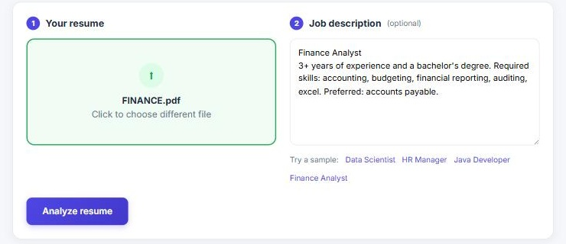
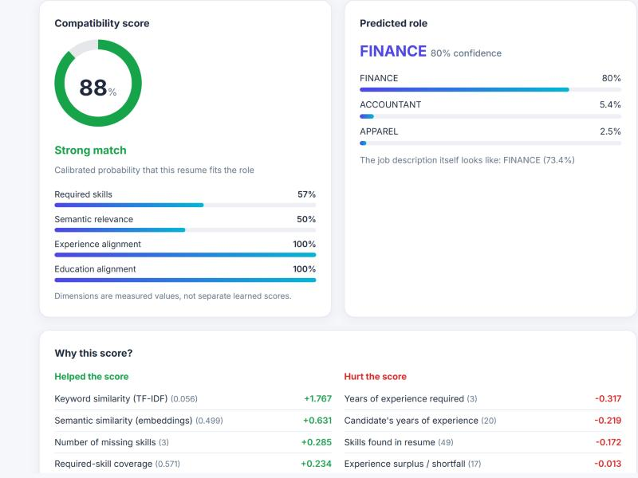
Demo: analyze a resume
Upload a PDF, DOCX or TXT resume
Paste a job description or pick a sample
The score, predicted role and explanation appear in a few seconds
Notes:
Upload, paste a job description, click Analyze; walk through the score, the role prediction and the explanation panel.

Slide 23
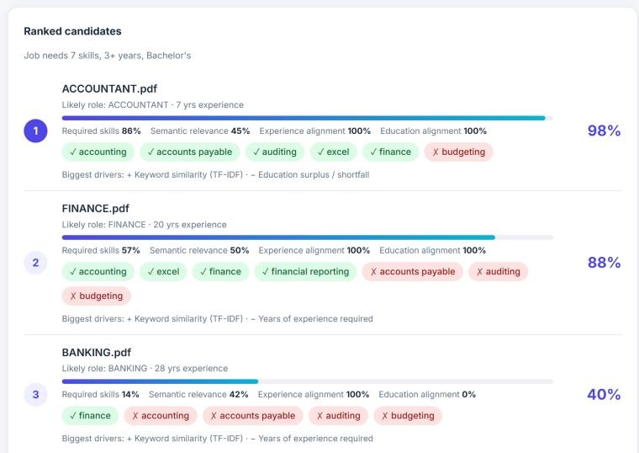
Demo: rank candidates
Five resumes ranked against one finance job
Accountant 98%, Finance 88%, Banking 40%
IT (7%) and Chef (4%) are ranked last
Each candidate shows matched and missing skills
Notes:
Expected order: Accountant, Finance, Banking, IT, Chef.

Slide 24
Unique selling points
Explainable: every score comes with the features that raised or lowered it (TreeSHAP).
Semantic: embeddings capture meaning, so different wording of the same skill still matches.
Calibrated: scores are probabilities, checked against observed outcomes.
Ranking built in: a LambdaRank model orders candidates for a job.
Self-built skill list: 419 skills mined from real resumes, not typed by hand.
Properly evaluated: baselines, ablation, error analysis and a bias check.
Fairness-aware: no protected attributes are used; adding names or pronouns changed scores by about 1% on average.

Slide 25
Future scope
Real hiring data: train on recruiter-labelled resume-job pairs and hiring outcomes.
Real job postings: replace generated descriptions with large public job-posting datasets.
Fine-tuned models: cross-encoders or resume-specific transformers.
Richer parsing: named-entity recognition for titles and projects; OCR for scanned PDFs.
Skill ontology: link to ESCO or O*NET to cover niche and emerging skills.
Fairness tooling: name masking, formal bias audits and human review.
Smarter thresholds: tune the match cutoff per role to catch more suitable candidates.
Deployment: cloud hosting, user accounts, feedback loop and periodic retraining.

Slide 26
Conclusion
End to end: a working system that parses resumes, matches them semantically, predicts compatibility, ranks candidates and explains each score.
Role classifier: 71.4% accuracy across 24 categories, about 17 times better than random guessing.
Compatibility model: beats keyword, TF-IDF and embedding baselines (ROC-AUC 0.80 vs 0.77, NDCG@10 0.70).
Trustworthy outputs: calibrated probabilities, TreeSHAP explanations, ablation, error analysis and a bias check.
Next step: validate and retrain on recruiter-labelled resume-job pairs.
Notes:
Summarise: it works end to end, beats baselines, is explainable, and has a clear path to real-world validation.

Slide 27
References
Bhawal, S. Resume Dataset. Kaggle. kaggle.com/datasets/snehaanbhawal/resume-dataset
Reimers, N. and Gurevych, I. (2019). Sentence-BERT: Sentence Embeddings using Siamese BERT-Networks. EMNLP-IJCNLP.
Wang, W. et al. (2020). MiniLM: Deep Self-Attention Distillation for Task-Agnostic Compression of Pre-Trained Transformers. NeurIPS.
Ke, G. et al. (2017). LightGBM: A Highly Efficient Gradient Boosting Decision Tree. NeurIPS.
Lundberg, S. and Lee, S.-I. (2017). A Unified Approach to Interpreting Model Predictions. NeurIPS.
Burges, C. (2010). From RankNet to LambdaRank to LambdaMART: An Overview. Microsoft Research Technical Report MSR-TR-2010-82.
Pedregosa, F. et al. (2011). Scikit-learn: Machine Learning in Python. Journal of Machine Learning Research, 12.
Notes:
Cite these in the report as well.

Slide 28
Thank you
https://github.com/Kiwi-Supreme/Resume-Analyser

