Slide 2
How do we present the problem to the optimizer?
What are smart ways to encode the Parameters, variables of the proposed Problem
Delta encoding
normalization
How can exploration of the Optimizer the enhanced
Optimum is the result of training on more than one data
What is the optimum?
Weight matrixes that minimize the loss during the encoding and decoding (reconstruction of compressed data)

Slide 3
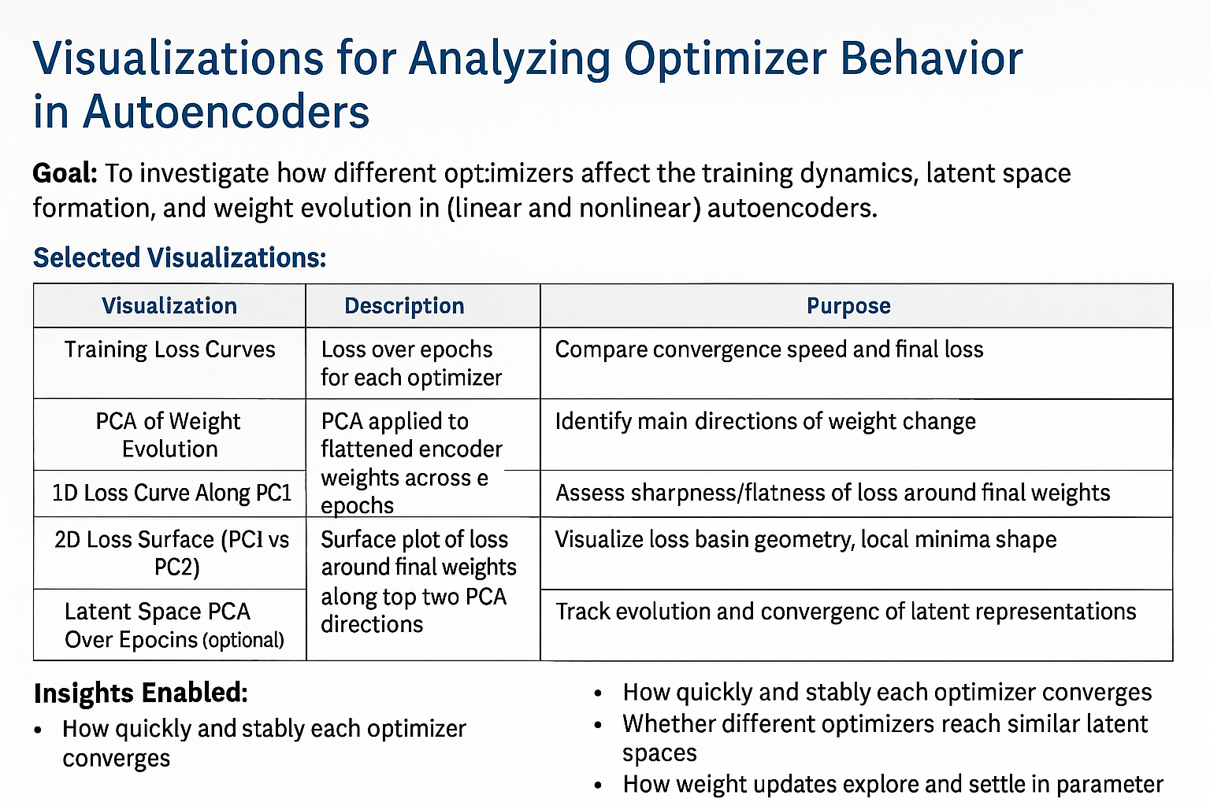

Slide 4
Analyse how the optimizer space looks
Once without the ReLU and once with
Do we have constraints => lossless compression
We want to reconstruct exactly one selected datapoint in the signal (this is a constraint)
The accuracy of the optimization (discrete or continuous)
Fix the weights and only vary like 10 of them with both matrixes
Brute force changes in the matrix to sample the noisiness of the optimization space
Statistical noise added, or specle noise added
Does the optimizer navigate the optimization space well?
Does the optimizer converge (finds the true reconstruction of the signal)
Does it find the global maximum/minimum or only the local one
Simulated annealing as a fourth optimizer technique
Why do we use gradient based optimization?
Why are Neural networks not simple Optimizers
Evaluate whether the Optimizer is good
Is the optimization space noisy
Does the optimizer converge (finds the true reconstruction of the signal)
Does it find the global maximum/minimum

Slide 5
Solution Space
What is the Solution space

Slide 6
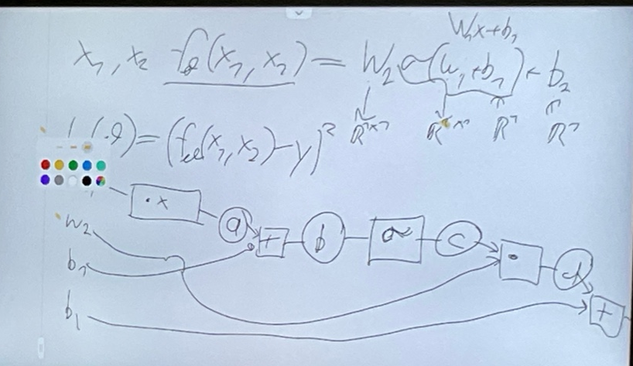

Autoencoder
Computation pathway of a 2layer Neural Network
1st layer Input Layer
2nd layer Output Layer
$$f\left(x_{1},x_{2}\right)=W_{2}σ\left(W_{1}x+b_{1}\right)+b_{2}$$
$$ℒ\left(θ\right)={\left(f_{θ}\left(x_{1},x_{2}\right)−y\right)}^{2}$$

Slide 7
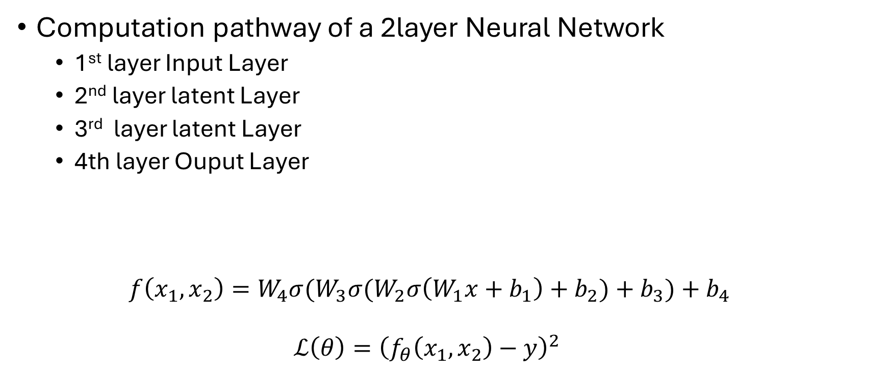
Autoencoder
Computation pathway of a 2layer Neural Network
1st layer Input Layer
2nd layer latent Layer
3rd layer latent Layer
4th layer Ouput Layer
$$f\left(x_{1},x_{2}\right)={{W_{4}σ(W}_{3}σ(W}_{2}σ\left(W_{1}x+b_{1}\right)+b_{2})+b_{3})+b_{4}$$
$$ℒ\left(θ\right)={\left(f_{θ}\left(x_{1},x_{2}\right)−y\right)}^{2}$$

