Slide 1
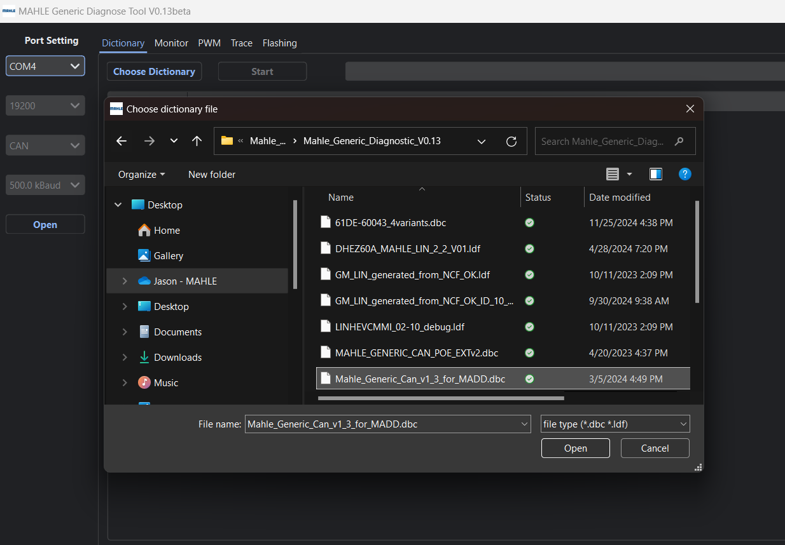
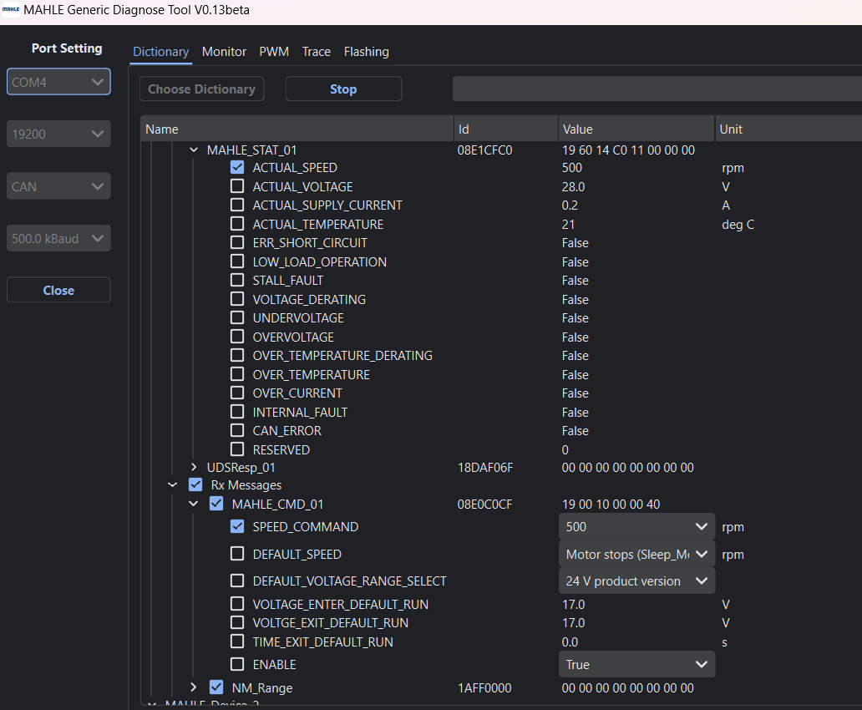
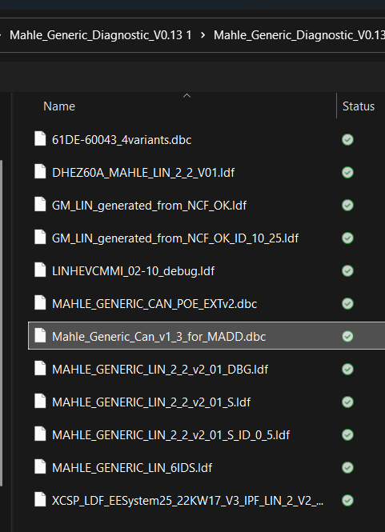
1
2
3
8
4
7
5
6

Slide 2
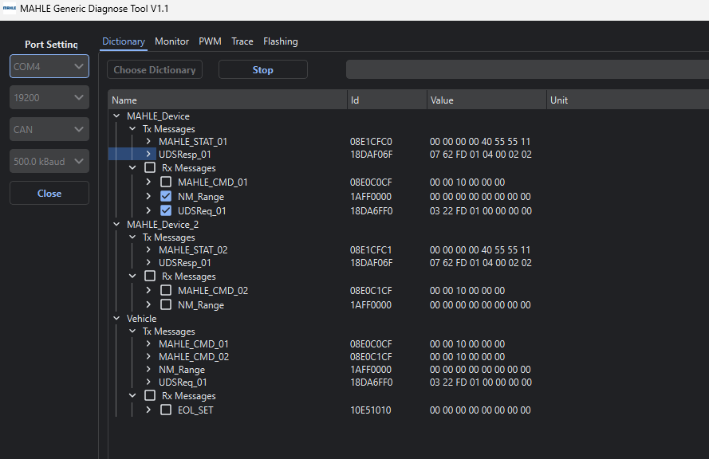
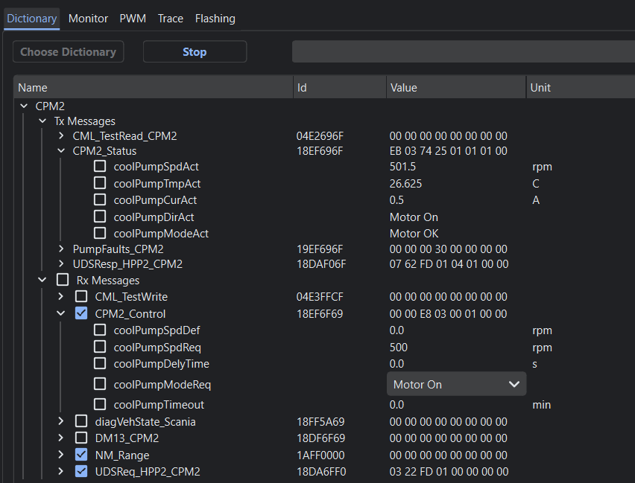
SCANIA&MAN
GENERIC
软件版本
软件版本设置打勾

Slide 3
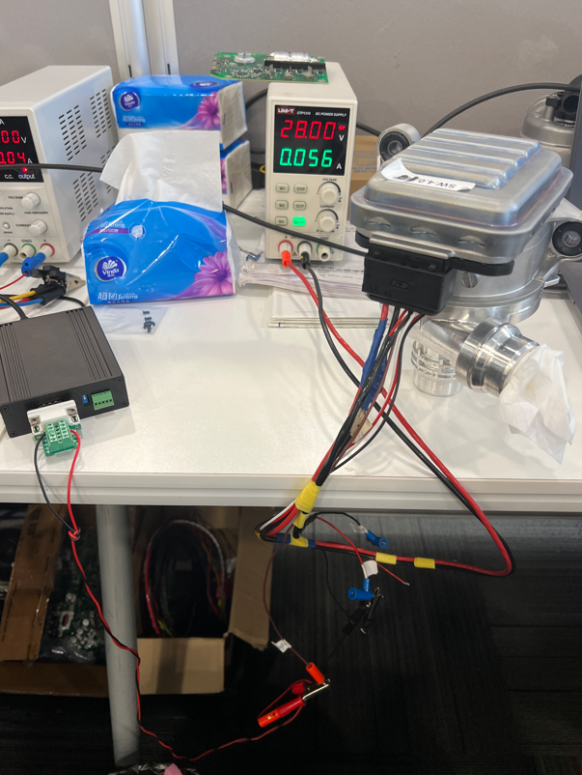
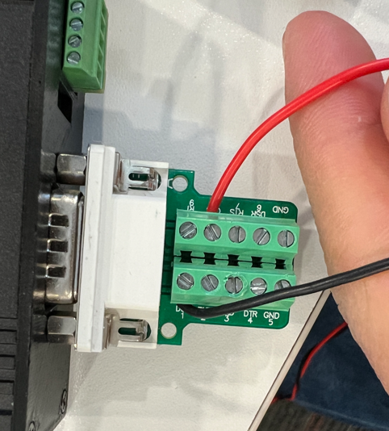
2
1

Slide 4
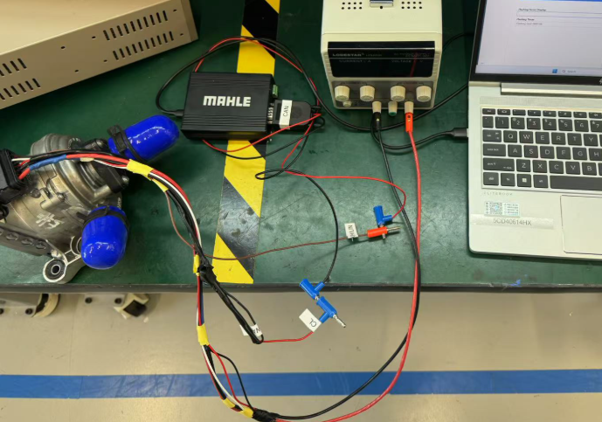
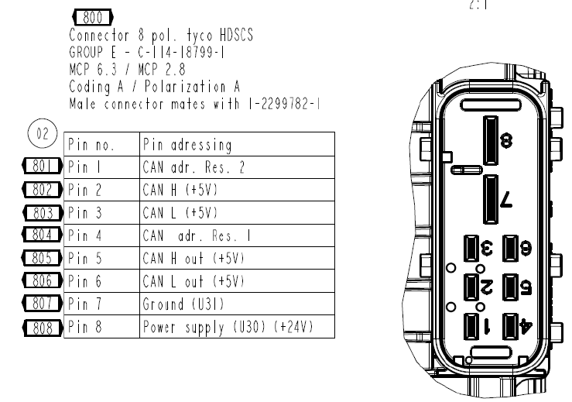
Wire connection layout
Set voltage to 28V
CAN H
CAN L

Slide 5
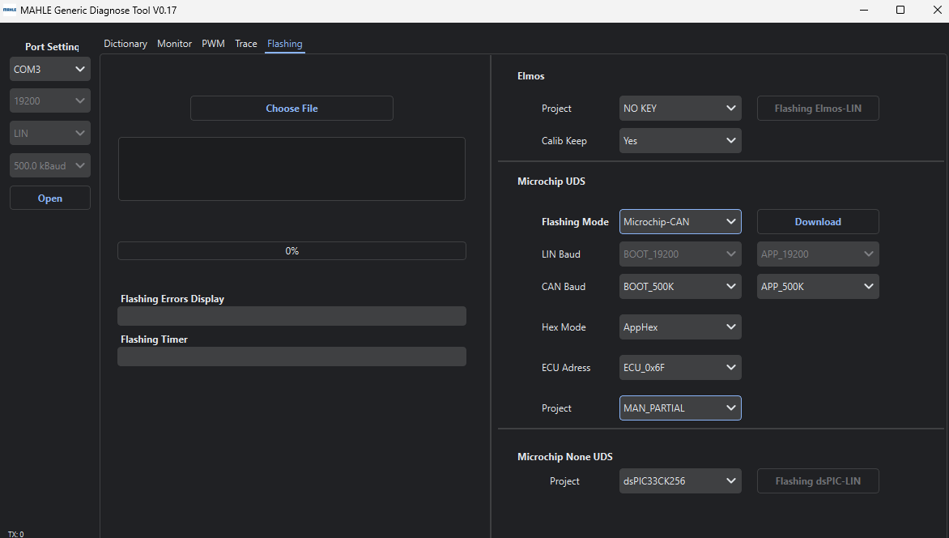
1
SW reflash guideline for Generic CAN
Select the port of computer which connect the reflash box
Click “Open”
Choose the hex file (software) need to be reflashed
Select “Microchip-CAN”, set the value as showed.
Click “Download”
Wait until the process to 100%
Reclick “Download” if reflash unsucessfully
3
2
4
5
6

Slide 6
1
2
3
8
4
7
5
6
Check the function after reflash
1 to 4: choose the “dbc” file to operate the pump，click “open” (green area) to “close” status.
5: Select “True”
6: Tick “NM_Range”
7: Set 500 rpm (lowest operation speed to avoid damage)
8: Actual speed “500” run at most 5 seconds.
If no actual speed shows, try to check the setup of 1-8. If still not working , reflash it again.

Slide 7
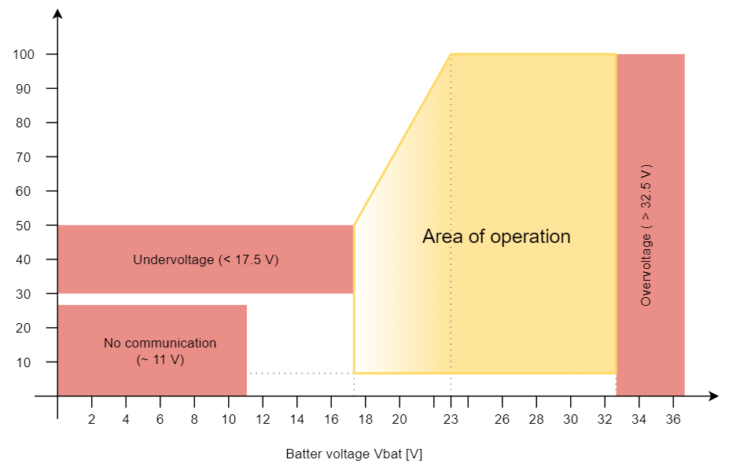
Undervoltage（＜15.5V）
15

