Slide 1
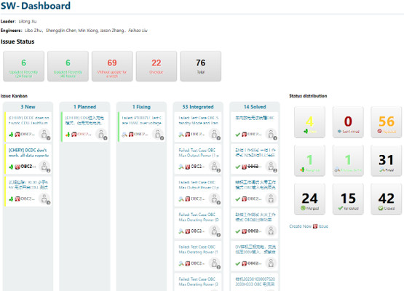
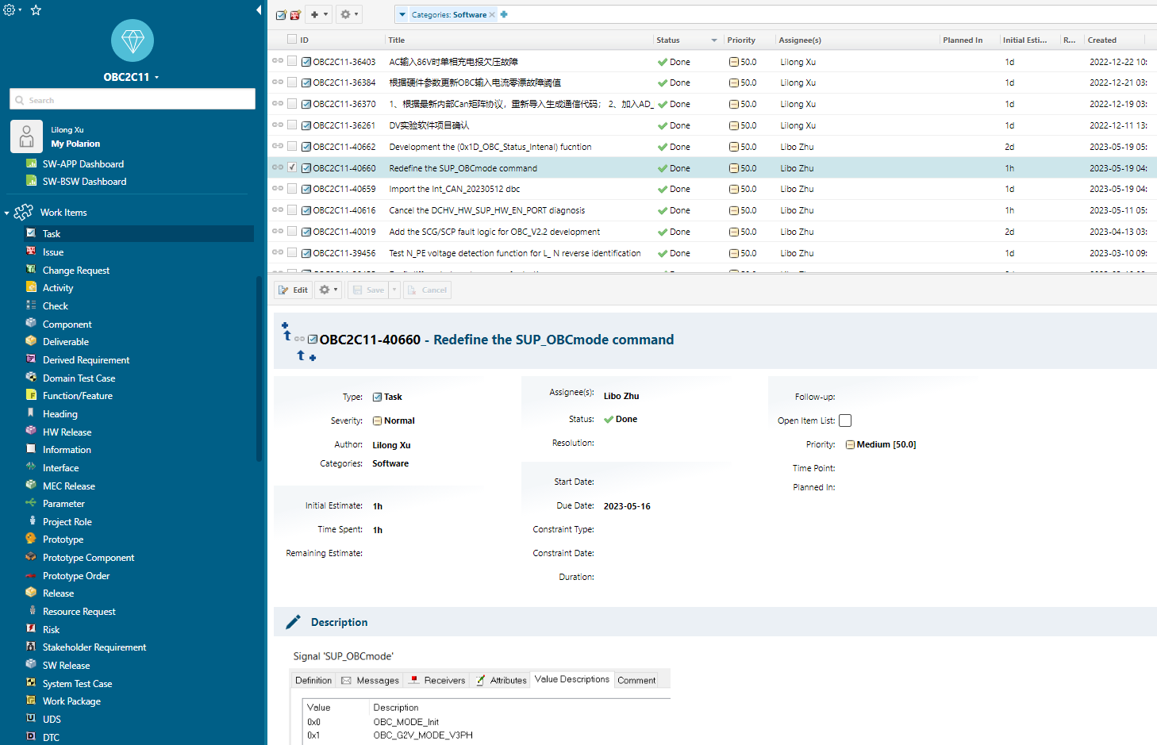
Issue and Work Task Management
Work Flow:
Create the task->Initial Estimate->Review->Done;
New: Author created issue;
Plan: Assignee(s) confirm this is a issue;
Fixing: Assignee(s) analyze & fix the issue;
Integrated: Assignee(s) merged the issue;
Soled: Author validated this issue

