Slide 1

🌿 COMPSCI 734 • UNIVERSITY OF AUCKLAND
SUSTAINABLE COMMUNITY MARKETPLACE
KiwiShare
A Decoupled, Cloud-Native & Cross-Platform Solution for Aotearoa
Team Five Guys · COMPSCI 734 · University of Auckland
● Live in Production
🌐 kiwishare.online
☁️ kiwishare.onrender.com
📱 Android APK Ready
Auckland Sky Tower · Campus Ecosystem · Sustainable Circular Economy
KiwiShare · Team Five Guys · COMPSCI 734 · University of Auckland
Slide 01 of 10

Slide 2

RUBRIC CRITERION 04 · USER NEED
Genuine User Need: Building Verified Trust in Aotearoa
Eliminating second-hand friction, seller ghosting, and commission tax for campus communities
1. Institutional Trust vs Anonymous Friction
• Student Identity Verification: Mandatory .ac.nz institutional email verification eliminates anonymous scammers and counterfeit items.
• Public Reputation Badges: Every profile displays verified student status, completed transactions, and transparent community feedback.
• Campus Safety Baseline: Builds inherent peer-to-peer accountability across student dorms, faculties, and campuses.
[Verified .ac.nz] [Zero Scammers] [Campus Safety]
2. Dynamic Trust Scores & Zero Platform Tax
• Dynamic Trust Scoring (0–100): Proprietary algorithm awards +5 reputation points for successful handovers and penalizes meetup cancellations.
• 100% Free Campus Exchange: Zero commission fees compared to Trade Me's 7.9%–12.9% cut, encouraging sustainable item reuse.
• Spatial Proximity Indexing: Geospatial indexing matches buyers with items within walking distance (CBD, Ponsonby, Grafton).
[Trust Score 0-100] [Zero Platform Tax] [Geospatial Matching]
University Crest Verification · 100% Trust Gauge · Localized NZ Proximity
KiwiShare · Team Five Guys · COMPSCI 734 · University of Auckland
Slide 02 of 10

Slide 3

RUBRIC CRITERIA 01 & 06 · ARCHITECTURE
Integrated Solution: Decoupled Tri-Tier Architecture
Clear functional separation: Mobile for physical exchange, Web for governance, Cloud for atomic data
📱 Flutter Mobile App (Physical Interaction)
• 60 FPS Discovery: Mobile-optimized browsing, category filtering, and nearby distance queries.
• Hardware Integration: Optical QR scanning for instant handovers; native voice recording in chat.
[Flutter 3.12+] [Provider] [GoRouter]
🌐 React Web Portal (Platform Governance)
• Live Administration: Responsive desktop portal at kiwishare.online for platform monitoring.
• Financial & Trust Moderation: Real-time GMV metrics, user trust score adjustments, and item moderation.
[React 18] [Vite] [Cloudflare SSL] [RBAC]
☁️ Koa RESTful API & MongoDB Atlas
• Stateless REST Gateway: Node.js/TypeScript backend deployed on Render with standardized error handling.
• ACID Multi-Document Sessions: MongoDB replica set guarantees atomic all-or-nothing state transitions.
[Koa.js] [TypeScript] [MongoDB Atlas] [ACID Sessions]
Isometric Architecture: Flutter Mobile · React Web Admin · Koa/Atlas Cloud
KiwiShare · Team Five Guys · COMPSCI 734 · University of Auckland
Slide 03 of 10

Slide 4
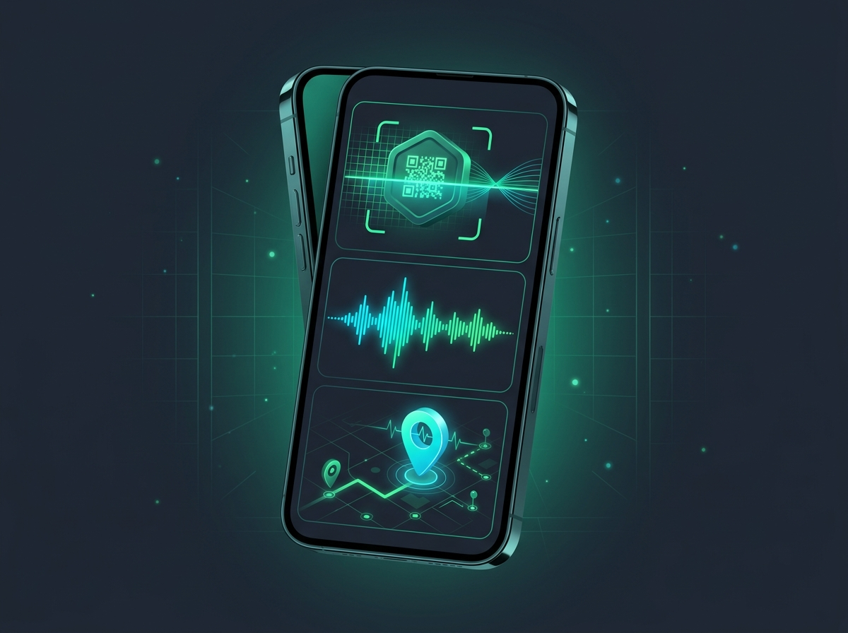
RUBRIC CRITERION 05 · MOBILE CAPABILITIES
Modern Mobile Capabilities: Native Hardware Integration
Unlocking device sensors to deliver capabilities fundamentally impossible on conventional web browsers
📷 Optical Vision & Camera Scanning
• mobile_scanner: Hardware camera reads seller's dynamic QR code at 60 FPS in < 200ms.
• image_picker: Fast listing photo capture with client-side compression to preserve cellular data.
[mobile_scanner] [60 FPS Vision] [Client Compression]
🎙️ Native Microphone & Audio Streamer
• record Package: Direct microphone capture with ambient noise filtering inside real-time chat.
• just_audio Streamer: Hardware-accelerated voice note playback with interactive scrubbing timeline.
[record] [just_audio] [Voice Memos]
📍 GPS Sensors & Vector Mapping
• geolocator & geocoding: High-precision device GPS automatically mapped to NZ suburbs (Ponsonby, CBD).
• flutter_map Integration: Offline-cached OpenStreetMap vector tiles with zero proprietary API fees.
[geolocator] [NZ Geocoding] [OpenStreetMap]
Native Hardware: Camera QR Beam · Audio Waveform · GPS Proximity
KiwiShare · Team Five Guys · COMPSCI 734 · University of Auckland
Slide 04 of 10

Slide 5

RUBRIC CRITERION 03 · INDEPENDENT LEARNING
Independent Learning: Technologies Applied Beyond Course Scope
Four research-backed architectural innovations explored, benchmarked, and implemented by the team
1. Audio Transcoding & Direct Edge Uploads
• FFmpeg-Static Pipeline: Integrated static FFmpeg Linux binary to sanitize, inspect, and transcode conflicting mobile audio codecs (M4A/AAC) for 100% universal playback.
• Cloudflare R2 Direct PUT: Koa API generates 15-min S3-presigned URLs; mobile clients upload images directly to Cloudflare R2, bypassing API servers with zero egress cost.
[ffmpeg-static] [Cloudflare R2] [S3 Presigned] [Zero Egress]
2. Generative AI Assistant & Automated Monorepo CI/CD
• Google Gemini 2.5 Flash: Integrated server-side Gemini AI model to infer item category, condition, and sustainability tags from minimal user prompts in < 1 second.
• Automated Monorepo CD: Configured PNPM workspaces with standard-version and 4 automated GitHub Actions pipelines auto-tagging SemVer releases on merge to main.
[Gemini 2.5 Flash] [PNPM Workspace] [GitHub Actions CD] [SemVer]
Neural AI Brain · FFmpeg Audio Pipeline · Cloudflare R2 Edge Storage
KiwiShare · Team Five Guys · COMPSCI 734 · University of Auckland
Slide 05 of 10

Slide 6
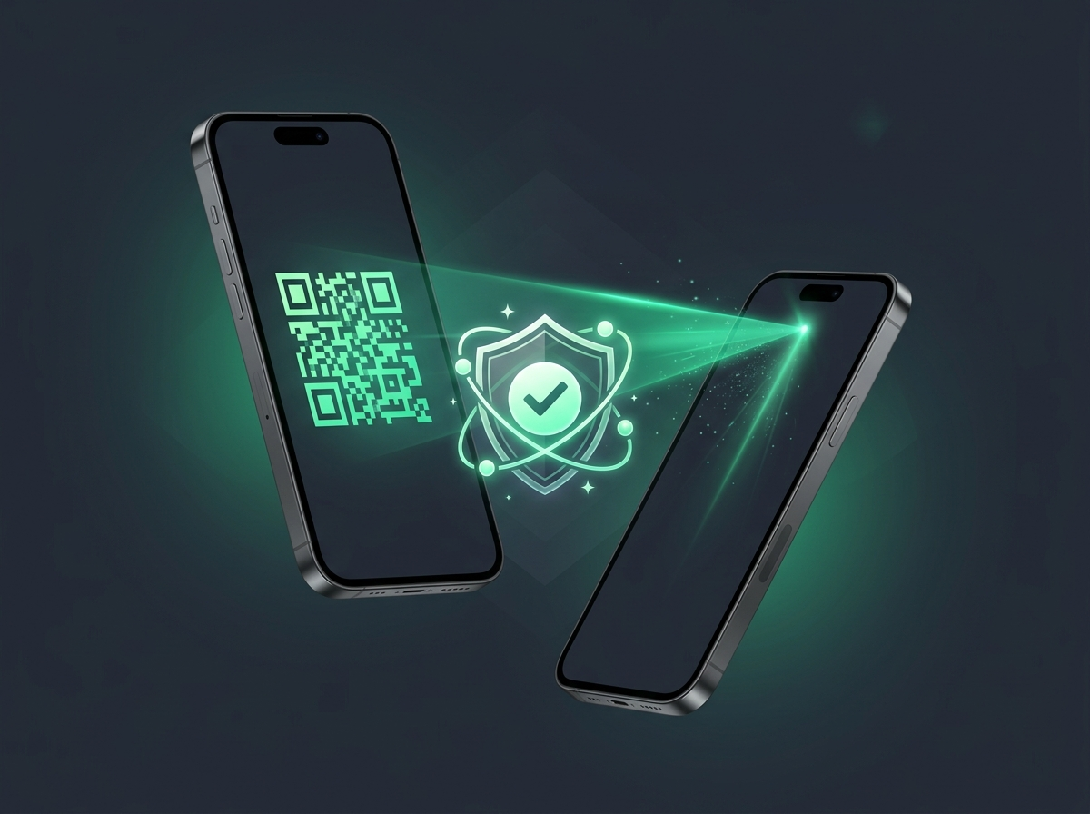
RUBRIC CRITERIA 02 & 06 · PROTOCOL & ACID
Technical Mastery: Cryptographic Handover Protocol
Eliminating in-person delivery fraud and ghosting disputes through atomic cryptographic verification
1. Four-Step Cryptographic Handover Flow
• Step 1: Dynamic QR Generation: Seller displays dynamic token QR_HANDOVER_TOKEN_<id>_<nonce> bound to 7-day MongoDB TTL index.
• Step 2: Optical Camera Scan: Buyer scans QR via mobile_scanner in < 200ms; sends authenticated claim request.
• Step 3 & 4: State Transition: Server commits transaction; seller receives +5 trust points and order is marked complete.
[Dynamic Nonce] [TTL Expiration] [+5 Trust Reward]
2. MongoDB ACID Multi-Document Atomicity
• All-or-Nothing Commit: Koa executes runMongoTransaction: [Transfer Ownership] ➔ [Seller TrustScore +5] ➔ [Burn Token] ➔ [Complete Order].
• Automatic Network Rollback: If cellular connection drops mid-exchange, all operations abort cleanly with zero partial state corruption.
[runMongoTransaction] [Zero State Drift] [Atomic Rollback]
Dynamic Optical QR Handover · Atomic Commitment Shield
KiwiShare · Team Five Guys · COMPSCI 734 · University of Auckland
Slide 06 of 10

Slide 7

RUBRIC CRITERION 09 · CYBERSECURITY
Cybersecurity & Privacy: Defense-in-Depth OWASP Controls
Proactive mitigation embedded across client apps, API gateway, and database layers
1. Access Control & Cryptographic Defense (A01, A02)
• JWT Authorization & RBAC: Cryptographically signed JWT bearer tokens required for mutations; requireAdmin middleware guards governance routes.
• Bcrypt Password Hashing: User passwords salted and hashed with bcrypt (12 work factor rounds).
• TLS 1.3 HTTPS & Secrets Vault: End-to-end encryption across Cloudflare edge; zero secrets stored in git repositories.
[JWT Bearer] [requireAdmin RBAC] [Bcrypt (12 Rounds)]
2. Injection Prevention & Server Hardening (A03, A05)
• NoSQL & ReDoS Sanitization: Strict Mongoose schemas block query injection; search queries sanitize regex expressions to prevent catastrophic backtracking.
• Security Header Hardening: Removed X-Powered-By fingerprint headers; strict CORS whitelist enforces approved production origins.
• Masked Error Interceptor: Runtime exceptions masked from client responses while detailed stack traces logged internally.
[NoSQL Defense] [ReDoS Mitigation] [CORS Whitelist] [Error Masking]
Cyber Defense: Padlock Encryption · Firewall Shield · OWASP Top 10
KiwiShare · Team Five Guys · COMPSCI 734 · University of Auckland
Slide 07 of 10

Slide 8

RUBRIC CRITERIA 07 & 08 · ENGINEERING & TESTING
Software Engineering Standards & Multi-Tier Testing Strategy
Enforcing production-grade code quality, automated test suites, and transparent team workflows
1. Multi-Tier Automated Testing Suites
• 12 Backend Jest Suites: Unit and integration tests with Supertest HTTP mocking covering Auth, OTP, Meetups, Transactions, and Admin.
• Flutter Test Suites: Granular repository, provider, navigation, and widget tests in mobile/test/ verifying offline states.
• Audit Verification Reports: Formal subsystem test reports archived in docs/testing-strategy/ for complete traceability.
[12 Jest Suites] [Flutter Widget Tests] [Supertest Mocking]
2. Git-Flow Branching & 4 Automated CI Pipelines
• Structured Git-Flow: Feature branches (feature/*) merge into pre for integration, with production releases tagged on main.
• 4 Parallel GitHub Actions: Automated workflows validate linting (ESLint, Dart Analyze), execute tests, and compile Android APKs.
• Pre-Commit Hygiene: Husky hooks enforce Prettier and Dart Format to ensure zero lint drift across the monorepo.
[Git-Flow Model] [GitHub Actions CI] [Husky Pre-Commit]
Continuous Testing: Automated Test Nodes · CI/CD Quality Gate
KiwiShare · Team Five Guys · COMPSCI 734 · University of Auckland
Slide 08 of 10

Slide 9

RUBRIC CRITERIA 10 & 11 · LIVE DEPLOYMENT
Realistic Deployment: 100% Live Production Ecosystem
Publicly accessible production services deployed across edge CDN, cloud containers, and physical mobile devices
1. Public Production Endpoints (Ready to Access)
• Web Portal (kiwishare.online): Live single-page application hosted with Cloudflare CDN, global edge caching, and automated SSL.
• REST API (kiwishare.onrender.com): Node.js 22 LTS container on Render with zero-downtime rolling updates and /health endpoint.
• Mobile APK (GitHub Releases): Compiled Android APK with release notes ready for immediate assessor download.
[kiwishare.online] [Render Cloud] [GitHub Releases APK]
2. Pre-Seeded MongoDB Atlas Database (Zero Setup)
• Campus Data Pre-Seeded: Live database populated with 10 categories, verified student accounts, and active listings in Auckland (CBD, Ponsonby, Grafton).
• Ready-to-Scan Demo Order: Includes confirmed meetup order #ORD_DEMO_MEETUP_2026 for instant QR handover evaluation without local configuration.
[MongoDB Atlas ReplicaSet] [Auckland Suburbs] [Zero Config]
NZ Production Mesh: Cloudflare CDN · Render API · MongoDB Atlas
KiwiShare · Team Five Guys · COMPSCI 734 · University of Auckland
Slide 09 of 10

Slide 10

RUBRIC CRITERION 12 · DEMONSTRATION
Assessor Live Walkthrough & Demonstration
Ready-to-evaluate live credentials and step-by-step 3-minute evaluation scenarios
🔑 Pre-Seeded Test Credentials
• Universal Password: password123 (applies to all seeded accounts).
• Platform Admin: admin@kiwishare.online ➔ Inspect kiwishare.online/admin for GMV analytics and user moderation.
• Verified Student Seller: moviegoer24@gmail.com ➔ Displays QR token for order #ORD_DEMO_MEETUP_2026.
• Verified Student Buyer: testbuyer@kiwishare.online ➔ Scans QR to claim ownership and test +5 trust reward.
[P/W: password123] [Instant Live Login]
🚀 Fast 3-Minute Assessment Flows
• Scenario A: Web Administration: Log into kiwishare.online as Admin; review live GMV metrics, fee turnover, and adjust trust scores.
• Scenario B: Optical QR Handover: Seller displays QR token on mobile; Buyer scans to witness atomic ownership transfer and +5 trust reward.
• Step-by-Step Guide: Refer to docs/demo-guide.md for comprehensive walkthrough instructions and API curl commands.
[Web Admin Board] [Live QR Scan] [docs/demo-guide.md]
Team Five Guys · COMPSCI 734 · University of Auckland
KiwiShare · Team Five Guys · COMPSCI 734 · University of Auckland
Slide 10 of 10

