Slide 1
Registers and Counters

Slide 2
Overview
Parallel Load Register
Shift Registers
Serial Load
Serial Addition
Shift Register with Parallel Load
Bidirectional Shift Register

Slide 3
Registers and Counters
An n-bit register
n flip-flops
Capable of storing n bits of binary information.
Counter:
FSM that goes through a predetermined sequence of states

Slide 4
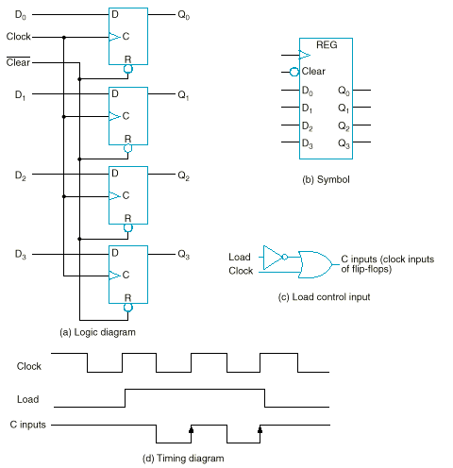
4-Bit Register
Load

Slide 5
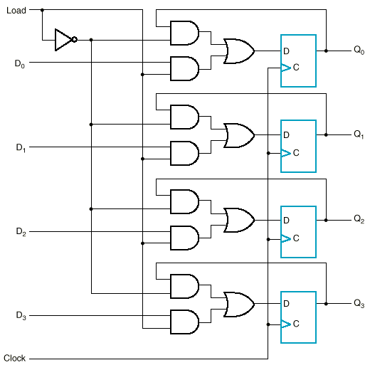
Register with parallel load

Slide 6
Shift Register
0
1
0
0
1

Slide 7
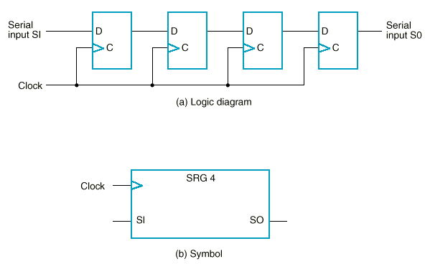
Shift Register
0
1
0
0
1
Output SO

Slide 8
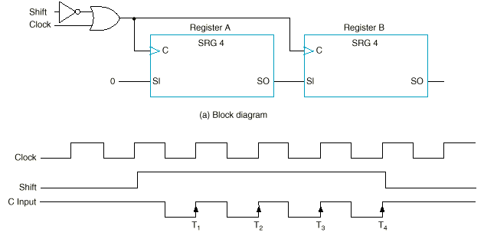
Serial data transfer
Serial transfer of information from register A to register B

Slide 9
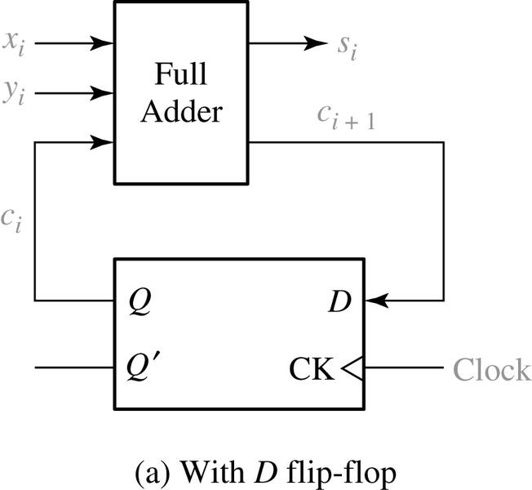
Serial addition using shift registers
The two binary numbers to be added serially are stored in two shift registers.
The sum bit on the S output of the full adder is transferred into the result register A.

Slide 10
Serial vs. parallel addition
Inputs come from a shift register
Outputs are saved in a shift register

Slide 11
Shift register with parallel load
Shift | Load | Operation
0 | 0 | Nothing
0 | 1 | Load parallel
1 | X | Shift Q0 → Q1, Q1→Q2…

Slide 12
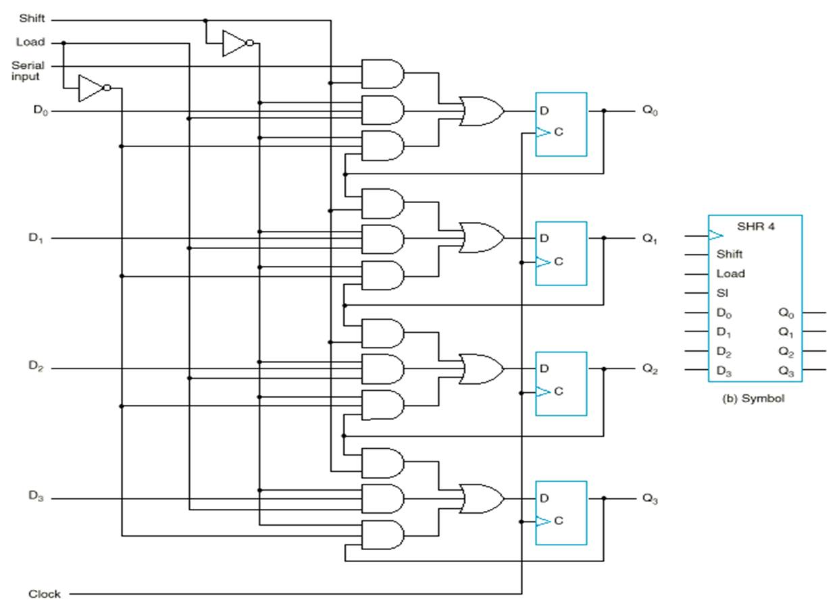
Shift register with parallel load

Slide 13
Bidirectional shift register
S₁S₀ | Action
00 | Nothing
01 | Shift down
10 | Shift up
11 | Parallel load

Slide 14
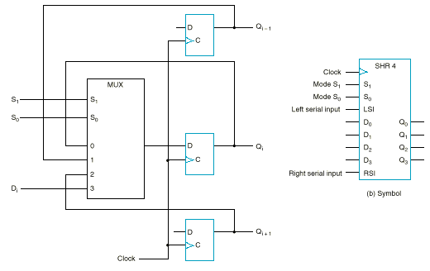
Bidirectional Shift Register

Slide 15
Counters
Counter
A predetermined sequence of states with each clock
Synchronous Counter: - All FFs receive a common clock
Ripple Counter: - FF output transition serves as a source for triggering other FFs.
- No common clock

Slide 16
Synchronous Binary Counters
Design procedure
Like other synchronous sequential circuits
Most efficient implementations: by T or JK
We will examine JK and D flip-flop designs

Slide 17
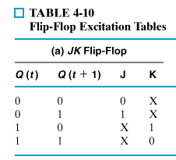
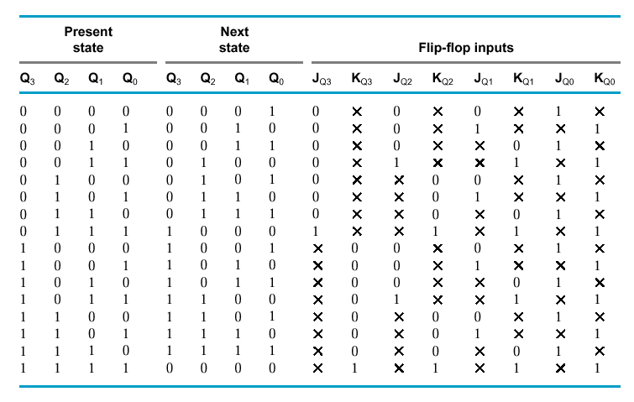
Synchronous Binary Counters:
J-K Flip Flop Design of a 4-bit Binary Up Counter

Slide 18

Synchronous Binary Counters:
J-K Flip Flop Design of a 4-bit Binary Up Counter

Slide 19
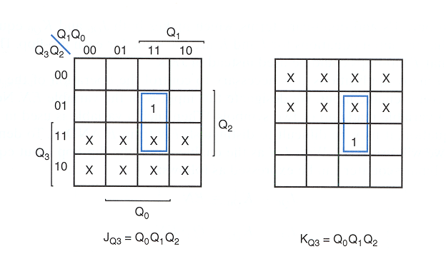
Synchronous Binary Counters
J-K Flip Flop Design of a Binary Up Counter (cont.)

Slide 20
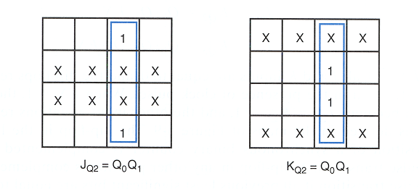
Synchronous Binary Counters
J-K Flip Flop Design of a Binary Up Counter (cont.)

Slide 21
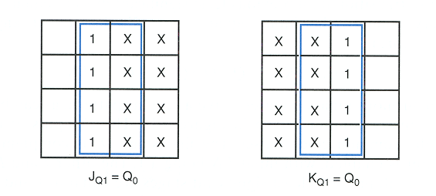
Synchronous Binary Counters
J-K Flip Flop Design of a Binary Up Counter (cont.)

Slide 22
Synchronous Binary Counters
J-K Flip Flop Design of a Binary Up Counter (cont.)
logic 1
J_{Q0} = 1
K_{Q0} = 1
J_{Q1} = Q₀
K_{Q1} = Q₀
J_{Q2} = Q₀ Q₁
K_{Q2} = Q₀ Q₁
J_{Q3} = Q₀ Q₁ Q₂
K_{Q3} = Q₀ Q₁ Q₂
J
Q₀
C
K
J
Q₁
C
K
J
Q₂
C
K
J
Q₃
C
K
CLK

Slide 23
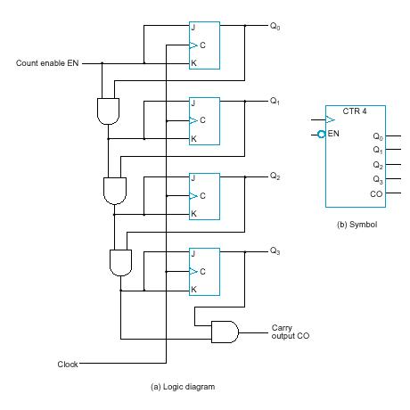
Synchronous Binary Counters:
J-K Flip Flop Design of a Binary Up Counter with EN and CO
EN = enable control signal, when 0 counter remains in the same state, when 1 it counts
CO = carry output signal, used to extend the counter to more stages
J_{Q0} = 1 · EN
K_{Q0} = 1 · EN
J_{Q1} = Q₀ · EN
K_{Q1} = Q₀ · EN
J_{Q2} = Q₀ Q₁ · EN
K_{Q2} = Q₀ Q₁ · EN
J_{Q3} = Q₀ Q₁ Q₂ · EN
K_{Q3} = Q₀ Q₁ Q₂ · EN
C0 = Q₀ Q₁ Q₂ Q₃ · EN

Slide 24
تمرين ها و امتحان
تمرین های سری آخر
مهم
تعداد کمتر ولی همه را انجام دهيد
آزمون پایانی:
نوشتن راه حل الزامی

Slide 25
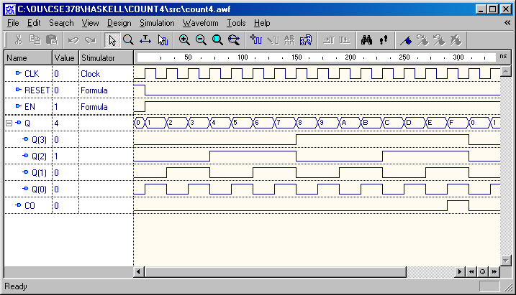
4-bit Upward Synchronous Binary
Counter in HDL - Simulation

Slide 26
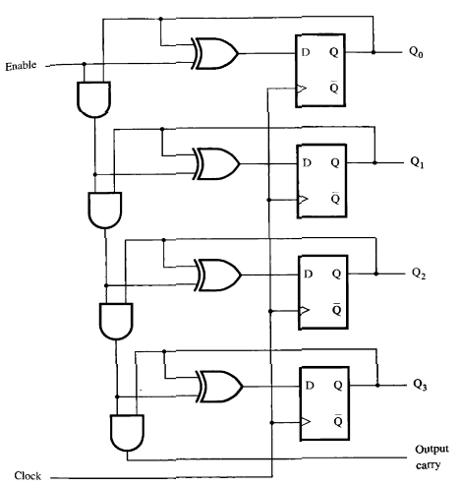
Synchronous Binary Counter Using DFF

Slide 27
Counter with Parallel Load
Load
Add path for input data
enabled for Load = 1
Add logic to:
disable count logic for Load = 1
disable feedback from outputs for Load = 1
enable count logic for Load = 0 and Count = 1
The resulting function table:
Count
D
0
D
Q
0
C
D
1
D
Q
1
C
D
2
D
Q
2
C
Load | Count | Action
0 | 0 | Hold Stored Value
0 | 1 | Count Up Stored Value
1 | X | Load D
D
3
D
Q
3
C
Carry
Clock
Output CO

Slide 28
Counting Modulo 7: Detect 7 and Asynchronously Clear
A synchronous 4-bit binary counter with an asynchronous Clear is used to make a Modulo 7 counter.
Use the Clear feature to detect the count 7 and clear the count to 0. This gives a count of 0, 1, 2, 3, 4, 5, 6, 7(short)0, 1, 2, 3, 4, 5, 6, 7(short)0, etc.
D3
Q3
D2
Q2
D1
Q1
D0
Q0
Clock
CP
0
LOAD
CLEAR

Slide 29
Counting Modulo 7: Detect 7 and Asynchronously Clear
A synchronous 4-bit binary counter with an asynchronous Clear is used to make a Modulo 7 counter.
Use the Clear feature to detect the count 7 and clear the count to 0. This gives a count of 0, 1, 2, 3, 4, 5, 6, 7(short)0, 1, 2, 3, 4, 5, 6, 7(short)0, etc.
DON’T DO THIS! Referred to as a “suicide” counter! (Count “7” is “killed,” but the designer’s job may be dead as well!)
D3
Q3
D2
Q2
D1
Q1
D0
Q0
Clock
CP
0
LOAD
CLEAR

Slide 30
Modulo 7 Counter
0
D3
Q3
A synchronous binary counter
Synchronous load
Asynchronous clear
Uses Load to detect "6" and load in "zero".
Counts: 0, 1, 2, 3, 4, 5, 6, 0, 1, 2, 3, 4, 5, 6, 0, ...
Using don’t cares for states > 0110
0
D2
Q2
0
D1
Q1
0
D0
Q0
Clock
CP
LOAD
Reset
CLEAR

Slide 31
Modulo 6 Counter Starting from 9
1
D3
Q3
Synchronous counter
Uses synchronous Load to preset to 9 on Reset and detection of 14.
Count 9, 10, 11, 12, 13, 14, 9, 10, 11, 12, 13, 14, 9, …
0
D2
Q2
0
D1
Q1
1
D0
Q0
Clock
CP
Reset
LOAD
1
CLEAR

Slide 32
Ripple Counter
How does it work?
A positive edge on clock input of A → A complements
Clock input of B = Q’ of flip-flop A
When A changes from 1 to 0 → positive edge on the clock input of B → B is complemented
D
Q
A
Clock
Q’
D
Q
B
Q’
Reset
CP
A
B
0
1
2
3
0
1

Slide 33
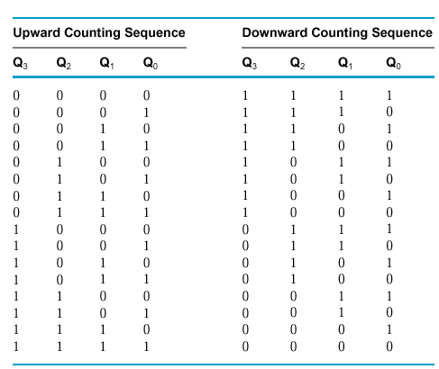
Example (cont.)

Slide 34
Ripple Counter (continued)
The arrows show the cause-effect relation- ship from the prior slide =>
The corresponding sequence of states => (B,A) = (0,0),
Each additional bit, C, D, …behaves like bit B, changing half as frequently as the bit before it.
For 3 bits: (C,B,A) = (0,0,0), (0,0,1), (0,1,0), (0,1,1), (1,0,0), (1,0,1), (1,1,0), (1,1,1), (0,0,0), …
CP
A
B
0
1
2
3
0
1
(0,1),
(1,0),
(1,1),
(0,0),
(0,1), …

Slide 35
Ripple Counter (continued)
Starting with C = B = A = 1, equivalent to (C,B,A) = 7, the next clock increments the count to (C,B,A) = 0. In fine timing detail:
The clock to output delay t_{PHL} causes an increasing delay from clock edge for each stage transition.
Thus, the count “ripples” from least to most significant bit.
For n bits, total worst case delay is n t_{PHL}.
t_{PHL}
CP
t_{PHL}
A
t_{pHL}
B
C

Slide 36
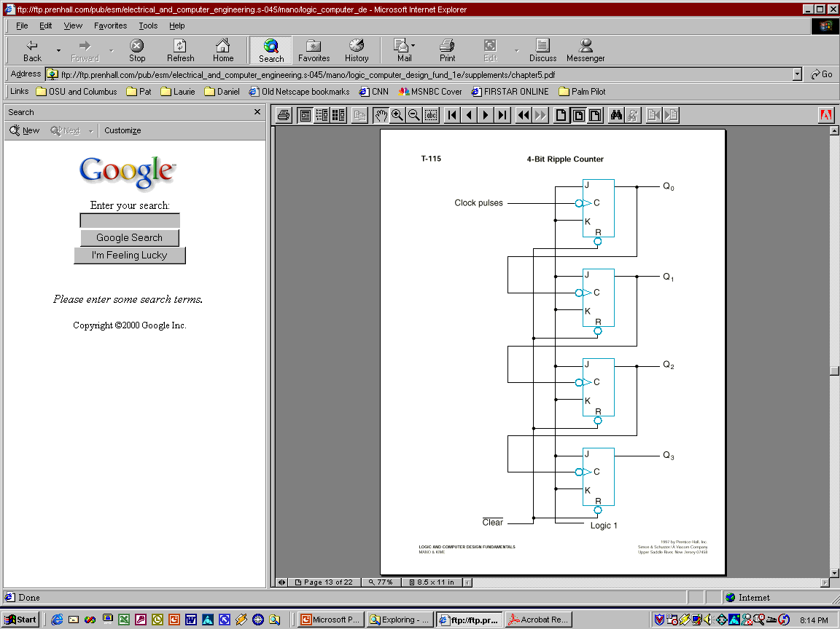
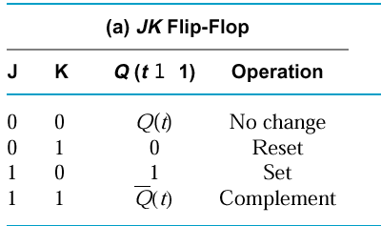
Example: A 4-bit Upward Counting Ripple Counter
Less Significant
Bit output is Clock
for Next Significant Bit!
(Clock is active low)
Recall...

Slide 37
A 4-bit Downward Counting Ripple Counter
Use direct Set (S) signals instead of direct Reset (R), in order to start at 1111.
Change edge-triggering to positive
Alternative designs:
Connect the complement output of each FF to the C input of the next FF in the sequence.

Slide 38
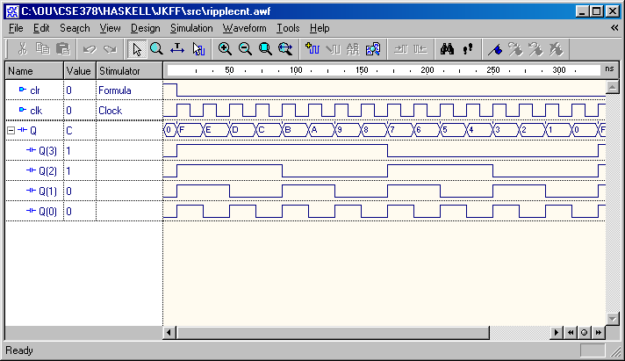
Simulation …

