Slide 1
DevOps Overview
Notes:
Notes to the Facilitator:
Summarize the module objectives for the participants.
Reiterate that at the end of the module you will be able to:
Enumerate the pitfall of traditional IT systems and its processes
Describe the evolution of DevOps
Explain the core concepts of DevOps
Enumerate the core principles of DevOps
Understand the benefits of embracing DevOps
Identify the need for building a business case for DevOps
Notes to the Participant:
At the end of the module, you will be able to:
Enumerate the pitfall of traditional IT systems and its processes
Describe the evolution of DevOps
Explain the core concepts of DevOps
Enumerate the core principles of DevOps
Understand the benefits of embracing DevOps
Identify the need for building a business case for DevOps

Slide 2
1. Challenges of Traditional IT systems
Module 3: Definition of DevOps
Traditional IT systems follow outdated processes that are not suited for products of today. This leads to many challenges for the organization
Poor Quality of products | Organizations create and deliver products that offer less or no value to the end customer leading to product – market gap Products fail to meet the expectations of the customer, who seek high performance, ease of use sturdy
Irregular release or updates | Software products need continuous updates and new releases to meet customer’s growing demands. Organization following traditional model are unable to update at shorter time spans, thereby becoming obsolete to the customer
Product backlog | Most of the traditional IT organizations follow archaic systems that results in huge product backlog and delay in delivery of products Product backlog further leads to business loss
Outdated processes | Traditional systems follow outdated processes leading to loss of effort, time and money for the organization Organization adhering to traditional practices are siloed and closed with little interaction between different functions leading to poorly built products
Notes:
Notes to the Facilitator:
Give a brief background to the participants on the evolution of the software industry. From mainframes computers to personal computer to mobile devices, walk them through the changes that have slowly pervaded their lives and changed the way we operate and function forever.
Talk about the evolution of software product building, which has moved from being an enterprise-ready application to customer-driven applications. The same processes that were employed during the monolithic days are not suited for today’s applications.
Explain the internal challenges such as lack of collaboration between teams, budget constraints, decision-making processes that deeply embroil organizations still following traditional systems. Also, talk about the external challenges such as staying competitive, offering products that meet the growing customer needs.
Talk to participants about the software delivery lifecycle and the different stages that are involved in building and delivery of a product. Draw a comparison of how products such as Lotus Notes, an enterprise application remained largely unchanged as opposed to customer applications such as an Uber or whatsApp that are used by millions of people.
Talk to participants about how traditional organizations were structured in silos completely cut away from each other. Product development is a complex activity and demands collaboration of different functions and teams to create world-class products. Discuss the apps that are used by participants on a daily basis such as whatsApp or Uber which cater to millions of people across geographies. A siloed organization with limited communication does not offer an environment that can build these world class apps.
Introduce participants to the traditional processes in how businesses operated. A linear method of product building where each department was responsible for different functionalities with limited interaction. Explain the effects of this such as poor feedback loops, lack of knowledge of product across teams, lack of uniformity in process etc.
Notes to the Participant:
In the last two decades, technology has undergone sea change starting from the advent of large-sized computers to microprocessors to personal computing to more recently the internet and now mobile phone. The rapid change has redefined the age-old wisdom that companies have been following and now forces them to change. Software products were in the past built for large enterprises that were used within the organization to manage their processes and products. Following the advent of the internet, this has dramatically changed and has moved from being enterprise-centric to a user-centric model, what businesses define as a B2C model. IT & Software is all-pervading and is prevalent across businesses, different industry segments and even our homes. For instance, think of the number of devices, an individual uses on a daily basis.
Traditionally organizations were highly linear, where information dissipation was very slow and decision making was limited to the management. Today this is not the case. Customer feedback is actively followed and implemented on a constant basis in order to stay relevant and competitive.
Organizations that follow the traditional way of software development work with strict principles, and in these organizations, the Development and Operations teams function as two separate entities. Development team tends to be driven by how many new functionalities can be churned out in a given time, therefore change is its incentive. Operations team on the other hand, tends to be driven by stability of the status quo and its incentive is therefore resisting change.
The lack of flexibility in the traditional organizations to switch from a traditional mindset has led to the creation of products that are irrelevant. Organizations constantly battle to create the right products that fit the customer or market needs within a given time frame and allocated cost & budgets. In today’s day and age, the barriers between the customer and organization are diminishing rapidly and customers constantly look for products that best suit their needs. Customer’s loyalty is directly determined by the organization’s ability to offer products that satisfy their need and offer value for their money. Traditional systems have a huge disconnect and follow age-old processes and invest more time in processes than the product itself.
Irregular release or updates
Traditionally enterprise applications such as IBM Lotus Notes would have a software update once in few months. Today such as long delay cannot be tolerated as customer’s needs and demands have vastly changed. For instance, how many updates does your phone undergo on a given day? How many mobile applications update on a daily basis? New-age companies push product releases and updates few times on a given day.
This is a critical factor to stay competitive and relevant to their customer needs. Product building is a time-consuming activity. However, in today’s day and age, staying relevant and steadfast is most critical for the survival of an organization. Many of the products lose their market and become obsolete within a few months of its launch. They are replaced with new products and new players at a merciless pace.
Product Backlog:
Traditional organizations follow traditional processes and are structured very centrally. Information dissipation is very slow leading to bottlenecks across the organization. Decision making is very slow and this impacts the product building and delivery on a large scale. The pace and processes of traditional IT systems can lead to a huge backlog in terms of product updates and product releases directly affecting the organizational growth. This can lead to losing to marquee customers and huge monetary loss for the company
For example, a ride-hailing application such as Uber is used by millions of users, both riders and drivers across geographies. This means that companies operate out of different geographies across different cultures catering to many different languages and different time zones. In such a scenario, how can a siloed organization with barriers create a product to suit the customer’s need? The business use case pushes organizations to rethink the way they operate and disrupt the traditional models.
Outdated processes:
Organizations continue to follow traditional IT processes that are obsolete in today’s day and age. Considering the type of products companies build today, they need to innovate and deliver products at a faster-pace and time compared to earlier generations. This pace can only be achieved by getting rid of traditional processes and adopting new processes that are best suited for a fast-paced, competitive environment. For example, a software engineer in Bangalore operates in a decentralized environment interacting with team members across different geographies collaborating to put together a product that is used globally.

Slide 3
1.1 Disconnect between Development & Operations teams
The primary challenges between two teams are
« Lack of collaboration « Disintegrated processes « Difference in tools & implementation processes « Disinterest in learning new tools « Difference of opinion « Work loss « Poor feedback system
TRADITIONAL IT CULTURE
DEVOPS CULTURE
Objective: Deliver Features
Objective: Maintain Availability
Objective: Deliver features and maintain availability
Development
Business Requirements
Software Development
Quality Assurance
Operations
Service Desk
NOC/Support
Infrastructure
Operations
Dev
SIT
UAT
Prod
SW Development – Infrastructure – Quality Assurance
Dev
SIT
UAT
Prod
Business
Requirements
Service Desk
NOC/Support
Dev vs. Ops – The organization’s culture mimics the organizations architectural design of two silos with competing objectives.
DevOps – The organization’s culture is focused on end-to-end operational delivery (speed and quality).
Notes:
Notes to the Facilitator:
Application building has undergone tremendous changes in the last decade. Computer applications are defined by logic. Applications, file systems, databases and later cloud all adhere to a logic. Traditionally, how applications interact with devices, how data centres were built to host and manage these applications remained largely the same. However, this is not the same as the applications that are built today. Applications today are built to run across devices, with different operating systems, hosted in cloud or data centres. The juxtaposing means that the lines between functions are blurring by the day. Development is no more purely development and operations is no more purely operations. The ‘Developers’ need to know operational aspects to build applications and the ‘Administrators’ need to know development to guide, offer feedback, run and manage the application on a daily basis.
Traditional methods and processes did not demand the coming together of different functionalities.
Notes to Participants:
In organizations, development & operations, the teams work independently which lead to a lot of friction internally which in turn impacts the business growth. The lack of knowledge sharing, poor handing over processes and miscommunication leads to innumerable delays and business loss for the organization. Application building has undergone tremendous changes in the last decade. Computer applications are defined by logic. Applications, file systems, databases and later cloud all adhere to a logic. Traditionally, how applications interact with devices, how data centers were built to host and manage these applications remained largely the same. However, this is not the same of applications that are built today. The Applications, today are built to run across devices, with different operating systems, hosted in cloud or data centres. The juxtaposing means that the lines between functions are blurring by the day. The ‘Development’ is no more purely development and the ‘Operations’ is no more purely operations. The Developers need to know operational aspects to build applications and administrators need to know development to guide, offer feedback, run and manage the application on a daily basis.
The traditional methods and processes did not demand the coming together of different functionalities.
In organizations, development & operations teams work independently and this leads to a lot of friction internally which in turn impacts the business growth. Lack of knowledge sharing, poor handing over processes and miscommunication leads to innumerable delays and business loss for the organization.
Lack of collaboration: Both development and operations function as separate teams and do not have the attitude or interest to collaborate with each other
Disintegrated processes: The processes followed by both the teams are naturally different considering the nature of the work. This leads to confusion and the processes of both teams do not integrate well
The differences in tools & implementation processes: Both Development and Ops teams using different tools and processes can lead to constant errors and bug fixes in the production environment. Similarly, both teams using different implementation processes to execute the same work can cause incompatibility also.
Disinterest in learning new tools: Both teams have their own tools and processes and consider their methods superior to the other. This leads to lack of cohesion and waste of time.
The difference of opinion: The development teams in every organization constantly look out for new technology or updates and continuously make changes, whereas operations teams believe this leads to instability.
Work loss: The constant back and forth between the teams lead to loss of work and in turn business loss.
Poor feedback system: The Ops and Development teams fail to collaborate and lack any structured process. This lack of processes also leads to poor feedback systems which in turn, lead to organizational gaps.
Because of the confusion and the disconnect that happens between Dev and the Ops teams, industry experts desperately wanted to find a common ground, that solves all these issues. This frustration led to the birth of DevOps movement, and the life of IT development and operations teams became a lot easier. Organizations found the concept to be useful and slowly started adopting it as a culture. The wall between the dev and ops teams started tearing down, which resulted in better quality products delivered in shorter time periods.

Slide 4

3. Definition for DevOps
Module 3: Definition of DevOps
“DevOps represents a change in IT culture, focusing on rapid IT service delivery through the adoption of agile, lean practices in the context of a system-oriented approach. DevOps emphasizes people (and culture), and seeks to improve collaboration between operations and development teams. DevOps implementations utilize technology — especially automation tools that can leverage an increasingly programmable and dynamic infrastructure from a life cycle perspective”
Source adopted from https://www.gartner.com/it-glossary/devops
Notes:
Notes to the Facilitator:
Explain each of the above mentioned definitions, to participant, in details.
Notes to the Participant:
DevOps has been a widely accepted and embraced by the various organizations worldwide. Each organization defines DevOps differently, based on their experience and the reception that people gave.
Gartner defines DevOps as ‘a change in the mindset of IT thought leaders, breaking age old traditional practices and adapting to Agile & Lean principles that emphasise on customer value.’
DevOps focuses on the tangible and intangible aspects of an organization. The People, culture, collaboration and communication among different functions within the organization come together to deliver efficient products. In the process, devops uses tools and technology, to automate processes that are manual and inefficient.

Slide 5
3.1 Agile, Lean & DevOps
Module 3: Definition of DevOps
Agile
Lean
DevOps
Product development is broken into smaller units and delivered at continuous intervals.
Lean processes is about creating and delivering customer value with efficient use of resources and minmizing waste.
DevOps methodology follows many of the principles adapted by agile and lean practitioners. Agile, lean and devops are linked together as there are many commonalities.
Notes:
Notes to the Facilitator:
The Agile, Lean & DevOps processes have one primary goal: To create the customer value.
Explain the three processes, to draw similarities, for the participants to better understand the principles DevOps is based on.
Notes to the Participant:
Agile: The Agile methodology is a break-away from the traditional methods of product-building to enable faster delivery cycles. The Agile methodology breaks product delivery into smaller iterations, offering a complete product, every time there is a product release. Agile also brings together different teams within an organization for faster delivery of the product.
Lean: The primary motive of lean processes is to deliver customer value with optimum utilization of process and to eliminate waste. Lean processes involve an overhaul of all processes in the product life-cycle eliminating any waste. Lean Startup tends to focus more on a method for product development.
DevOps imbibes these philosophies and embraces a culture that propagates collaboration & seamless communication between the teams to speed up delivery of products. DevOps is one of the central pillars on which many of the new breed of IT organizations realize a new modus operandi for delivering IT services. Adopting DevOps across the entire organization helps organizations redesign their business and IT departments. DevOps thus becomes a new operating model that bids adieu to traditional demand-supply models, centralized IT operations, and complex value streams with an excess of hand overs, waste and error-prone manual activities that do not deserve the label ‘engineering’. DevOps is the most holistic way and more likely to take cultural aspects and the existing operation into consideration.

Slide 6
3.1.1 DevOps – A Culture & Its Benefits
Module 3: Definition of DevOps
DevOps Culture
DevOps is not a framework or a standard to be implemented but a culture that pervades the organization and enables speedy delivery of products and services.
DevOps is an amalgamation of development and operations to create a more efficient, foolproof process that supports collaboration and teamwork leading to high performance.
Communication
Transparency
Grassroots innovation
Rewarding good behaviors
Embrace failure
Chang is Good
No blame
Trust
Honesty and openness
Tools
Accountability
Collaboration
Notes:
Notes to the Facilitator:
Explain the core foundation of DevOps and the necessity for the implementation of DevOps. Then address the different issues that organize the face in the battle, to stay competitive and relevant.
Notes to the Participant:
DevOps is a synopsis of Lean & Agile practices coming together, to offer faster delivery of the products. It is not a standard or an IT framework that the organizations implement but more of a philosophy and culture that forms the core of how the organizations’ function.
Traditional organizations followed outdated processes that offered no room for collaboration. They had rigid structures and the decisions were dictated top-to-down making, day to day operations of a business, cumbersome and inefficient. DevOps disrupts the traditional models by following a decentralized organization, where the environment encourages and supports open communication, teamwork and an open culture. This leads to many benefits to the organization.

Slide 7
3.1.2 DevOps – Benefits
Module 3: Definition of DevOps
DevOps adoption offers numerous benefits to organizations at large
Reduction of lead time
DevOps propagates efficiency and reduces the lead time for product delivery
Reduction in failure of product & its releases
A stable environment facilitates stable product building. With the amalgamation of development and operations, processes are streamlined and product releases happen at shorter timelines
Collaboration
DevOps is about collaboration. Different teams such as development, operations, quality assurance, testing and support coming together and work cohesively and deliver products in a shorter time span than traditional systems
Scalability
Automation helps you manage large infrastructure efficiently and devops adoption helps companies scale faster
Reliability
As a culture, devops strives for stability and fault proof products. DevOps creates efficient processes that eliminate errors and time loss
Optimum utilization of cost and resources
Implementing a devops culture means a thorough study of end to end lifecycle and removing bottlenecks if any. The primary goal is to offer customer value and continuously eliminate wastage
Notes:
Notes to the Facilitator:
Tell the participants that you will talk about the benefits of DevOps.
Notes to the Participant:
DevOps has the following benefits:
Reduction of lead time: DevOps brings together the development, operations and QA teams together and creates a process that allows collaboration. This reduces the feedback loops between the teams leading to shorter delivery cycles.
Reduction in a failure of the product & its releases: Since the different functions involved in product-building & delivery of the work are in unison, under efficient processes, the room for error is reduced drastically in comparison to the traditional systems.
Collaboration: In a pre-DevOps scenario, the development teams build and push the product to QA team for testing. They, in turn, test the product and do the test runs to identify issues or what we call the bugs in the Developer-Jargon. This is then brought back to the development team to rework upon and this loop continues. Once this comes to closure, the product is handed over to the operations. The next round of challenges starts for the operations’ team in maintaining and running the product on a daily basis. The lack of a standard product manual, poor handing-over process and constant fire-fighting leads to excessive delay. This can only be overcome by implementing DevOps, for smooth transitioning of product, from the development to the operations team, where they come together to serve the customers.
Scalability: DevOps involves automation of processes and eliminates bottlenecks and inefficiencies across the product lifecycle. This allows organizations to scale more rapidly and propel organizational growth.
Reliability: DevOps implementation involves streamlining the processes which lead to product stability.
Optimum utilization of cost and resources: Similar to the lean practices, DevOps also focuses on maximizing the product value to the customers and eliminating waste at every level.

Slide 8


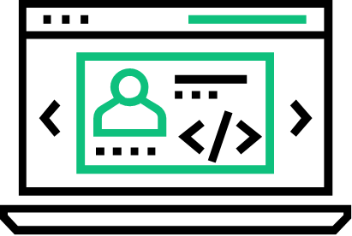
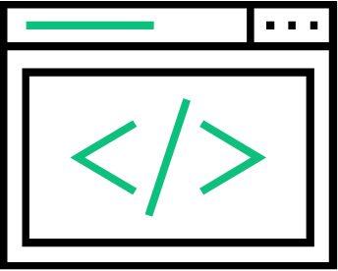


3.1.3 Principles Governing DevOps
Module 3: Definition of DevOps
Globally organizations, independent bodies and front runners have observed different views and attributed various aspects as the principles
DASA, the DevOps Agile Skills Association, Microsoft, Accenture and other forerunners define DevOps based on principles such as agile, customer-centric action, creating product with end in mind, performance orientation, teamwork, end to end responsibility, cross-functional teams, continuous improvement and automation among many others
DEV
OPS
Application Performance
Application Availability
Modern developers use APM tools to decrease latency, have complete visibility into code, databases, caches, queues, and third-party services.
The applications need to be up and running and it’s Ops responsibility to ensure uptime and SLAs are in order.
Application Performance
End User Analytics
Classic Ops generally rely on infrastructure metrics – CPU, memory, network and disk I/O, etc. Modem Ops correlate all of those metrics with application metrics to solve problems 10x faster
A great developer understands end users have the best feedback and analytics play an enormous part of understanding users. Developers are constantly monitoring end user latency and checking performance by devices and browsers.
End User Complaints
!
The goal is to know about and fix problems before end users complain, reduce the number of support tickets, and eliminate false alerts.
Quality Code
Developers need to ensure their deployments and new releases don’t implode or degrade the overall performance
Performance Analytics
Code-Level Errors
Automatically generated baselines of all metrics help Ops understand what has changed and where to focus their troubleshooting efforts. Alerts based upon deviation from observed baselines improved alert quality and reduce alert noise.
When you have a large distributed application its is vital to lower MTTR by finding the root cause of errors and exceptions.
Notes:
Notes to the Facilitator:
Introduce the different principles or attributes that organizations across the globe believe, are the governing principles of DevOps.
Notes to the Participant:
The different technologies and the forerunners of DevOps have attributed different factors that influence and govern the implementation of DevOps in an organization. Each of the attributes, add another dimension to DevOps and its philosophy.
DevOps is predominantly a new age concept that is implemented to expedite the product building and delivery process to ensure that customer needs are met from time to time. Teamwork, cross- functional collaboration, continuous learning and experimentation and automation are all factors that define DevOps.

Slide 9
What did you Grasp?
Module 3: Definition of DevOps
Which of the following is not a DevOps principle?
Culture
Automation
Processes
None of the above
Disconnect between development and operations team can occur due to
Disintegrated processes
Closed feedback loops
Lack of collaboration
Unanimity in usage of tools
Notes:
Notes to the Facilitator:
Tell the participants that it is time for a quick knowledge check.
Answer:
1. C. Processes
2. A. Disintegrated processes
B. Closed feedback loops
Notes to the Participant:
You have to attempt the question.
You have one attempt.

Slide 10
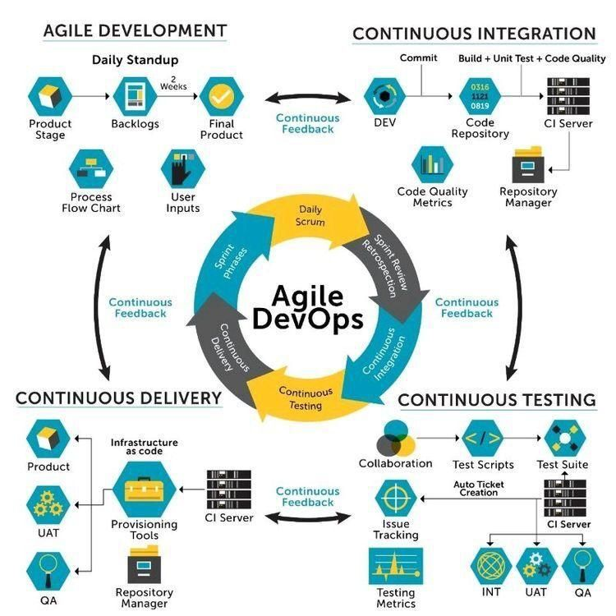
5. DevOps and Agile
Module 3: Definition of DevOps
DevOps and agile are embedded with the same values and principles.
They increase the efficiency of the product delivery
They propagate collaboration
They offer structured processes embracing different functions within an organization
They help companies in staying relevant
Notes:
Notes to the Facilitator:
Tell the participants that DevOps and Agile have the same values and principles.
Inform the participants that Agile is a part of DevOps.
Notes to the Participant:
DevOps and Agile have the same value system and core principles. DevOps is an extension of agile methodologies.
The primary objective of Agile software development is to offer superior value to the customer. It works to integrate development and quality assurance teams for a faster delivery of product.
DevOps is more an extension of agile software development, i.e. DevOps integrates development, quality assurance and operations teams to build products at a faster pace.
Both, DevOps and Agile, propagate the same value of collaboration and active interaction among the teams for a speedy product delivery. Both, Agile and DevOps break the barriers creating cross-functional teams across the organization, to collaborate and create the products that are relevant to the existing customers’ need. Both the methodologies follow the same philosophy of catering to ever-growing customers’ needs and continuously offering value. Agile and DevOps adopt practices that allow quicker response at every stage of product building.

Slide 11
5.1 Agile Methodology
Module 3: Definition of DevOps
The four values as per the Agile Manifesto are
Individuals and interactions
Working software
Customer collaboration
Responding to change
Notes:
Notes to the Facilitator:
Talk about the values that govern the agile software methodology as discussed in module 2.
Notes to the Participant:
The four values are the foundation of the agile software methodology:
Individuals and interactions over processes and tools
Functional software over comprehensive documentation
Customer collaboration over contract negotiation
Responding to change over following a plan.
There twelve principles that govern Agile, drafted by industry experts who proposed Agile as an alternative, lightweight methodology to traditional software development methods.
Our highest priority is to satisfy the customer through an early and continuous delivery of valuable software.
Welcome changing requirements, even late in the development. Agile processes harness change for the customer's competitive advantage.
Deliver working software frequently, from a couple of weeks to a couple of months, with a preference to the shorter timescale.
Business people and developers must work together daily throughout the project.
Build projects around motivated individuals. Give them the environment and support they need, and trust them to get the job done.
The most efficient and effective method of conveying information to and within a development team is a face-to-face conversation.
Working software is the primary measure of progress.
Agile processes promote sustainable development. The sponsors, developers, and users should be able to maintain a constant pace indefinitely.
Continuous attention to technical excellence and good design enhances agility.
Simplicity‒the art of maximizing the amount of work not done‒is essential.
The best architectures, requirements, and designs emerge from self-organizing teams.
At regular intervals, the team reflects on how to become more effective, then tunes and adjusts its behaviour accordingly.

Slide 12
5.2 Comparison between DevOps and Traditional IT Cultures
Module 3: Definition of DevOps
Dimension | DevOps Culture | Traditional IT Culture
Batch Size | Micro | Big
Organization | Dedicated cells | Skill-centric silos
Scheduling | Decentralized and Continuous | Centralized
Release | Uneventful | High risk event
Information | Actionable | Disseminated
Culture | Fail early | Do not fail
Metric | Cost, Capacity and Flow | Cost and Capacity
Define “Done” | “It’s ready to deploy” | “I did my job”
Source: IBM
Notes:
Notes to facilitator:
Explain the participants how DevOps culture and Traditional IT culture compare to each other.
Notes to participant:
The table summarizes the core differences in adopting DevOps culture and Traditional IT culture. The differences can be understood on the basis of three categories:
Planning and Organization
Batch Sizes: Traditional organizations plan big, have bigger teams to maximize productivity, write huge amounts of code that are bundled and jammed for production. On the other hand, DevOps teams have smaller batch sizes, that are easy to manage and teams can perform frequent product releases.
Organization: Skill centric silos form the core of traditional IT culture. Silos have some benefits, but mostly a new feature will go through at least 3-4 silos before reaching the customer. DevOps also has silos but at a different dimension. Teams are arranged in cells, with different cross-functional teams, focused on a single application. Thus a cell is self-sufficient and movement happens smoothly without any hand-offs.
Scheduling: Traditional IT culture focuses on efficient scheduling and companies also invest hugely on planning/scheduling systems. These systems are sensitive, but can be inaccurate. In case of DevOps scheduling is handled locally within the cells. Smaller batch sizes, autonomous teams and automated processes aid in efficient planning. Teams will have a better insight, as planning is done only for the near future.
Performance and Culture
Release: Software release phase in traditional IT is an eventful, high-risk operation. The phase is full of issues, escalations and back and forth code movements. The process involves personnel from all levels and management becomes clumsy. In case of DevOps the release phase is almost uneventful. Code is checked in on a regular basis and testing processes and short feedback loops ensure that the processes are in sync. This makes smoother releases.
Information: Information in traditional IT is generated by specialists, which is then combined to form a massive datasets, which again goes for approval and then sent to managers, which reaches the teams finally. Most of the times the report is not given much attention, as it contains massive amounts of data. In DevOps, the team cells generate only the necessary the data that is circulated locally. This gives room for the team to quickly read and work on action items.
Culture: Traditional systems oppose failures, by means of stringent processes, approvals, etc. Despite all this, in more than 50% of traditional systems, projects are delivered late. Most of it is due to infrastructure and quality issues. DevOps believes that failure is unavoidable, but failing early helps in faster recovery. Failure at early stages cause only minimal damage, as compared to the final product failure that causes irreparable damage to the business.
Measure
Metric: Cost and capacity are the two measurement models, to see how much gets done and at what cost. DevOps works on three measurement models cost, capacity and flow. Flow forces an organization to take a look at its end to end cycle time, identify areas of waste, calculate true productive time, quantify quality, and focus on activities that add the most value.
The definition of “Done”: In traditional IT, ‘Done’ is seen from the individual’s viewpoint, and is focused on meeting the hand-off deadline. DevOps is focused on creating dedicating cross-functional teams. It’s the goal of the team: Bring the software to market.

Slide 13
5.3 Why to Build a Business Case for DevOps
Module 3: Definition of DevOps
Here are the 10 reasons to build a business case for Devops
Collaboration
1
Improved speed to market
2
No silos, no waste
3
Encouraging innovation and creativity
4
Effective utilization of resources and reduction in cost
5
Increased employee engagement and job satisfaction
6
Continuous integration and delivery
7
Fewer Failures
8
Increased Performance
9
Stability
10
Notes:
Notes to the facilitator:
Explain the participants about the need for building a business case for DevOps.
Notes to the participants:
There are 10 major reasons why we should build a business case for DevOps. Let’s see each one of them in detail here.
1. Collaboration
For effective problem solving teams need to come together and use the available time and resources. Because, challenges do not affect the individual teams alone. It is the business that gets affected and regardless of who is responsible, the problem needs to be solved. Without collaboration, this process takes longer and can create further problems that may not be immediately apparent. DevOps fosters collaboration, hence efficient problem solving. Togetherness and communication between the teams help to work faster and smarter and similar issues can be prevented.
2. Improved speed to market
Improved speed to market is critical for organizations to get the early mover advantage. Businesses need to gain a competitive edge in an industry where software and tools are outmoded almost as quickly as they are released. Introducing a DevOps approach will enable an organization to go from an initial concept to a viable product in a shorter timescale.
3. No silos, no waste
By combining multiple teams and disciplines into one lean, mean DevOps team that has cross-functional skill sets and communicate efficiently, DevOps allows teams to complete tasks quickly and efficiently while maintaining stability and quality.
4. Encouraging innovation and creativity
Continuous Integration, standardized production environments, and automated deployments allow practitioners to focus on the more inventive and creative side of their role. The environment and culture of DevOps encourage a deeper understanding and implementation of best practices in an organization.
5. Effective utilization of resources and reduction in cost
By implementing a DevOps approach, the costs and demand for resources associated with traditional IT implementations is significantly reduced. When the organizations use continuous delivery and Lean Management practices, higher quality results and shorter cycle times are achieved which further reduce costs. Other factors that help to reduce cost and resource requirements, include minimal project start-up and ongoing operational costs, increased collaboration, increased data availability and accessibility, and improved security.
6. Increased employee engagement and job satisfaction
DevOps provides a collaborative and multi-skilled environment which contributes heavily to job satisfaction. DevOps practices and culture increase employee satisfaction which leads to better business outcomes.
7. Continuous integration and delivery
Continuous integration is a development practice that involves deploying code to a shared repository several times per day. Using an automated build process in combination with automated testing helps to verify each check-in, which produces more stable software.
8. Fewer Failures
The 2014 State of DevOps report showed that high-performing organizations had 50 percent fewer failures. The 2015 State of DevOps report showed a continuation in trend by revealing that the organizations who adopt a DevOps mindset and culture have 60 times fewer failures than those not implementing a DevOps approach.
9. Increased Performance
Standardized production environments and automation tools help make deployments predictable. These processes free people from routine tasks, allowing them to concentrate on the more creative aspects of their role, hence, leading to increased performance.
10. Stability
DevOps allows a single team to handle both, new functionality and the stability of the system. Each team member takes ownership of the business goals. Deploying often and in smaller, indivisible groups allows engineers to troubleshoot and resolve issues faster. The combination of tools and best practices, along with automation allows a DevOps team to increase overall stability.

Slide 14
What did you grasp?
Module 3: Definition of DevOps
The following is not a value of Agile software methodology?
Interaction & individuals
Collaboration
Sequential development approach
Quicker response time
The communication channels in agile and devops teams have to be linear and follow a sequential order.
True
False
Notes:
Notes to the Facilitator:
Tell the participants that it is time for a quick knowledge check.
Answer:
1. C. Sequential development approach
2. B. False

Slide 15
What did you grasp?
Module 3: Definition of DevOps
Agile and devops methodologies can be successful only if, _________ exists
Open collaboration
Disintegration
Different processes
Tools & technologies
Notes:
Notes to the Facilitator:
Tell the participants that it is time for a quick knowledge check.
Answer
3. A. Open collaboration

Slide 16


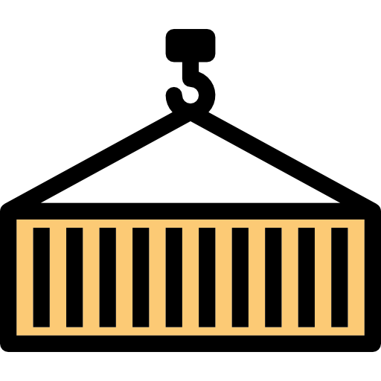


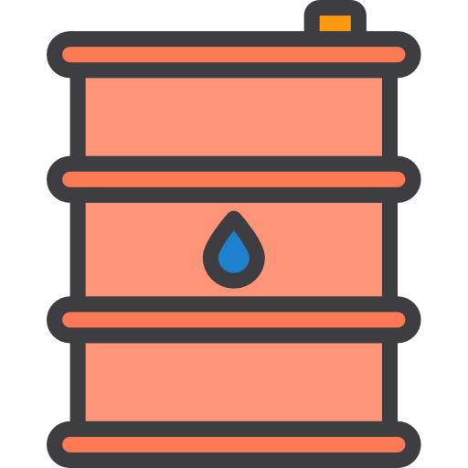
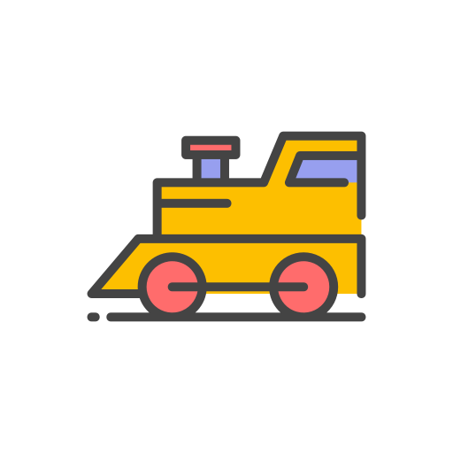
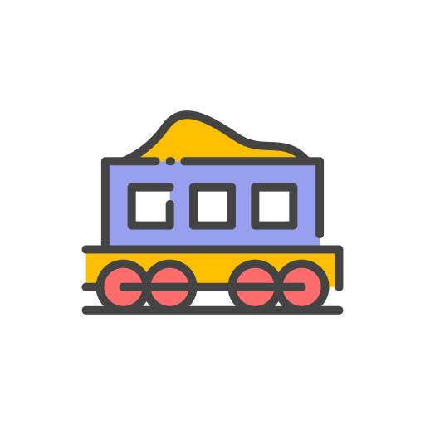
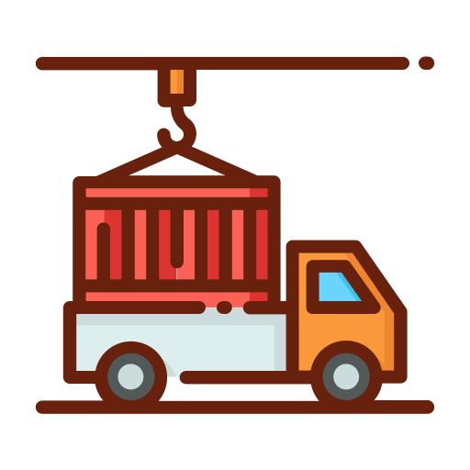
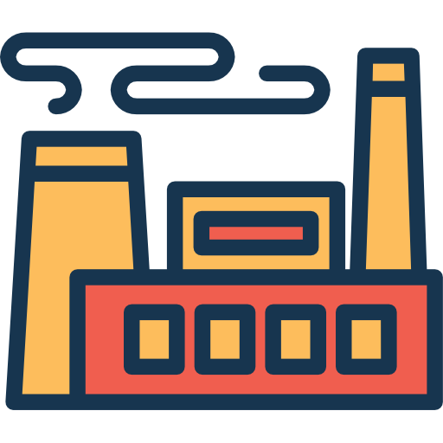
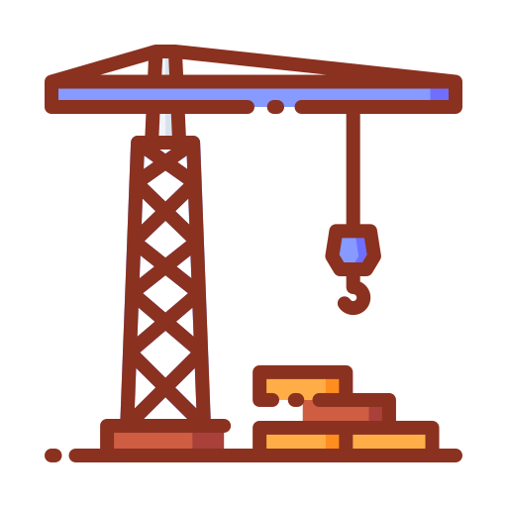
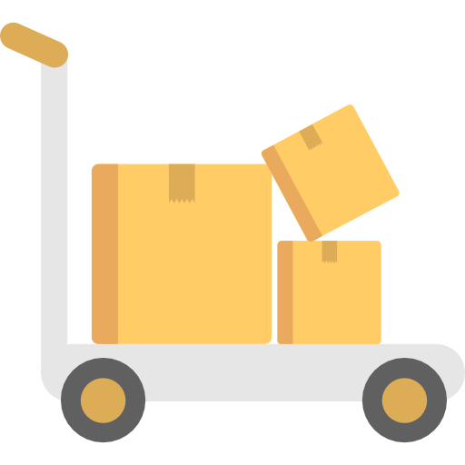
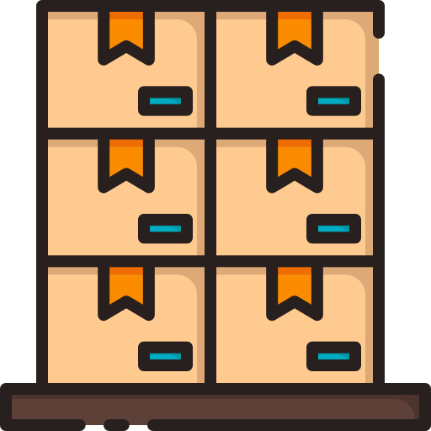
1.3 Shipping Industry Challenges
The various challenges faced by the shipping industry.
Multiplicity of goods
Do I worry about how goods interact? (e.g., coffee beans next to spices)
Multiplicity of methods for transporting/storing
Can I transport quickly & smoothly? (e.g., from boat to train to truck)
Notes:
Notes to the Facilitator: Inform the participants about the challenges faced by shipping industry.
Notes to the Participants: The one major problem faced by shipping industry was stacking up different types of goods together, which was resulting in damaged goods. So when the containers came into the picture, they ensured that fragile goods to be stored in one container and the same goes for other kinds of goods. Thus, when a glassware was being stacked in one container, all sorts of dependencies was being enclosed in that particular container, like wrapping up glassware in foam and cardboard to avoid breakage. And an organized container stacks allowed better resource utilisation in terms of floor area, since containers can be stacked upon one another.
In the picture, we can see different goods like:
Cars
Wine
Oil tanks
Piano
Servers
Spices
Fruits
The way to ship them is also different depending upon their fragility. Therefore, the main challenges were as follows:
How to be sure that the cargo of a port wine company won't damage or contaminate the cargo of another company?
How to isolate the cargo?
How to be sure that the cargo is inviolate?
How to make sure that the cargo is being transported in the best conditions (correct temperature for instance)?

Slide 17

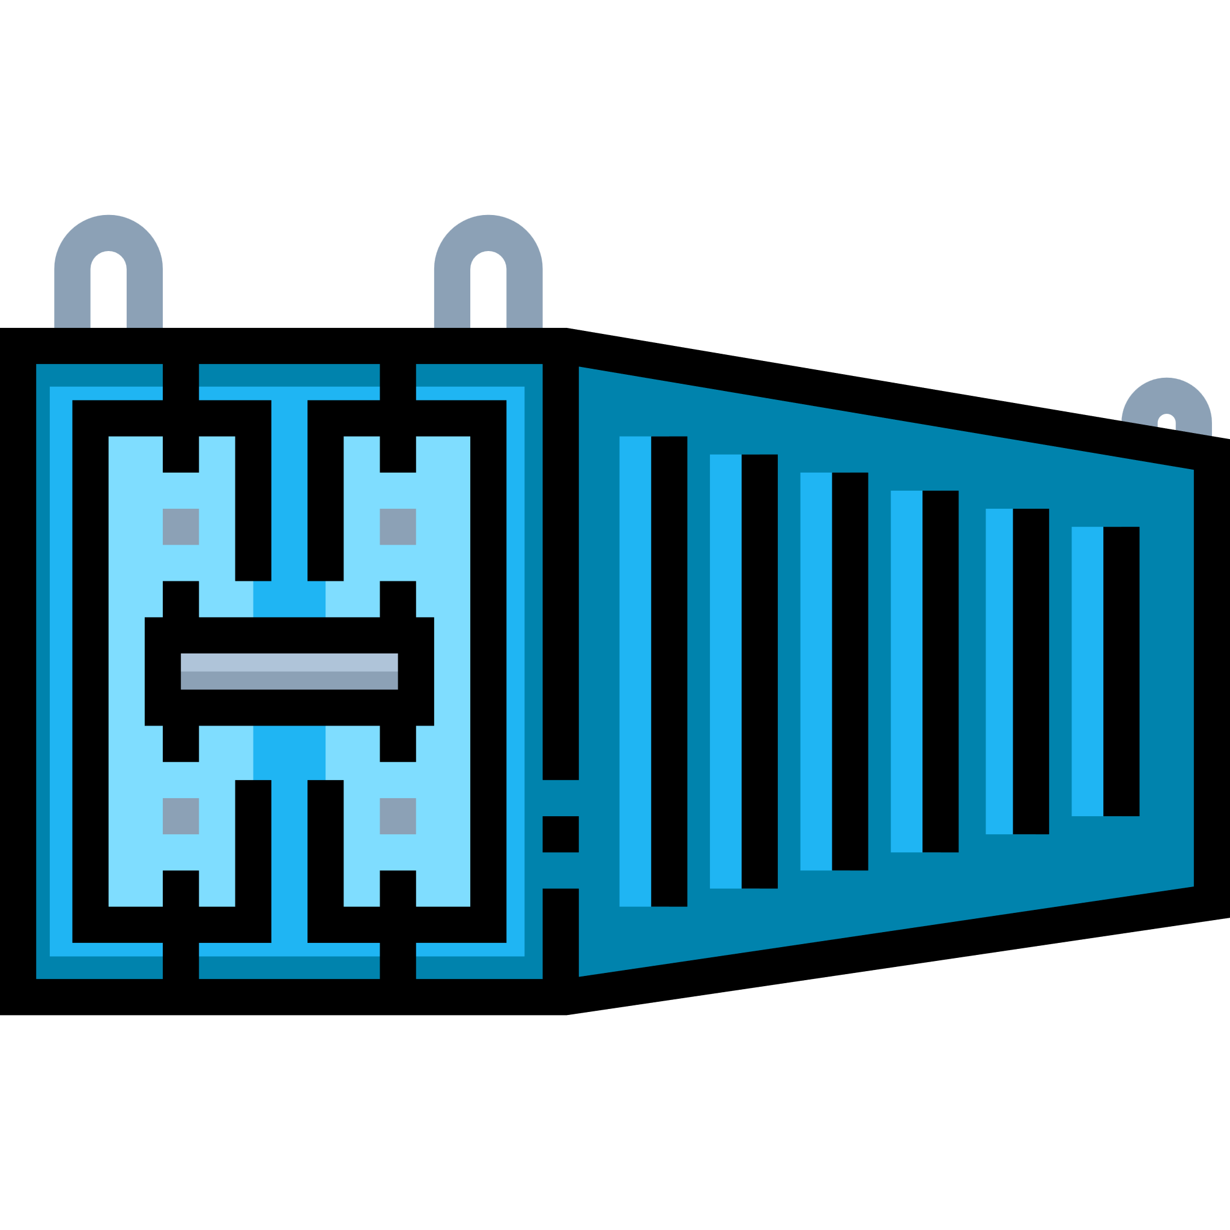
1.4 Container: The Saviour
How did the container become the saviour?
Multiplicity of goods
Do I worry about how goods interact? (e.g., coffee beans next to spices)
A standard container that is loaded with virtually any goods, & stays sealed until it reaches final delivery.
Multiplicity of methods for transporting/storing
Can I transport quickly & smoothly? (e.g., from boat to train to truck)
In between, can be loaded & unloaded, stacked, transported efficiently over long distances, & transferred from one mode of transport to the other.
CONTAINER
Notes:
Notes to the Facilitator: Explain how containers solve the problem of shipping different types of goods together and use this analogy to explain shipping off different application stacks.
Notes to the Participants: If we put things in a container isolating them from the other, then it will solve most of the problems. Let’s discuss them in detail here: Challenge-1: How to be sure that the cargo of a port wine company won't damage or contaminate the cargo of another company?
Solution: Since, we have put cargos of different merchants in different containers, there is no chance that things would contaminate each other.
Challenge-2: How to isolate the cargo? Solution: We can isolate the cargo by keeping different variety of goods in separate containers, which will isolate them from each other.
Challenge-3: How to be sure that the cargo is inviolate?
Solution: Each container will have compartments which are stacked up with soft material, which will safeguard the goods from getting damaged.
Challenge-4: How to make sure that the cargo is being transported in the best conditions (correct temperature for instance)?
Solution: Suppose, we have put all the fruits in a single container, so that we can manage the environment inside it, like deep freezing it. Thus, they won’t get stale.

Slide 18
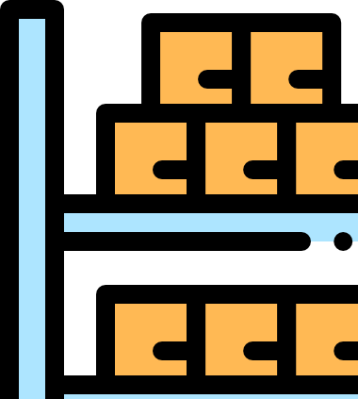
1.5 Solution by Containers in the Shipping Industry
Everything falls into place with the help of containers.
Notes:
Notes to the Facilitator: Discuss the how everything works fine with containers.
Notes to the Participants: So, as you can see that everything falls into place with the help of containers. According to the image;
Now all of the Wine will be stacked in one container which can be shipped over ship, trucks or by any other means, and won’t get damaged because they are protected with soft material.
Oil containers will not contaminate and smudge the other goods since the oil container has spilled proof shield around it.
Cars won’t get scratched as they are nicely placed inside the container locked by the hinges.
The Piano can now be safely shipped without any damage.
Fruits and spices are shipped under appropriate temperature, protecting them to get ruined because the container has refrigeration.

Slide 19
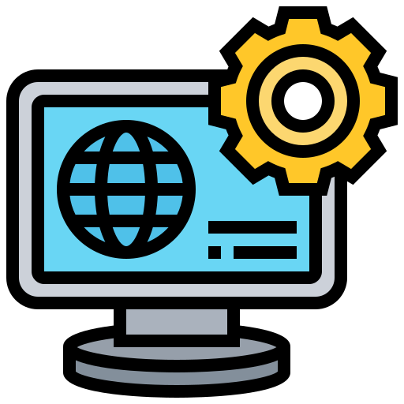


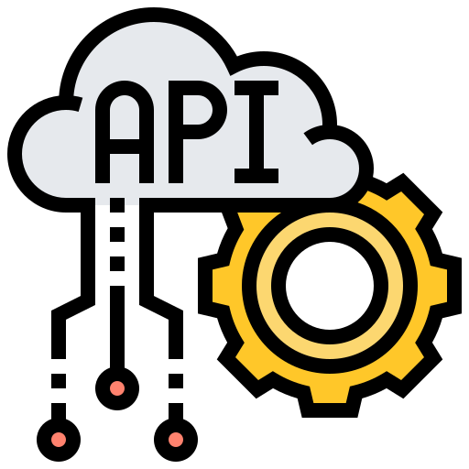

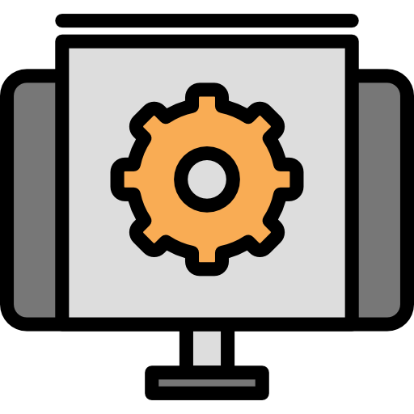

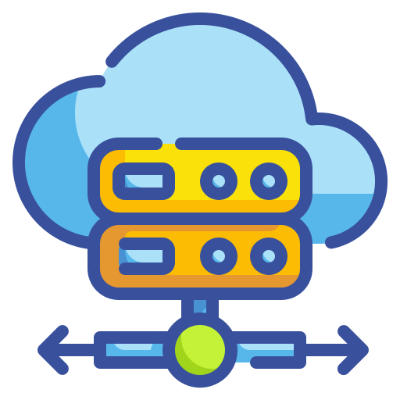
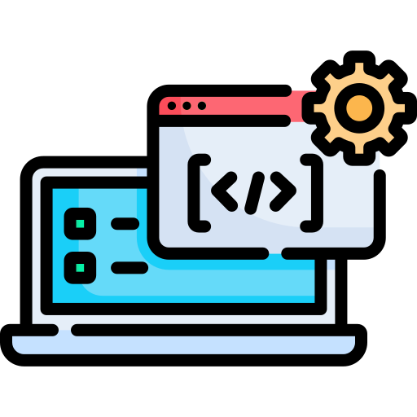

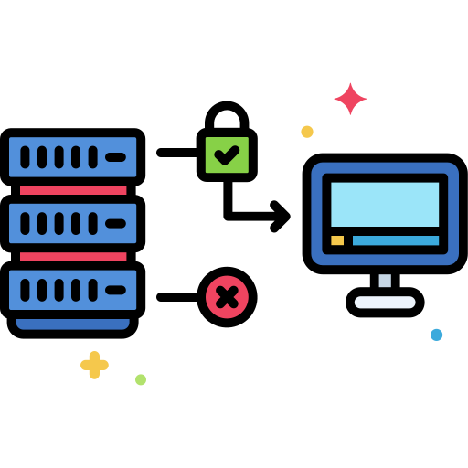
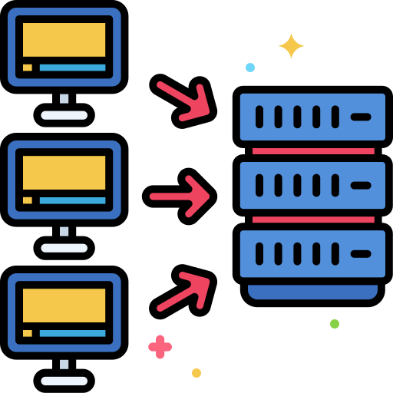

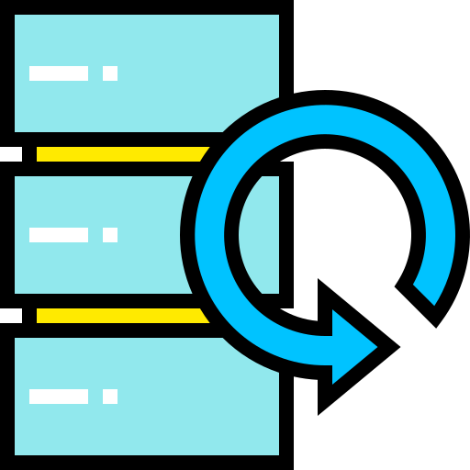
1.6 Challenges in the Software Industry (Contd.)
The various challenges in the software industry are as follows:
Do services & apps interact appropriately?
Multiplicity of Stacks
Background workers
Static Website
nginx 1.5, modsecurity, openssl, bootstrap2
Python 3.0, celery, pyredis, libcurl, ffmpeg, libopencv,nodejs, phantomjs
User DB
API Endpoint
postgresql, pgv8, v8
Python 2.7, Flask, pyredis, celery, psycopg, postgresql-client
Web frontend
Queue
Ruby, Rails, sass, Unicorn
Redis, redis-sentinel
Can I migrate smoothly & quickly?
Multiplicity of hardware environments
Development VM
Customer Data Center
Contributor’s laptop
Public Cloud
QA server
Production cluster
Data recovery
Production Servers
Notes:
Notes to the Facilitator: Discuss the various issues in the software industry.
Notes to the Participants:
Backup restore: If we consider the stateful applications, the major concern in their life cycle is to have a consistent backup if they are running on VMs, but if they go down you need to have a restore plan altogether, but this too cause downtime irrespective of how good is your restore strategy.
Disaster recovery: When a VM goes down it takes time to recover from that disaster even if you have the best strategy in place, but the duration of the recovery is long enough to have a downtime.

Slide 20
1.7 Problems in Software Industry Before Containers (Contd.)
The chaos in the software industry while managing diverse stack in different environments:
 | Development VM | QA Server | Single Prod Sever | Onsite Cluster | Public Cloud | Contributor Laptop | Customer Servers
Static Website | ? | ? | ? | ? | ? | ? | ?
Background Workers | ? | ? | ? | ? | ? | ? | ?
Web Front End | ? | ? | ? | ? | ? | ? | ?
User DB | ? | ? | ? | ? | ? | ? | ?
Analytics DB | ? | ? | ? | ? | ? | ? | ?
Queue | ? | ? | ? | ? | ? | ? | ?
Notes:
Notes to the Facilitator:
Explain the chaos in the software industry while managing diverse stack in different environments.
Notes to the Participants:
Platforms
Contributor laptop: The system where the code has been developed, i.e., the local system of the developer, e.g.: Laptop and PC.
Development VM: The first environment where the developer runs the code after developing it on the local system. It has other dependencies required for an application to function properly.
QA server: A QA Server usually refers to a machine that handles the QA process, and runs software that helps create environments that can test different code branches, as part of the QA process. This can range from switching environments and checking out a branch, to rebuilding entire machines that match production environments and deploying code to them. The basic principle of a QA Server is to help create QA environments for testing.
Single prod server: A production server may be a dedicated machine, virtual server, basic PC or multiple machines dispersed geographically. For small businesses and simple applications, all the activities involved in deployment may be conducted on a single computer. In enterprise-level software deployment, multiple servers are typically used for the stages required to create and work on software and deliver applications to end-users.
Onsite cluster: It is a platform where the client runs the code once it is delivered to them, after all, sorts of testing done by the delivery team.
Public cloud: The public cloud is defined as computing services offered by third-party providers over the public Internet, making them available to anyone who wants to use or purchase them. They may be free or sold on-demand, allowing customers to pay only per usage for the CPU cycles, storage, or bandwidth they consume.
Customer servers: It is a platform where the application will finally be used by the end-user.
We have to make sure that all the cells should be functional, i.e, the application if it works on the local developer machine should work without any issue on fellow developers and should work without any issues on the production server. One of the standard things that usually there is a difference in the server operating system and the operating system of a local developer.

Slide 21
1.8 Put that in Container!
Multiplicity of stacks
Multiplicity of hardware environments
Developer: Build once, run anywhere(finally)
Operator: Configure once, run anything
Static Website
Development VM
nginx 1.5, modsecurity, openssl, bootstrap2
User DB
Production Servers
postgresql, pgv8, v8
Web frontend
Customer Data Center
Ruby, Rails, sass, Unicorn
Background workers
Contributor’s laptop
Python 3.0, celery, pyredis, libcurl, ffmpeg, libopencv,nodejs, phantomjs
QA server
API Endpoint
CONTAINER
Production cluster
Python 2.7, Flask, pyredis, celery, psycopg, postgresql-client
Data recovery
Queue
Redis, redis-sentinel
Source: https://encrypted-tbn0.gstatic.com/images?q=tbn:ANd9GcRWHcB-4JmViuSdW3tEtckQ2HLOrIhv-AnO9_6jzUohl1NmPyOV&s
Notes:
Notes to the Facilitator:
Discuss how putting the application in a container solves the issues faced by the software industry while managing diverse stack in different environments.
Notes to the Participants:
The problems which we discussed can be solved if we put things inside a container. Suppose, we have two application which needs to be run on the same VM, one of them runs on python2.7 and other runs on python3. While running both of the applications, we have injected the versions of python as environment variables. If the environment variables are overlapped then both of the applications will suffer. And If we compare this respect to resource utilisation, if there is no isolation at the process level, that means if any of the application starts consuming more resources it will try to kill the other application, which will bring vulnerability to the system. Solution
We can put those in separate containers like:
Container-1: It will have binaries of python2.7 along with the application-1 code.
Container-2: It will have binaries of python3 along with the application-2 code.
With this, the python version will not clash as both of the applications will be completed isolated because of containers. And we can put the limits on containers with respect to CPU and memory utilisation.

