Slide 1
JAVASCRIPT BOM. EVENTS HANDLING
By Olena Shchadylo

Slide 2
Agenda
What is BOM?
The window object
window.screen
window.location
window.history
window.navigator
Popup boxes
Cookies
Event handlers

Slide 3
WHAT IS BOM?
The Browser Object Model (BOM) allows JavaScript to "talk to" the browser.
There are no official standards for the Browser Object Model (BOM).
Since modern browsers have implemented (almost) the same methods and properties for JavaScript interactivity, it is often referred to, as methods and properties of the BOM.

Slide 4
THE WINDOW OBJECT
The window object is supported by all browsers. It represents the browser's window.
All global JavaScript objects, functions, and variables automatically become members of the window object.
Global variables are properties of the window object.
Global functions are methods of the window object.

Slide 5


THE WINDOW OBJECT(EXAMPLE)
Even the document object (of the HTML DOM) is a property of the window object:
is the same as:

Slide 6
WINDOW SIZE
Two properties can be used to determine the size of the browser window.
Both properties return the sizes in pixels:
  window.innerHeight - the inner height of the browser window (in pixels)
  window.innerWidth - the inner width of the browser window (in pixels)
For Internet Explorer 8, 7, 6, 5:
  document.documentElement.clientHeight
  document.documentElement.clientWidth
or
  document.body.clientHeight
  document.body.clientWidth

Slide 7
OTHER WINDOW METHODS
Some other methods:
  window.open() - open a new window
  window.close() - close the current window
  window.moveTo() - move the current window
  window.resizeTo() - resize the current window

Slide 8
THE window.screen OBJECT
The window.screen object contains information about the user's screen.
The window.screen object can be written without the window prefix.
Properties:
  screen.width
  screen.height
  screen.availWidth
  screen.availHeight
  screen.colorDepth
  screen.pixelDepth

Slide 9
THE window.location OBJECT
The window.location object can be used to get the current page address (URL) and to redirect the browser to a new page.
The window.location object can be written without the window prefix.
Some examples:
  window.location.href returns the href (URL) of the current page
  window.location.hostname returns the domain name of the web host
  window.location.pathname returns the path and filename of the current page
  window.location.protocol returns the web protocol used (http: or https:)
  window.location.assign() loads a new document

Slide 10
THE window.history OBJECT
The window.history object contains the browsers history.
The window.history object can be written without the window prefix.
To protect the privacy of the users, there are limitations to how JavaScript can access this object.
Some methods:
  history.back() - same as clicking back in the browser
  history.forward() - same as clicking forward in the browser

Slide 11
THE window.navigator OBJECT
The window.navigator object contains information about the visitor's browser.
The window.navigator object can be written without the window prefix.
Some examples:
  navigator.appName
  navigator.appCodeName
  navigator.platform

Slide 12
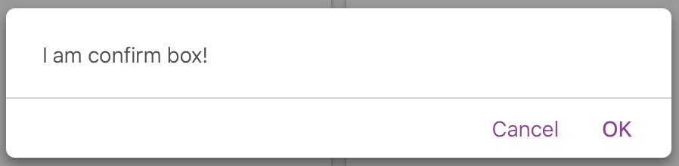
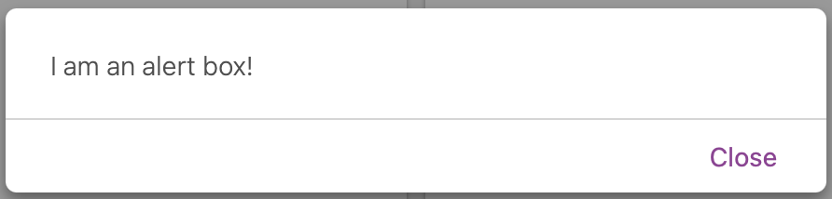
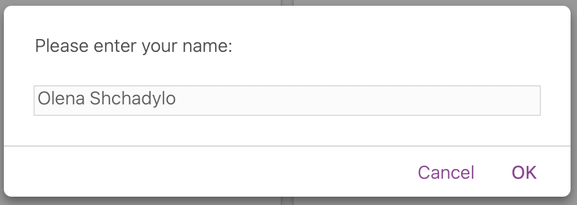
JAVASCRIPT POPUP BOXES
JavaScript has three kind of popup boxes: Alert box, Confirm box, and Prompt box.
propmt box

Slide 13
JAVASCRIPT TIMING EVENTS
JavaScript can be executed in time-intervals.
This is called timing events.
The window object allows execution of code at specified time intervals.
These time intervals are called timing events.
The two key methods to use with JavaScript are:
  setTimeout(function, milliseconds)
  Executes a function, after waiting a specified number of milliseconds.
  setInterval(function, milliseconds)
  Same as setTimeout(), but repeats the execution of the function continuously.

Slide 14

JAVASCRIPT COOKIES
Cookies are data, stored in small text files, on your computer.
When a web server has sent a web page to a browser, the connection is shut down, and the server forgets everything about the user.
Cookies were invented to solve the problem "how to remember information about the user":
When a user visits a web page, his/her name can be stored in a cookie.
Next time the user visits the page, the cookie "remembers" his/her name.
Cookies are saved in name-value pairs like:
When a browser requests a web page from a server, cookies belonging to the page are added to the request. This way the server gets the necessary data to "remember" information about users.

Slide 15

CREATE A COOKIE
JavaScript can create, read, and delete cookies with the document.cookie property.
With JavaScript, a cookie can be created like this:
You can also add an expiry date (in UTC time). By default, the cookie is deleted when the browser is closed:
With a path parameter, you can tell the browser what path the cookie belongs to. By default, the cookie belongs to the current page.

Slide 16
EVENT HANDLERS
The onevent handlers are properties on certain DOM elements to manage how that element reacts to events. Elements can be interactive (links, buttons, images, forms, and so forth) or non-interactive (such as the base <body> element). Events are actions like:
  Being clicked
  Detecting pressed keys
  Getting focus
The onevent handler is usually named with the event it reacts to, like onclick, onkeypress, onfocus, etc.

Slide 17
SPECIFY EVENT
You can specify an on<…> event handler for a particular event (such as click) for a given object in different ways:
  Adding an HTML attribute named on<eventtype>:
  <button onclick="handleClick()">,
  Or by setting the corresponding property from JavaScript:
  document.querySelector("button").onclick = function(event) { … }.

Slide 18
TERMINOLOGY
The term event handler may refer to:
  Any function or object that is registered to be notified of events
  Or more specifically, to the mechanism of registering event listeners via on… attributes in HTML or properties in Web APIs, such as <button onclick="alert(this)"> or window.onload = function() { … }.
When discussing the various methods of listening to events:
  Event listener refers to a function or object registered via EventTarget.addEventListener()
  Event handler refers to a function registered via on… attributes or properties

Slide 19
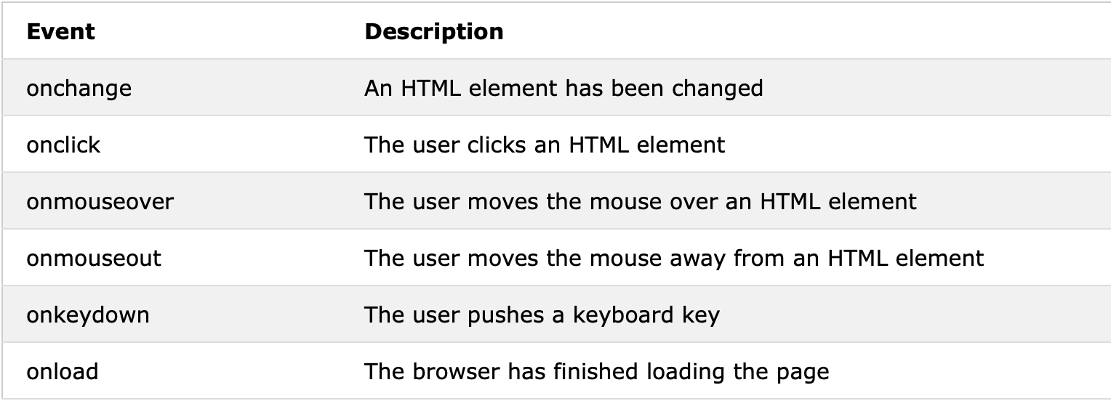
COMMON HTML EVENTS

Slide 20
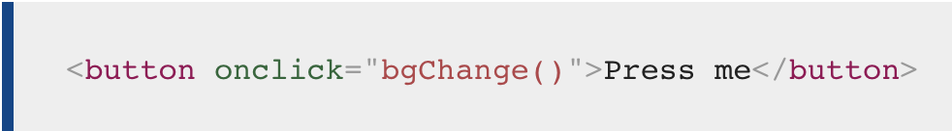
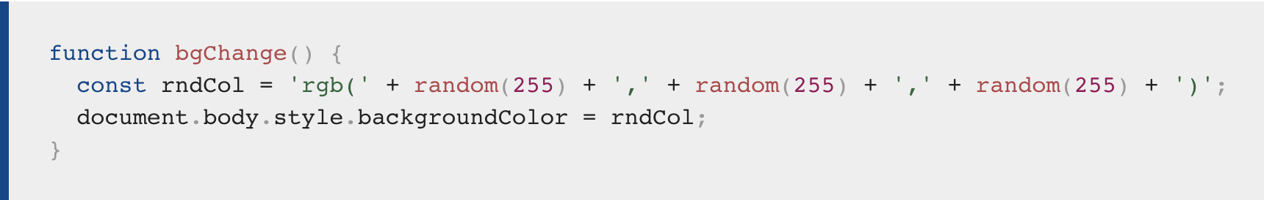
EVENT(example)

Slide 21
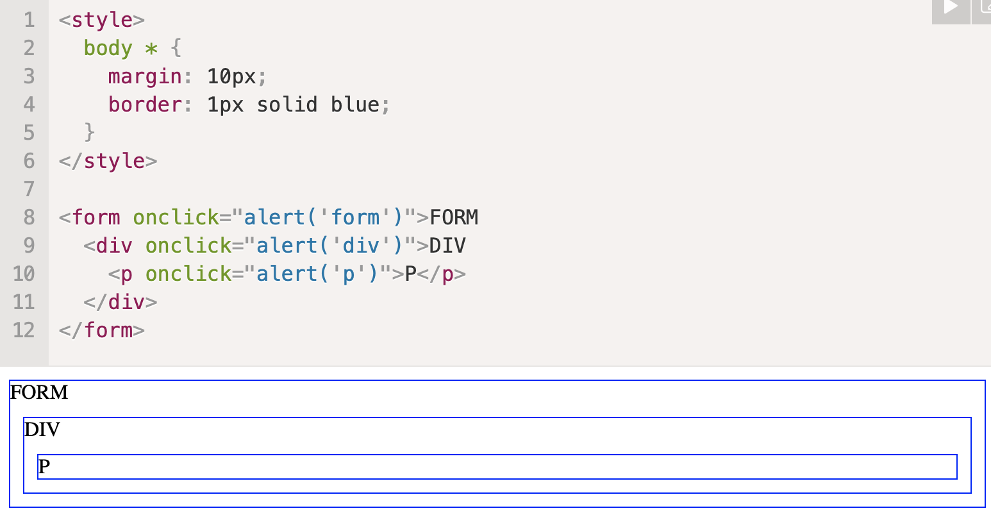
BUBBLING
The bubbling principle is simple.
When an event happens on an element, it first runs the handlers on it, then on its parent, then all the way up on other ancestors.
Let’s say we have 3 nested elements FORM > DIV > P with a handler on each of them:
A click on the inner <p> first runs onclick:
  On that <p>.
  Then on the outer <div>.
  Then on the outer <form>.
  And so on upwards till the document object.

Slide 22
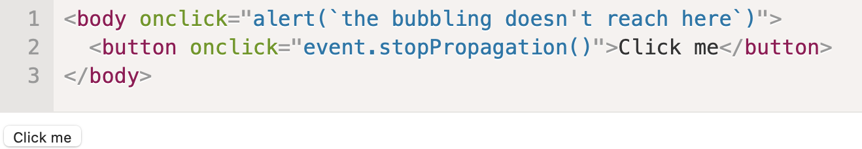
STOPPING BUBBLING
A bubbling event goes from the target element straight up. Normally it goes upwards till <html>, and then to document object, and some events even reach window, calling all handlers on the path.
But any handler may decide that the event has been fully processed and stop the bubbling.
The method for it is event.stopPropagation().
For instance, here body.onclick doesn’t work if you click on <button>:

Slide 23


