Slide 1
REGULAR EXPRESSIONS
By Olena Shchadylo

Slide 2
Agenda
What is regular expression?
Why regular expressions?
RegExp methods
RegExp modifiers
Patterns(brackets, metacharacters, quantifires)
test(), exec(), toString()

Slide 3
WHAT IS /^[REG]ULAR[EX]PRESSION$/ ?
Regular expressions are patterns used to match character combinations in strings. When you search for data in a text, you can use this search pattern to describe what you are searching for. In JavaScript, regular expressions are also objects.

Slide 4
Why /^[REG]ULAR[EX]PRESSION$/ ?
You won't understand the real importance of Regular expressions until you are given a long document and are told to extract all emails from it.
You could do that manually, but there is a super fast method that can do it for you. Most modern text editors allow Regex in their Find option. It is usually denoted by .*.

Slide 5
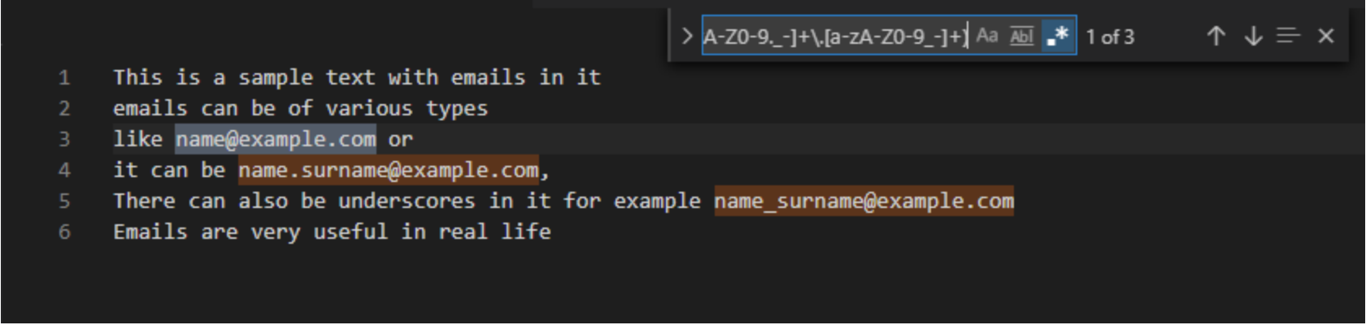
Why /^[REG]ULAR[EX]PRESSION$/ ? (continue)
Extracting Emails using Regex
And that's not all regex can do – emails are just an example. You could search any type of string that follows a pattern, for example URLs or text between parentheses.

Slide 6

SYNTAX
Example explained:
/olena/i is a regular expression.
olena is a pattern (to be used in a search).
i is a modifier (modifies the search to be case-insensitive).

Slide 7
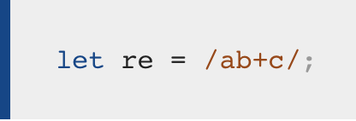
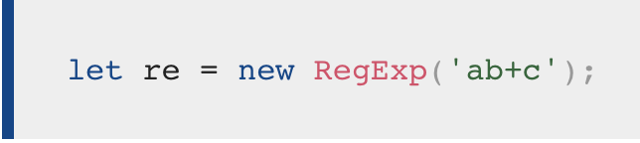
CREATING A REGULAR EXPRESSION
You construct a regular expression in one of two ways:
Using a regular expression literal, which consists of a pattern enclosed between slashes, as follows:
Or calling the constructor function of the RegExp object, as follows:

Slide 8
METHODS
In JavaScript, regular expressions are often used with the two string methods: search() and replace().
The search() method uses an expression to search for a match, and returns the position of the match.
The replace() method returns a modified string where the pattern is replaced.

Slide 9
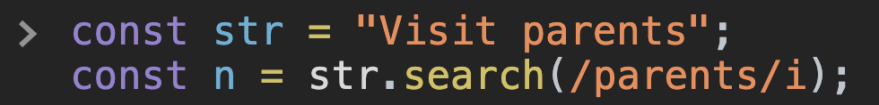
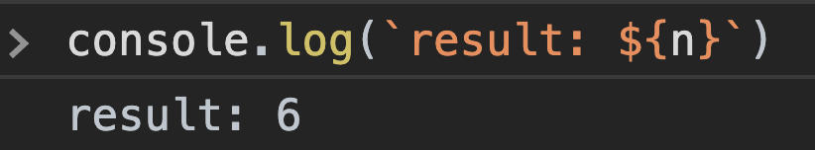
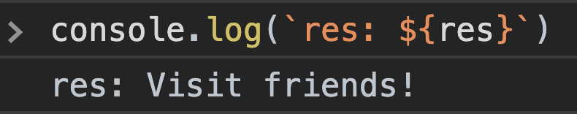
METHODS(continue)
search()
replace()

Slide 10
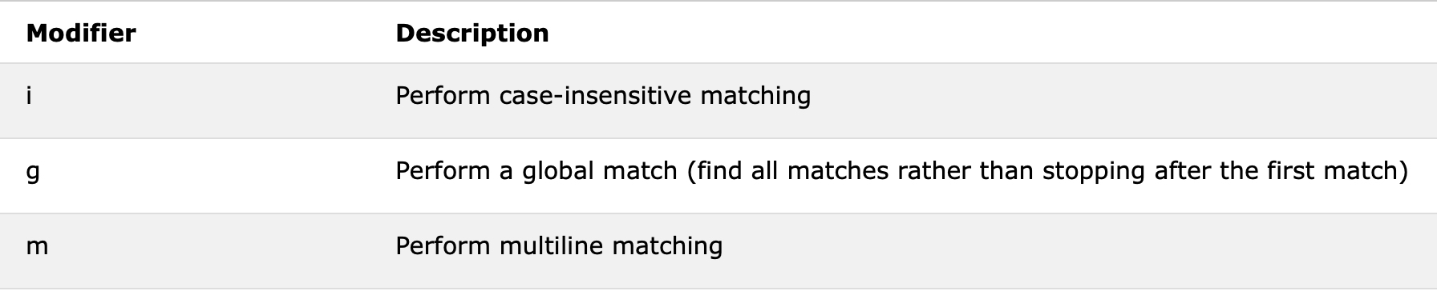
MODIFIERS
Modifiers can be used to perform case-insensitive more global searches:

Slide 11
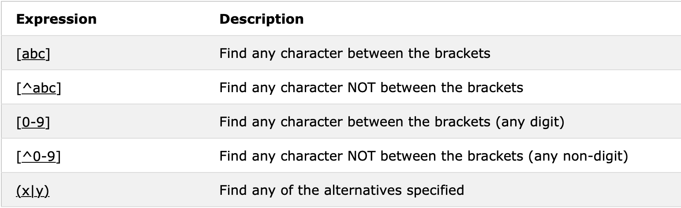
PATTERNS(brackets)
Brackets are used to find a range of characters:

Slide 12
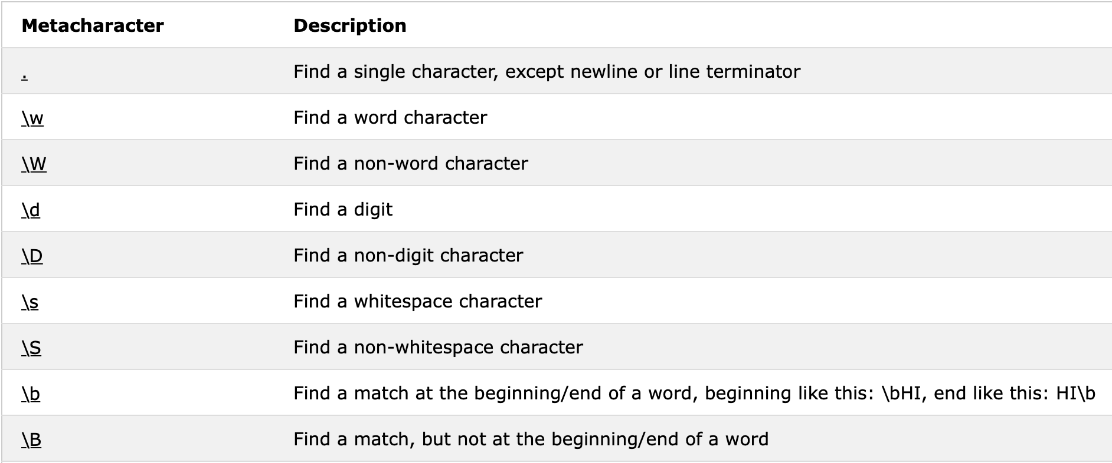
PATTERNS(metacharacters)
Metacharacters are characters with a special meaning:

Slide 13
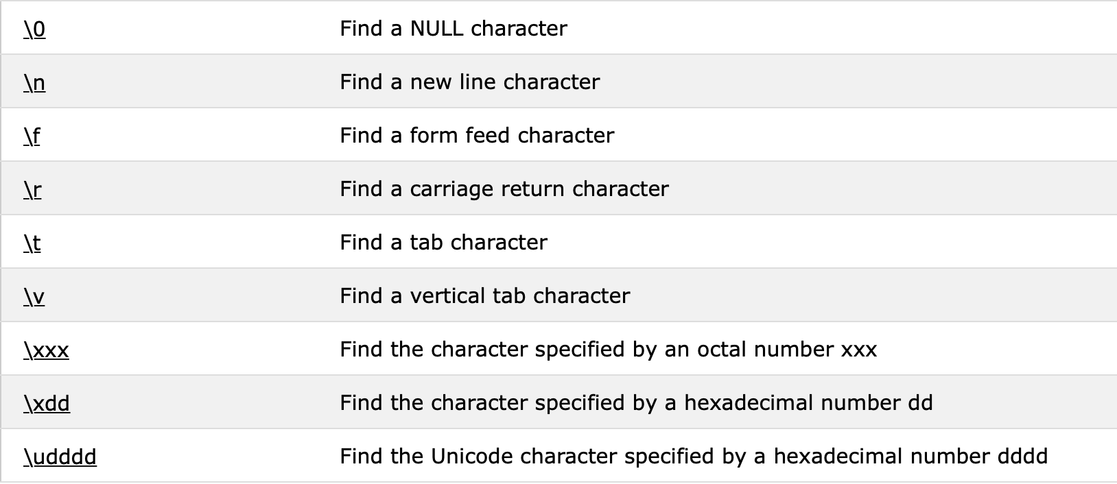
PATTERNS(metacharacters continue)

Slide 14
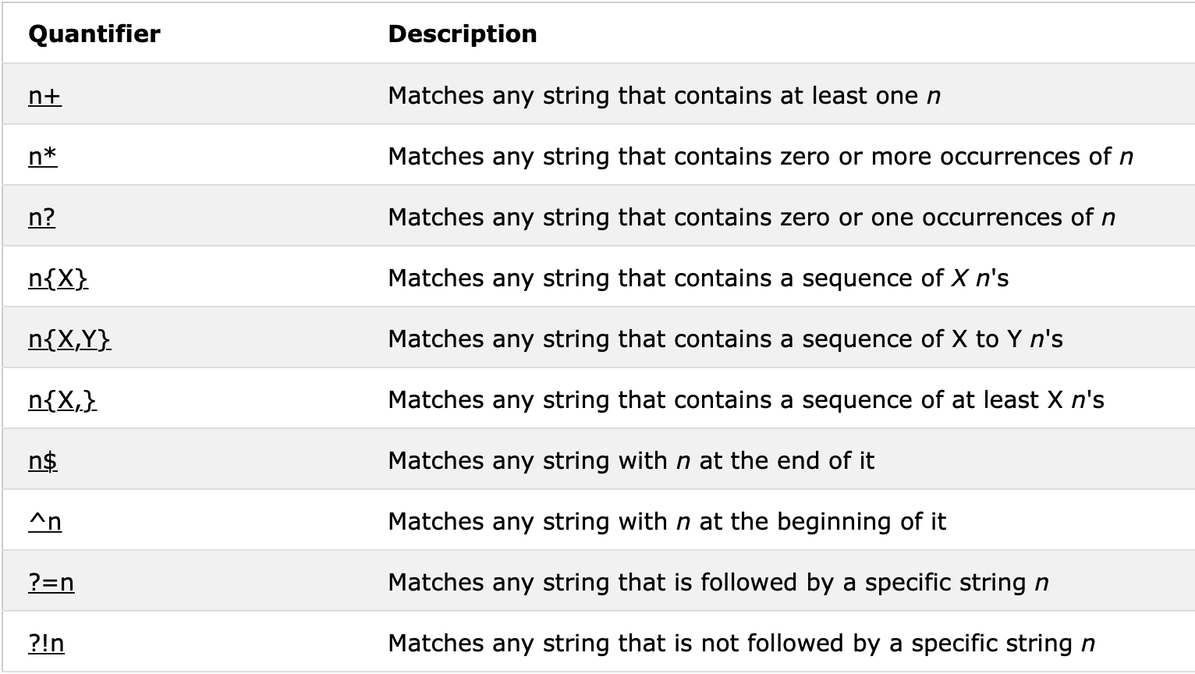
PATTERNS(quantifiers)
Quantifiers define quantities:

Slide 15
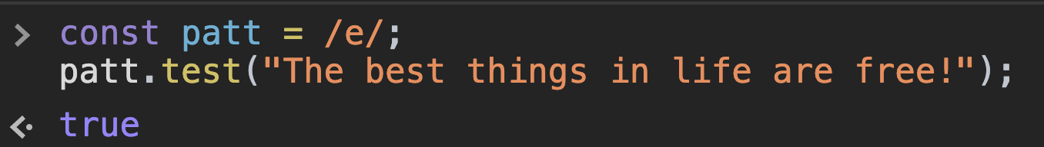
USING test()
The test() method is a RegExp expression method.
It searches a string for a pattern, and returns true or false, depending on the result.
The following example searches a string for the character "e":

Slide 16
USING exec()
The exec() method is a RegExp expression method.
It searches a string for a specified pattern, and returns the found text as an object.
If no match is found, it returns an empty (null) object.
The following example searches a string for the character "e":

Slide 17
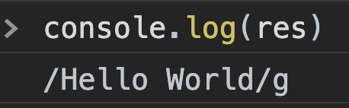
USING toString()
The toString() method returns the string value of the regular expression.

Slide 18
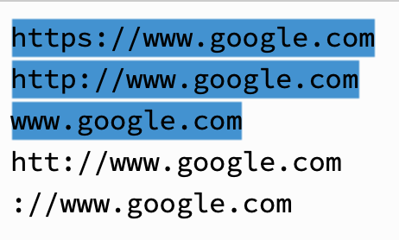
EXAMPLE(url)
^(http:\/\/www\.|https:\/\/www\.|http:\/\/|https:\/\/)?[a-z0-9]+([\-\.]{1}[a-z0-9]+)*\.[a-z]{2,5}(:[0-9]{1,5})?(\/.*)?$

Slide 19


