Slide 1
Visualizations
Line Chart
Area Chart
Stacked Area Chart

Slide 2
Line Chart A line chart is a common type of visualization used to display data points as individual markers connected by lines.
Characteristics of Line Charts
Markers: Each data point is represented by a marker (such as a dot or a cross).
Lines: The markers are connected by lines, emphasizing the trend or progression.
Trend Analysis: Line charts are excellent for tracking changes over time.
Continuous Data: Line charts work well with continuous data (e.g., time series data).

Slide 3
When?
We use line chart when we need to visualize the data for a specific period of time.
Comparison of multiple data simultaneously.
Why?
Illustrating trends and changes in data over time.
Comparing multiple data series simultaneously.
Identifying patterns and anomalies in data.
Displaying continuous data like stock prices or temperature changes.

Slide 4
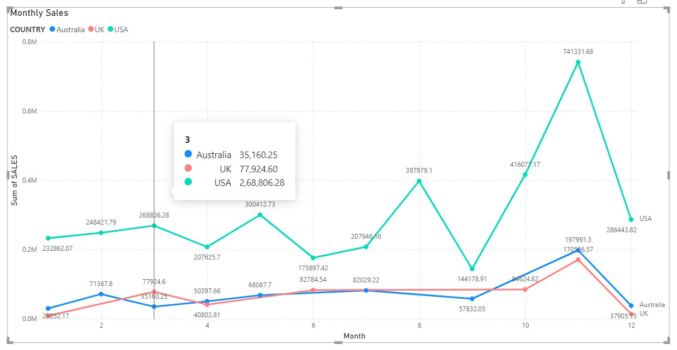
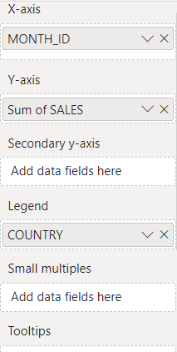
Example - Sales Data of 3 countries for 12 Months.
Australia
USA
UK
So, we are visualising the data of these three countries using Line Chart as shown below.

Slide 5
Implementation
The Horizontal View is X-Axis and Month number is placed in Value.
In Y-Axis Data Values I inserted Sales and summarized as SUM,
The Secondary Axis Means we can consider as sub of Y-axis (1, 1.1).
Legend means division, the no of data types are present, it will show the no of countries sales data.
Small multiples are nothing but total visualization is divided into no of parts.
Tooltips means when we hover the curser at any point, the added column details will be added to existing details and shown as in the above figure.

Slide 6
Area Chart An area chart is a type of visualization that displays data as a series of filled areas, typically stacked on top of each other.
Characteristics of Area Charts:
Filled Areas: Unlike line charts, area charts fill the area below the line with colour. This shading emphasizes the space between the line and an axis.
Magnitude of Change: Area charts visually emphasize the magnitude of change over time or across categories.
Stacked or Unstacked: Area charts can be either stacked (showing cumulative totals) or unstacked (showing individual components).

Slide 7
When?
We use area chart to quickly understand overall trends in our data.
Unlike line chart by using area chart, we can Show how different components contribute to these trends.
Why?
Because it represents the data in volume like temperature, STOCK price, monthly sales etc.
It shows the difference graphically by drawing the attention with its layering the area.

Slide 8
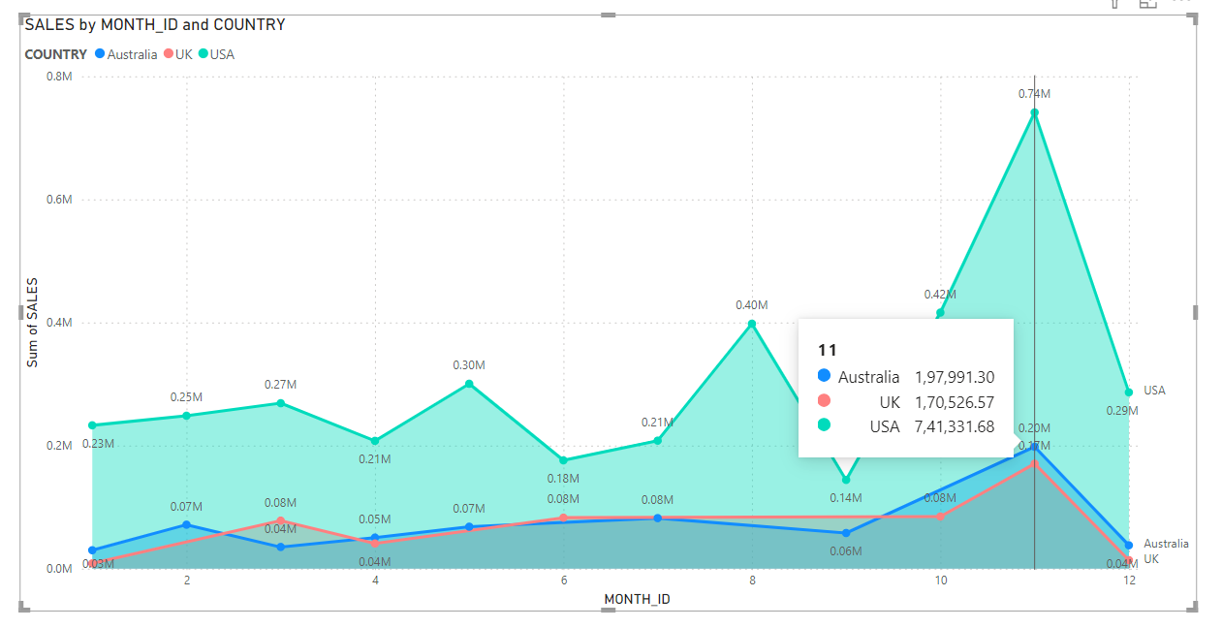
Example - Sales Data of 3 countries for 12 Months.
Australia
USA
UK
So, we are visualising the data of these three countries using Area Chart as shown below.

Slide 9
Implementation
The Horizontal View is X-Axis and Month number is placed in it.
In Y-Axis Data Values I inserted Sales and summarized as SUM,
The Secondary Axis Means we can consider as sub of Y-axis,
Legend means division, the no of data types are present, it will show the no of countries sales data.
Small multiples are nothing but total visualization is divided into no of parts.
Tooltips means when we hover the curser at any point, the added column details will be added to existing details and shown as in the above figure.

Slide 10
STACKED AREA CHART A Stacked Area Chart helps to compare different variables by their quantities over a time interval. Every variable is stacked one upon the other with different colours or shading.
Characteristics of Stacked Area Chart Stacked Area Charts in PowerBI, as in other visualization tools, are used primarily to illustrate how individual components contribute to the whole over time. Here's why they're commonly used
Comparison of Trends: Stacked Area Charts allow you to compare the overall trend as well as the relative contribution of each category or component to that trend over time. This makes it useful for spotting patterns, shifts, or anomalies in data.
Showing Cumulative Data: Stacked Area Charts are effective for displaying cumulative data, where each layer represents the sum of the layers beneath it. This is particularly useful when you want to emphasize the total while still showing the breakdown of individual components.
Highlighting Proportions: They help in understanding the proportion of each category relative to the total at any given point in time. This can be helpful for identifying which components are driving changes in the overall trend.

Slide 11
When?
Stacked area charts are effective when you want to show how different categories contribute to a total over time.
Ex- you might use it to visualize the distribution of revenue across different product categories over time.
Why?
Stacked Area Charts can be used to highlight differences and relationships between different categories.
Ex- you can easily see if one category is growing at the expense of another.

Slide 12
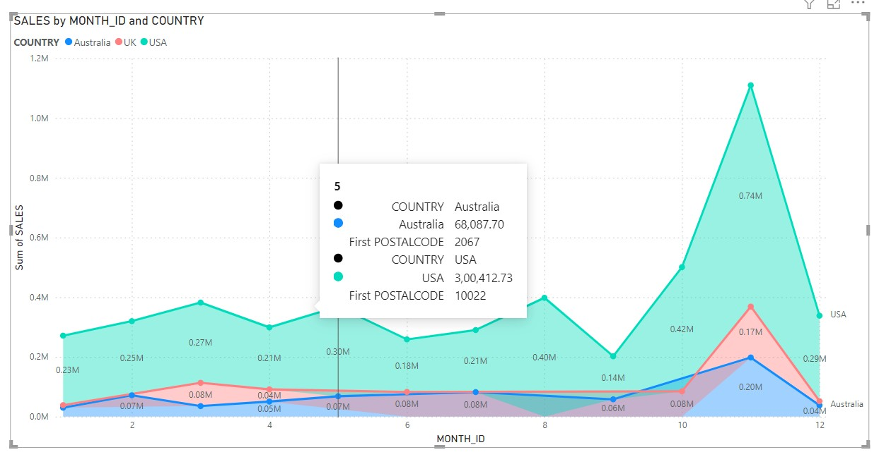
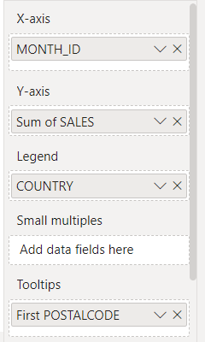
Example - Sales Data of 3 countries for 12 Months.
Australia
USA
UK
So, we are visualising the data of these three countries using Stacked Area Chart as shown below.

Slide 13
Implementation
The Horizontal View is X-Axis and Month number is placed in it.
In Y-Axis Data Values I inserted Sales and summarized as SUM,
Legend means division, the no of data types are present, it will show the no of countries sales data.
Small multiples are nothing but total visualization is divided into no of parts.
Tooltips means when we hover the curser at any point, the added column details will be added to existing details and shown as in the above figure. (First Postal Code).

Slide 14
Thank You.

