Slide 1
Predicting vaginal-microbiome instability
— a Claude Science discovery, end to end
A workflow story: how Claude Science ran the whole discovery —
literature search, dataset identification, hypothesis formation.
…and how it led us to a novel finding: L. iners marks mobility, not decline.
Built with Claude: Life Sciences — Lab Track · Data: ENA PRJEB37731 (public)

Slide 2
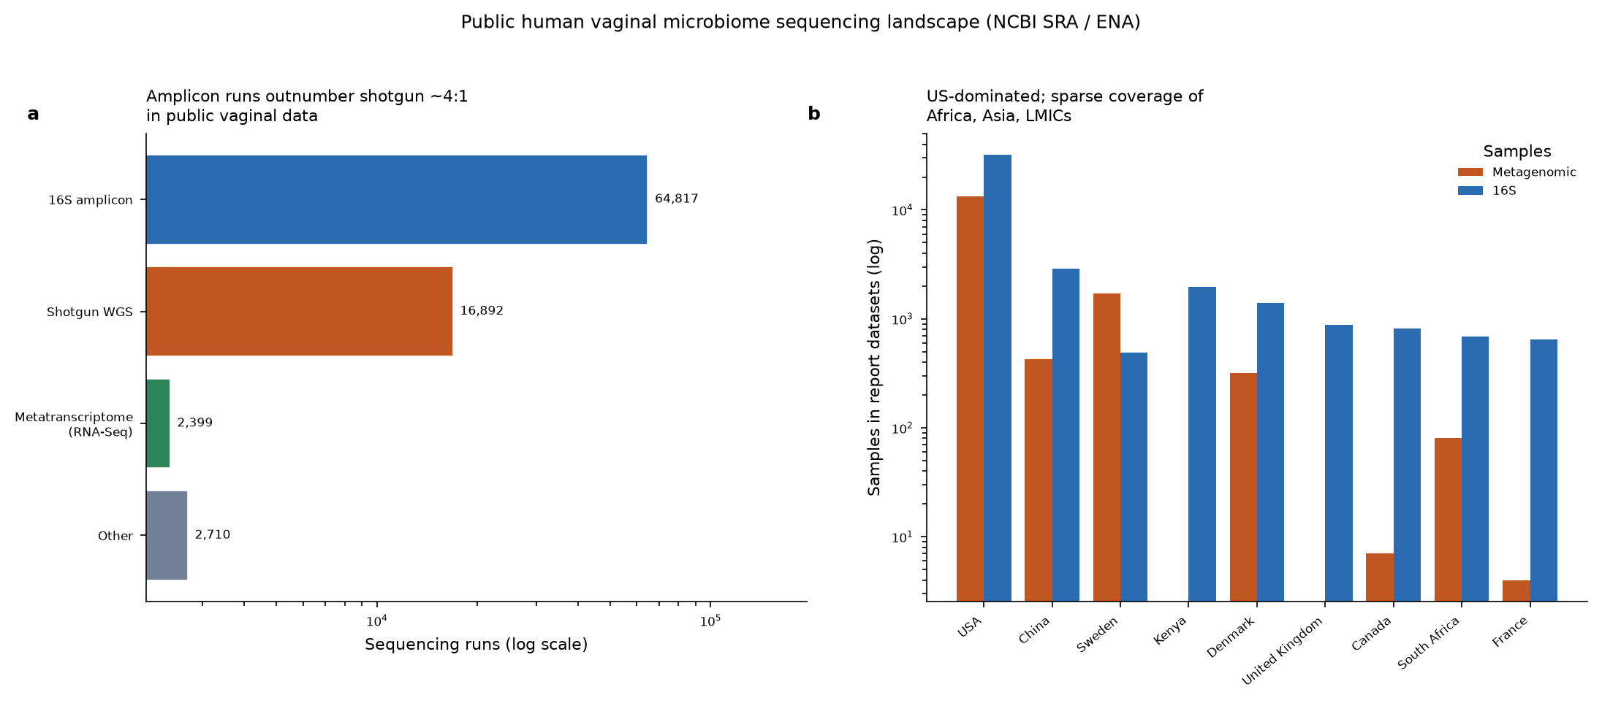
The challenge
0:00–0:22
▸ Vaginal-microbiome data is scarce and scattered across archives
▸ Outcome labels usually live in papers, not in the data records
▸ Our real question: can Claude Science turn that mess into a discovery?
figures/vaginal_landscape.png
Notes:
[0:00–0:22] Human vaginal-microbiome data is scarce, scattered across archives, and the outcome labels you'd actually want to predict usually live buried in the papers, not in the data records. So our project wasn't just to build a model — it was to see whether Claude Science could run the *entire* discovery pipeline: read the field, find the data, form a hypothesis, and take it all the way to a novel finding.

Slide 3
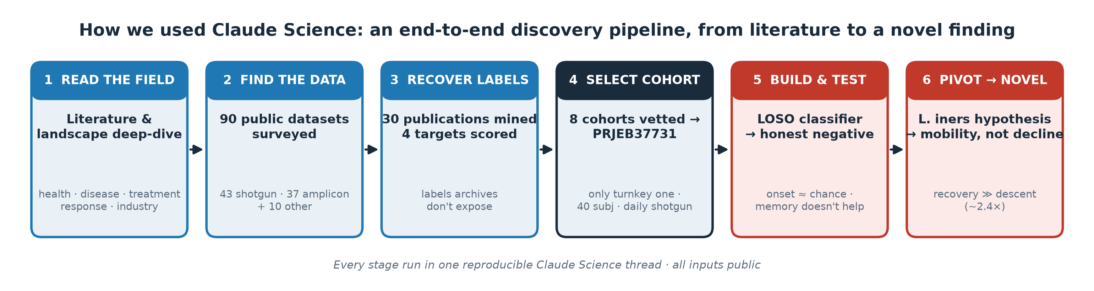
Claude Science read the field & found the data
0:22–0:52
▸ Claude Science ran a full literature & landscape deep-dive
▸ Surveyed 90 public datasets — 43 shotgun, 37 amplicon, 10 other
▸ One reproducible thread, every input public
▸ This is the workflow — six stages, literature to novel finding
figures/claude_science_workflow.png
Notes:
[0:22–0:52] First, Claude Science read the field for us — a full literature and landscape deep-dive across health, disease, and treatment response. Then it went looking for data, surveying ninety public datasets: forty-three shotgun-metagenomic, thirty-seven amplicon, the rest whole-genome-amplified or restricted. All of this ran inside a single reproducible thread — this diagram is the whole pipeline, six stages from reading the literature to the finding we'll end on.

Slide 4
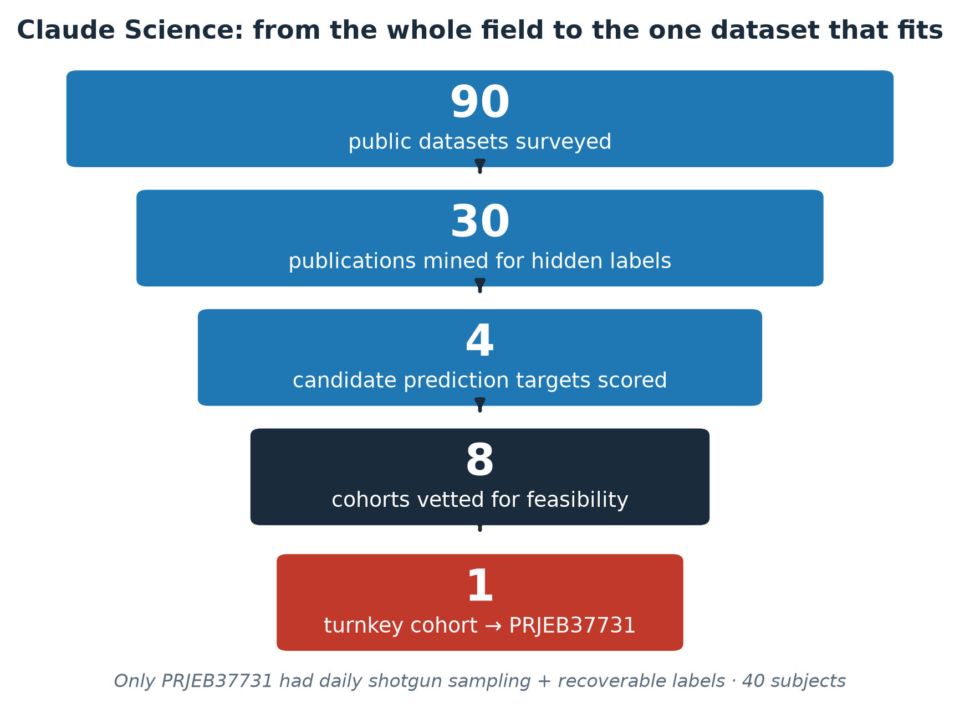
It recovered the hidden labels & picked the cohort
0:52–1:24
▸ Archives don't expose outcome labels — Claude Science mined the papers
▸ 30 publications read to recover labels for 4 candidate targets
▸ 8 cohorts vetted for feasibility → only PRJEB37731 was turnkey
▸ Danish cohort · 40 subjects · daily shotgun metagenomics
figures/dataset_selection_funnel.png
Notes:
[0:52–1:24] The catch: the archives don't expose the labels you need. So Claude Science mined the literature — reading thirty publications to recover outcome labels and score four candidate prediction targets on what was *actually* available. It vetted eight cohorts for feasibility, and only one was turnkey: PRJEB37731, a Danish cohort of forty women sampled daily by shotgun sequencing. That dataset selection — matching a question to the one dataset that could answer it — was the pivotal move, and Claude Science did it end to end.

Slide 5
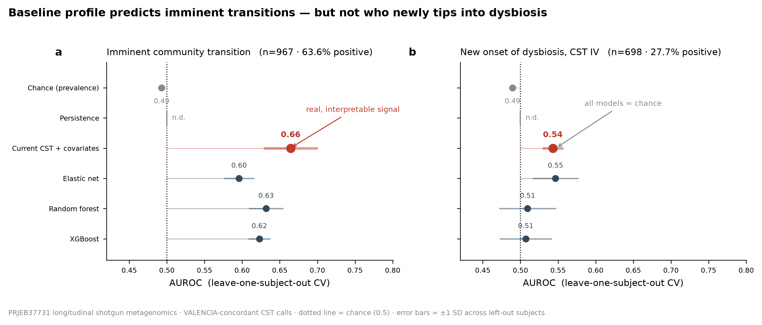
It built the classifier — and reported an honest negative
1:24–1:52
▸ Claude Science built the full pipeline: elastic net · RF · gradient boosting
▸ Leave-one-subject-out CV — no leakage, honest baselines
▸ Result: composition adds nothing beyond current state
▸ Dysbiosis onset ≈ chance; even 5 days of memory don't help
figures/hero_transition_vs_onset.png
Notes:
[1:24–1:52] Then it built the classifier — elastic net, random forest, gradient boosting, all evaluated leave-one-subject-out so no person leaks between train and test. And it reported the result honestly, even though the result was negative: the microbiome composition adds essentially nothing beyond the current state, and predicting who newly tips into dysbiosis comes out at chance. Claude Science even tested adding five days of memory. It didn't help.

Slide 6
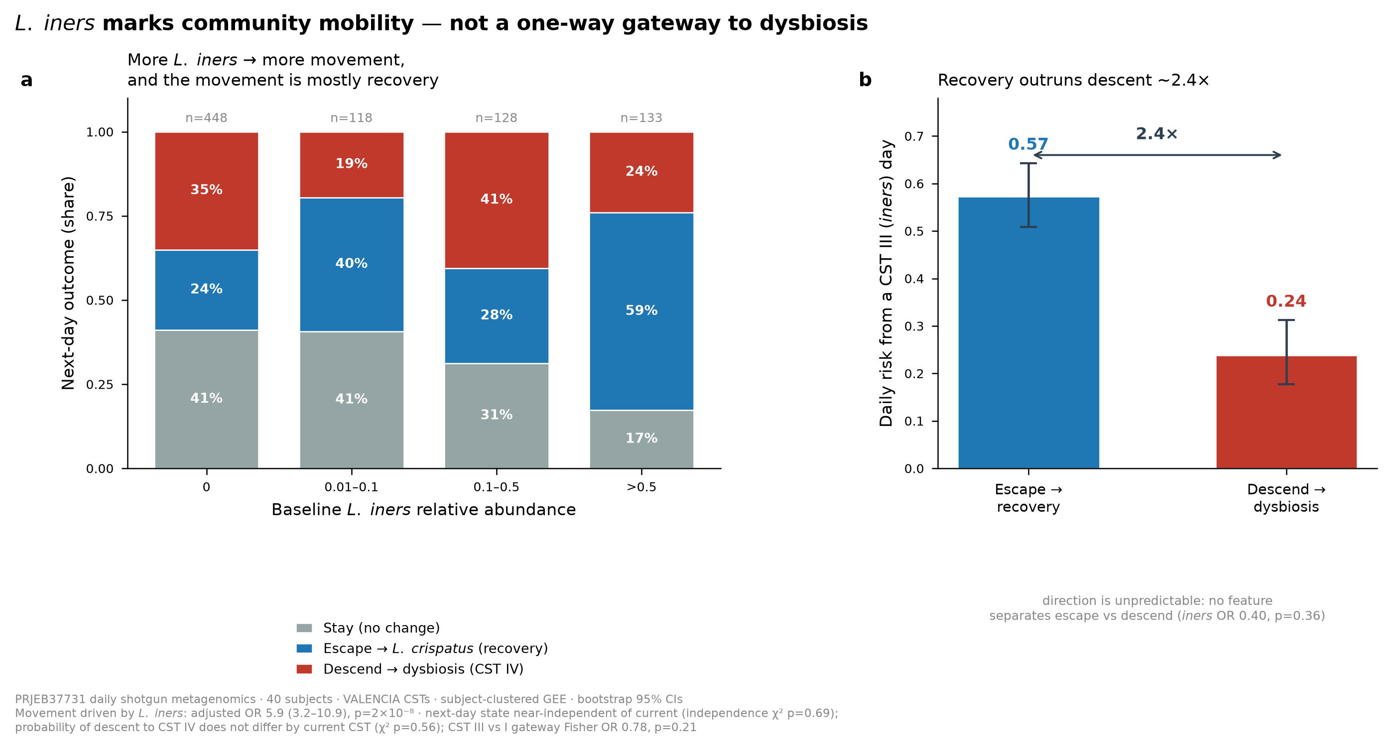
The negative led it to form a new hypothesis — the novel finding
1:52–2:28
▸ A negative result is a clue — Claude Science asked what carried signal
▸ It flagged L. iners and formed a testable hypothesis
▸ iners predicts movement (OR ≈ 6) — but movement is recovery
▸ Recover 0.57 vs descend 0.24 (~2.4×); CST III is not a gateway
figures/hero_iners_mobility.png
Notes:
[1:52–2:28] But a negative result is a clue if you ask what it's telling you — and here's where it gets interesting. Claude Science flagged the one thing carrying signal, Lactobacillus iners, and formed a testable hypothesis about it. iners strongly predicts that the community will move — odds ratio near six. But when we asked *where* it moves, the textbook flips: from an iners day, the community recovers toward health at nearly two-and-a-half times the rate it declines into dysbiosis. iners marks mobility, not decline — a genuinely novel correction, reached because the platform followed the negative instead of hiding it.

Slide 7
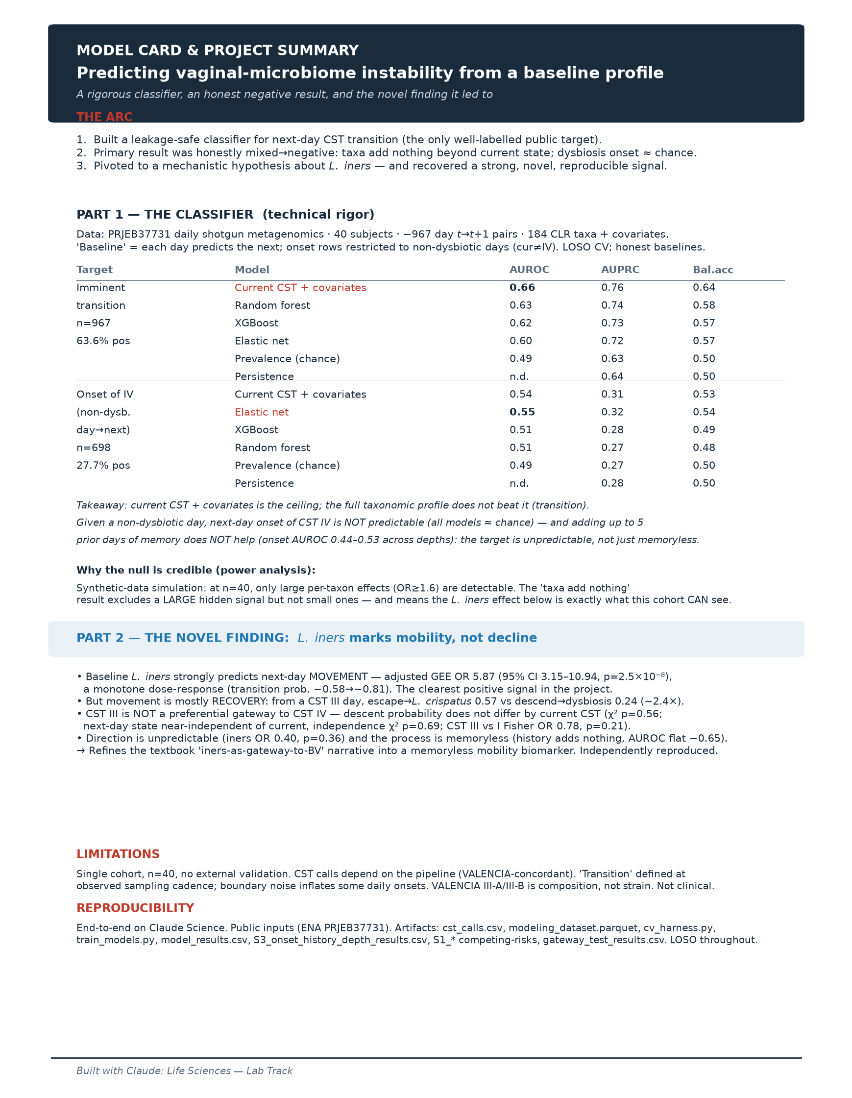
What Claude Science enabled
2:28–3:00
▸ Literature → data → hypothesis → novel finding, one reproducible thread
▸ Honest reporting turned a null into a discovery
▸ Public data, fully reproducible, no external validation yet
▸ Next: a cohort with intervention outcomes → predict therapy response
figures/model_card.png
Notes:
[2:28–3:00] So the story here isn't really the model — it's the workflow. Claude Science read the literature, found and vetted the data, recovered the hidden labels, built and honestly tested the classifier, and then turned the negative into a novel finding — all in one reproducible thread on public data. Give that same pipeline a cohort with intervention outcomes, and it goes after the real prize: predicting who responds to microbiome-directed therapy. Thanks for watching.

