Slide 1

DRUGS USED IN THE TREATMENT OF NEURODEGENERATIVE DISORDERS AND PSYCHIATRIC DISORDERS
BY:NN LEDWABA(222918430)

Slide 2
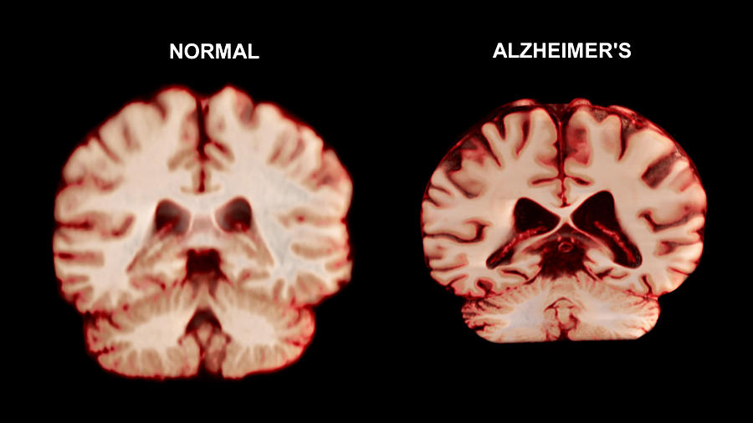
ALZHEIMER’S DISEASE

Slide 3
AETIOLOGY
TYPES OF AD
Early-Onset Alzheimer’s Disease (EOAD):
Occurs before age 65.
Less common form.
Late-Onset Alzheimer’s Disease (LOAD):
Occurs after age 65.
Accounts for ~95% of AD cases. (Sheppard & Coleman, 2020)
GENETIC FACTORS
AD has a Mendelian inheritance pattern in some cases.
Caused by mutations in:
Aβ Precursor Protein (APP)
Presenilin 1 (PSEN1)
Presenilin 2 (PSEN2)
These mutations affect Aβ production and lead to autosomal dominant AD.
PSEN1 and PSEN2 encode part of the γ-secretase complex important in APP processing. (Sheppard & Coleman, 2020)
RISK FACTORS
Age is the greatest risk factor:
3% incidence at age 65.
Increases to 30% by age 85.
Risk is low under age 65. (Sheppard & Coleman, 2020)
INFLAMMATION AND AD
Inflammation is linked to:
Trauma
Infection
Sepsis
Leads to short- and long-term cognitive decline.
Elevated interleukin-6 (IL-6) and other inflammatory markers increase AD risk.
Activates microglia and astrocytes, contributing to cognitive decline. (Sheppard & Coleman, 2020)
INFECTION AND AD
Aβ has antimicrobial properties—its production increases in response to infection.
Aβ deposits activate:
Microglia
Astrocytes
Lymphocytes
Macrophages
This activation causes:
Reduced cytokines, chemokines, and neurotransmitters.
Programmed cell death.
Blood-Brain Barrier (BBB) impairment.
BBB dysfunction allows Peripheral Blood Leukocytes (PBL) to enter the brain, increasing inflammation and worsening AD. (Sochocka et al., 2017)

Slide 4
PATHOGENESIS & SIGNS AND SYMPTOMS
The exact pathogenesis of AD is still under investigation.
Early-Onset AD (EOAD) is associated with the accumulation of amyloid-beta (Aβ). (Sheppard & Coleman, 2020)
Effects of Aβ Build-up:
Leads to neuronal death via:
Ecotoxicity
Mitochondrial dysfunction
Synaptic disruption
Reduction in synaptic proteins observed in AD patients. (Sheppard & Coleman, 2020)
Role of Inflammation:
Chronic elevation of inflammatory markers contributes to:
Neurotoxicity
Increased Aβ deposition
Prolonged activation of:
Microglia
Astrocytes
This prolonged activation causes brain degradation. (Sheppard & Coleman, 2020)
SIGNS AND SYMPTOMS
Memory decline
Depression
Decline in language
Disorientation
Changes in behaviour and personality

Slide 5
DIAGNOSIS
Diagnosis involves multiple steps: (Alzheimer’s Association)
1. Medical History Review
Evaluates:
Medications the patient is taking
Psychiatric or behavioural changes
Family history of AD
2. Physical Examination
Checks:
Blood pressure (BP)
Heart and lung function
Collects urine and blood samples
3. Neurological Examination
Assesses:
Reflexes
Speech
Eye movement
Sensation
Coordination
4. Brain Imaging
Helps detect structural changes in the brain using:
MRI (Magnetic Resonance Imaging)
CT (Computed Tomography)

Slide 6

SCHIZOPHRENIA

Slide 7
AETIOLOGY
Genetic Factors:
40% chance of inheritance if both parents have schizophrenia (Fatani et al., 2017)
Dopaminergic Dysfunction:
Mesolimbic area: Chaotic, hyperactive dopaminergic neurons.
Leads to positive symptoms: delusions, hallucinations, hostility, aggression (Rubeša et al., 2011).
Mesocortical area: Hypoactive dopaminergic neurons (Rubeša et al., 2011)
Developmental Factors:
Impaired neurodevelopment.
Maternal stress, infection, nutritional deficiencies.
Birth complications (Fatani et al., 2017)
Environmental Factors:
Stress from social environments.
Discrimination.
May trigger delusions and paranoia (Fatani et al., 2017
Incidence and Course:
Typically occurs between ages 15–44.
Chronic condition (Jackson, 1960)

Slide 8
PATHOGENESIS
Structural Brain Abnormalities:
Reduction in grey matter:
Progressive over time.
Noted in temporal lobe (due to antipsychotic meds).
Observed in caudate nucleus and thalamus in patients not on medication. (Fatani et al., 2017)
White matter irregularities are also associated with schizophrenia. (Fatani et al., 2017)
Prefrontal cortex is strongly linked to cognitive dysfunction. (Fatani et al., 2017)
Dopamine Neurotransmission:
Hyperactivity in mesolimbic pathway → Positive symptoms (delusions, hallucinations). (Fatani et al., 2017)
Hypoactivity in mesocortical pathway → Negative symptoms (e.g., social withdrawal) and cognitive impairment. (Fatani et al., 2017)
Reduced dopamine in nigrostriatal pathway (from substantia nigra to caudate nucleus):
Affects the extrapyramidal system, causing motor symptoms. (Fatani et al., 2017)
Glutamate Dysfunction:
Affects interneurons in cerebral cortex and hippocampus.
Leads to synchronous firing of pyramidal neurons.
Causes abnormal gamma brain wave activity.
Results in cognitive deficits. (Fatani et al., 2017

Slide 9
SIGNS AND SYMPTOMS
Negative symptoms:
Abnormal behaviour
Social withdrawal
Lack of interest in pleasurable and productive activities
Depression
Dementia
Post traumatic stress disorder(PTSD)
Anxiety
Obsessive compulsive disorder(OCD)
Positive symptoms:
Delusions
Hallucinations (visual and auditory)
Disorganized behaviour
Unusual beliefs

Slide 10
DIAGNOSIS
Diagnosis is made using the DSM-5. (Fatani et al., 2017)
Requires presence of 2 or more active-phase symptoms for at least 1 month:
Delusions
Hallucinations
Disorganized speech
Catatonic or grossly disorganized behavior (Fatani et al., 2017)
Functional impairments must be evident:
Difficulty functioning at work or school
Poor interpersonal relationships
Inability to maintain self-care
(Fatani et al., 2017
Symptoms must persist for 6 months, including at least 1 month of active-phase symptoms. (Fatani et al., 2017)
Other psychiatric disorders must be ruled out before confirming the diagnosis. (Fatani et al., 2017)

Slide 11
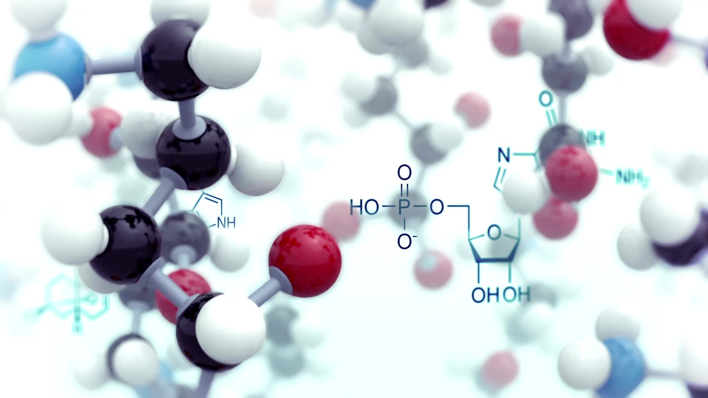
MEMANTINE
 | A primary aliphatic amine, a 3,5-dimethyl derivative of 1-aminodamantane.(PubChem-memantine) A N-methyl-D-asparatate(NMDA) receptor antagonist which binds to the NMDA receptor cation channels.( PubChem-memantine) Its roles included being a dopaminergic agent, a neuroprotective agent and an antidepressant.( PubChem-memantine) It additional blocks the effects of glutamate.( PubChem-memantine)
CHEMISTRY | Primary aliphatic amine, a 3,5-dimethyl derivative of 1-aminodamantane.( PubChem-memantine) The molecular formula: C12H21N(PubChem-memantine)
PHARMACOLOGICAL CLASS | NMDA antagonist
PHYSIOCHEMICAL AND BIOPHARMACEUTICAL PROPERTIES | Molecular weight- 197,30g/mol Solubility- water Melting point- 290˚-295˚ C LogP- 3,28 pKa- 10,27
STABILITY AND DEGRADATION REACTIONS | Storage Conditions: Airtight packaging, in dry ventilated area,( PubChem-memantine) at room temperature of 20˚ to 25˚ C.( Kuns, B., et al 2024) Incompatible materials: Strong oxidizing agents Memantine is degraded by the use of photo-based advanced oxidation processes.( Papac, J., et al 2023) Memantine is a bioaccumalative drug which can cause harm to the environment.( Papac, J., et al 2023) The use of memantine over time will increase due to an expected increase in prevalence in the coming years.( Papac, J., et al 2023) Total degradation of memantine is observed within 3.5 minutes by UV-C/H2O2 process, with the pH of 5.1[H2O2]=15.21mM.( Papac, J., et al 2023) The process of degradation by UV-A/TiO2 takes much longer(90 min) however, memantine degradation is complete.( Papac, J., et al 2023)

Slide 12
MEMANTINE
FORMULATION OF DOSAGE AND ROUTINE OF ADMINISTRATION | Route of administration: Oral Solution: 5mL Film coated tablets: 5mg and 10mg Generic name: Namenda The initial oral tablet dosage begins at 5mg once per day, the target dosage is 20mg once per day.( Kuns, B., et al 2024) In regard to titration, the dosage is increased weekly by 5mg daily.( Kuns, B., et al 2024) Whenever a dosage is missed doubling on the dosage the next day is not advised.( Kuns, B., et al 2024) The dosage is given orally in either capsules, tablets or a titrated solution.
KINETICS | ABSORPTION: Memantine’s concentration peaks roughly around 3-7 hours post oral intake.( PubChem-memantine) When administered at normal therapeutic doses it shows linear pharmacokinetics. Can be taken with or without food. (PubChem-memantine) ROUTE OF ELIMINATION: Memantine is excreted via the urine, approx. 48% of the drug is excreted in the urine in its original from.( PubChem-memantine) the remaining 52% is metabolized to N-glucuronide conjugate, 6-hydroxyl memantine and 1-nitroso-deminated memantine.( PubChem-memantine) The elimination half-life is 60- 80 hours.( Kuns, B., et al 2024) VOLUME OF DISTRIBUTION: 9-11L/kg.( PubChem-memantine) The binding of memantine to plasma is at 45%.( Kuns, B., et al 2024) CLEARANCE: Tubular secretion in the kidneys.( PubChem-memantine) METABOLISM: Memantine(48%) is metabolised in the liver by the hepatic enzyme CYP450.( PubChem-memantine) The remaining to N-glucuronide conjugate, 6-hydroxyl memantine and 1-nitroso-deminated memantine that has been converted to metabolites acts as a receptor antagonist.( PubChem-memantine

Slide 13
MEMANTINE
MECHANISM OF ACTION | Memantine is an NMDA receptor antagonist, which prevents the functions of glutamate on the receptors in the central nervous system.( PubChem-memantine) This prevents the persistent activation of NMDA receptors, which cause the excessive release of glutamate, which induces neuronal degradation.( PubChem-memantine) Memantine also inhibits the nicotinic acetylcholine receptors. Additionally, it prevents the calcium elevation, which reduces AD symptoms and dementia.( PubChem-memantine)
THERAPEUTIC USES/INDICATIONS | Dementia Anti-Parkinson Agent Dopamine Agent Excitatory Amino Acid Agent AD
CONTRAINDICATIONS | Alcohol(PubChem-memantine) Hepatic impairment: The half-life of memantine is elevated by 16% in pts with moderate hepatic impairment.( Kuns, B., et al 2024) Renal impairment: The half-life of memantine is elevated by 18%, 41% and 95% in pts with mild, moderate and severe renal impairment, respectively.( Kuns, B., et al 2024)
WARNINGS AND SPECIAL PRECAUTIONS | Genitourinary conditions Cardiovascular disease Hepatic impairment
INTERACTIONS | The co-ingestion of memantine with anti-diabetic medication results in agitation, coma, low platelet count, elevated serum uric acid, and serum phosphatase.( PubChem-memantine) Drugs causing alkaline urine(Kuns, B., et al 2024)
TOXICITY | Toxicity is observed when a pt ODs, therefore, it is important for physicians to understand the contraindications and interactions of memantine.( Kuns, B., et al 2024)

Slide 14
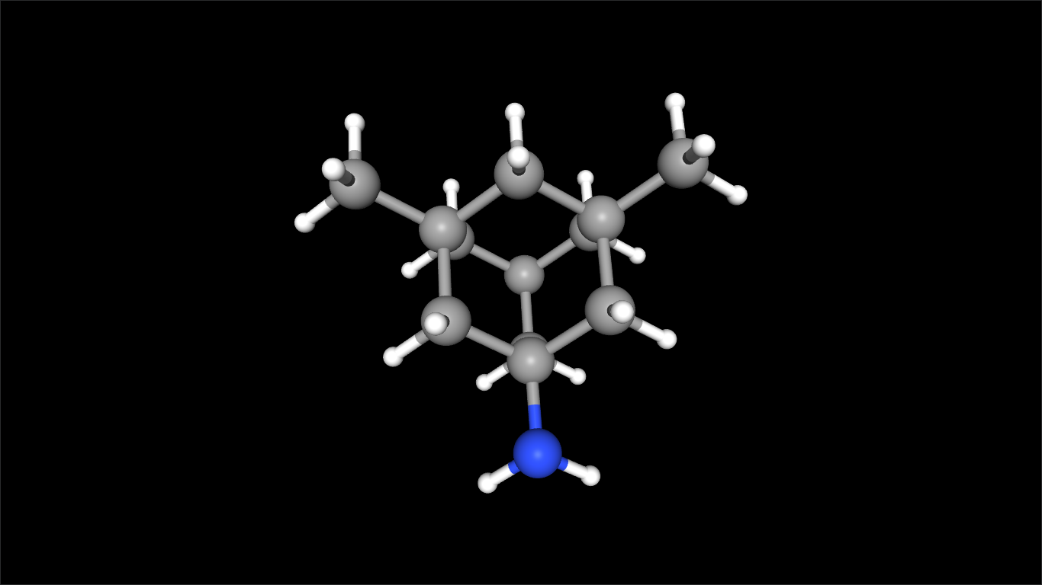
MEMANTINE
SYMPTOMS AND TREATMENT OF OVERDOSE | Symptoms cause by OD include dizziness, psychosis, hallucinations, emesis, somnolence, lethargy and hypertension.( PubChem-memantine) In the case of an OD the elimination of memantine should eradicated via the urine by acidification.( PubChem-memantine)

Slide 15
THE ROLE OF THE CLINICAL TECHNOLOGIST- NEUROPHYSIOLOGIST
Neurophysiologists are often involved in the diagnostic process; however, the scope of practice does not expand beyond biomedical measures.
The diagnostic procedures performed by a neurophysiologist include Electroencephalography(EEG), Electromyography(EMG) and Evoked Potentials.
An EEG is used to analyse the brain activity in pt in order to find answers to neurological questions.
The EMG is used to measure muscle activity alongside the Nerve conduction study(NCS), which is used to assess the integrity of the nerves.
Evoked Potentials assess visual pathways, auditory pathways and the neuronal pathway to the spine.
Having established to uses of these procedures it can be ascertained that the most relevant procedure would be the EEG. This procedures would be utilized in the proving the presents of the disorders.
The EEG of an AD pt would show increased slowing and elevated temporal and parietal brain activity. On the other hand, an EEG of a schizophrenic pt also shows generalized slowing. It is important to understand that the EEG is not a primary diagnostic tool, however, a diagnostic tool used hand in hand with physiological and image monitoring and psychological analysis.
The final diagnosis is compiled by the physician, and the necessary treatment plan is presented to the pt. Persistent testing may be required for the monitoring of the disorder progression.
ETHICAL AND LEGAL CONSIDERATIONS
AD is a disorder that affects the pts ability to make decisions regarding their care.( Chiong, W., et al 2021) This makes it difficult for a practitioner balance medical care and respect for the pts ideals.( Chiong, W., et al 2021) It is important that the pts autonomy be respected, that the pt is treated just, treated to their benefit and without harm.( Chiong, W., et al 2021) at the point where the patient is unable to make decisions for themselves their next of kin is involved in order to carry out the pts wishes and appropriate care.( Chiong, W., et al 2021) Providing the pt with all the information is an imperative step throughout the diagnosis. This ensures autonomy and transparency.
Advance care planning is important while the pt can still make decisions.( Chiong, W., et al 2021) All the necessary documents are required that confer legal authority to caregivers, family and spouses. (Chiong, W., et al 2021)
In regard to schizophrenia the fact remains, it is of utmost importance that the pts autonomy be respected, that the pt is treated just, treated to their benefit and without harm. All information should be provided as require and the pt is not to be coerced into clinical trials, especially when they are most vulnerable.

Slide 16
REFERENCES
Kochunov, P., Zavaliangos-Petropulu, A., Jahanshad, N., Thompson, P.M., Ryan, M.C., Chiappelli, J., Chen, S., Du, X., Hatch, K., Adhikari, B. and Sampath, H., 2021. A white matter connection of schizophrenia and Alzheimer’s disease. Schizophrenia bulletin, 47(1), pp.197-206.
Frisoni, G.B., Prestia, A., Geroldi, C., Adorni, A., Ghidoni, R., Amicucci, G., Bonetti, M., Soricelli, A., Rasser, P.E., Thompson, P.M. and Giannakopoulos, P., 2011. Alzheimer's CSF markers in older schizophrenia patients. International journal of geriatric psychiatry, 26(5), pp.640-648.
White, K.E. and Cummings, J.L., 1996. Schizophrenia and Alzheimer's disease: clinical and pathophysiologic analogies. Comprehensive psychiatry, 37(White, and Cummings, 1996), pp.188-195.
DeMichele-Sweet, M.A.A., Weamer, E.A., Klei, L., Vrana, D.T., Hollingshead, D.J., Seltman, H.J., Sims, R., Foroud, T., Hernandez, I., Moreno-Grau, S. and Tárraga, L., 2018. Genetic risk for schizophrenia and psychosis in Alzheimer disease. Molecular psychiatry, 23(4), pp.963-972.
Sheppard, O. and Coleman, M., 2020. Alzheimer’s disease: etiology, neuropathology and pathogenesis. Exon Publications, pp.1-21.
Sochocka, M., Zwolinska, K. and Leszek, J., 2017. The infectious etiology of Alzheimer's disease. Current neuropharmacology, 15(7), pp.996-1009.
Bature, F., Guinn, B.A., Pang, D. and Pappas, Y., 2017. Signs and symptoms preceding the diagnosis of Alzheimer’s disease: a systematic scoping review of literature from 1937 to 2016. BMJ open, 7(8), p.e015746.
Alzheimer’s Association. https://www.alz.org/alzheimers-dementia/diagnosis#:~:text=To%20diagnose%20Alzheimer's%2C%20physicians%20may,diagnostic%20tests%20and%20brain%20imaging. Accessed: 05 April 2025
Fatani, B.Z., Aldawod, R., Alhawaj, A., Alsadah, S., Slais, F.R., Alyaseen, E.N., Ghamri, A.S., Banjar, J. and Qassaim, Y.A., 2017. Schizophrenia: etiology, pathophysiology and management-a review. The Egyptian Journal of Hospital Medicine, 69(6), pp.2640-2646.
Jackson, D.D. ed., 1960. The etiology of schizophrenia (p. 456). New York: Basic Books.
Rubeša, G., Gudelj, L. and Kubinska, N., 2011. Etiology of schizophrenia and therapeutic options. Psychiatria Danubina, 23(3.), pp.308-315.
Correll, C.U. and Schooler, N.R., 2020. Negative symptoms in schizophrenia: a review and clinical guide for recognition, assessment, and treatment. Neuropsychiatric disease and treatment, pp.519-534.
National Center for Biotechnology Information (2025). PubChem Compound Summary for CID 4054, Memantine. Retrieved April 6, 2025 from https://pubchem.ncbi.nlm.nih.gov/compound/Memantine.
Papac, J., Ballesteros, S.G., Tonkovic, S., Kovacic, M., Tomic, A., Cvetnić, M., Kusic, H., Senta, I., Terzić, S., Ahel, M. and Wang, Z., 2023. Degradation of pharmaceutical memantine by photo-based advanced oxidation processes: Kinetics, pathways and environmental aspects. Journal of environmental chemical engineering, 11(2), p.109334.
Kuns, B., Rosani, A., Patel, P. and Varghese, D., 2024. Memantine. In StatPearls [Internet]. StatPearls Publishing.

