Slide 1

Text-to-SQL using LLMs, RAG and Vector Databases
Building an Intelligent Natural Language Interface for Databases

Slide 2


Problem Statement
SQL Barrier
Databases hold vast structured data — but only SQL experts can access it
Excluded Users
Non-technical users cannot easily retrieve information on their own
Manual Bottleneck
Writing SQL manually is slow, error-prone, and impossible to scale
The Need
An intelligent system that converts natural language → SQL automatically

Slide 3

Project Objective
Accept Question
Understand Intent
Retrieve Schema
Validate & Execute
Generate SQL
A full-cycle intelligent pipeline — from question to insight — with accuracy and safety at every stage.

Slide 4
System Architecture
End-to-End Pipeline
Frontend
Backend
Streamlit UI
FastAPI orchestration
Retrieval
LLM
FAISS + LangChain RAG
Gemini 2.5 Flash
Validation
Database
SQL safety checks
SQLite + SQLAlchemy

Slide 5
Complete Workflow
01
01
User enters natural language question
Gemini LLM generates SQL query
02
02
Convert question into embeddings
Validate SQL for safety and correctness
03
03
Search FAISS for similar schemas
Execute SQL against SQLite database
04
04
Retrieve relevant tables and relationships
Fetch and process results
05
05
Build context-aware prompt with schema
Display results as table and interactive charts

Slide 6








Technology Stack
Frontend
Backend
Streamlit
FastAPI · Python
LLM & Embeddings
RAG Framework
Google Gemini 2.5 Flash
LangChain
Vector Database
Visualization
FAISS
Pandas · Plotly
Database
Deployment
SQLite · SQLAlchemy ORM
Docker · Docker Compose

Slide 7
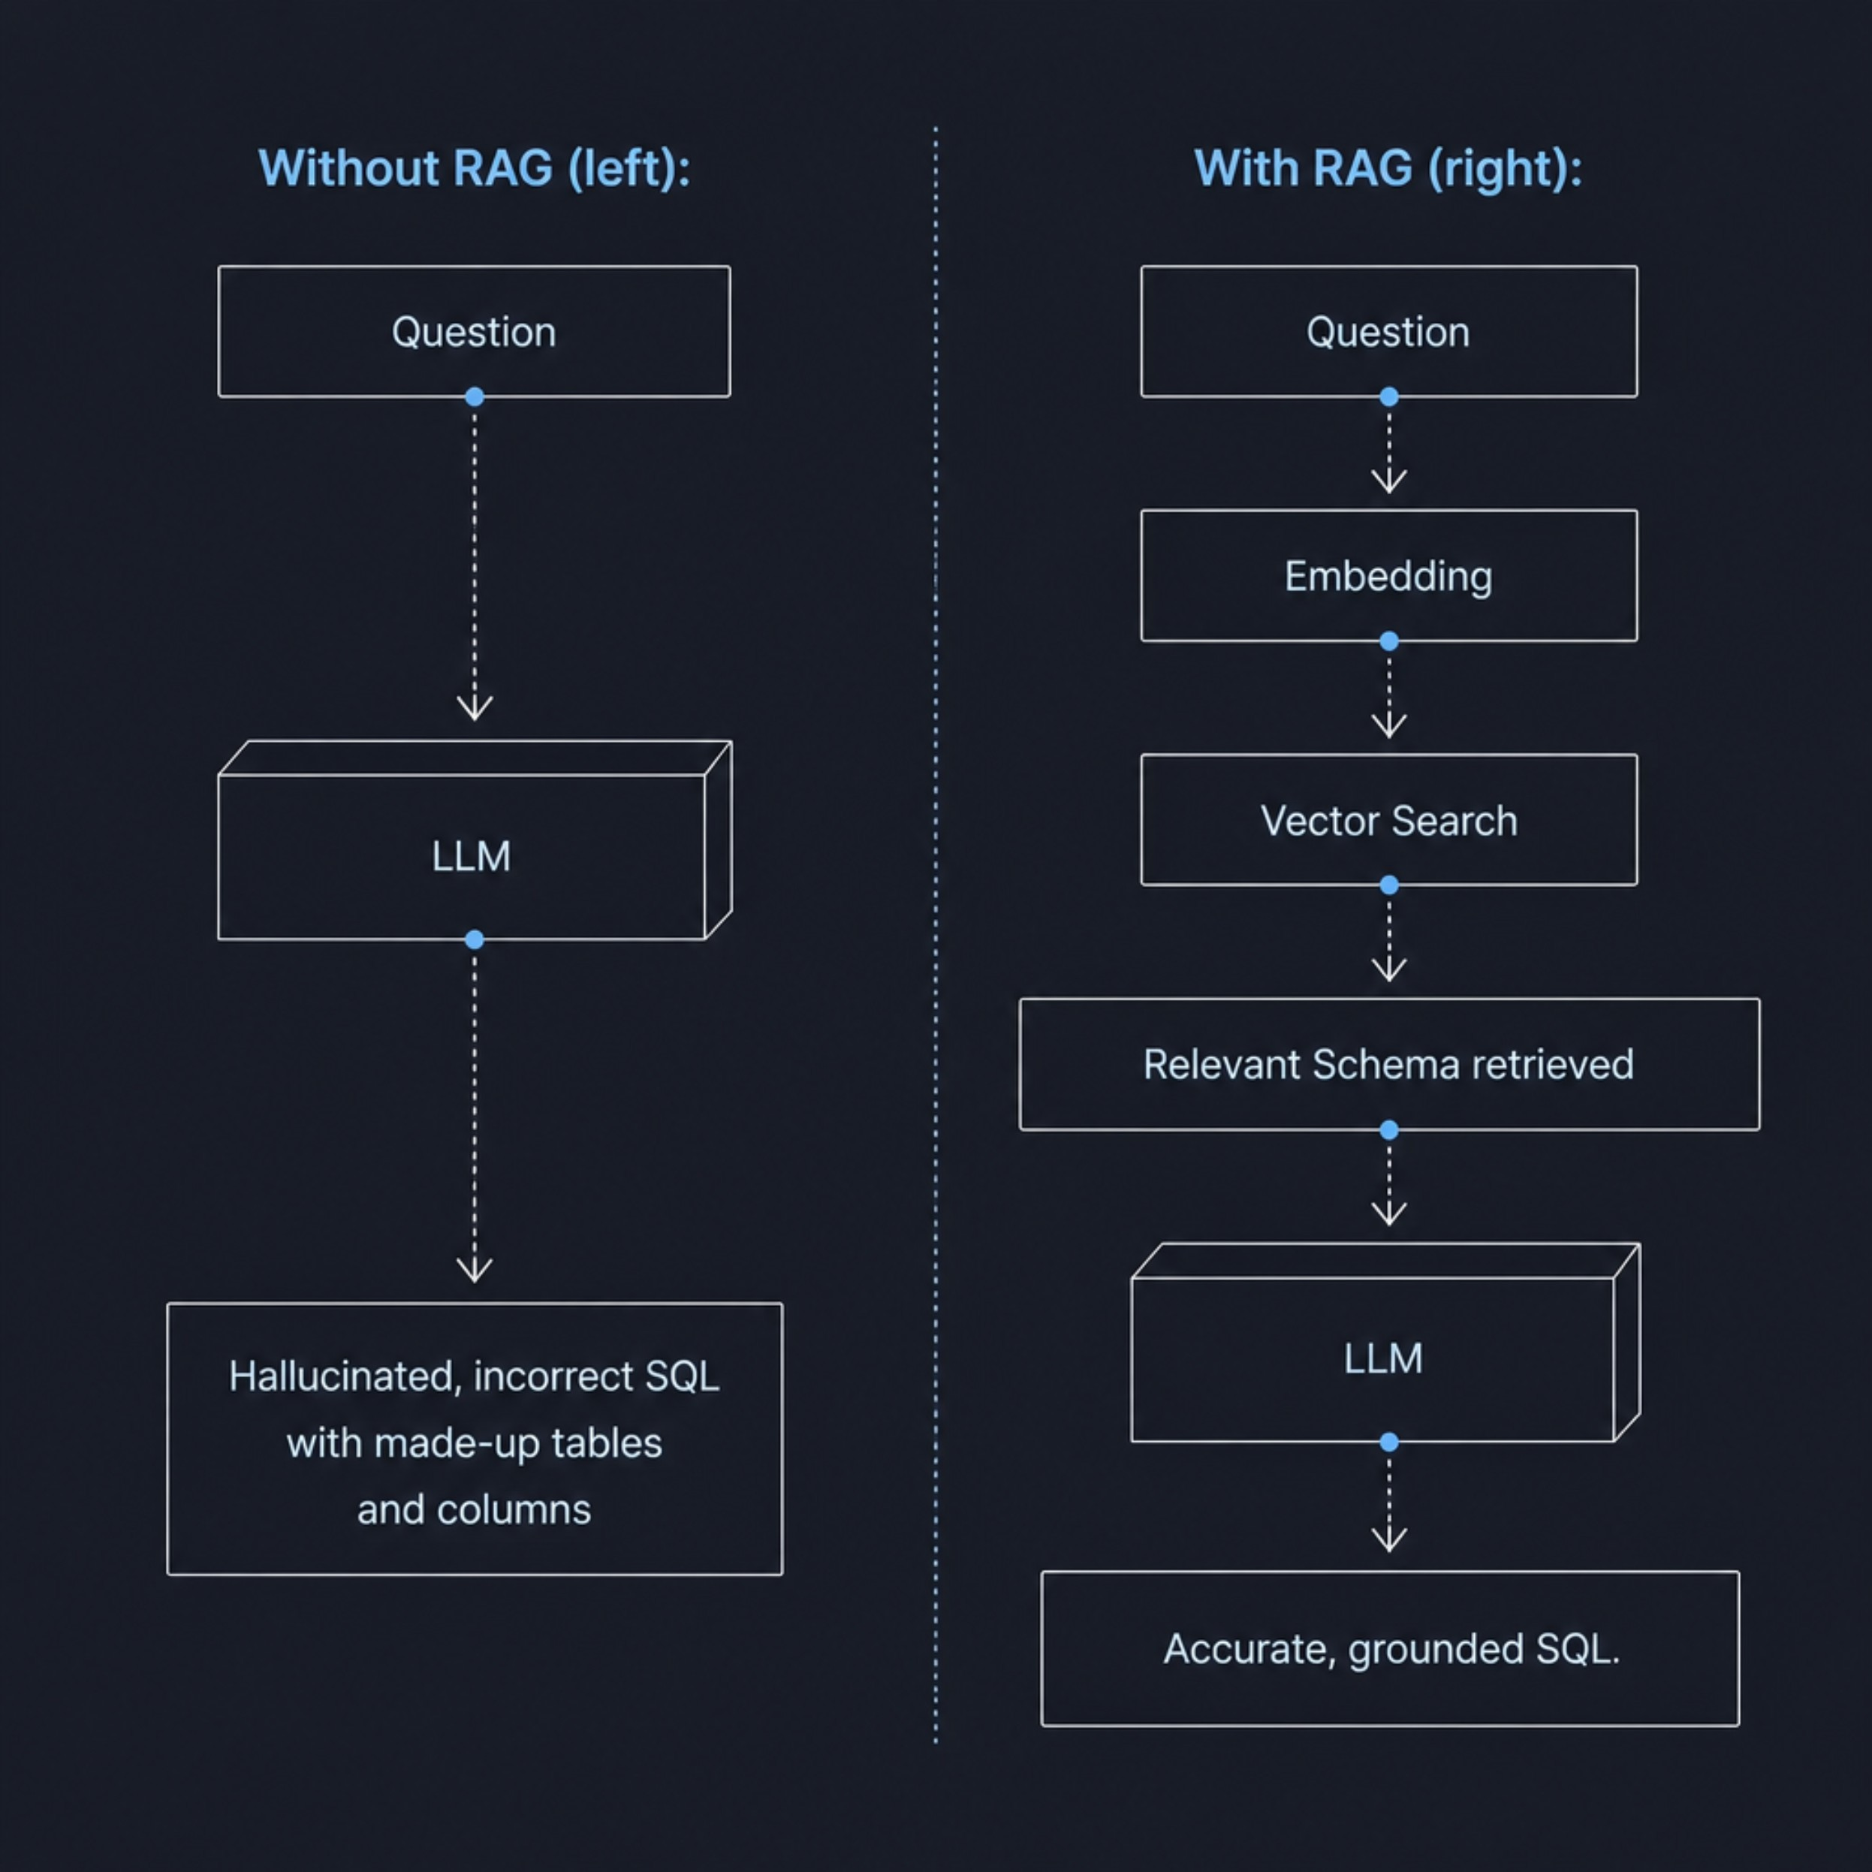

Role of RAG: Improving Accuracy
Why RAG Changes Everything
Provides LLM with only relevant schema — no noise
Eliminates hallucination of non-existent tables or columns
Grounds SQL generation in actual database structure
Dramatically improves query accuracy and reliability
RAG is the critical accuracy layer between ambiguous questions and precise SQL.

Slide 8





Why Vector Database (FAISS)?
Semantic Search
Find relevant schemas by meaning, not keywords
Fast Retrieval
Sub-millisecond similarity search at scale
Better Context
Retrieve the most relevant tables for each question
Scalability
Efficient indexing for large schema repositories

Slide 9

System Features
Natural Language Query Interface
Read-only Query Execution
Semantic Schema Retrieval via RAG
Interactive Result Visualization
LLM-based SQL Generation
Query History & Logging
Automatic SQL Validation & Safety Checks
Fast, Scalable API Backend

Slide 10
Current Progress
The project is currently in the conceptual and design phase, with the overall architecture and workflow defined as a proposal. The focus is on outlining the system structure, implementation approach, and planned functionality before development begins.
Architecture Components
Database design & schema
Embedding pipeline
FAISS + RAG pipeline
Gemini LLM integration
SQL validation & execution
Result visualization

Slide 11

Future Enhancements
Capability Expansion
Security & Deployment
Multi-database support — PostgreSQL, MySQL, and more
Conversation memory for multi-turn queries
Query explanation and reasoning transparency
SQL optimization and performance tuning
Analytics dashboard for query patterns
Role-based access control (RBAC)
User authentication and authorization
Cloud deployment — AWS, GCP, Azure
Feedback-based learning and model refinement

