Slide 1
A Proposed K-Means Initialization Algorithm
Replication of Murat et al. (2011) study

Slide 2
Clustering and the K-Means Challenge
Clustering: Grouping data points based on similarity.
K-means: Popular non-hierarchical clustering algorithm.
The Initialization Problem: K-means results are highly sensitive to the initial placement of cluster centers. Poor starting points can lead to suboptimal clustering solutions.

Slide 3
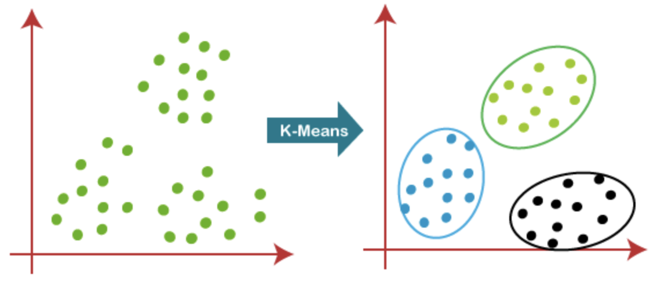
Clustered dataset using K-means

Slide 4
Review of Initialization Techniques
Method | Approach | Key Idea
Duda and Hart (1973) | Multiple Random Starts | Run k-means multiple times with random starting points, hope one run produces a good clustering result.
Jain and Dubes (1988) | Best of Multiple Runs | Run k-means many times with random starts. Then pick the clustering result with the lowest error and use that as your final clustering.
Bradley and Fayyad (1998) | Subsampling | Break the data into smaller samples, cluster those using k-means. Combine the results of these smaller clusters to seed the clustering of the entire dataset.

Slide 5
Review of Initialization Techniques
Method | Approach | Key Idea
Likas et al. (2003) | Global K-means | Incremental approach. Start with one cluster center and gradually add more, carefully choosing the best position for each new center.
Khan and Ahmad (2004) | CCIA | Analyze the overall shape of the data to find dense areas. These dense areas are likely to be good starting points for clusters.
Deelers and Auwatanamongkol (2007) | Grid-Based | Divide the data into grid-like cells. Use the center point of each cell as an initial cluster center.

Slide 6
The Murat et al. (2011) Algorithm
Main Axis & Second Axis: Algorithm identifies the variable with the highest coefficient of variation and a second axis with minimal correlation to the first.
Initial Center: The data point furthest from the mean of these axes is the first center
Iterative Selection: Subsequent centers are chosen based on the maximum cumulative distance from existing centers.

Slide 7
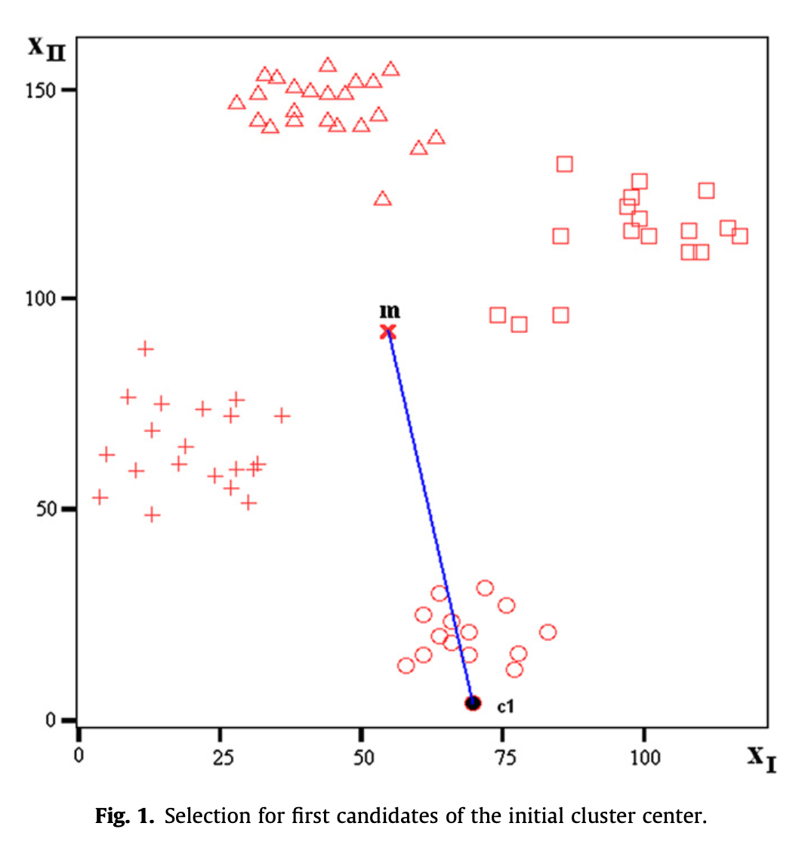
Initialization

Slide 8
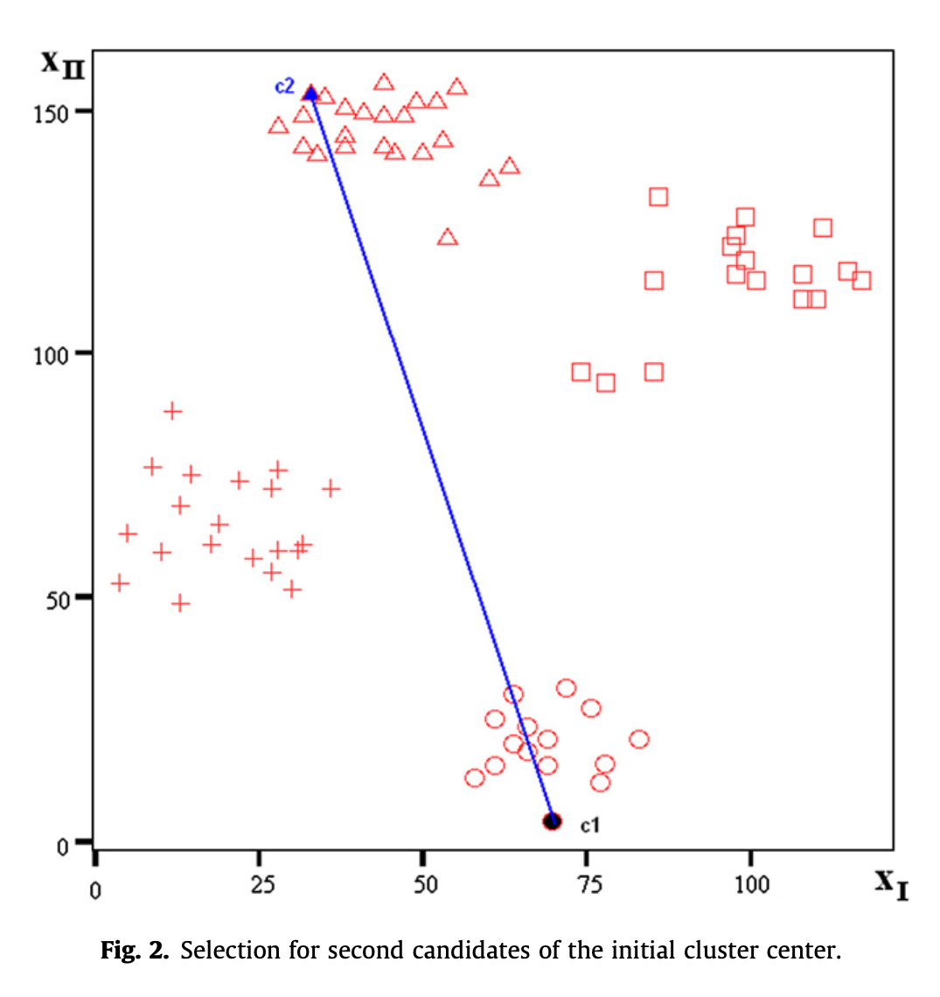
Main axis

Slide 9
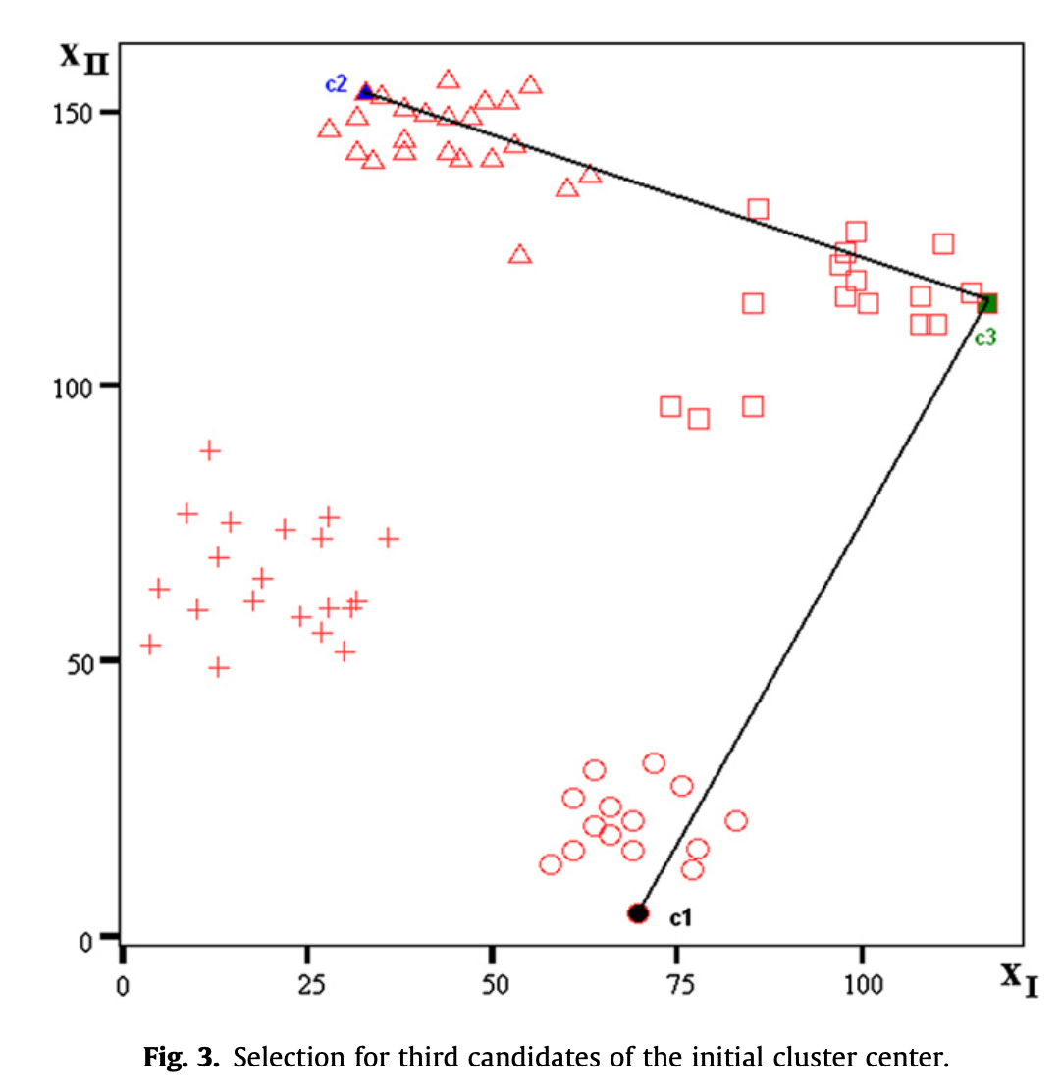
Second Axis

Slide 10
The Iris dataset (Fisher, 1936)
Standard for testing clustering algorithms.
Three classes that represents three different varieties of Iris flowers namely (I) Iris setosa (II) Iris versicolor and Iris virginica (III).
150 samples (Fifty samples were obtained from each of the three classes)
Four attributes viz sepal length, sepal width, petal length and petal width.

Slide 11
Other datasets
The Wine dataset:
Chemical analysis of wines
Derived from three different cultivars.
Total 178 instances (59, 71 and 48 in class I, class II and class III respectively).
The letter image recognition data:
Identify black-and-white rectangular pixel displays as one of the 26 capital letters in the English alphabet.
789 patterns of letter A and 805 patterns of letter D from the dataset

Slide 12
Other datasets
The Ruspini dataset (Ruspine, 1970):
75 observations on two variables making up four natural groups including 23, 20, 17 and 15 entities in classes I, II, III and IV respectively.
The Spambase dataset (Arthur and Vassilvitskii, 2006):
Represent features available to an e-mail spam detection system
4601 data points (1813 and 2788 points in spam and non-spam classes respectively).

Slide 13
Assessment Metrics
Error Percentage: Measures the proportion of misclassified data points. Lower is better.
Rand Index: Compares the agreement between created clusters and known true clusters. Higher is better.
Wilks' Lambda: Demonstrates the statistical distinctness of the clusters. Lower values indicate well-separated clusters.

Slide 14
Replication Results
Random Initialization method:
Error percentage of 10.67%
Rand index of 1.77 and
Wilks lamda of 0.97
Proposed algorithm on the basis of variation
Error percentage of 55.33%
Rand index of 1.45
Wilks' lambda of 0.95.

Slide 15
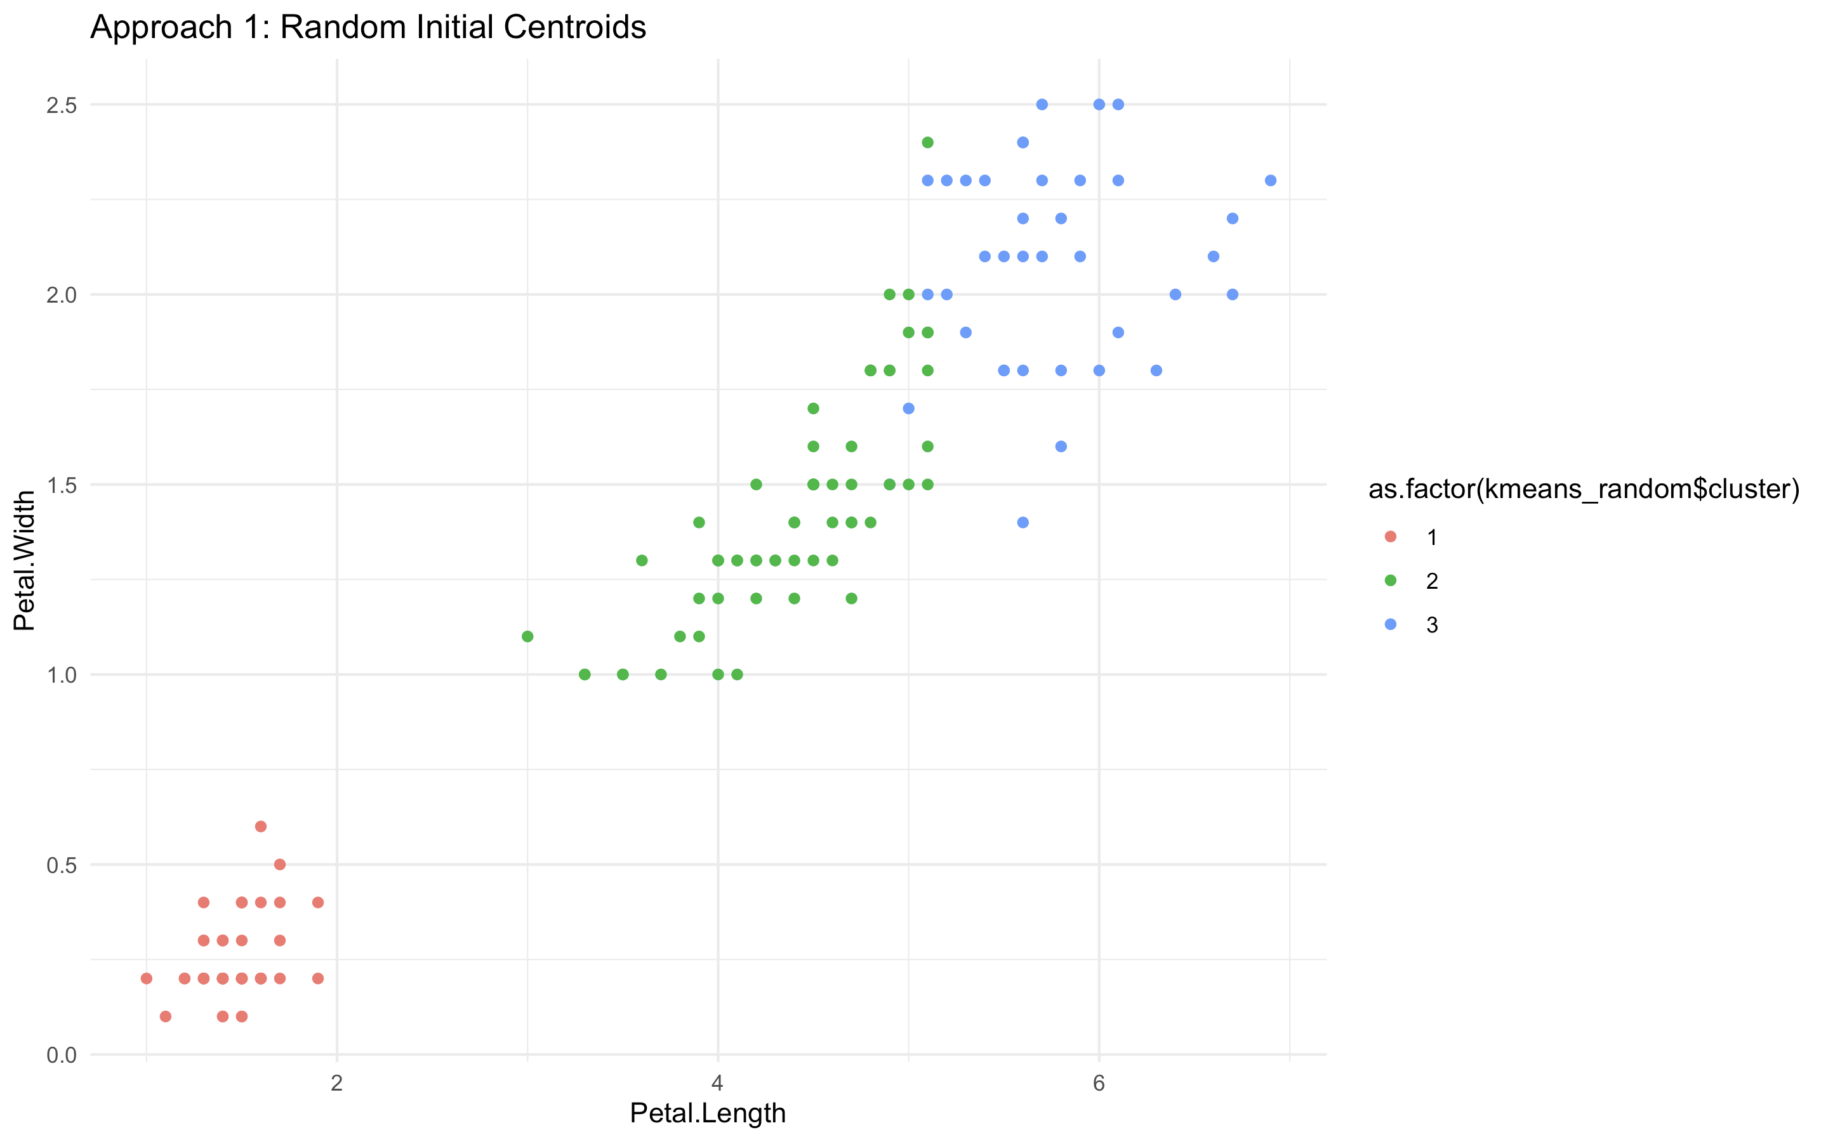
Replication Results

Slide 16
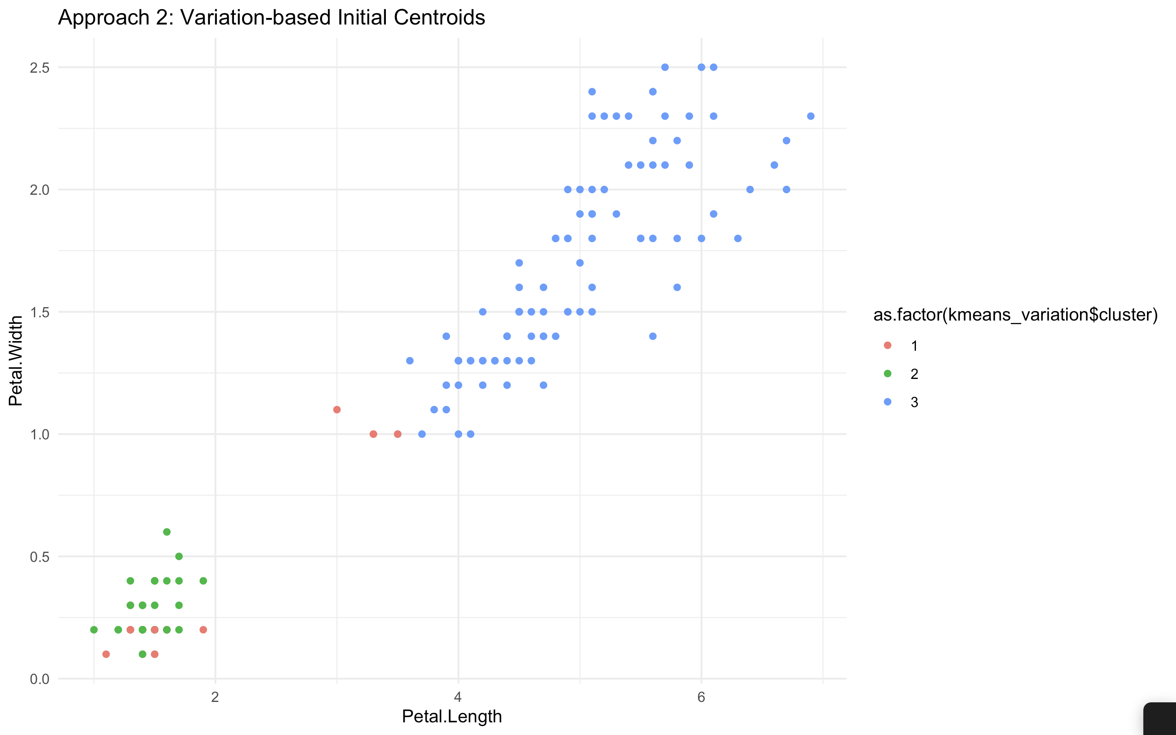
Replication Results

Slide 17
Way forward
Potential Explanations: Code errors, dataset differences, random variations, or flaws in the proposed algorithm itself.
Further Testing: Incorporate other metrics like Silhouette score and Dunn index.

