Slide 1



NATIONAL RESEARCH CENTRE
«KURCHATOV INSTITUTE»
PETERSBURG NUCLEAR PHYSICS INSTITUTE
Russia, 188300, Leningrad District ^{, Gatchina, Orlova Roscha}
WG3 PIK collaboration
WP3 Task 3.4:
General blueprint for the instrumentation at PIK
CREMLIN+ Task 3.4 KICK-OFF Meeting|12 June 2020

Slide 2
NATIONAL RESEARCH CENTRE
«KURCHATOV INSTITUTE»
PETERSBURG NUCLEAR PHYSICS INSTITUTE
Russia, 188300, Leningrad District ^{, Gatchina, Orlova Roscha}
Based on the outcome of the CREMLIN project it was decided that additionally to the national Russian instruments, 5 new neutron instruments will be designed and built in Germany and then installed at the reactor PIK.
Partners will carry out extensive simulation work to define the optimal positioning of both Russian and German instruments on the neutron beams and provide the conceptual design of the neutron blueprint accounting for specific features of the cold sources.
This work will be done under the supervision of the instrumental subcommittees of the PIK-SAC (to be realised within task 3.6) that will provide recommendations aiming maximal complementarity of Russian and international neutron instruments.
CREMLIN+ Task 3.4 KICK-OFF Meeting|12 June 2020

Slide 3
NATIONAL RESEARCH CENTRE
«KURCHATOV INSTITUTE»
PETERSBURG NUCLEAR PHYSICS INSTITUTE
Russia, 188300, Leningrad District ^{, Gatchina, Orlova Roscha}
Important dates
01.02.2021 Definition of optimal suite of instruments
01.08.2021 Primary layout of NGs & instruments in the PIK guide hall for optimal instrument suite
After that – detailed calculations for the selected suite with fixed CNS design
CREMLIN+ Task 3.4 KICK-OFF Meeting|12 June 2020

Slide 4
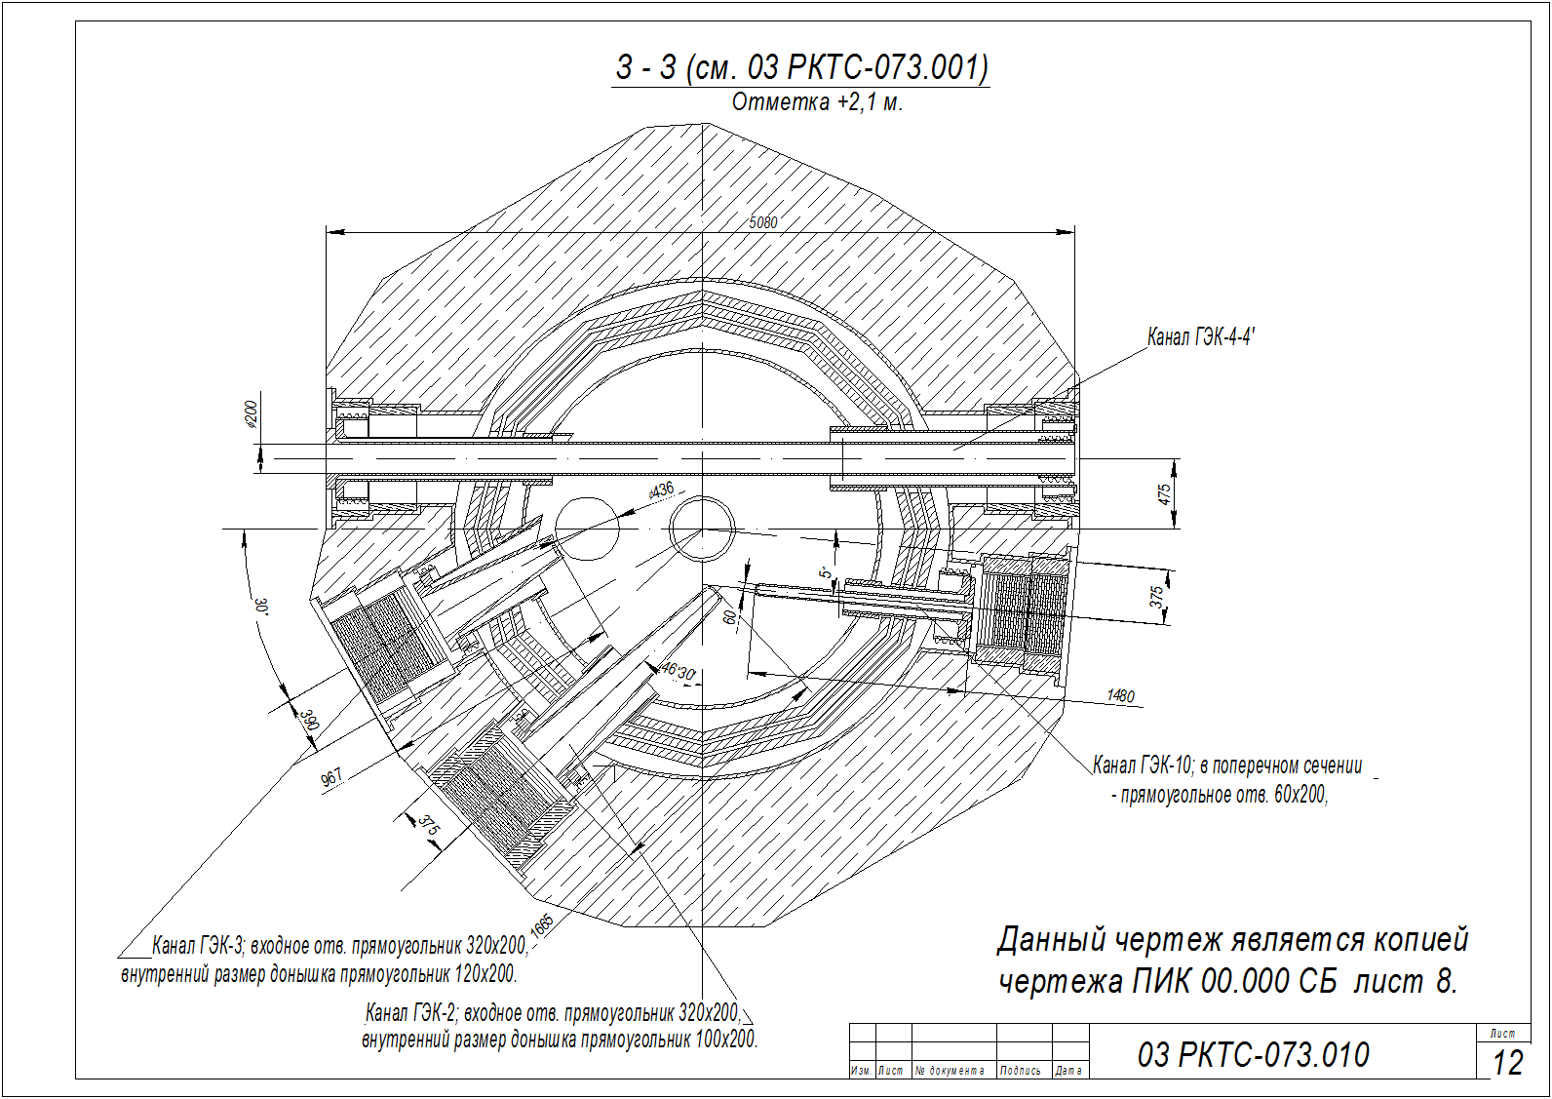

Slide 5
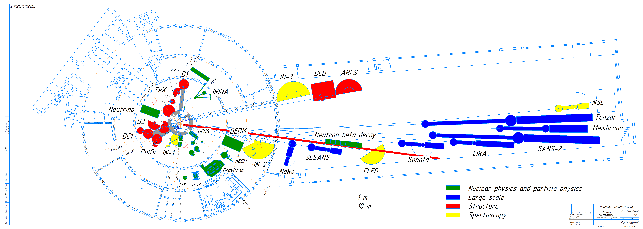


Slide 6
NATIONAL RESEARCH CENTRE
«KURCHATOV INSTITUTE»
PETERSBURG NUCLEAR PHYSICS INSTITUTE
Russia, 188300, Leningrad District ^{, Gatchina, Orlova Roscha}
PNPI manpower
Team
  Petr Konik
  Yurii Kireenko
Later expanded with master and phd students
Same people on task 3.2
CREMLIN+ Task 3.4 KICK-OFF Meeting|12 June 2020

Slide 7
NATIONAL RESEARCH CENTRE
«KURCHATOV INSTITUTE»
PETERSBURG NUCLEAR PHYSICS INSTITUTE
Russia, 188300, Leningrad District ^{, Gatchina, Orlova Roscha}
PNPI plans
01.02.2021 Definition of optimal suite of instruments
Prerequisites:
cold source model
bi-spectral extraction model
list of instruments
CREMLIN+ Task 3.4 KICK-OFF Meeting|12 June 2020

Slide 8
NATIONAL RESEARCH CENTRE
«KURCHATOV INSTITUTE»
PETERSBURG NUCLEAR PHYSICS INSTITUTE
Russia, 188300, Leningrad District ^{, Gatchina, Orlova Roscha}
Prerequisites
CNS models:
  Old HEC3 CNS (exist)
  New HEC2 D2 CNS (will be provided by PNPI team)
  New HEC2 pH2 CNS with optimized options (will be provided by PNPI and FZJ teams)
Bi-spectral extraction developed in task 3.2
List of instruments
  SANS - HZG
  Reflectometer - FZJ
  PD – TUM+LLB(observer)
  TAS - PNPI
  TOF spectrometer – PNPI+TUM
  NSE spectrometer - FZJ
CREMLIN+ Task 3.4 KICK-OFF Meeting|12 June 2020

Slide 9
NATIONAL RESEARCH CENTRE
«KURCHATOV INSTITUTE»
PETERSBURG NUCLEAR PHYSICS INSTITUTE
Russia, 188300, Leningrad District ^{, Gatchina, Orlova Roscha}
Workflow
For given simplistic instrument model optimize a fixed length guide on different CNSs
Create a comparison table
Generally applicable result on performance of pH2 moderator and different types of instruments
Suggest new instrumentation for PIK and relocation of national instruments
Create a common repository?
CREMLIN+ Task 3.4 KICK-OFF Meeting|12 June 2020

Slide 10
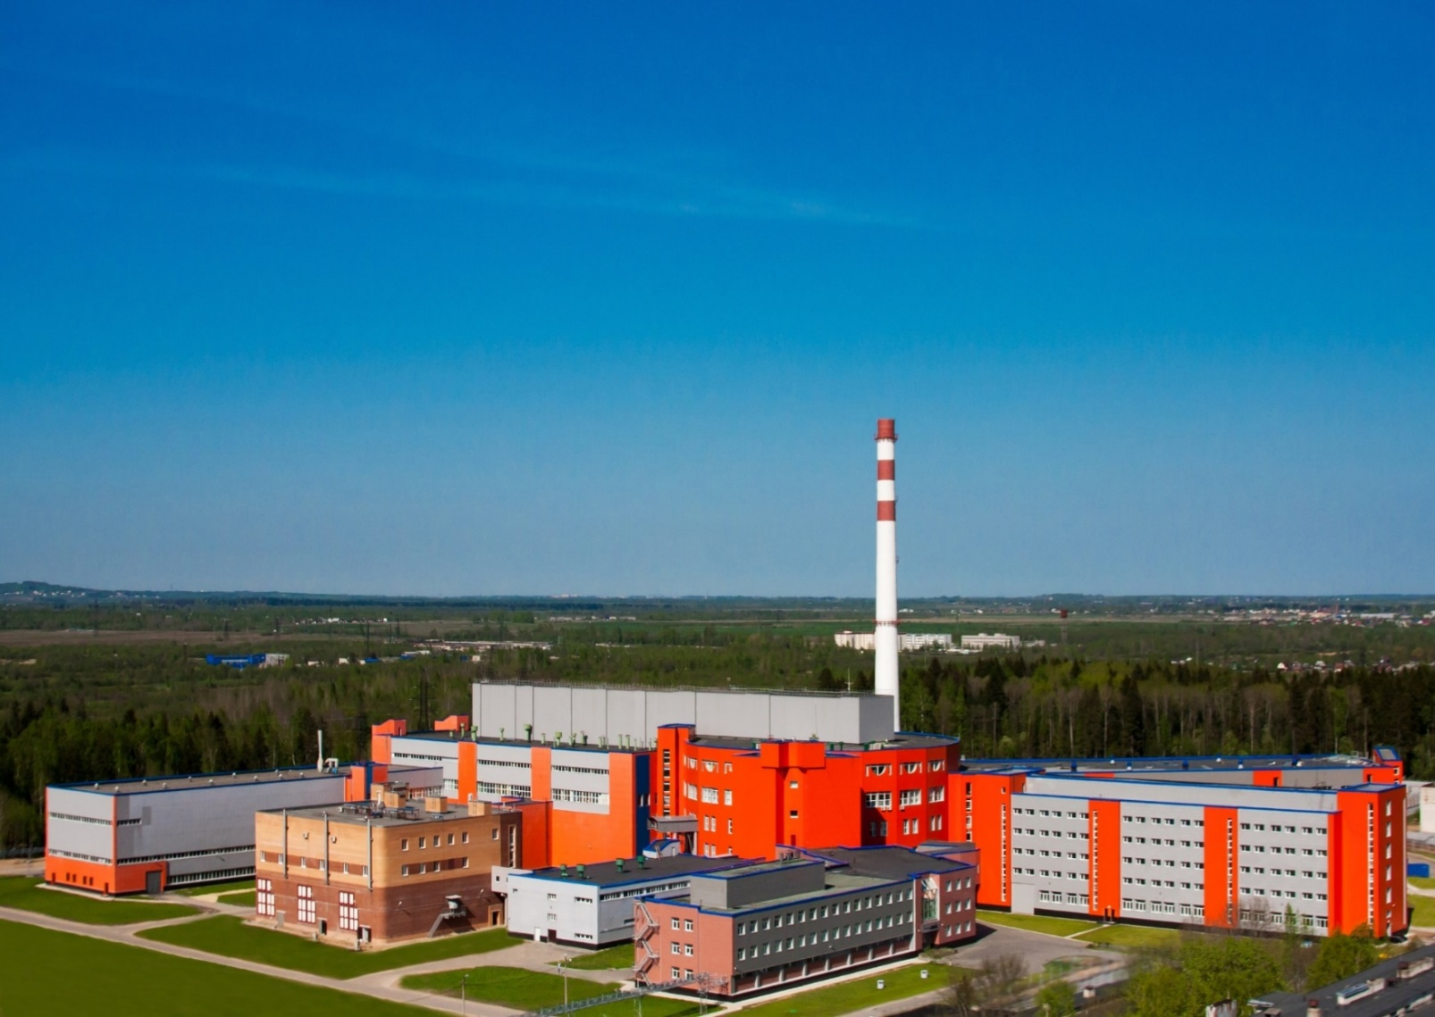
Thank you for attention!
CREMLIN+ Task 3.4 KICK-OFF Meeting|12 June 2020

