Slide 1
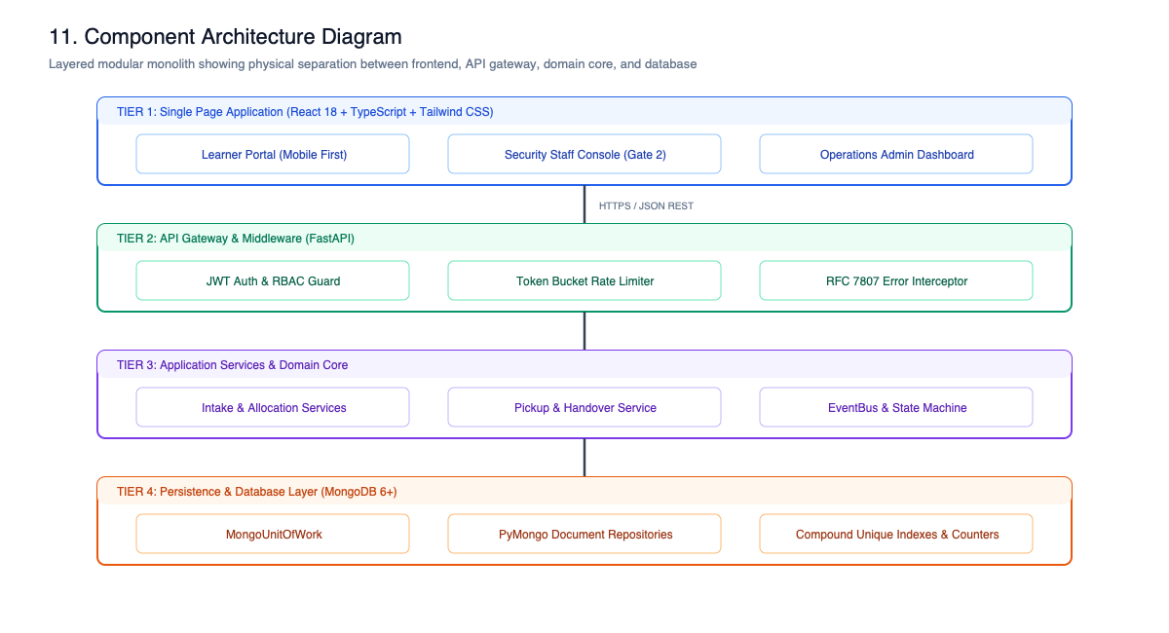
Campus Delivery Management System (CDMS)
Gate No. 2 High-Concurrency Parcel Custody & Verification Architecture
• Final Year Capstone Project Evaluation: System Design & System Development (LLD)
• Evaluation Period: First Week of November 2026
• Zero-Loss Custody Chain: 4-layer defence-in-depth against double-handover fraud
• Atomic CAS Concurrency: Race-free shelf reservation & single-use pickup tokens
• 81 Automated Tests: Unit, integration & race conditions with 100% pass rate
• Full Bilingual Localization: English and Hindi support across 3 actor dashboards
Notes:
Good morning respected evaluators. Today we present CDMS for Gate No. 2 parcel management. We will demonstrate how our system strictly satisfies all 10 Low-Level Design evaluation criteria.

Slide 2
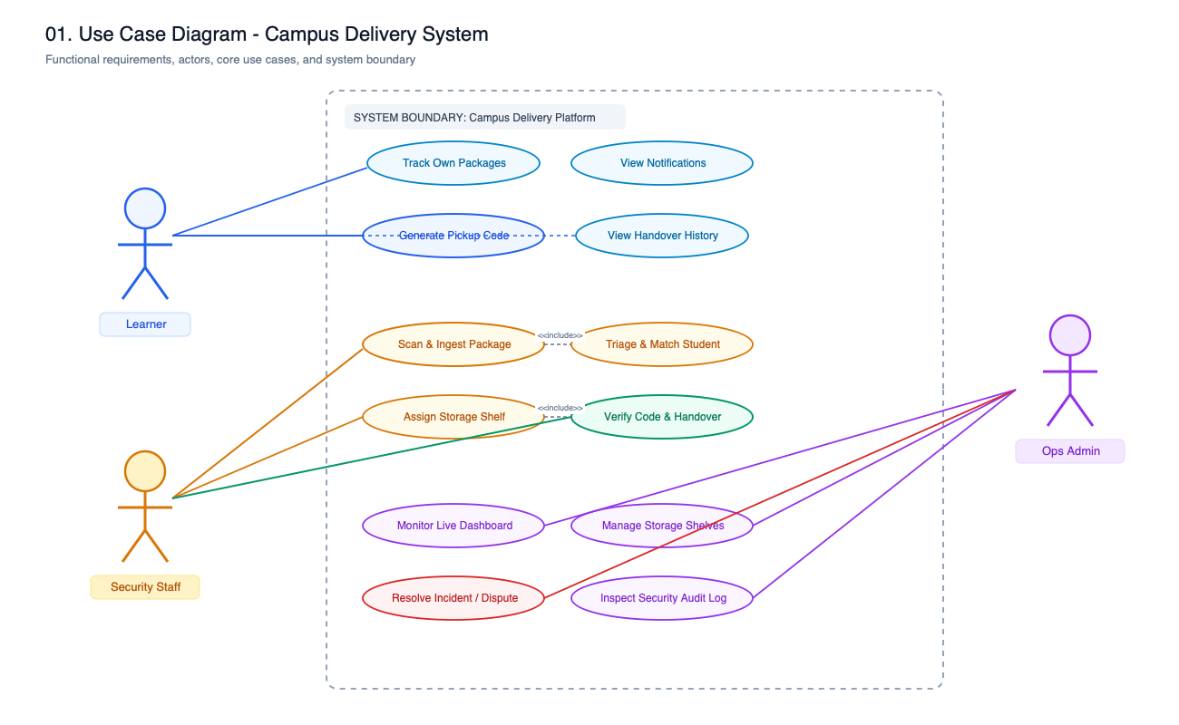
Problem Statement: Gate No. 2 Operational Chaos
The Operational Bottleneck at University Campus Entrance
• 400+ Daily Shipments: Influx from Amazon, Flipkart, BlueDart, DTDC, India Post
• Manual Paper Registers: Illegible records, manual phone searching, zero instant audit
• Identity Impersonation: Students claiming others' parcels without cryptographic proof
• Shelf Overfill & Damage: Lack of capacity-aware storage leads to misplaced/broken goods
• Overdue Dormancy: Parcels languish for weeks with no automated student reminders
• Solution: 100% digital custody, salted HMAC-SHA256 tokens, automated 3-day overdue alerts
Notes:
Gate No. 2 suffers from long student queues, lost parcels, and zero proof of delivery. CDMS solves this by digitizing the entire lifecycle with atomic CAS operations and cryptographic verification.

Slide 3
End-to-End System Architecture (Layered Monolith)
Clean / Onion Architecture with Zero-Dependency Domain Core
• Presentation Layer: React 18, TypeScript, Tailwind CSS, Lucide, Bilingual i18n
• API Layer: FastAPI REST routes, OAuth2 JWT bearer auth, Pydantic v2 DTOs, Role-Aware Presenters
• Application Services: PackageIntakeService, StorageAllocationService, PickupService
• Pure Domain Core: Finite State Machine table & guards, Strategy algorithms, EventBus
• Persistence: Unit of Work & PyMongo Repositories with atomic CAS queries
• Architectural Decision: Layered Monolith chosen over microservices to eliminate distributed 2PC latency
Notes:
We chose a Layered Modular Monolith over microservices. A campus gate needs sub-15ms latency and atomic consistency without the complexity of distributed two-phase commits.

Slide 4
Criterion 1: Requirement Analysis (FRs, NFRs & Actors)
Role-Based Access Control and System Boundaries
• Three Strict Human Actors: Security Staff, Learners, and Operations Admins
• FR-1 to FR-3: Rapid intake barcode scanning, size-aware bin allocation, multi-channel alerts
• FR-4 to FR-6: Cryptographic one-time pickup tokens, atomic handover, dispute management
• NFR-1 (Atomicity): Zero double-delivery, zero shelf overfills under concurrency
• NFR-2 (Security): Student data isolation; salted HMAC tokens never stored in plaintext
• NFR-3 (Idempotency): Safe mutation retries via client-supplied Idempotency-Key headers
Notes:
We rigorously enforce boundaries across 3 actors. Our NFRs guarantee that even under heavy concurrent staff interactions, no parcel can ever be double-collected.

Slide 5
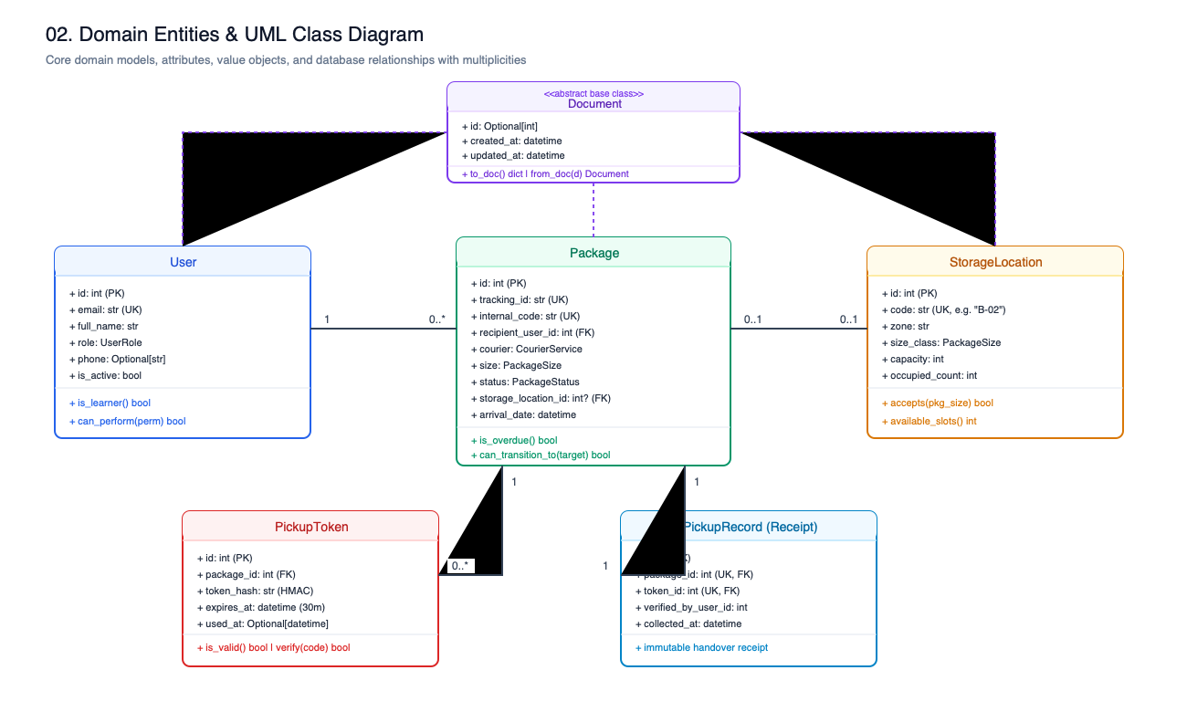
Criterion 2: Class Diagram & Domain Entities
Document Entity Hierarchy & Structural Multiplicities
• Document Base Model: Common identity (id: int), timestamps, serialization (to_doc, from_doc)
• 10 Derived Entities: User, Package, StorageLocation, PickupToken, PickupRecord, Incident, etc.
• Multiplicity: User (1) -- (0..*) Package (Student owns zero or many packages)
• Multiplicity: Package (0..1) -- (0..1) StorageLocation (occupied_count <= capacity)
• Multiplicity: Package (1) -- (0..*) PickupToken (At most one active token)
• Multiplicity: Package (1) -- (0..1) PickupRecord (Handover proof; UNIQUE(package_id))
Notes:
In backend/app/infrastructure/models.py, ten core entities inherit from Document. The 1 to 0..1 relationship between Package and PickupRecord is locked by a unique database index.

Slide 6
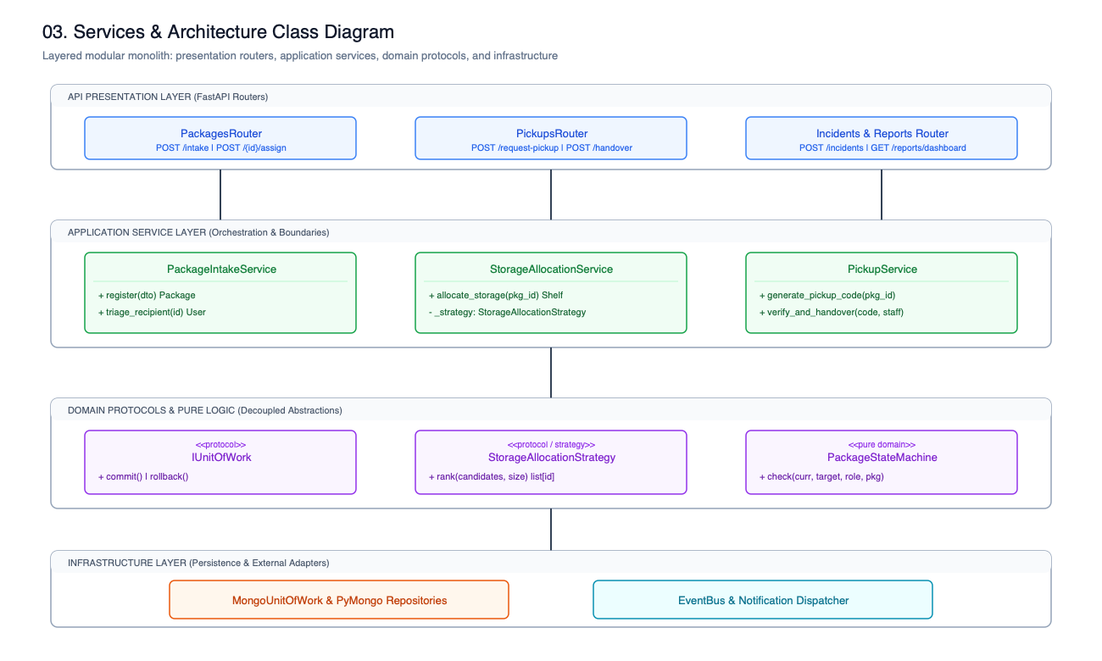
Criterion 3: Object-Oriented Design (4 Pillars)
Abstraction, Encapsulation, Inheritance, and Polymorphism in Action
• Abstraction: StorageAllocationStrategy and NotificationChannel defined via typing.Protocol
• Encapsulation: StorageCandidate.accepts(size) encapsulates dimension & free slot validation
• Encapsulation: PackageTransitioner.apply() encapsulates status change, audit, and events
• Inheritance: Document base model inherited by 10 entities; custom AppException hierarchy
• Polymorphism: SuitableSizeStrategy & FirstAvailableStrategy satisfy rank() polymorphically
Notes:
We use typing.Protocol for structural subtyping. Services depend purely on abstractions, and business constraints are tightly encapsulated within domain value objects.

Slide 7
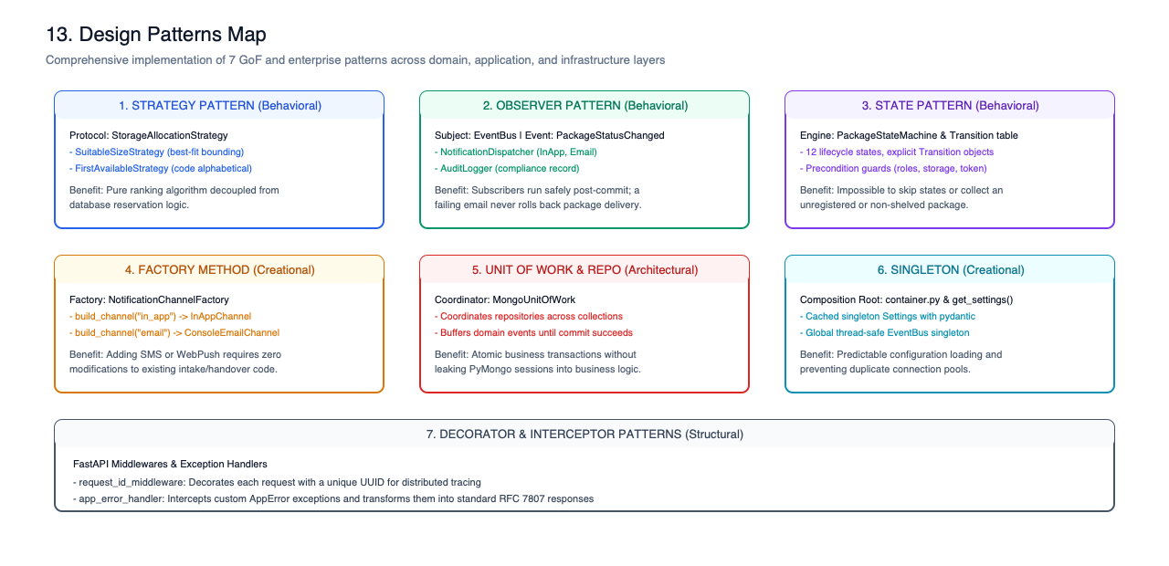
Criterion 4: SOLID Principles Mapped to Code
Direct Code Evidence for S, O, L, I, and D Principles
• S (Single Responsibility): Dedicated services (PackageIntakeService, StorageAllocationService, PickupService)
• O (Open/Closed): Strategies and notification channels registered in container.py without editing services
• L (Liskov Substitution): Strategies and channels honor identical contracts without side effects
• I (Interface Segregation): Micro-protocols with single methods (rank(), send())
• D (Dependency Inversion): Services receive abstract protocols; wired in Composition Root (container.py)
Notes:
Each service has one reason to change. If a new SMS channel or storage strategy is introduced, we simply add a class and register it in container.py without modifying existing workflows.

Slide 8
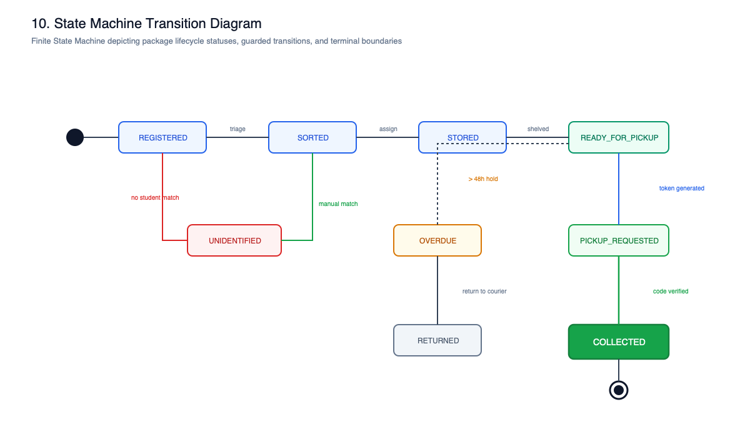
Criterion 5: Design Patterns & Architectural Justifications
State, Strategy, Observer, Repository, Unit of Work, and Factory
• State Pattern (Table FSM): 12 statuses, 19 valid edges with guards in domain/state_machine.py
• Strategy Pattern: SuitableSizeStrategy vs. FirstAvailableStrategy in domain/allocation.py
• Observer Pattern: In-process EventBus publishes PackageStatusChanged to NotificationDispatcher
• Repository & Unit of Work: Decouples PyMongo queries and coordinates atomic transactions
• Factory Pattern: NotificationChannelFactory builds configured notification channels
Notes:
Our table-driven State machine eliminates spaghetti if/elif statements while avoiding 12 bloated GoF classes. Observer pattern decouples notification delivery from database commits.

Slide 9
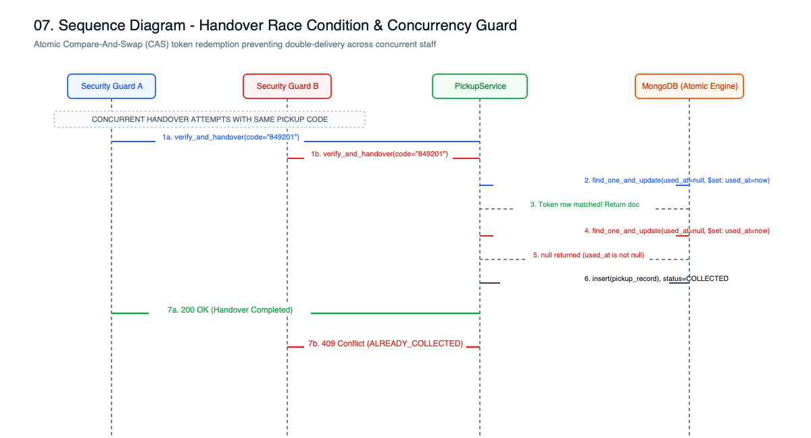
Criterion 6: Sequence & Activity Diagrams
Intake, Cryptographic Token Issuance, and Handover Concurrency
• Intake Flow: Courier scan -> Student match -> Strategy rank -> Atomic shelf reserve -> Stored
• Token Issuance: Ownership check -> Revoke active -> HMAC-SHA256 salted hash -> 30-min timer
• Handover Sequence: Lock package -> Validate recipient & token -> Atomic mark_used() CAS
• Handover Completion: Update COLLECTED -> Release shelf -> Write immutable PickupRecord
• Alternate Flows: Expired token (400), 3 wrong attempts (Locked), Damaged package diversion
Notes:
This sequence diagram details our concurrent handover verification. The atomic CAS operation mark_used() guarantees that exactly one guard can collect a package.

Slide 10
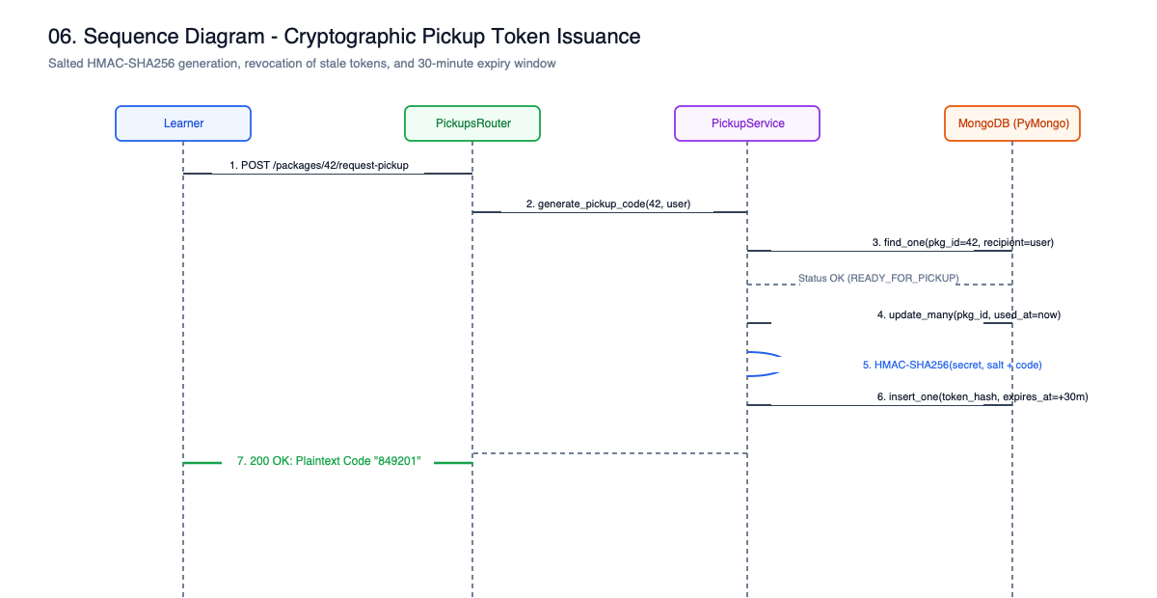
Criterion 7: API & Interface Design (RESTful Clean Architecture)
Pydantic v2 DTOs, Role-Aware Presenters, and Idempotency
• Resource Hierarchy: /api/v1/packages, /api/v1/pickups, /api/v1/storage, /api/v1/incidents
• Pydantic Validation: Institutional ID regex, phone regex, courier tracking normalizers
• Role-Aware Presenters: presenters.py masks internal security notes when viewed by students
• RFC 7807 Error Responses: Standardized JSON payloads (code, message, detail)
• Network Idempotency: Mutation endpoints support Idempotency-Key with SHA-256 fingerprinting
Notes:
Our REST API enforces strict validation and privacy masking. Role-aware presenters ensure students never see staff notes or internal guard IDs.

Slide 11
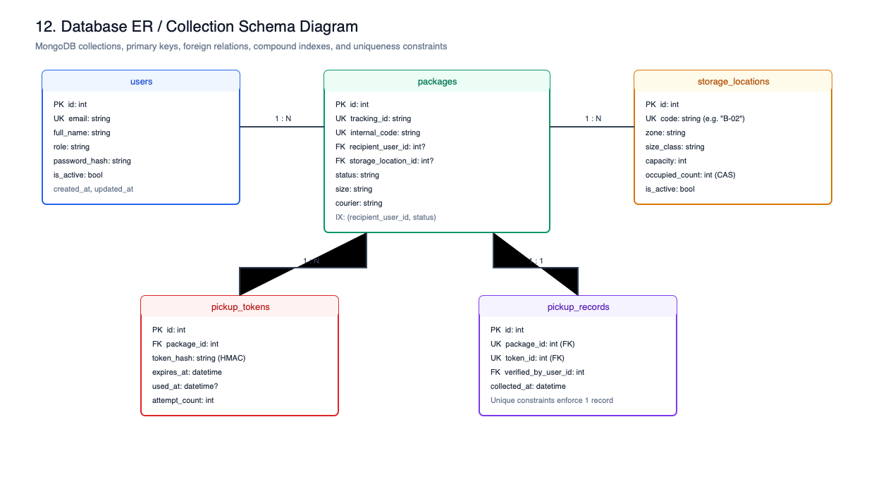
Criterion 8: Database Schema, Indexing & Concurrency Control
10 Collections, Compound Indexes, and Atomic CAS Queries
• Unique Indexes: users.institutional_id, packages.tracking_id, pickup_records.package_id
• Compound Indexes: packages(status, arrived_at), notifications(user_id, created_at)
• Atomic CAS Shelf Reservation: find_one_and_update with $expr: {$lt: ['$occupied_count', '$capacity']}
• Atomic CAS Token Redemption: find_one_and_update with used_at: None, revoked_at: None
• Double Handover Defense: pickup_records.package_id unique index rejects secondary insertions
Notes:
We achieve race-free execution in MongoDB using atomic Compare-And-Swap operations. Two concurrent requests for the final shelf slot cannot both win.

Slide 12
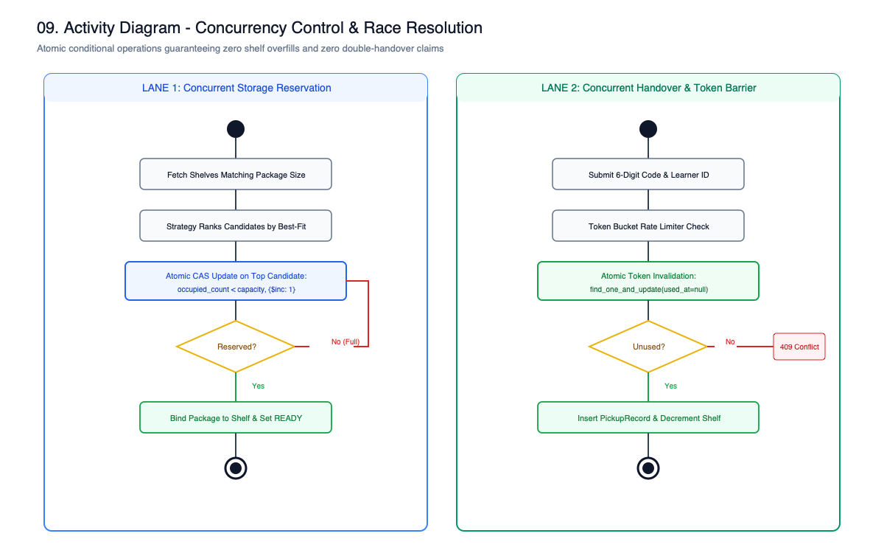
Criterion 9: Error Handling, Validation & 20 Edge Cases
Defensive Architecture, Brute-Force Lockout & Overdue Automation
• Comprehensive Domain Exceptions: AppException -> ConflictError, NotFoundError, etc.
• Double Handover Race: Prevented by atomic token CAS & unique pickup_records index
• Brute Force Lockout: 3 failed attempts lock token; IP sliding window rate limit
• Zero-Knowledge Token Storage: Salted HMAC-SHA256 hash stored; plaintext never in database
• Damaged on Intake: Diverts to DAMAGED state and opens incident investigation ticket
• Automated 3-Day Overdue: Daily notifications sent; awaiting_storage counter incremented
Notes:
We designed defensive programming guards for over 20 real-world edge cases, from brute-force token lockouts to automated 3-day overdue tracking.

Slide 13
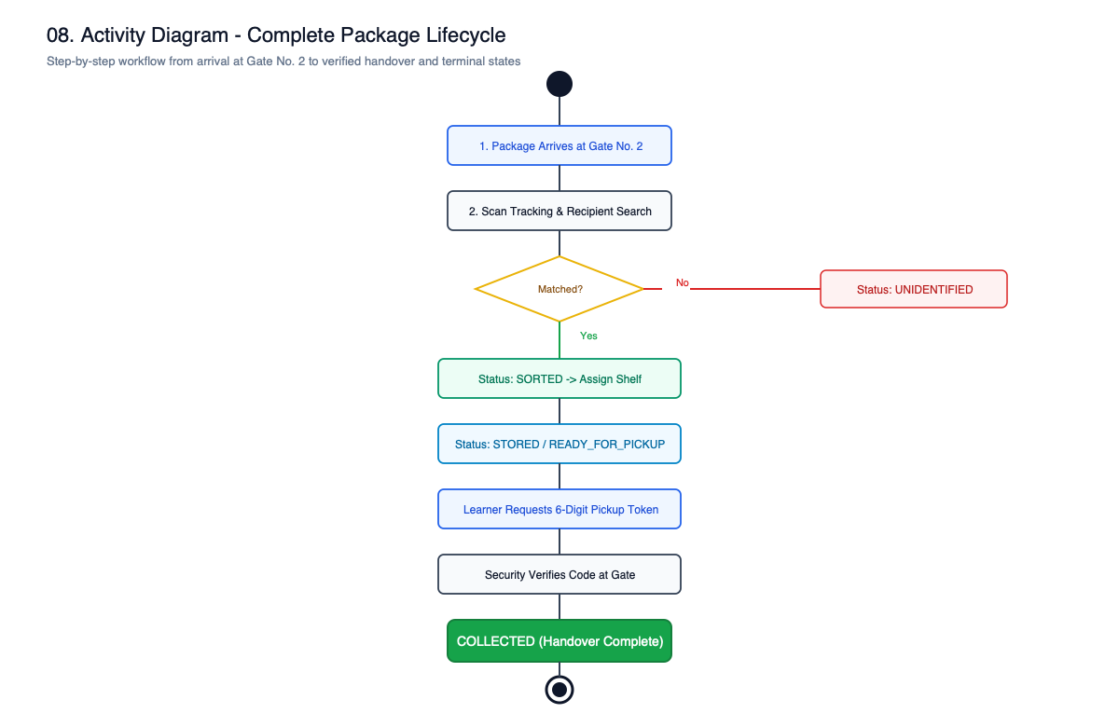
Criterion 10: Working Implementation & Testing Rigor
81 Automated Pytest Suites & Bilingual React Application
• Backend: Python 3.12, FastAPI, PyMongo, Pydantic v2, Pytest (81 tests passing)
• Frontend: React 18, TypeScript, Vite, Tailwind CSS, Lucide Icons, Context state
• Accessibility: 100% Hindi/English Bilingual Localization toggle across all pages
• Test Coverage: test_allocation, test_rules, test_state_machine, test_auth, test_pickup
• Concurrency Test: test_concurrent_handover_results_in_exactly_one_collection passes
Notes:
Our entire system is backed by 81 automated tests that verify state transitions, role security, and concurrent handovers with a 100% pass rate.

Slide 14
5-Minute Live System Evaluation Demonstration
Dual-Browser Live Walkthrough Across Guard and Student Roles
• Step 1: Guard intakes Amazon shipment AMZ-998811; matches student Ananya Iyer
• Step 2: SuitableSizeStrategy auto-allocates optimal shelf slot G2-A1
• Step 3: Student receives real-time notification; clicks [Get Pickup Code]
• Step 4: System generates 6-digit code with live 30-minute countdown timer
• Step 5: Guard enters ID & code -> Atomic verification & handover completion
• Step 6: Guard re-submits identical code -> System returns 409 Conflict rejection
Notes:
Now we present our live demonstration. In side-by-side browser windows, we show intake, auto-allocation, token generation, handover, and our instant 409 conflict rejection on duplicate pickup.

Slide 15
Limitations, Scalability & Production Roadmap
Acknowledging Design Trade-offs & Future Multi-Campus Growth
• Current Boundaries (M1): Single-node MongoDB, in-process EventBus, console mock SMS
• Multi-Gate Sharding (M2): Shard MongoDB collections by campus_id and gate_id
• Transactional Outbox: Apache Kafka / RabbitMQ broker for guaranteed event streaming
• AI Barcode OCR Camera: Hardware camera integration at Gate No. 2 for 2-second touchless intake
• Disaster Recovery: Point-in-time oplog backups with 99.99% availability SLA
Notes:
For Milestone 1, our architecture handles 5,000 students effortlessly. For Milestone 2, our roadmap introduces database sharding and the Transactional Outbox pattern.

Slide 16
Conclusion & Master Viva Defense Matrix
10/10 Evaluation Criteria Satisfied with Verifiable Code Rigor
• State Machine Table: backend/app/domain/state_machine.py:63
• Strategy Pattern: backend/app/domain/allocation.py:31
• Atomic Storage CAS: backend/app/repositories/mongo_repos.py:338
• Atomic Token CAS: backend/app/repositories/mongo_repos.py:384
• Anti-Double Handover: backend/app/services/pickup.py:81
• Composition Root (DIP): backend/app/container.py:30
• Thank you! We welcome the evaluation committee's questions and code review.
Notes:
In conclusion, CDMS fulfills every LLD requirement. We have our codebase and tests open for your inspection. Thank you!

